Slide 1
12-28-2021 Updates

Slide 2
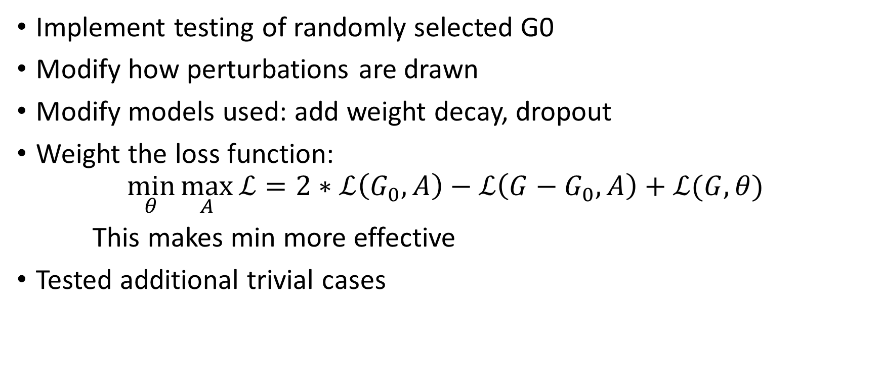
Progress
Implement testing of randomly selected G0
Modify how perturbations are drawn
Modify models used: add weight decay, dropout
Weight the loss function:
$$\min_{θ}{\max_{A}{ℒ}=2∗ℒ\left(G_{0},A\right)−ℒ\left(G−G_{0},A\right)+ℒ(G,θ)}$$
This makes min more effective
Tested additional trivial cases

Slide 3
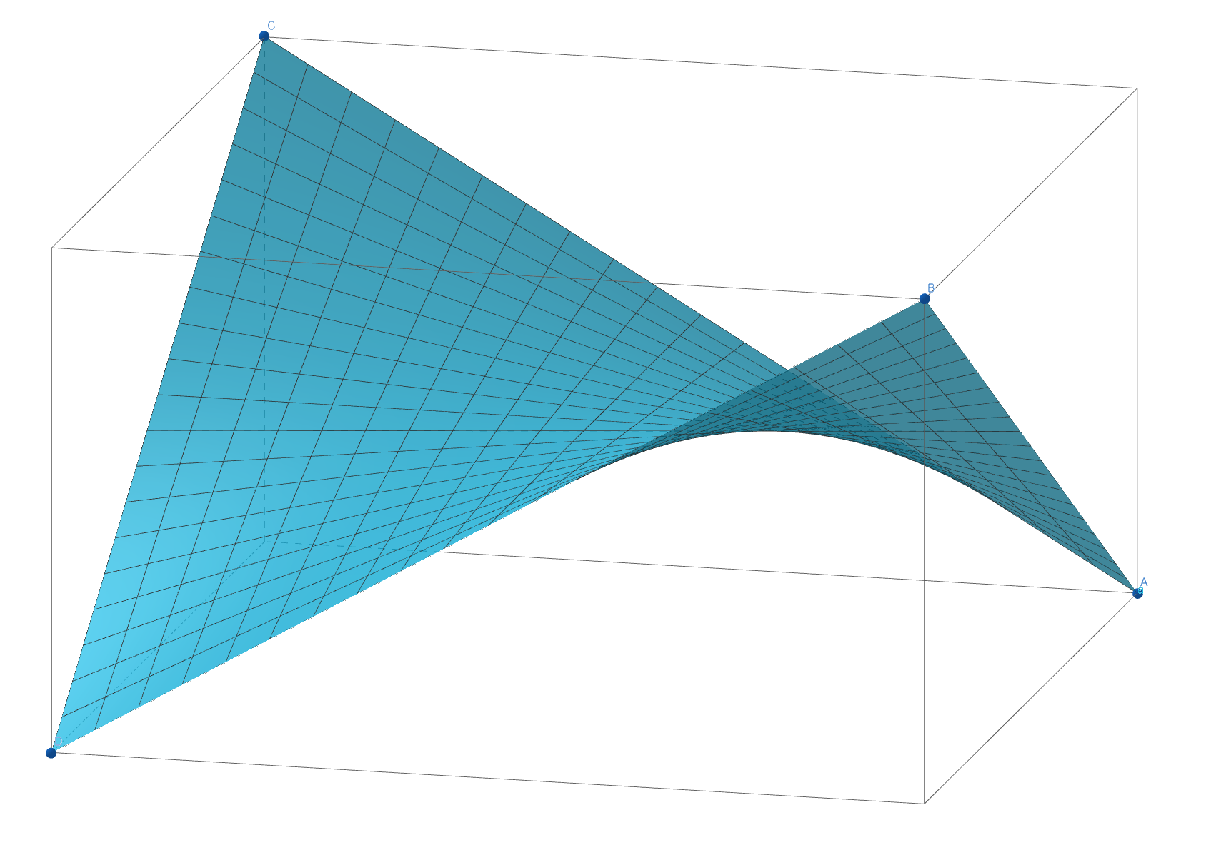
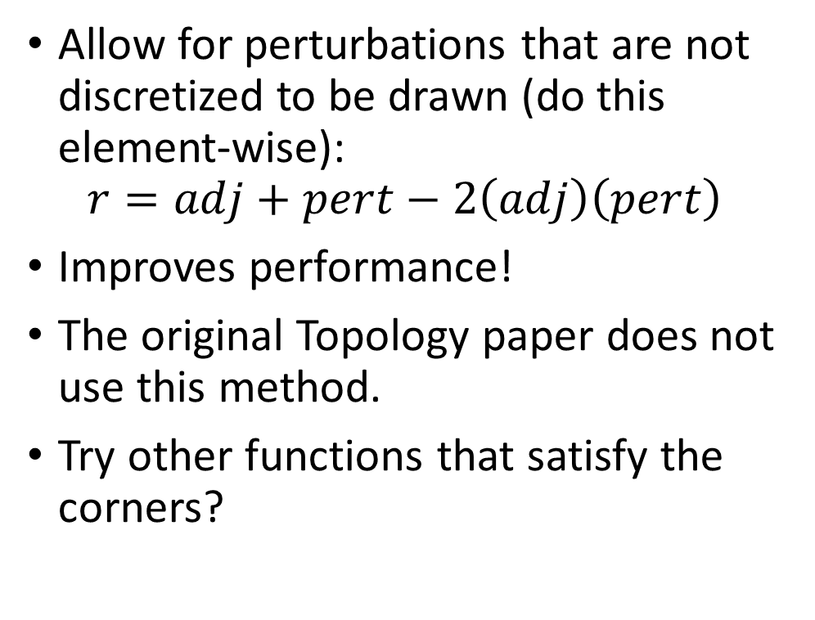
Modifying how perturbations are drawn
Allow for perturbations that are not discretized to be drawn (do this element-wise):
$$r=adj+pert−2\left(adj\right)\left(pert\right)$$
Improves performance!
The original Topology paper does not use this method.
Try other functions that satisfy the corners?
Adj (x) | Pert (y) | R (z)
0 | 0 | 0
0 | 1 | 1
1 | 0 | 1
1 | 1 | 0

Slide 4
Notable test (best result for given ptb_rate)
Randomly chosen G0 (~14%)
Ptb_rate: 0.05
With retrain (include min)
 | Base | Lock | Change
G0 | 79.0% | 69.5% | -9.5%
GX | 80.8% | 81.0% | 0.2%
 | Add | Remove
G0-G0 | 15 | 0
G0-GX | 106 | 0
GX-GX | 15 | 0
reg_epochs | ptb_epochs | surrogate_epochs | randomized | ptb_rate | protected_size | retrain | base_g0 | lock_g0 | change_g0 | base_g_g0 | lock_g_g0 | change_g_g0 | g0g0_add | g0g0_remove | g0gX_add | g0gX_remove | gXgX_add | gXgX_remove | total
200 | 20 | 10 | Y | 0.05 | 0.14 | Y | 79.0% | 69.5% | -9.5% | 80.8% | 81.0% | 0.2% | 15 | 0 | 106 | 0 | 15 | 0 | 136

Slide 5
Notable test (best result for given ptb_rate)
Randomly chosen G0 (~14%)
Ptb_rate: 0.5
With retrain (include min)
 | Base | Lock | Change
G0 | 79.0% | 45.4% | -33.6%
GX | 80.8% | 77.2% | -3.7%
 | Add | Remove
G0-G0 | 151 | 0
G0-GX | 972 | 1
GX-GX | 229 | 0
reg_epochs | ptb_epochs | surrogate_epochs | randomized | ptb_rate | protected_size | retrain | base_g0 | lock_g0 | change_g0 | base_g_g0 | lock_g_g0 | change_g_g0 | g0g0_add | g0g0_remove | g0gX_add | g0gX_remove | gXgX_add | gXgX_remove | total
200 | 20 | 10 | Y | 0.5 | 0.14 | Y | 79.0% | 45.4% | -33.6% | 80.8% | 77.2% | -3.7% | 151 | 0 | 972 | 1 | 229 | 0 | 1353

Slide 6
Notable test (best result for given ptb_rate)
Clustered G0 (label == 5, ~14%)
Ptb_rate: 0.05
Without retrain (no min)
 | Base | Lock | Change
G0 | 84.4% | 72.2% | -12.2%
GX | 80.3% | 79.4% | -0.9%
 | Add | Remove
G0-G0 | 0 | 0
G0-GX | 90 | 0
GX-GX | 34 | 0
reg_epochs | ptb_epochs | surrogate_epochs | randomized | ptb_rate | protected_size | retrain | base_g0 | lock_g0 | change_g0 | base_g_g0 | lock_g_g0 | change_g_g0 | g0g0_add | g0g0_remove | g0gX_add | g0gX_remove | gXgX_add | gXgX_remove | total
200 | 20 | 10 | N | 0.05 | 0.14 | N | 84.4% | 72.2% | -12.2% | 80.3% | 79.4% | -0.9% | 0 | 0 | 90 | 0 | 34 | 0 | 124

Slide 7
Notable test (best result for given ptb_rate)
Clustered G0 (label == 5, ~14%)
Ptb_rate: 0.5
Without retrain (no min)
 | Base | Lock | Change
G0 | 84.4% | 59.4% | -25.0%
GX | 80.3% | 76.2% | -4.1%
 | Add | Remove
G0-G0 | 8 | 0
G0-GX | 835 | 0
GX-GX | 477 | 0
reg_epochs | ptb_epochs | surrogate_epochs | randomized | ptb_rate | protected_size | retrain | base_g0 | lock_g0 | change_g0 | base_g_g0 | lock_g_g0 | change_g_g0 | g0g0_add | g0g0_remove | g0gX_add | g0gX_remove | gXgX_add | gXgX_remove | total
200 | 5 | 10 | N | 0.5 | 0.14 | N | 84.4% | 59.4% | -25.0% | 80.3% | 76.2% | -4.1% | 8 | 0 | 835 | 0 | 477 | 0 | 1320

Slide 8
Some notes
Changing the weighting of the loss function has big impacts on the performance over GX and can improve G0 in some cases. This varies with what the setting is (randomized G0, min-max or just min, ptb_rate)
If I disable mirroring the perturbation matrix to create an “impossible” matrix (it is not symmetric about the diagonal), the performance greatly increases (to > 50% reduction over G0).
Model retrain seems to be beneficial when G0 is random. Not good when G0 is clustered.

Slide 9
Important trivial cases
When G0 is clustered, most trivial cases perform poorly.
When G0 is randomized, some trivial cases perform exceptionally well.
Although empirically effective, these can likely be algorithmically overcome by a competent downstream user.
G0_Type | G0-G0 | G0-GX | Change_G0 | Change_GX
Clustered | Remove | Remove | -20.6% | 1.1%
Randomized | Add | Remove | -66.7% | -3.0%
Randomized | None | Remove | -11.8% | -1.4%
Randomized | Remove | Remove | -10.6% | -1.1%

Slide 10
Datasheet
Two tabs: Randomized and Clustered
reg_epochs: epochs to train baseline and comparison model
ptb_epochs: epochs to perturb
surrogate_epochs: epochs to train surrogate
Randomized: randomize G0 or use a label (5)
ptb_rate: perturbation budget
protected_size: If not randomized, proportion of random nodes
Retrain: enable training surrogate (add min)
base_g0: accuracy of baseline over baseline g0
lock_g0: accuracy of locked model on g0 of locked graph
base_g_g0: accuracy of baseline over baseline gX
lock_g_g0 : accuracy of locked model on gX of locked graph
g0g0_add: edges of type g0-g0 added
g0gX_add: edges of type g0-gX added
gXgX_add: edges of type gX-gX added
trivial_g0g0: if not “”, apply add/none/remove to all possible g0-g0 type edges
trivial_g0gX: if not “”, apply add/none/remove to all possible g0-gX type edges

