Slide 1
1-25-2022 Updates

Slide 2
Testing multi-task lock for subgraph
For a graph, select n tasks (in addition to label) from features
In this case, selecting first 2 features from all nodes to become tasks
Remove these features from nodes (model treats them like labels)
Have n additional surrogate models
Total loss is just sum of G0-GX loss for all surrogate models
Tested: Cora, Blogcatalog, PolBlogs
Task 0 is just label
Known issue:
Projection becomes worse as gradients get larger
LR is becoming more variable (need different initial LR to account, no distinct pattern though)

Slide 3
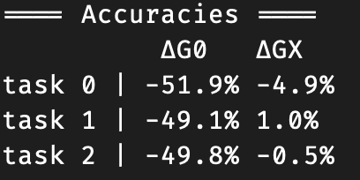
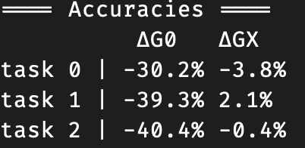
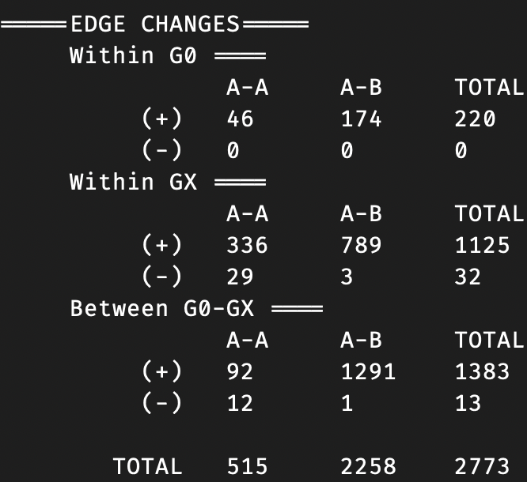
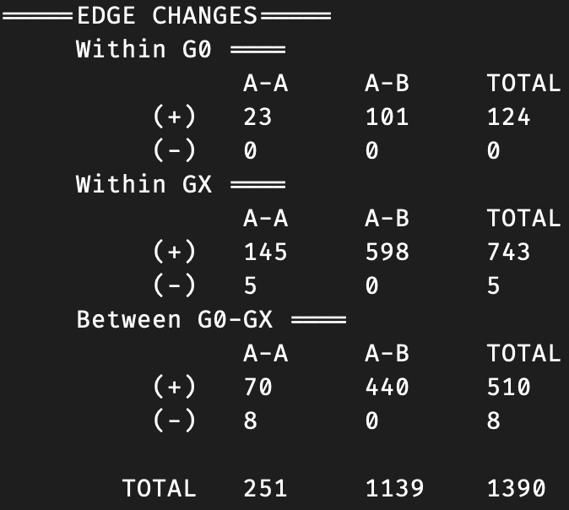
Results on Cora (random)
1.0 Ptb rate
0.5 Ptb rate
Notes:
1.0 ptb rate result basically obscured all tasks completely

Slide 4
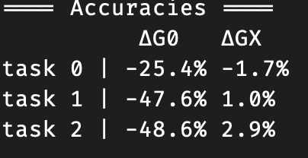
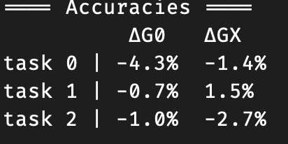
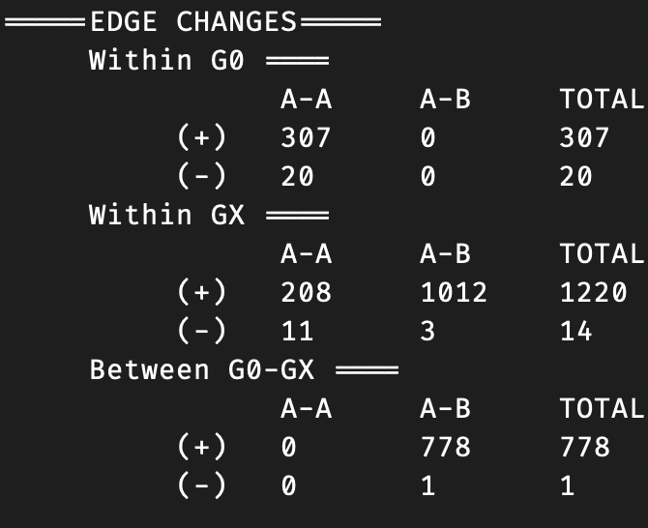
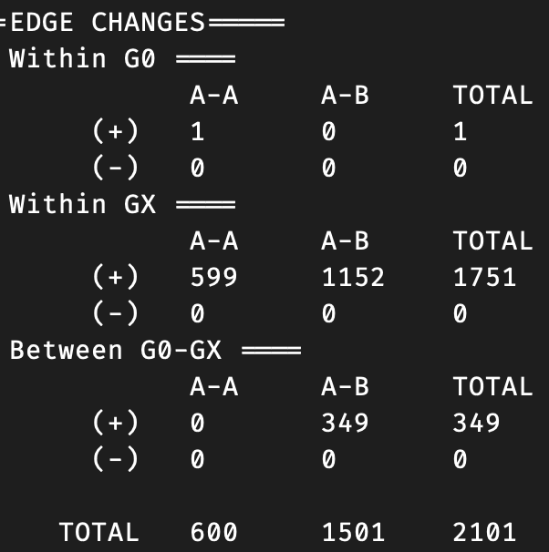
Results on Cora (not random)
1.0 Ptb rate
0.5 Ptb rate
Notes:
Tasks 1 and 2 are binary, so reducing roughly 45% completely obscures the feature

Slide 5
Notes about blogcatalog
Social network
Users are in “groups”

Slide 6
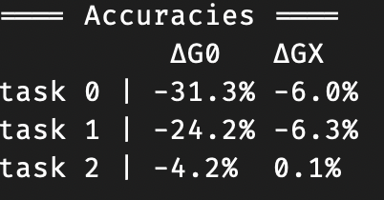
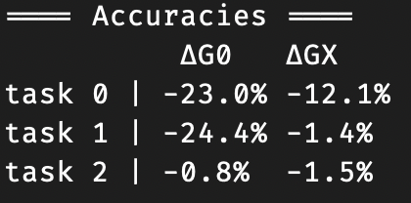
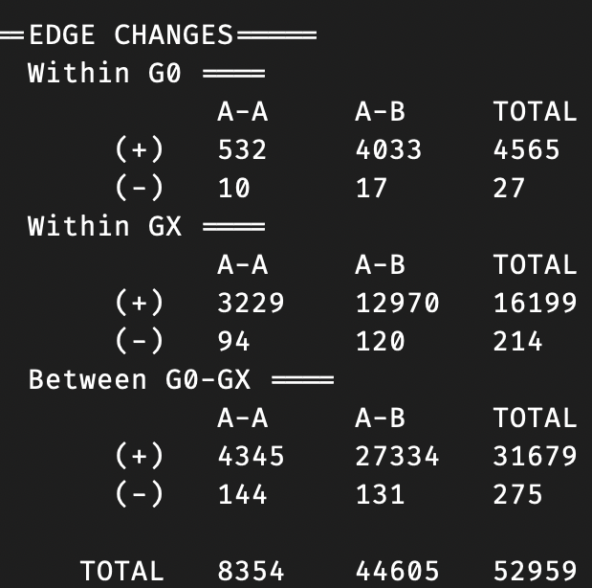
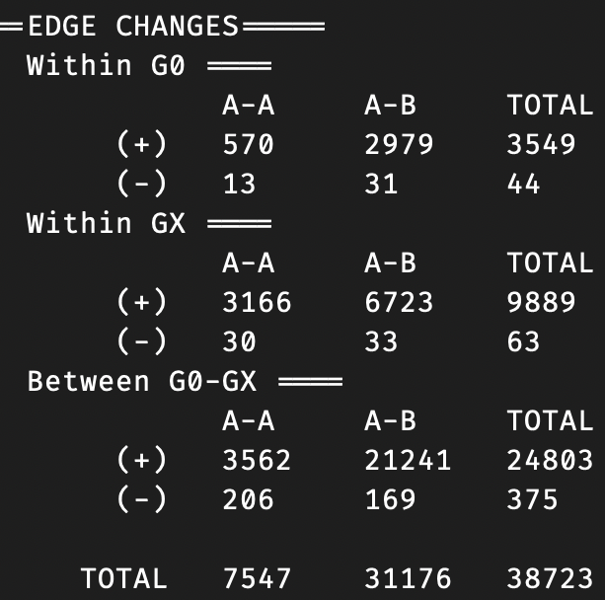
Results on Blogcatalog (random)
1.0 Ptb rate
0.5 Ptb rate
Notes:
Task 2 is a feature that is very uniform

Slide 7
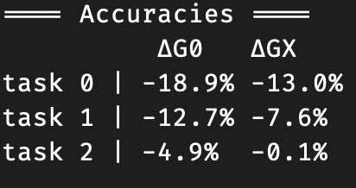
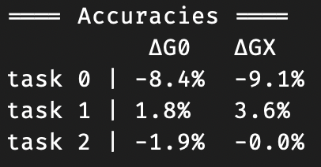
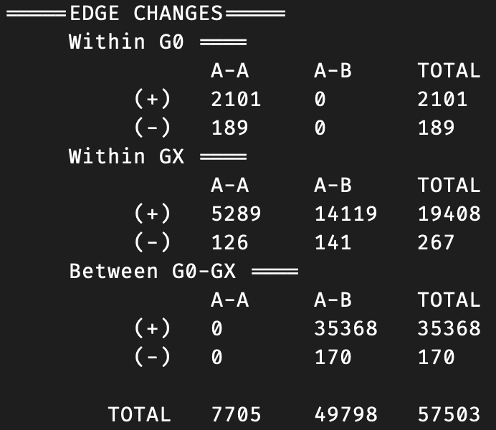
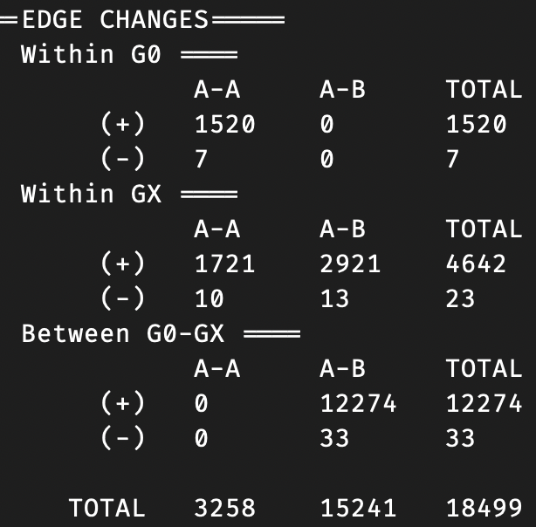
Results on Blogcatalog (not random)
0.5 Ptb rate
1.0 Ptb rate
Doesn’t seem very effective
Loss is very large during perturbation compared to randomized G0
Inconsistent total perturbations (projection is hitting max tries)

Slide 8
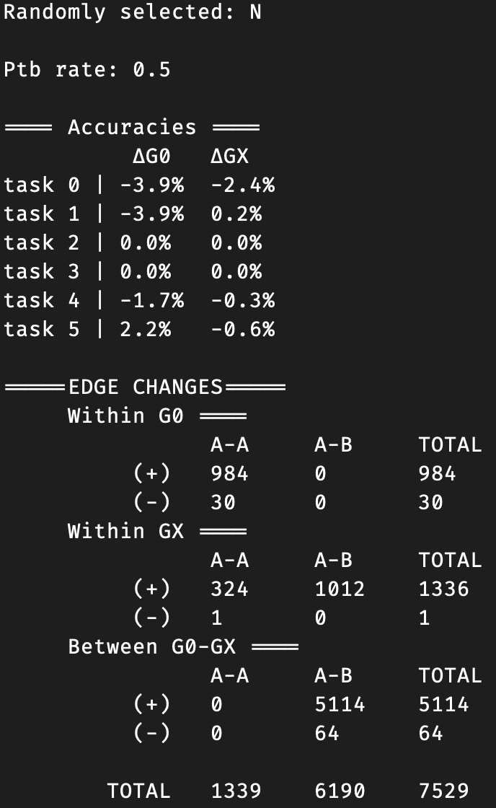
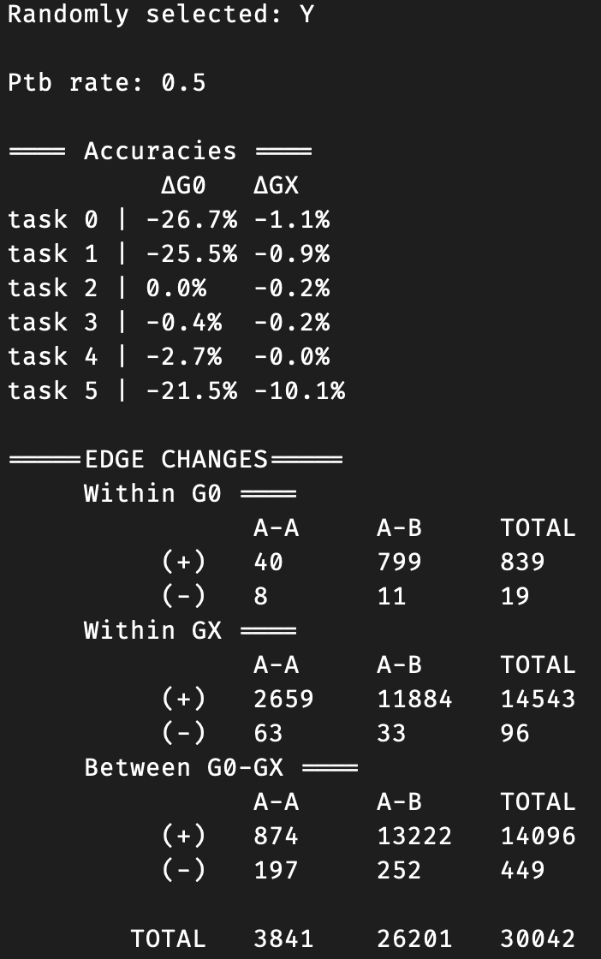
Blogcatalog (Many tasks)

Slide 9
Notes about polblogs
Political blogs (label is binary for left/right)
Binary label: too much accuracy reduction is bad
Poor results for grouped scenario (since protected size is 50% of all nodes)
Means there are lots of nodes for very small budget (compared to other scenarios with 7+ classes)
Great results for random
Because there is only one other class to optimize towards?

Slide 10
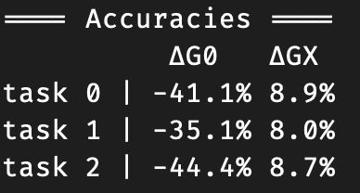
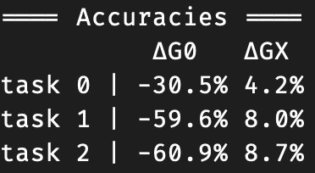
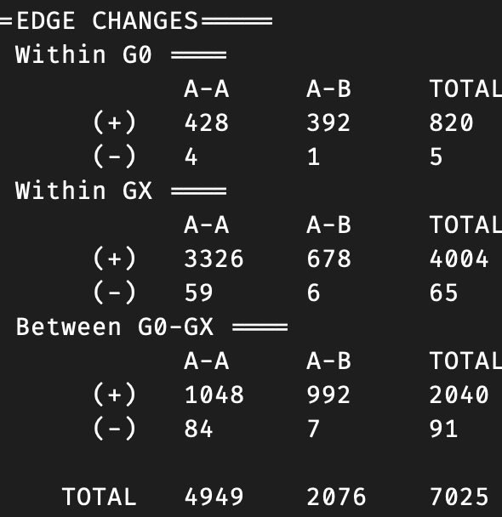
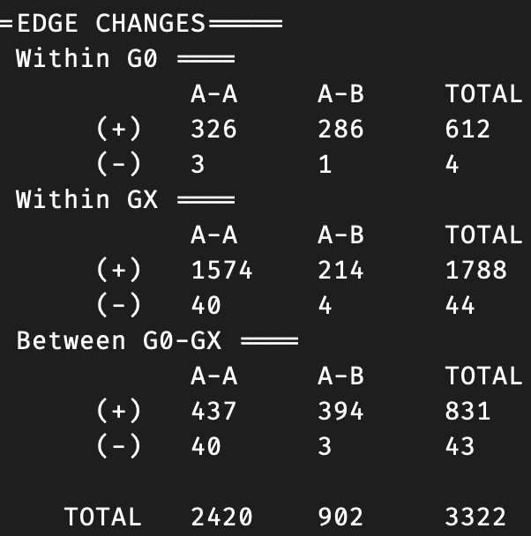
Results on Polblogs (random)
1.0 Ptb rate
0.5 Ptb rate
Notes:
Tasks 1,2 are uniform, so model is exposing information (final accuracy is less than 50%)

Slide 11
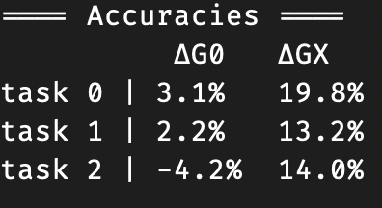
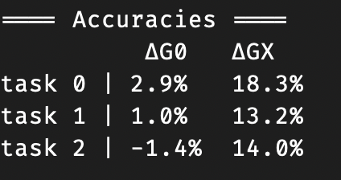
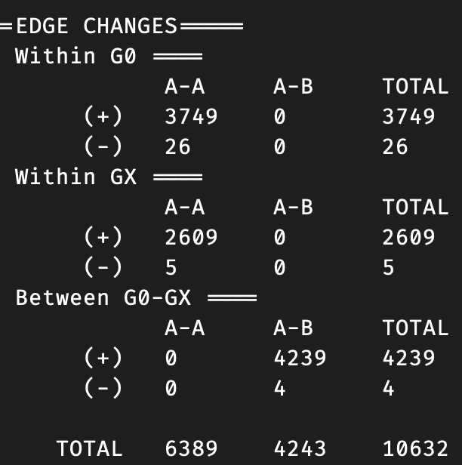
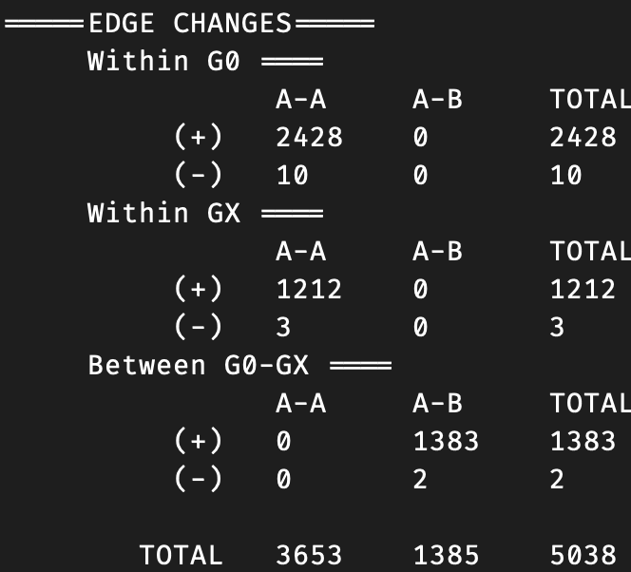
Results on Polblogs (not random)
0.5 Ptb rate
1.0 Ptb rate

Slide 12
Summary
N-task works well on most data for all tasks, regardless of structure
Can completely obscure some features
Exceptions (doesn’t perform well):
When protected class is very large
When gradient is very large (more of an implementation issue, will see if this can be overcome)
When ptb rate is too small (cora results show very weak performance but then large jump when ptb rate is increased)
What is different from just 1 task?
Edges in similar places → I think the attack is simply choosing better edges in same place to impact other task performance
Model doesn’t weight any task more than any other, so which task gets priority? So far, it doesn’t seem to matter too much, as either all/most tasks are impacted or none are.

