Slide 1
2-15-22 Updates

Slide 2
Current direction
Original attack implementation was determined to be effective, but not feasible
Calculating the gradient w.r.t the entire adj is too large (ex Pokec > 16GB)
Idea: Batch the adj into smaller parts, calculate grad, then re-assemble

Slide 3
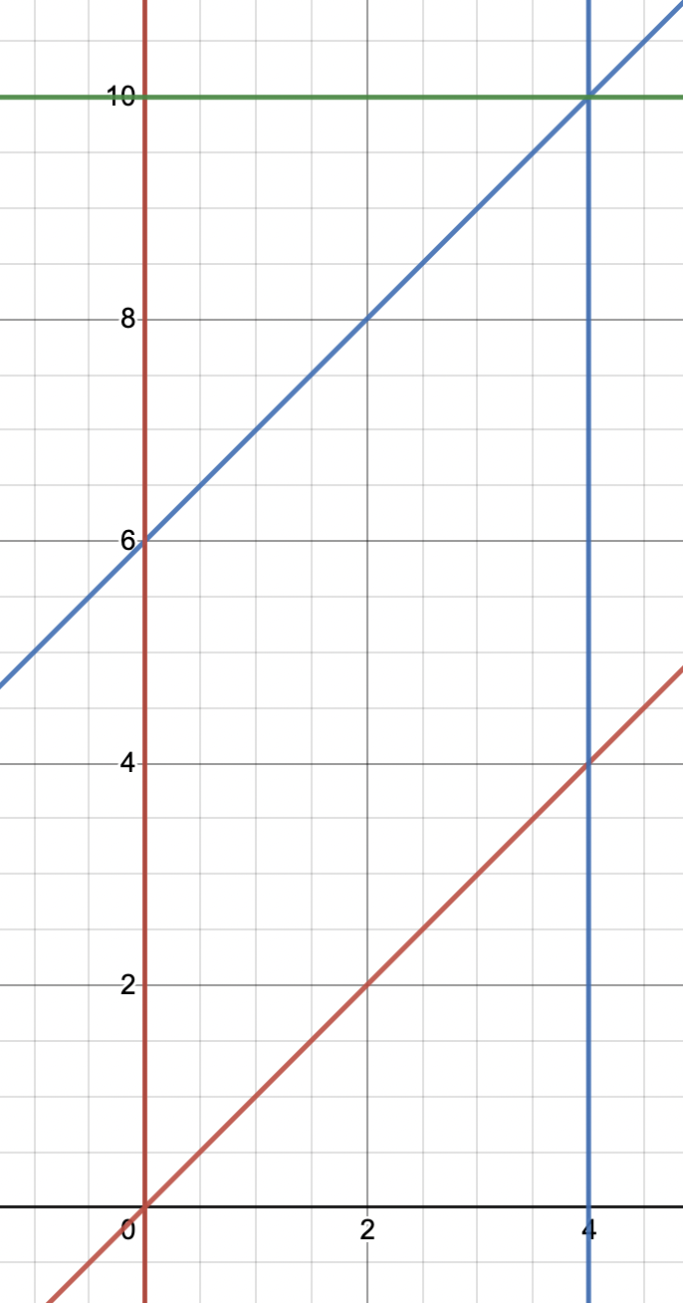
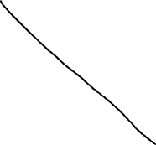










Implementation
Randomize the indices of the adj
Create n batches of width w, space the centers evenly
Adj matrix
Randomized indices of nodes
[7,8,1,6,2,9,4,5,3]
Each bar is a subset of all nodes (indices are y-axis)

Slide 4
Experimental performance
Simple gradient use case: train the model
Train using ”batches”, test using the complete original graph
Num batches: 4, Batch size: 75%, Epochs: 50
When training batches, divide epochs by num batches
Then for each epoch, train the model once on each batch
Memory and computations are ~45% less than without batching
Dataset | Mean baseline acc | stddev | Mean batch-trained acc | stddev
Blogcatalog | 0.67 | 0.024 | 0.62 | 0.022
Cora | 0.76 | 0.003 | 0.75 | 0.013
Polblogs | 0.84 | 0.026 | 0.82 | 0.059

Slide 6
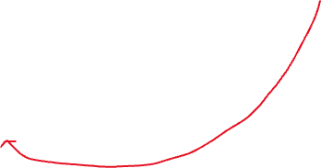




Other implementation (incomplete)
Reduce the amount of overlap of batches
Get the four corners then remove middle
Recover part of the bottom that is lost
Adj matrix

Slide 7
Next steps
How to re-assemble the gradient?
Keep the original position of each batch, then average the overlap?
Test it with Pokec
Test it with multitask-lock

