Slide 1
Alzheimer’s Disease and Aging: Aims 1 and 2
Project 2
Ezra Weible
30 March 2026

Slide 2
Aim 1 and Aim 2 Overview
Aim 1: Are inflammatory markers (IL-6, TNF-α, MCP-1, Eotaxin-1) associated with 1 year changes in episodic memory and cortical thickness?
Hypothesis 1a: Baseline inflammatory markers
Hypothesis 1b: 1 year change inflammatory markers
Aim 2: Does amyloid deposition modify these associations?
Primary Hypothesis: Baseline inflammatory markers
Secondary Hypothesis: 1 year change inflammatory markers

Slide 3
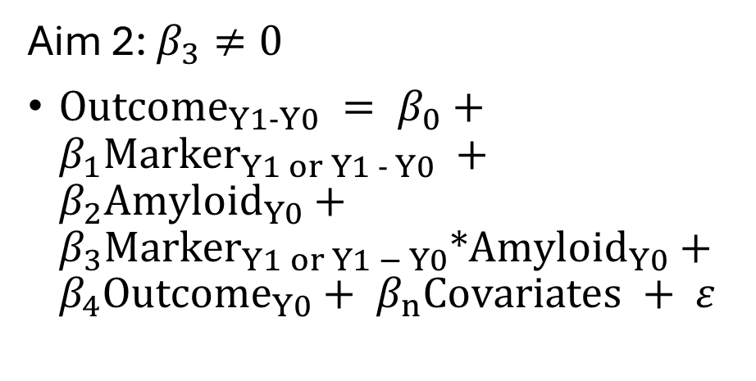

Data Analysis Plan
Aim 1: $β_{1}≠0$
${Outcome}_{Y1−Y0} = β_{0}+β_{1}{Marker}_{Y1 or Y1 − Y0} + β_{2}{Outcome}_{Y0}+β_{n}Covariates + ε$
Aim 2: $β_{3}≠0$
${Outcome}_{Y1−Y0} = β_{0}+β_{1}{Marker}_{Y1 or Y1 − Y0} +β_{2}{Amyloid}_{Y0}+β_{3}{Marker}_{Y1 or Y1 − Y0}∗{Amyloid}_{Y0}+β_{4}{Outcome}_{Y0}+{ β}_{n}Covariates + ε$
Covariates will be evaluated as precision variables in an exploratory manner
Age, sex, APOE status added a priori
Missing data will be investigated for bias
Type I Error will be controlled as 0.05/4 (markers), 0.05/6 (outcomes), or 0.05/24
More formal adjustments will be explored once empirical correlations are known

Slide 4
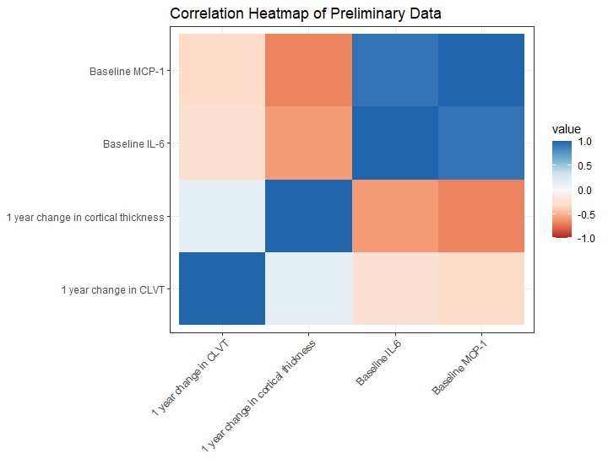
Preliminary Data
Preliminary data included two change outcomes and two baseline inflammatory markers
Correlations between markers and outcomes ranged from 0.2-0.7
Informed effect size range for power calculations

Slide 5
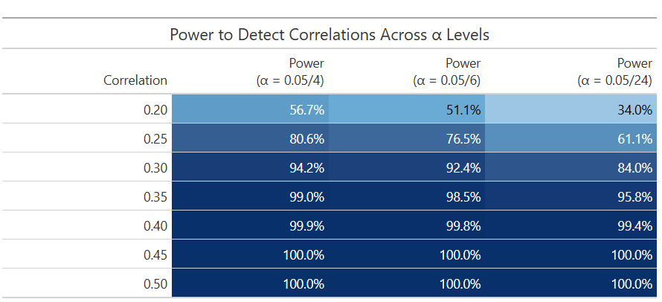
Aim 1 Power
Power > 80% for correlations ≥0.30 across all α levels
Aim 1 is well-powered for moderate effects

Slide 6
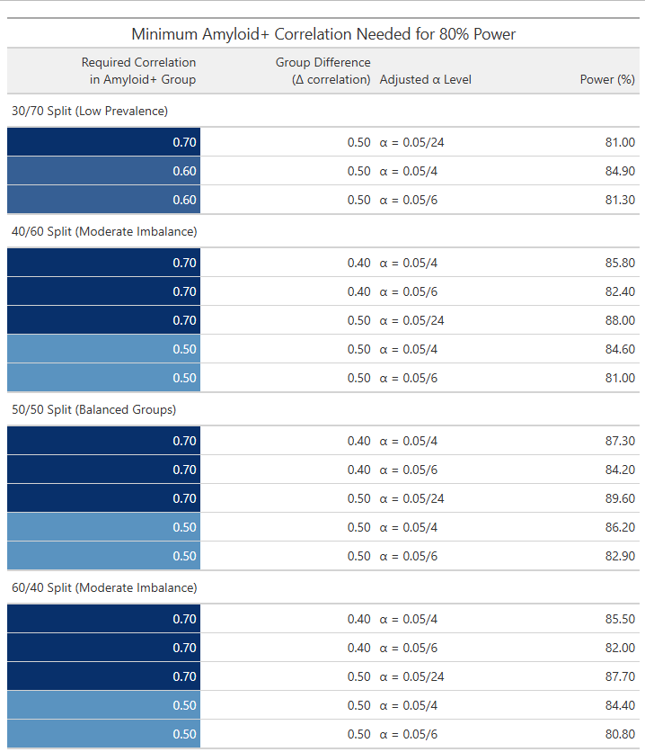
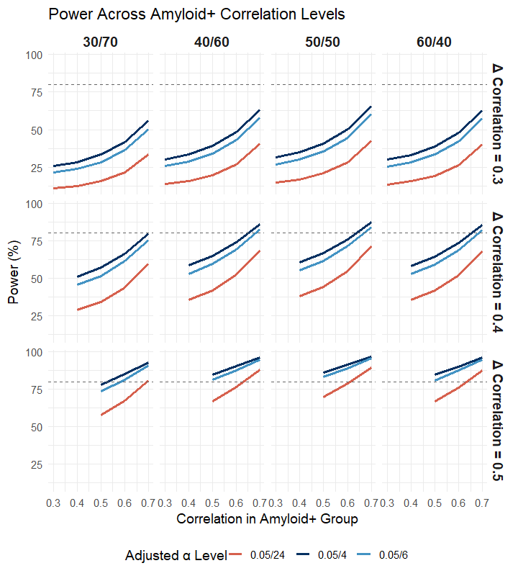
Aim 2 Power
Large interactions (0.50) detectable with moderate amyloid+ correlations
Moderate interactions (0.40) require strong correlations
Under α = 0.05/24, only very strong effects are detectable
Notes:
Power to detect differences in marker-outcome correlations between amyloid+ and amyloid- groups across interaction sizes, amyloid prevalence ratios, and $\alpha$ levels. Lines show the power achieved for a given amyloid+ correlation, with separate panels for each interaction size (difference in correlations) and each amyloid+:amyloid- group ratio (30/70, 40/60, 50/50, 60/40). Power was calculated using two-sample correlation difference tests with N = 175 and adjusted Type I error thresholds ($\alpha$ = 0.05/4, 0.05/6, 0.05/24). The dashed horizontal line marks 80% power. Larger interaction effects and more balanced group ratios yield higher power, while stricter $\alpha$ thresholds require stronger underlying correlations in the amyloid+ group to achieve comparable power. Some differences in correlations never reach 80% power for any measured amyloid+ correlation.

Slide 7
Discussion
Interpretation
Aim 1: Powered for moderate associations between inflammatory markers and cognitive decline
Aim 2: Likely detectable only for large interaction effects
Limitations
Known correlations in predictors, covariates, and outcomes
Limited preliminary data
Few known empirical correlations
No preliminary data for amyloid deposition
α thresholds may be too conservative
Formal adjustments will be explored when empirical correlations are known.

