Slide 1
Associations Between Baseline Hard Drug Use and Two-Year Treatment Outcomes After HAART Initiation
Project 1
Ezra Weible
2 March 2026

Slide 2
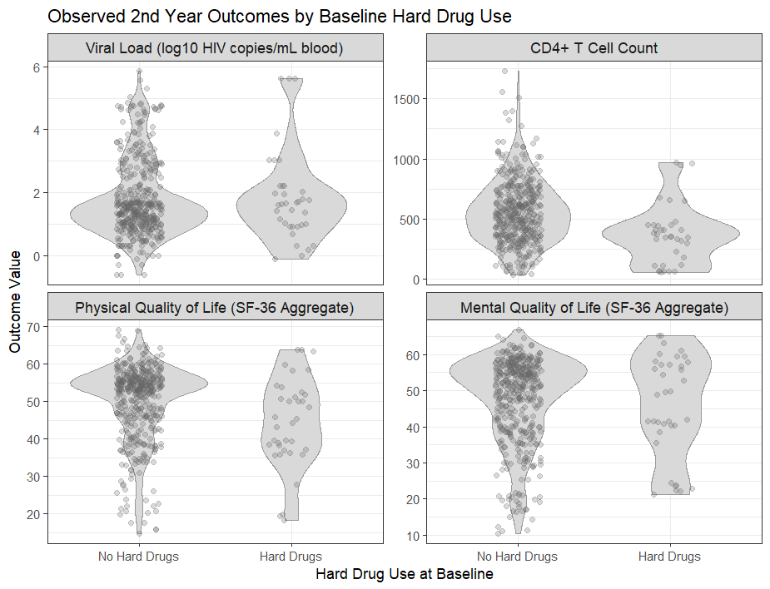
Research Question
Does baseline hard drug use affect treatment response two years after initiating HAART?
Outcomes: viral load (log10 scale), CD4 count, physical and mental quality of life
Null Hypothesis: No difference in year-2 response between baseline hard drug users and non-users
Can this be explained by differences in second year adherence?
Notes:
- As you can see, the distributions largely agree between those that reported using hard drugs and those that did not, though there are many more non-users present. You can see that the shape of the CD4 and physical quality of life figures are the most different by group.

Slide 3
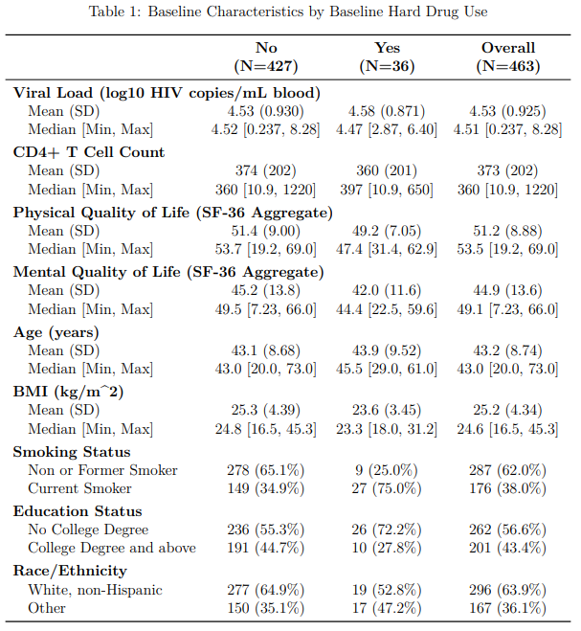
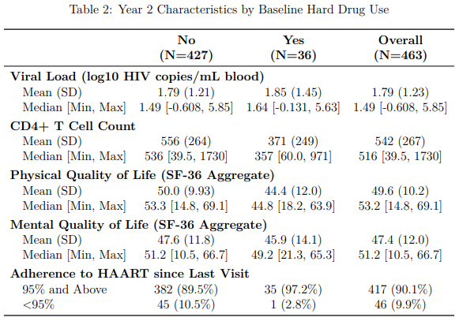
Data Overview
*Collapsed to 2 categories each based on sample sizes
463 subjects had complete outcome and covariate data
*
* *
*
Notes:
This dataset includes 715 participants that were filtered to 463 who had complete baseline and year‑2 outcomes, baseline covariates, and year two adherence. This allows for easy comparison across models.
A few data issues needed attention: some BMI values were miscoded or implausible, and several categorical variables had very small categories that needed to be collapsed. Viral load is analyzed on the log10 scale.

Slide 4
Analysis Overview
Primary Models
Linear regression for each year 2 outcome by hard drug status
Adjusted for: baseline outcome, age, BMI, smoking, education, race/ethnicity
Bayesian implementation
Priors: N(0,1000) for coefficients, half Normal(0,1000) for residual SD
Stan (HMC/NUTS), 4 chains, 2000 burn-in followed by 5000 iterations
Diagnostics: R-hat, ESS, trace, autocorrelation, and posterior density plots
Used clinically meaningful thresholds for posterior probability
Secondary Models
Refit each model including year 2 adherence
Compare estimates descriptively
Notes:
Frequentist and Bayesian approaches for a total of 16 models
No p-value adjustment for frequentist due to the prior specification of the importance of all outcomes, just noted in the discussion
Bayesian STAN used Hamiltonian Monte Carlo algorithm with the no-U-turn sampler
Diagnostics all looked good

Slide 5
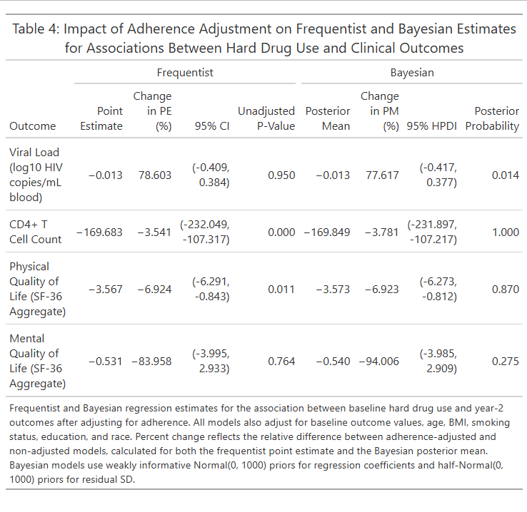
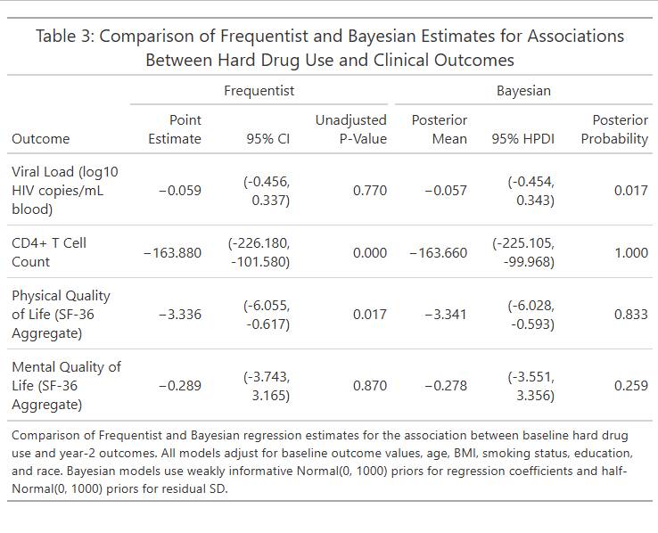
Results
Strong evidence of lower CD4 counts among hard drug users
Moderate evidence of lower physical quality of life among hard drug users
Adherence adjustment did not change any conclusions
Notes:
Clinically meaningful effect for CD4: 50 cells. Estimate and HPDI were lower and posterior probability was 1.000
Clinically meaningful effect for physical quality of life: 2 points. Estimate was lower but HPDI overlapped with smaller posterior probability
The largest % changes from adherence were

Slide 6
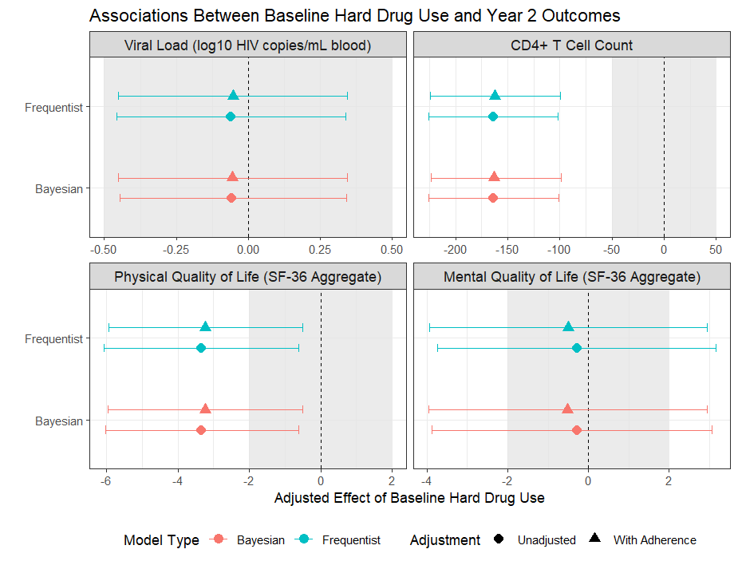
Results
Strong agreement across models
Notes:
Grey rectangles represent the clinically significant differences by group. CD4 is well outside the range and physical quality of life is overlapping with intervals but not with point estimates, matching the previous conclusions.

Slide 7
Discussion
Limitations
Hard drug use and adherence are self reported and only measured once
Complete case analysis may introduce bias
Potential differential dropout by drug use
Potential unmeasured confounders (SES, mental health, co-infections)
Generalization beyond MACS cohort

