Slide 1
Timing, Adherence, and Hormone Profiles in a Novel, At-Home Saliva Collection Device
Project 0
Ezra Weible
4 February 2026

Slide 2
Research Questions
How closely do the booklet reported sampling times agree with electronic cap times?
Do participants adhere to the 30 minute and 10 hour sampling times required by a study protocol?
How do cortisol and DHEA change from wake to 30 minutes and from 30 minutes to 10 hours?
Notes:
Translated investigator questions into the following scientific research questions.

Slide 3
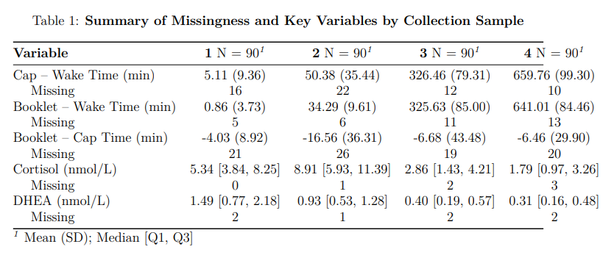
Data Overview
Notes:
31 healthy adults, one was excluded from RQ3 for 4x high DHEA over assay detection limit
Created new variables for time relating to differences between values
Cap times had more missingness than booklet times
Cortisol and DHEA had higher values at start than end of day as expected

Slide 4
Analysis
LMM testing perfect agreement between booklet and cap times
Adherence summaries (±7.5 min, ±15 min) at 30 min and 10 hr targets
Piecewise LMM for log-transformed cortisol and DHEA (knot at 30 min)
Notes:
To test the scientific research questions, I had the following three approaches.
LMMs were used to allow for subject-level intercepts accounting for repeated measures.
Only descriptive statistics for RQ2, looked at collection samples 2 and 4
Log transformation due to right skew, knot at 30 minutes to account for diurnal nature

Slide 5
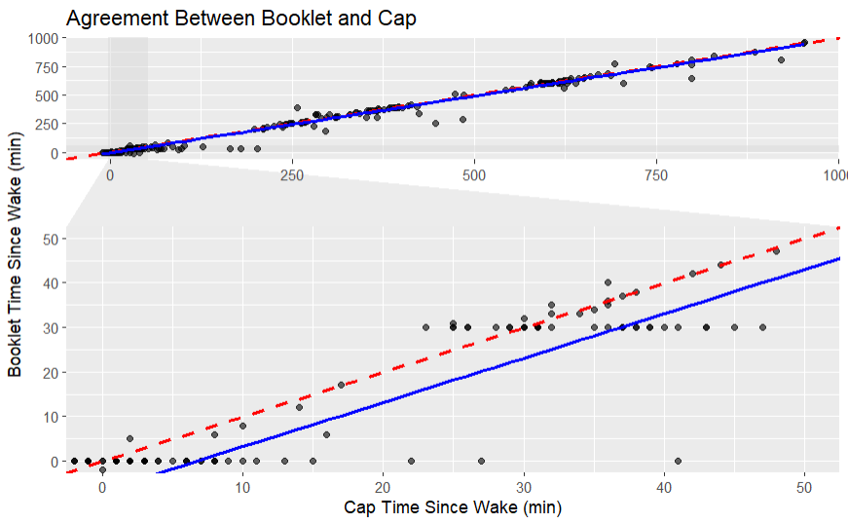
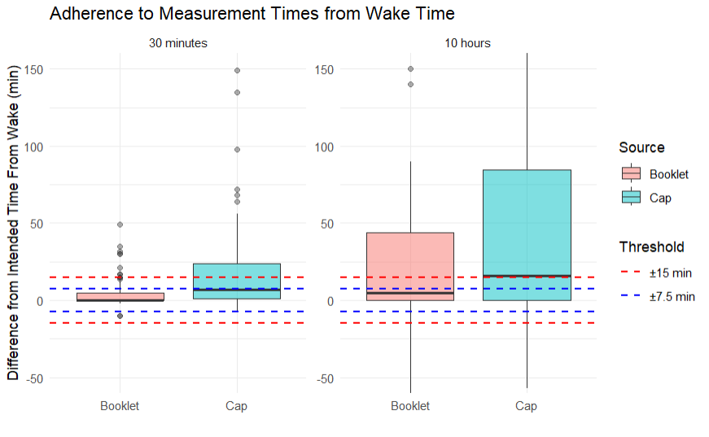
Results – RQ1 and RQ2
Notes:
Booklet and cap times showed a near one‑to‑one relationship (slope = 1 (CI = 0.98 to 1.01))
Booklet times were recorded 6.7 minutes earlier on average (intercept != 0 with a p-value of 0.028)
Booklet times were consistently closer to the intended sampling windows than cap times
Adherence was lower at the 10‑hour mark, especially for cap times

Slide 6
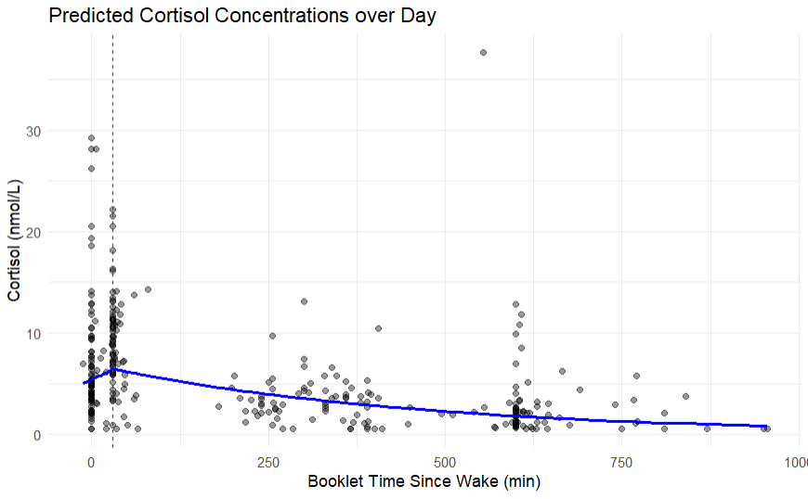
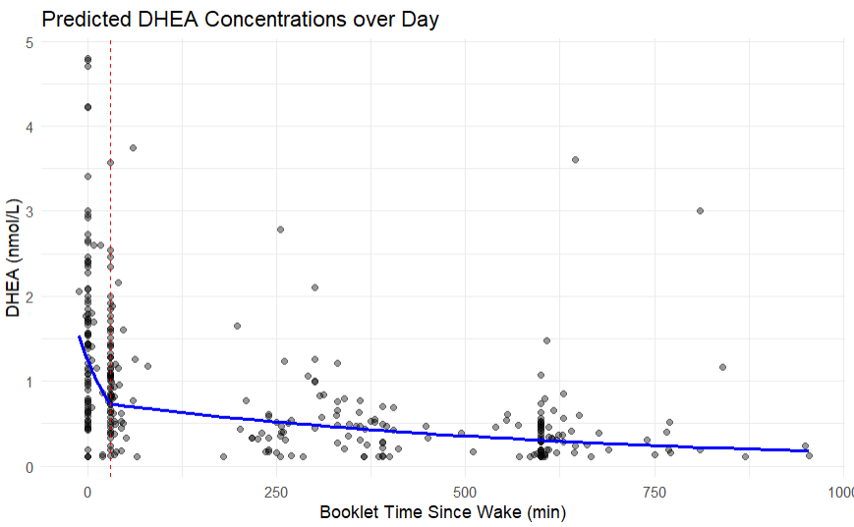
Results – RQ3
Notes:
Cortisol showed the expected decline after 30 minutes, but the slight rise from wake to 30 minutes wasn’t statistically significant (p = 0.094)
DHEA declined sharply in the first 30 minutes and continued to decline more gradually afterward

Slide 7
Discussion - Limitations
No gold‑standard/“ground truth” sampling time
Missing and inconsistent cap data
Modest sample size
Assay constraints
Notes:
No gold‑standard sampling time, making it hard to determine whether discrepancies reflect reporting error, device issues, or participant behavior.
Missing and inconsistent cap data, plus small sample size, limit precision and generalizability.
Assay and data constraints (DHEA censoring, excluded participant) may affect hormone trajectory estimates.

