Slide 1
Framingham Longitudinal Stroke Risk Profile
Project 3
Ezra Weible
22 April 2026

Slide 2
Research Question
What baseline risk factors predict time to first stroke within 10 years?
Separate for males and females
What are the 10 year stroke probabilities for clinically relevant risk profiles?
No baseline risk factors,
High systolic blood pressure (≥ 160 mmHg),
Diabetes,
Both high systolic blood pressure and diabetes,
One additional profile chosen based on model results (current smoker).
Describe how systolic blood pressure and diabetes change over time
Notes:
This study focuses on understanding which baseline factors predict stroke within 10 years, how those predictors differ by sex, and how risk varies across common clinical profiles. I also examined how blood pressure and diabetes change over time to consider whether time‑varying models might be needed.

Slide 3
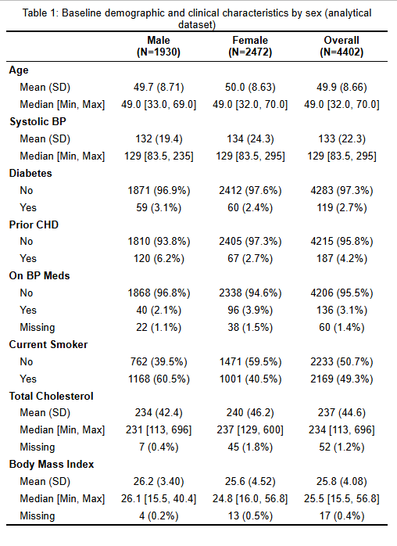
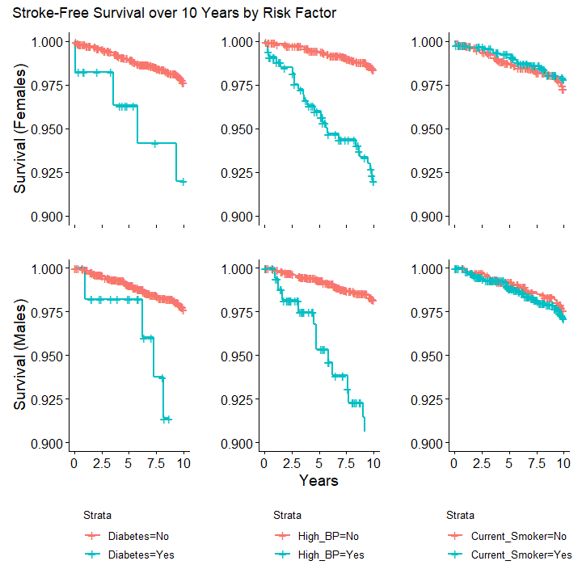
Data Overview
Notes:
This table shows the baseline characteristics. The KM curves highlight that diabetes and high systolic BP have the strongest unadjusted associations with stroke‑free survival.

Slide 4
Analysis
Excluded baseline stroke; created indicator for first stroke within 10 years
Stratified analyses by sex
Kaplan-Meier curves and log-rank tests for key risk factors
Cox Proportional Hazards Models
Age, systolic BP, diabetes included a priori
Additional covariates evaluated through backwards selection (AIC)
Checked proportional hazards assumptions
Predicted 10 year stroke-free survival for 5 clinical profiles across ages 40, 50, and 60

Slide 5
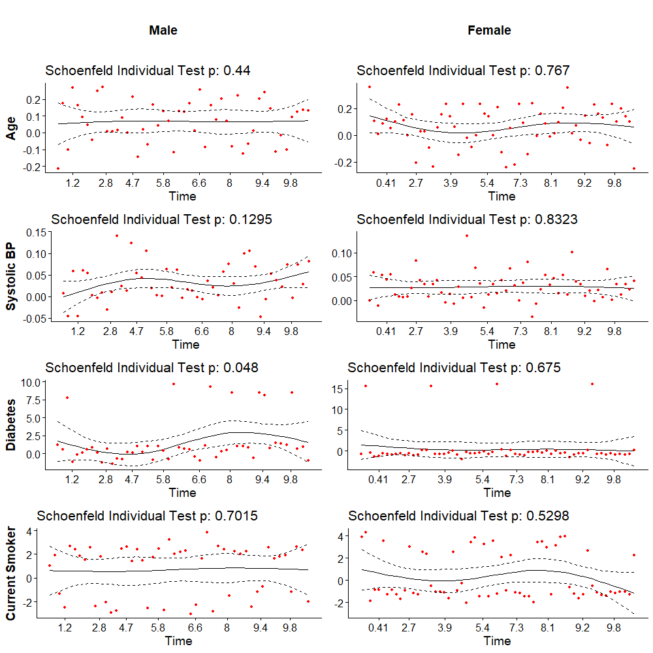
Results
Backward selection identified smoking status for males
Also included for females for comparability
PH assumptions generally met for both sexes
Global tests:
Males: 0.2277
Females: 0.9575

Slide 6
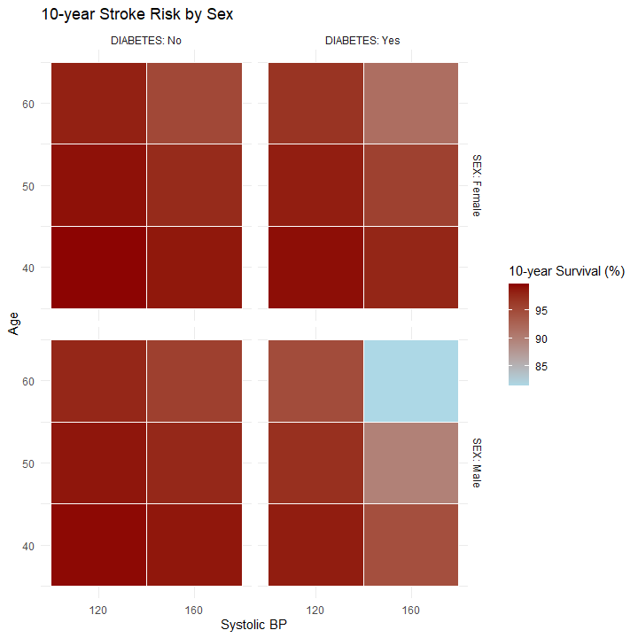
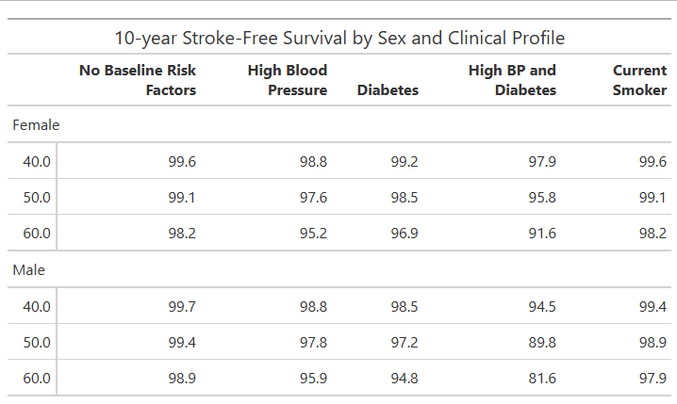
Results
Stroke risk increases with age
Combined high BP + diabetes yields the highest risk

Slide 7
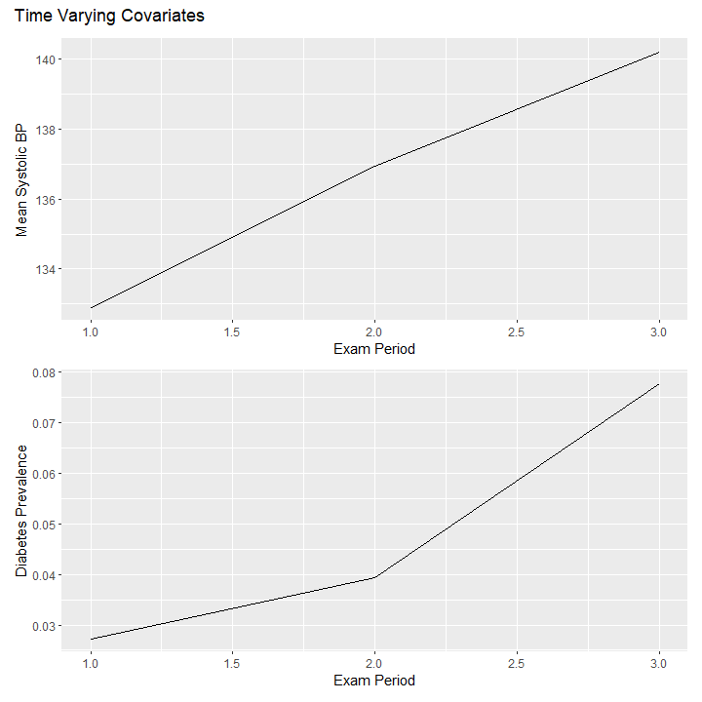
Discussion
Systolic BP is the strongest baseline predictor of stroke
Diabetes contributes substantial risk, particularly in males
Time varying patterns for both predictors are present
Limitations
Complete case analysis
No competing risks
Cohort demographics limit generalizability
Notes:
BP and diabetes change meaningfully over time, suggesting that future work could benefit from time‑varying models. Still, baseline‑only models remain appropriate for 10‑year risk prediction.

