Slide 1
Multi-Omic Clustering in Children with Cystic Fibrosis at the Initiation of a Pulmonary Exacerbation
Ezra Weible
23 April 2026

Slide 2
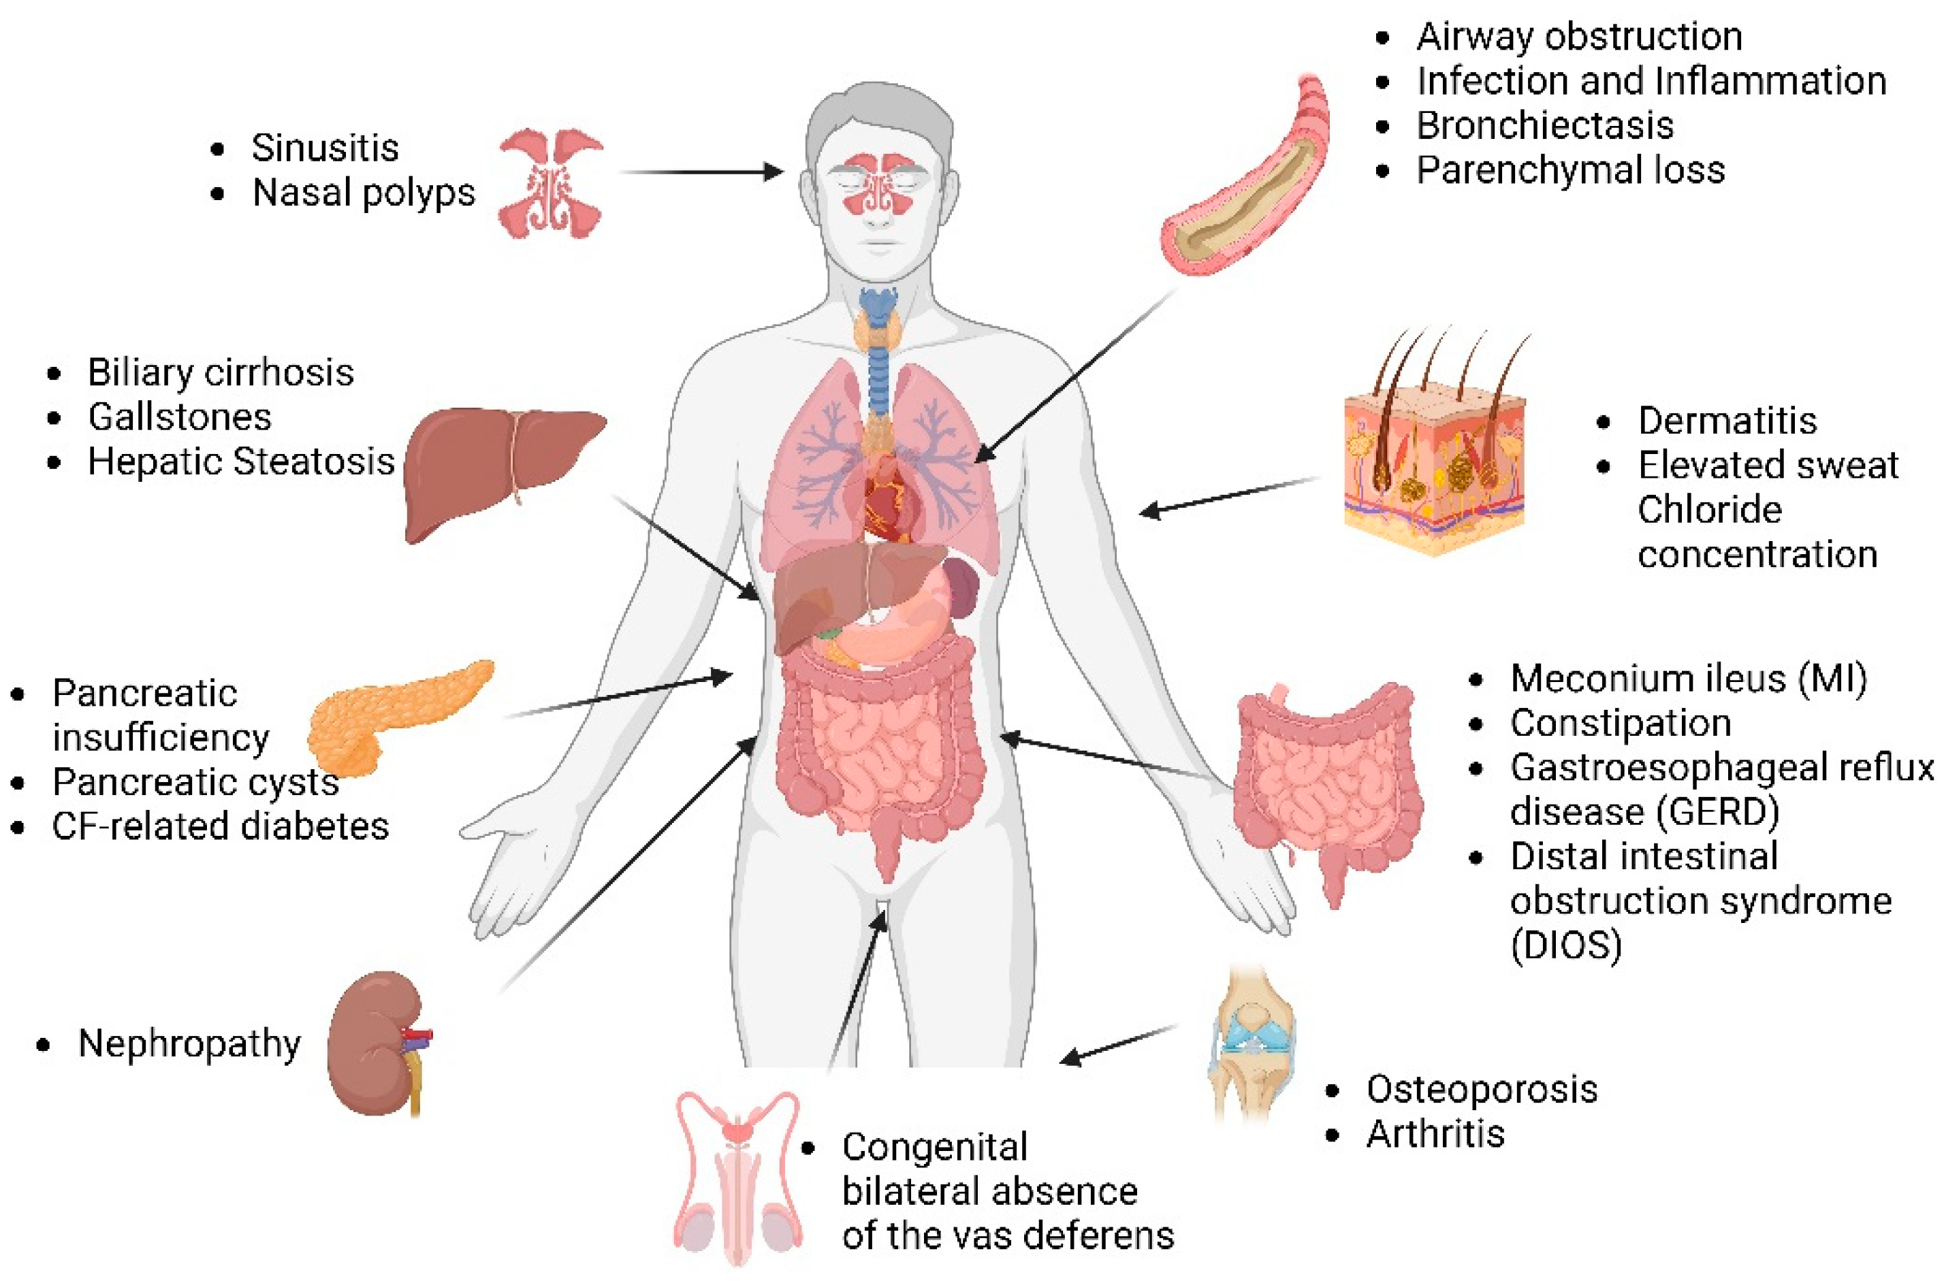
Cystic Fibrosis Overview
Notes:
Cystic Fibrosis is a genetic disorder that impacts the entire body
Caused by a mutation in CFTR protein which is a chloride ion channel. Without chloride leaving cells, water can’t hydrate the surface causing thick mucus to cover the cells.

Slide 3
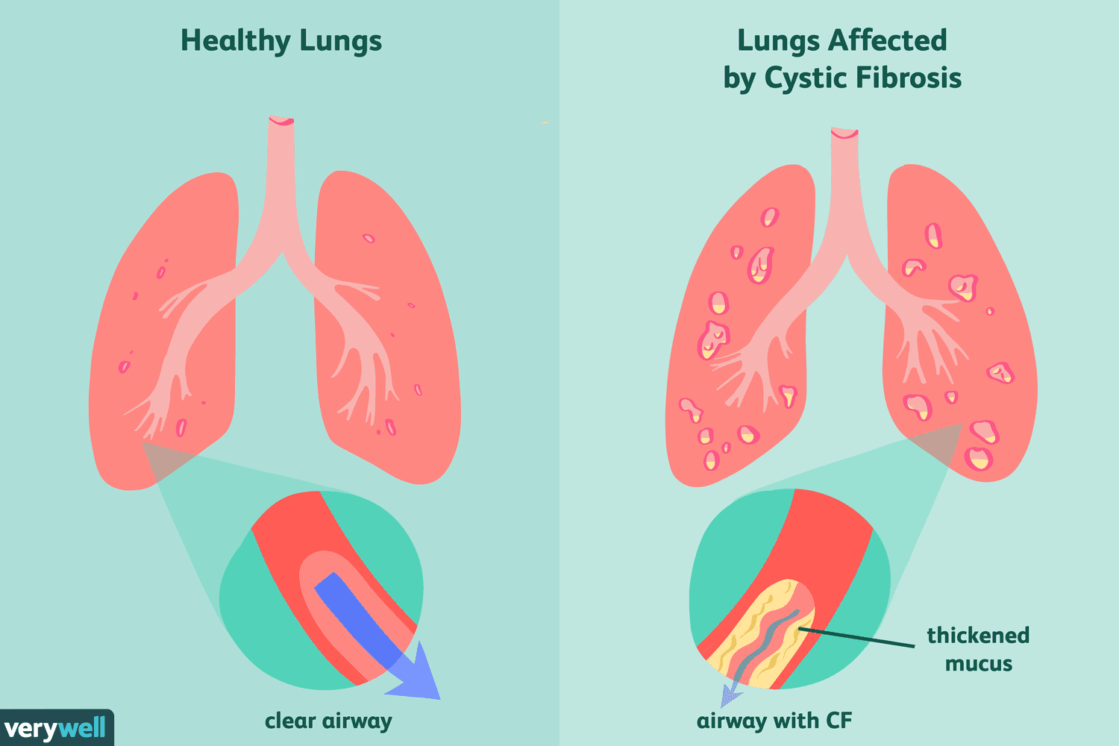
Cystic Fibrosis Overview
Notes:
This can be seen in the lungs, where the mucus can reduce airflow and increase infection risk.
Pulmonary exacerbations (sudden worsening of respiratory symptoms) are common due to bacterial infections and often result in hospitalization.
Contribute to long-term morbidity and lung function decline

Slide 4
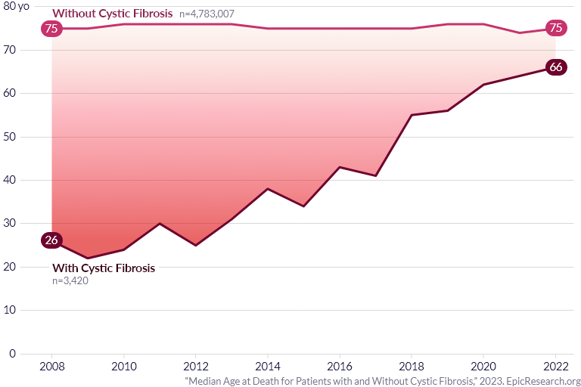
Cystic Fibrosis Overview
Notes:
There has been a lot of rapid progress in treating CF (drug modulator therapy to restore protein function, reduction of mucus, etc.), but still room for improvement especially among individuals who don’t qualify for modulators.

Slide 5





Cystic Fibrosis Overview
Notes:
One big issue is that during exacerbations, each person reacts differently
Exacerbations are often attributed to traditional CF-related pathogens such as Pseudomonas
But, particularly in children who may not have clear pathogens, it is hard to tell what is causing their illness and what approach to use for treatment, even after identifying the pathogens present in their airway

Slide 6
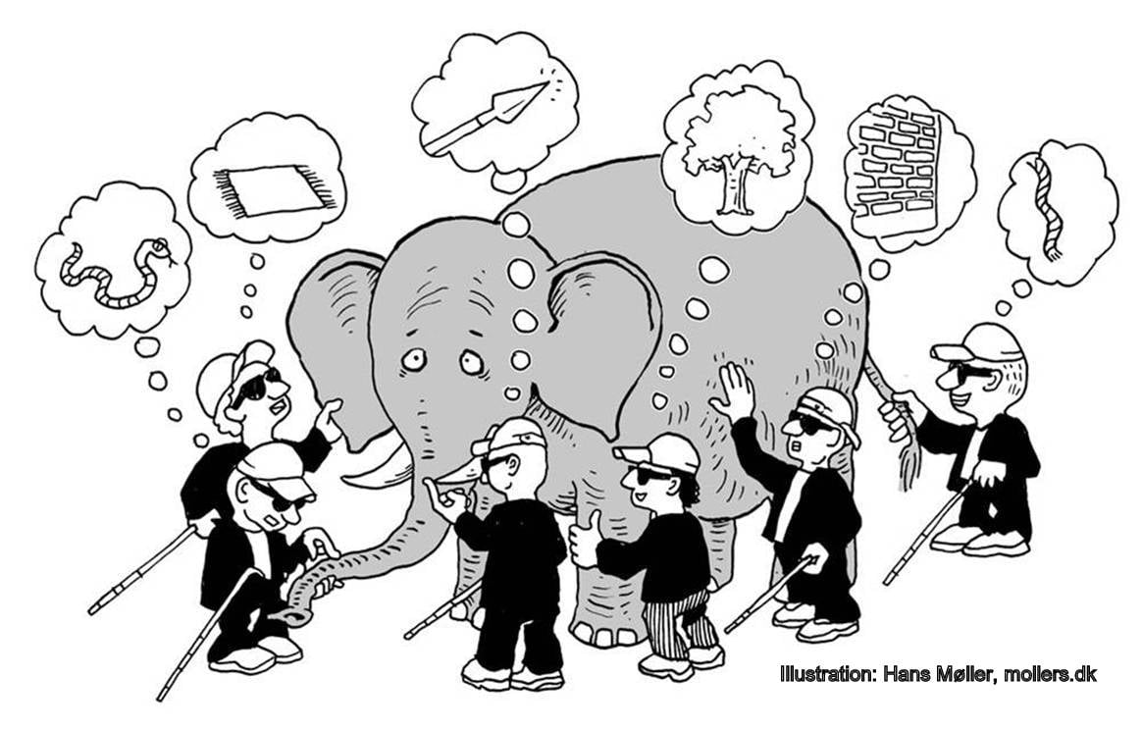
Why Single-View Approaches Fall Short
By integrating the lung microbiome (bacterial infections) with blood proteomics (host’s response), we may identify meaningful subgroups to aid in clinical decision making
Individuals can show very different host responses to similar bacterial infections
No single measurement or omics approach captures the full picture
Notes:
As I alluded to, these single-view approaches fall short because individuals can show very different host responses to similar bacterial infections
There is no single measurement or omics approach that reveals the full picture of an exacerbation. So, how do we capture that complexity?
Our approach was to integrate two omics to get a larger perspective. By looking at both the lung microbiome, which reveals the bacterial infections, and proteomics to reveal the host’s response, we may be able to identify meaningful subgroups to aid in clinical decision making.

Slide 7
Dataset Overview
 | Overall (N = 31)
Gender Female Male | 16 (51.6%) 15 (48.4%)
Age (years) | 15.8 [10.5, 22.0]
Number of F508del Alleles | 2.00 [0, 2.00]
Height (cm) | 162 [145, 174]
Pulmonary Exacerbations in the Past Year Missing | 1.00 [0, 4.00] 2 (6.5%)
Hospitalizations in the Past Year Missing | 1.00 [0, 4.00] 1 (3.2%)
Forced Expiratory Volume in 1 Second (FEV1) % Predicted Missing | 80.5 [30.0, 119] 1 (3.2%)
Forced Vital Capacity (FVC) % Predicted Missing | 92.0 [42.0, 123] 1 (3.2%)
Pulmonary Exacerbation Score (PES) Total | 12.0 [2.00, 16.0]
31 subjects (ages 10–22) hospitalized at a single site for CF pulmonary exacerbation (PEx)
Analysis on samples collected at admission with relevant clinical data
Notes:
The dataset we used for this approach had a final sample size of 31 subjects aged 10–22 who were hospitalized for a CF pulmonary exacerbation.
At admission for an exacerbation, we collected sputum for microbiome profiling and blood for proteomics, along with detailed clinical data including genotype, pulmonary exacerbations in the previous year, and measures of lung health such as FEV1 (forced expiratory volume in 1 second) and FVC (forced vital capacity, total amount of exhaled air)
These are measured as percent predicted to account for the fact that these are children whose lungs are still growing)
Add details about study (inclusion/exclusion criteria)
Charlie’s is not probably going to be published so cite the dissertation

Slide 8
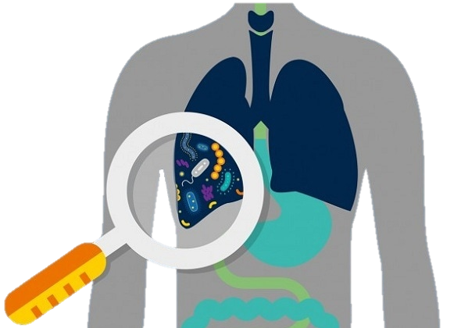
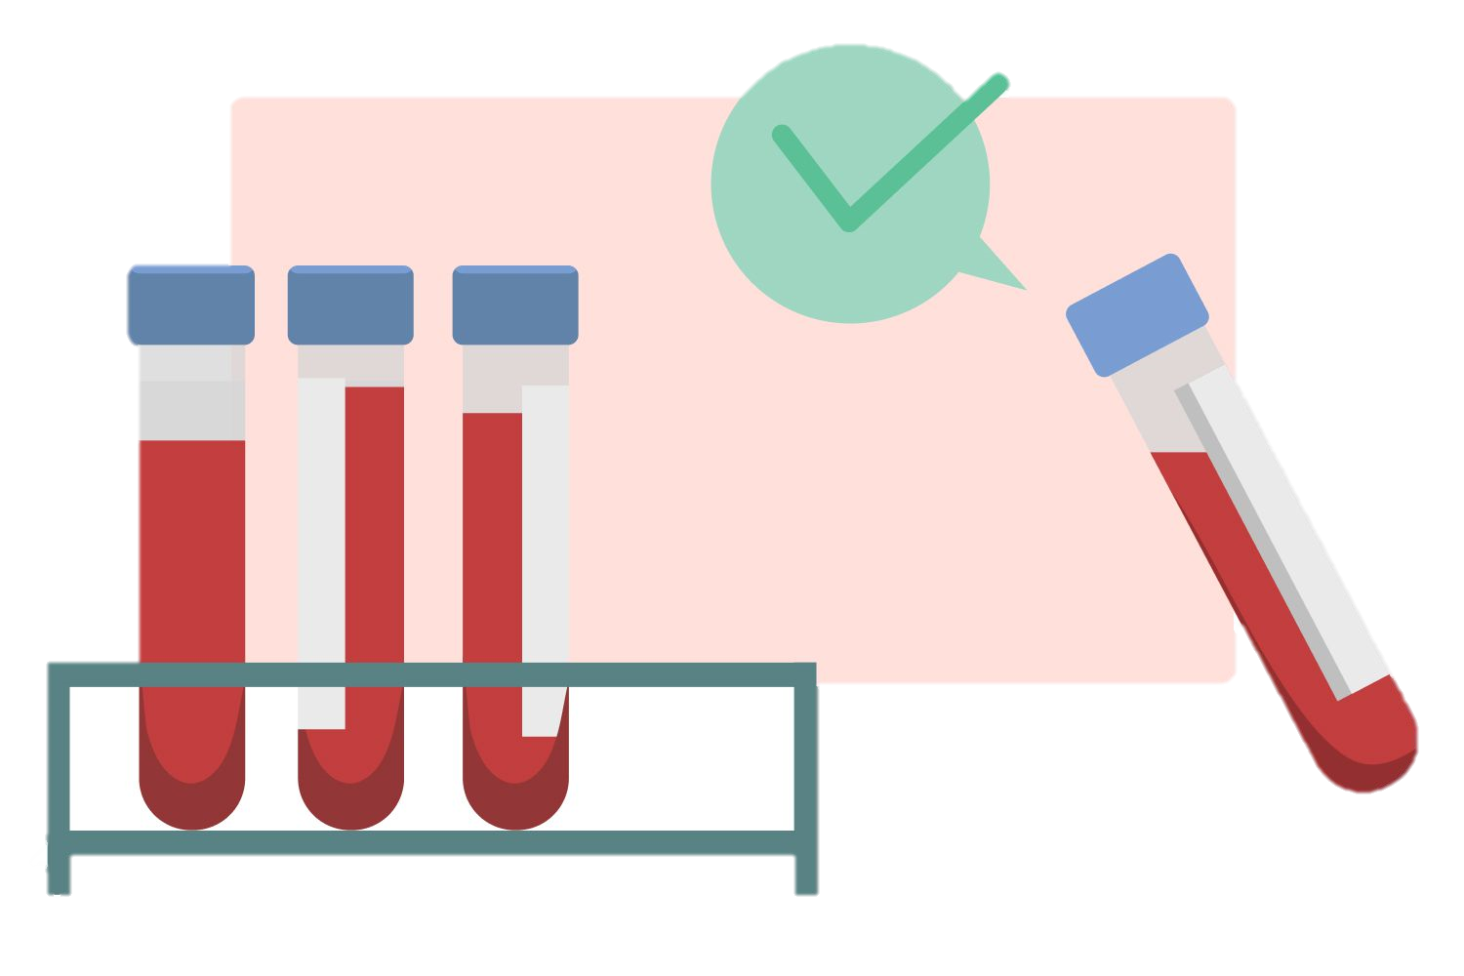
Microbiome and Proteome Overview
Microbiome – sputum (16s rRNA sequencing)
Identifies which bacteria are present in the lungs
Applied centered log-ratio (CLR) transformation
Filtered based on relative abundance and presence in subjects
73 bacterial taxa retained after filtering
Proteome – blood (SomaScan)
Reflects the host’s response, particularly by looking at proteins related to the inflammatory and immune system
Analyzed as relative fluorescent unit (RFU; log2 transformed)
3,895 proteins
Notes:
Minimum relative abundance of 0.1% in at least one subject and presence in at least 10% of subjects resulting in 73 taxa (333 for T1; 700 measured overall)
Outlier subjects were identified with principal components. There were two outliers that were removed. A batch correction was implemented.
A log2 transformation and batch correction was applied to the proteomic data
RFU is a way to quantify the relative amount of protein
How bright the spot, brighter = more protein (not a concentration)
Can be difficult to compare across proteins (why we account for batches)

Slide 9
Research Question
Can we identify subgroups of patients who share similar microbiome-proteome patterns during CF PEx?
Is a multi-omics approach providing additional information than either individually?
What makes these subgroups distinct on a bacterial-protein level?
Is there any clinical relevance to these subgroups?

Slide 10
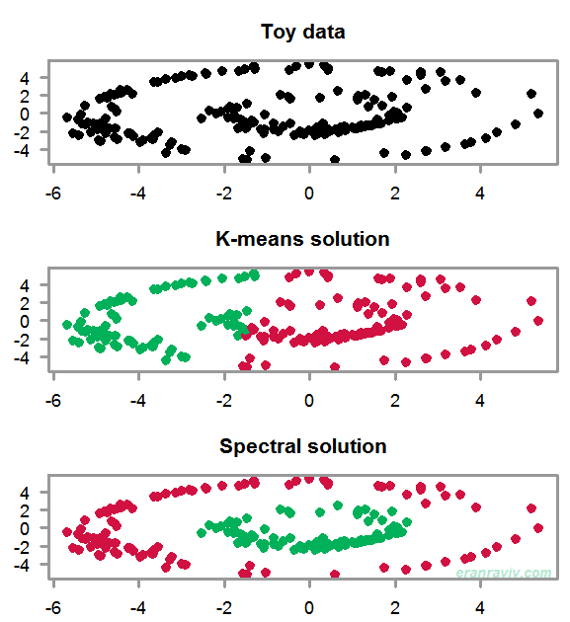
Spectral Clustering
Captures complex, non‑linear structure that k‑means cannot
Suitable for high-dimensional biological data
Builds a similarity graph between subjects and finds structure using the graph Laplacian’s eigenvectors
Notes:
Spectral clustering works by building a similarity graph between subjects and then using the graph’s eigenvectors to reveal structure.
This lets us detect clusters that aren’t spherical or linearly separable, which is important for biological data, where patterns are often irregular.
It also gives us a low‑dimensional representation that we can use across both microbiome and proteomic views.

Slide 11
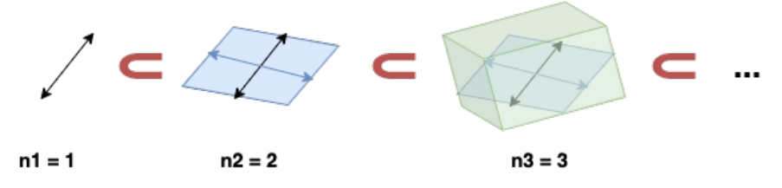
Flag Manifold
A flag is a sequence of nested subspaces
The flag manifold is the space of all nested subspaces
Captures both broad and fine patterns
Allows for flexible integration
Provides a shared geometric space where layers can be aligned without forcing them to perfectly match
Notes:
For a flag, think a line inside a plane inside a volume as visualized below
Flag manifold is a way to track structure at multiple scales simultaneously, not just one projection.

Slide 12
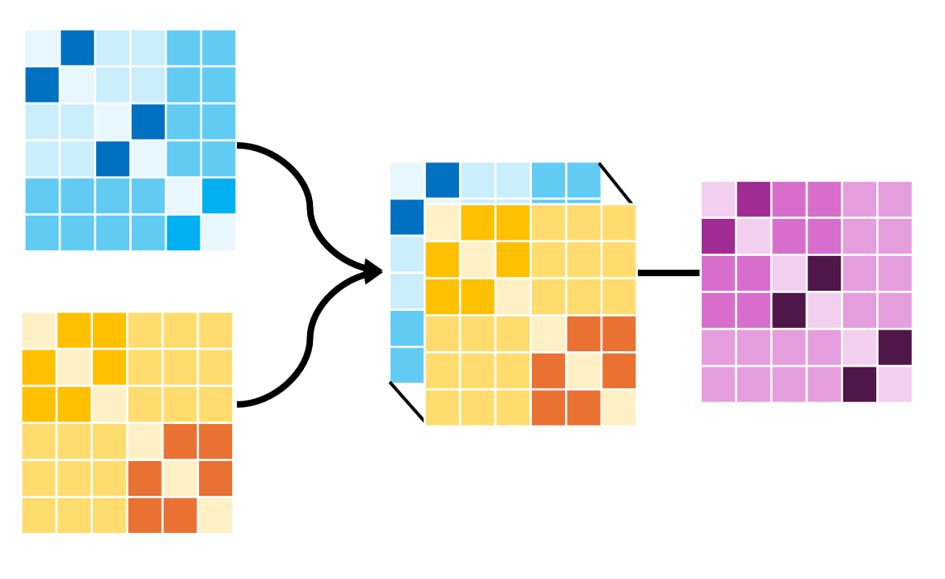
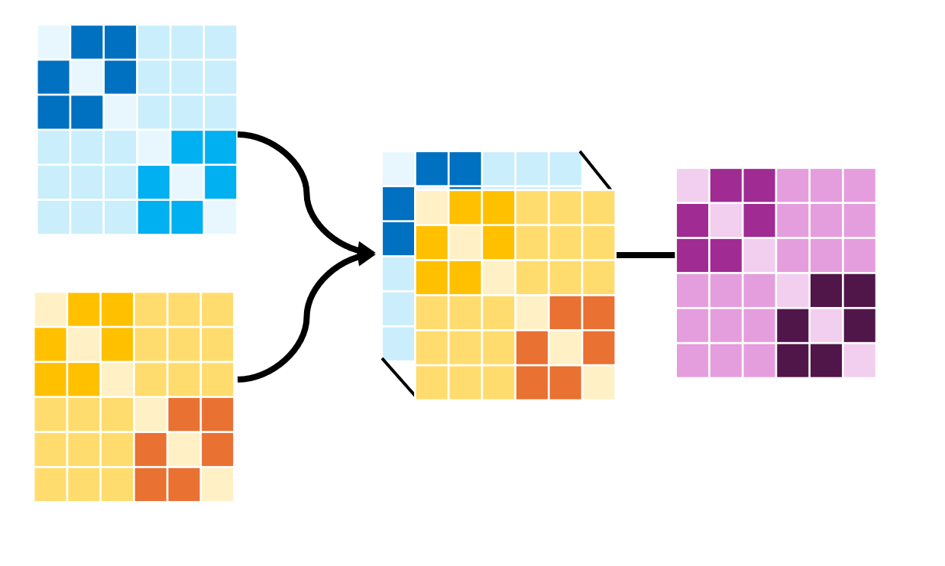
Multi-Omic Spectral Clustering using the Flag Manifold (MMOC) Charlie Carpenter
MMOC allows for multi-view spectral clustering
Can handle difference in number of features or clusters across views
Notes:
To expand the spectral clustering, I used a method developed by a previous student here, Charlie Carpenter, called Multi-Omic Spectral Clustering using the Flag Manifold, or MMOC
I spent a lot of time working with his original code to clean, rearrange, and adjust it to apply to this new project
We chose this method because it allows for more flexibility in the multi-omic clustering due to the flag manifold.
Rather than restricting to the same number of features, or clusters, across the different views, MMOC allows for flexibility in the individual omics when integrating to joint clusters, which is essential for this diverse omic data
“[other methods] may fail to capture heterogeneity that is biologically meaningful in multi-omic studies, where different molecular layers can reflect distinct (yet valid) stratifications of samples.”
Features include signal-to-noise
Focus on combining the estimated clustering subspaces using the flag mean
Distance matrices are the same size (this looks like that because of diagonal)
Same number of samples, different number of features
Maybe do a heatmap or blobs or something

Slide 13
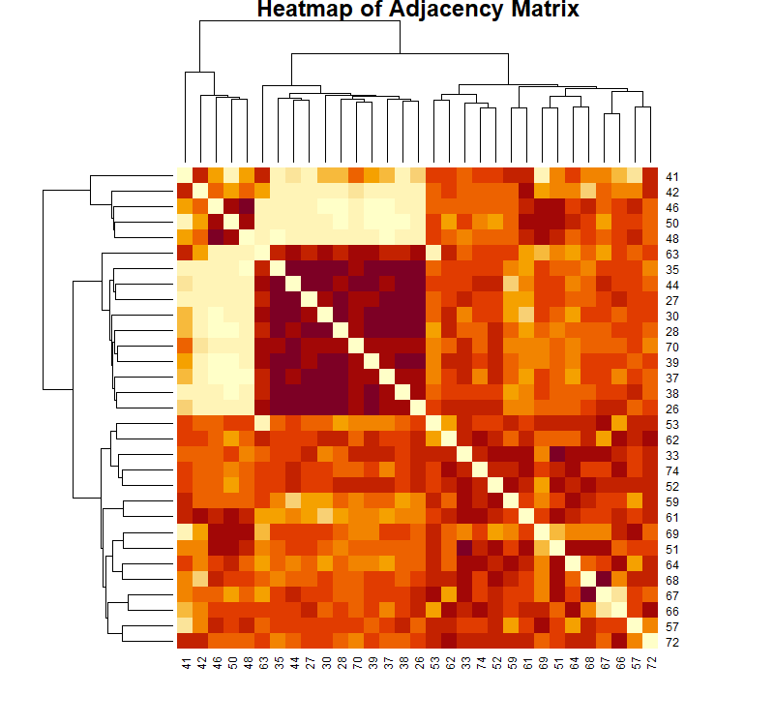
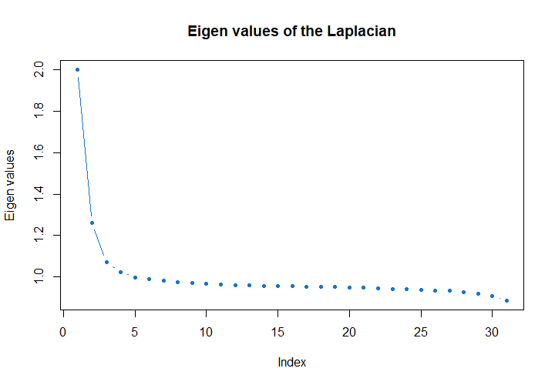
Microbiome Clustering
3 Microbiome Clusters based on TraceCovW index and visual inspection
Notes:
First, we wanted to cluster the two omics individually. These are the results for the microbiome, where we identified three clusters (point out on figure)
One of the ways we identified the number of clusters was the TraceCovW index, which measures the trace of the within-cluster pooled covariance matrix.
Helps to identify when the total within-cluster variation is minimized
The index was chosen as it aligned with the visual inspection of the eigen values of the Laplacian, where 3 clusters were chosen based on the elbow joint

Slide 14
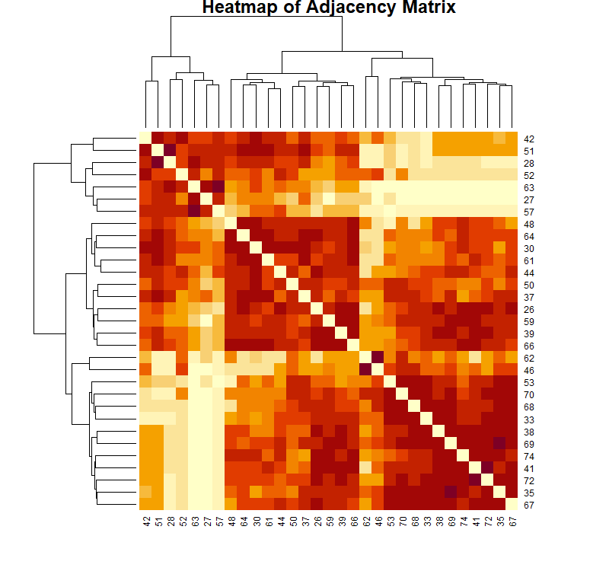
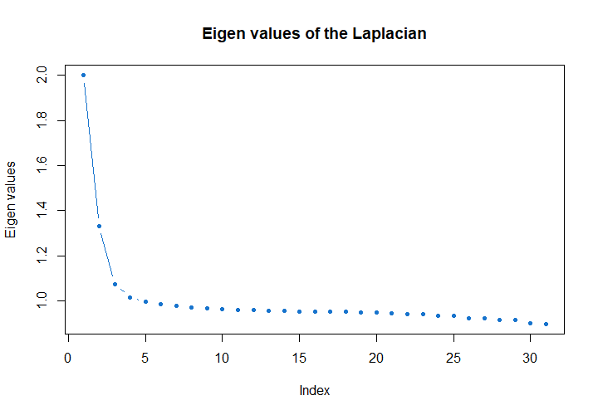
Proteomics Clustering
3 Proteomics Clusters based on TraceCovW index and visual inspection

Slide 15
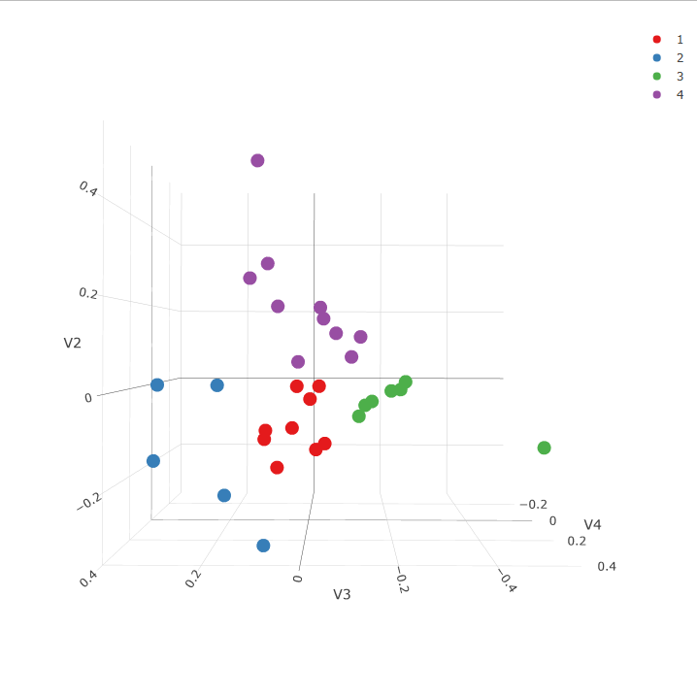
Joint Clustering
4 joint Clusters based on TraceCovW index
Cluster 1: 9 subjects
Cluster 2: 5 subjects
Cluster 3: 7 subjects
Cluster 4: 10 subjects
Notes:
The same index was then used to identify the number of clusters after the two omics were integrated
The integrated joint clustering split the participants into 4 clusters. Cluster 1 had 9 subjects, …
Axes are the left singular vectors from singular value decomposition

Slide 16
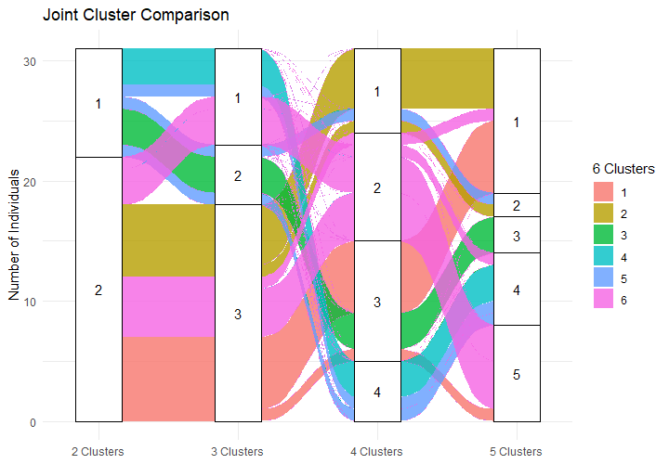
Validation of Number of Joint Clusters
There is moderate stability in cluster assignments when changing the number of groups
Notes:
Once we had the joint clustering assignments, we wanted to validate the choice of 4 clusters based on the TraceCovW index
The groupings are moderately stable when changing the number of clusters chosen. Here, the colors represent 6 clusters and each column is 2-5. Since the groupings were not drastically changing, we felt comfortable moving forward with our original pick of 4

Slide 17
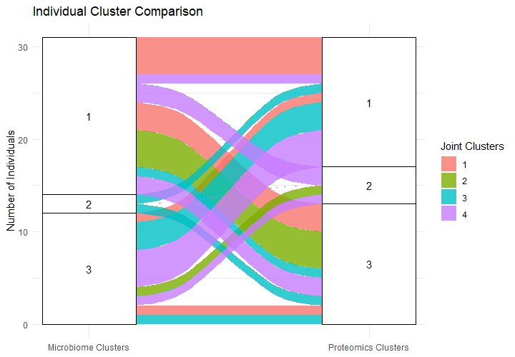
Cluster Comparison
Microbiome and proteome clusters do not correspond directly
Joint clusters defined distinct subgroups
Not one-to-one with the individual clusters
Notes:
Then, we compared the integrated joint clusters to the individual microbiome and proteome clusters.
The microbiome is on the left and the proteome is on the right. You can see that the two individual clusters do not directly correspond to each other.
The colors represent the integrated joint clusters. We can see that they are not fully 1-to-1,
No pair of proteome and microbiome clusters perfectly goes into one joint cluster
Thus, it is capturing something different than just combining the individual clusters (exciting!)

Slide 18
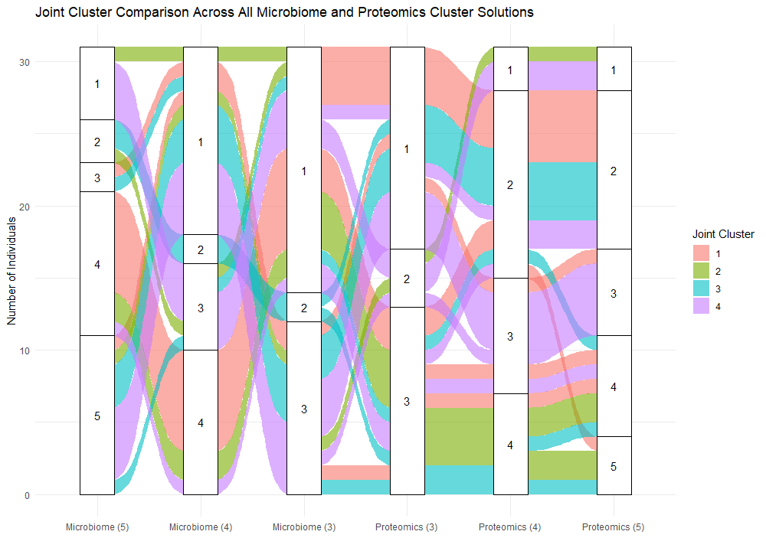
Cluster Comparison
Pattern maintains when microbiome or proteome clusters are increased
Notes:
This pattern does not change when we look at a different number of microbiome or proteome clusters
The inner section of this is the same figure as the previous slide
Additional microbiome or proteome clusters do not better explain the joint clusters
Interesting to see whether things stabilize after you remove the 3 participants who are always separate (may be pushing everything closer together)

Slide 19
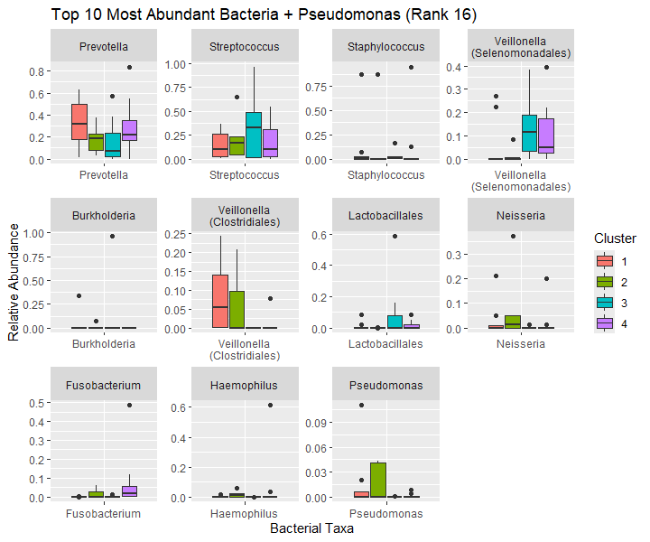
Abundant Bacteria
Visualized with relative abundances, not CLR-transformation
Fusobacterium and both Veillonella have statistically significant group differences after FDR correction
Notes:
Cluster 1 showed the highest median relative abundance of PRevotella
Cluster 2 showed higher relative abundances of Veillonella (C) and Pseudomonas
Clusters 3 and 4 had similar relative abundances of Prevotella, Streptococcus, Neisseria, and Pseudomonas

Slide 20
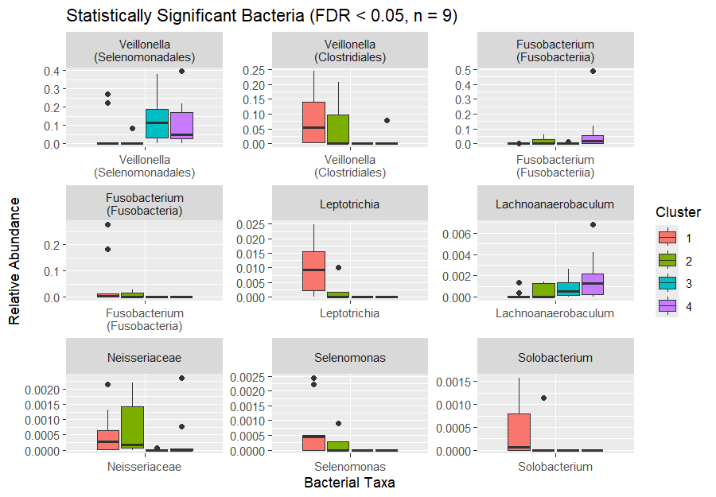
Significant Bacteria
Fusobacterium and both Veillonella are also abundant
Levene’s test indicated no violations of homogeneity of variance
All p > 0.29
Notes:
Cluster 2 showed higher relative abundance of Neisseriaceae
Clusters 3 and 4 showed higher relative abundance of Veillonella (S)

Slide 21
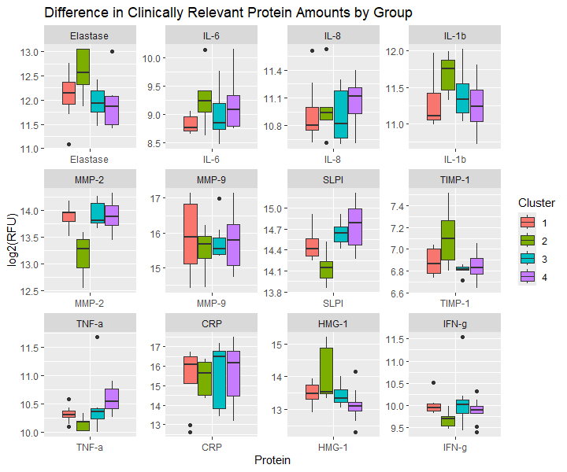
Clinically Relevant Proteins
Features of CF lung disease: elevated elastase, IL-1b, and HMG-1, alterations in MMP/TIMP balance
Airway damage, impaired repair mechanisms, persistent inflammation
Notes:
No proteins were statistically significant after FDR adjustment
Cluster 1 had higher elastase levels than Clusters 3 and 4, but similar IL-1b and MMP-2 levels
Cluster 2 was characterized by higher levels of Elastase, IL-1b, TIMP-1, and HMG-1 and:
Lower levels of MMP-2, TNF-alpha, SLPI, and IFN-g
Clusters 3 and 4 had comparable levels of most clinically relevant proteins
Cluster 3 had higher HMG-1 levels and lower TNF-alpha levels than Cluster 4

Slide 22
Cluster Description Summary
Cluster 1:
Non-traditional pathogens; lower inflammatory response
Leptotrichia, Selenomonas, Solobacterium
Lower IL-6, IL-8, IL-1b
Cluster 2:
Pseudomonas and Nessieria; stronger inflammatory response
Elevated Elastase, IL-1b, HMG-1, TIMP-1; lower MMP-2
Cluster 3:
Streptococcus; moderate inflammatory response
Lower IL-8
Cluster 4:
Streptococcus; moderate inflammatory response
Elevated TNF-α, lower HMG-1
Notes:
Helpful for context of inflammation, traditional/nontraditional pathogens, etc.

Slide 23
Cluster Demographic and Clinical Descriptions
No significant associations were found between missing data and cluster assignment (all p > 0.38)
 | Cluster 1 (N = 9) | Cluster 2 (N = 5) | Cluster 3 (N = 7) | Cluster 4 (N = 10)
Gender Female Male | 5 (55.6%) 4 (44.4%) | 2 (40.0%) 3 (60.0%) | 4 (57.1%) 3 (42.9%) | 5 (50.0%) 5 (50.0%)
Age (years) | 14.3 (2.53) | 16.6 (1.22) | 15.7 (4.10) | 16.9 (2.83)
Number of F508del Alleles | 1.67 (0.500) | 1.40 (0.548) | 1.43 (0.787) | 1.70 (0.675)
Height (cm) | 159 (9.00) | 164 (5.40) | 159 (8.71) | 163 (7.68)
Pulmonary Exacerbations in the Past Year Missing | 0.778 (0.833) 0 (0%) | 1.60 (1.82) 0 (0%) | 0.667 (1.21) 1 (14.3%) | 0.889 (1.05) 1 (10.0%)
Hospitalizations in the Past Year Missing | 0.667 (0.707) 0 (0%) | 1.60 (1.82) 0 (0%) | 0.667 (0.816) 1 (14.3%) | 1.00 (1.05) 0 (0%)
FEV1 % Predicted Missing | 76.4 (20.1) 0 (0%) | 77.6 (32.1) 0 (0%) | 85.4 (12.1) 0 (0%) | 73.4 (19.0) 1 (10%)
FVC % Predicted Missing | 91.0 (19.1) 0 (0%) | 89.0 (28.3) 0 (0%) | 97.1 (12.8) 0 (0%) | 85.1 (11.4) 1 (10%)
PES Total | 11.4 (2.13) | 11.2 (2.59) | 12.0 (2.31) | 11.0 (3.74)
Notes:
Cluster 2 exhibited a higher number of prior Pex events and hospitalizations in the preceding year
They are not all starting at very different spots (not what is driving the improvement)

Slide 24
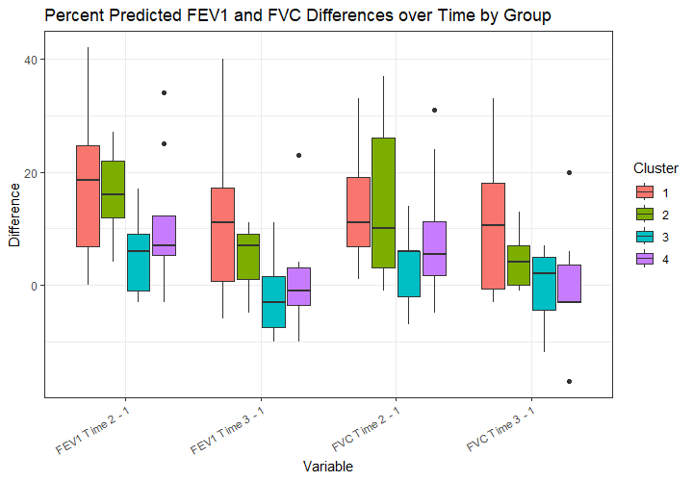
FEV1/FVC Across Visits
Times:
1: Admission
2: Discharge
3: Follow-up (1 month)
No demographic or clinical characteristics were statistically significant after FDR adjustment
Notes:
This figure represents lung function recovery by looking at the differences in FEV1 and FVC across time points. The times are admission (T1, focus of analysis), discharge, and a 1 month followup
Clusters 1 and 2 demonstrated the largest median improvements in both FEV1pp and FVC at later timepoints
Not statistically significant after FDR correction
Compare across time for bac and prots
Could we also longitudinally add views for later timepoints with bac and prots? Maybe some concern with non-independence/correlations
Ecological turnover (1 vs 2 m-age)
Scope creep

Slide 25
Discussion
Integrated clusters showed coordinated but distinct microbial and inflammatory patterns
Heightened early inflammation may not impede short-term lung function improvement (Cluster 2)
May provide evidence for bacterial infection that was successfully treated (rather than viral)
Clusters 3 and 4: Similar microbiota, different inflammatory mediators, less FEV1 improvement
Host-response differences may drive variability in PEx outcomes even with comparable microbiomes
Findings challenge pathogen-centric or inflammation-centric models and support multidimensional views of PEx biology
Complex relationships between inflammation and clinical recovery
Notes:
The integrated clusters were characterized by coordinated but distinct microbial and inflammatory patterns.
Highlights complex relationship between inflammation and clinical recovery during Pex
Cluster 2 had higher relative abundance of Neisseria and a heightened systemic inflammatory profile, but relatively greater recovery in FEV1pp
Suggests that heightened inflammatory signaling at onset may not prevent short-term lung function improvement
Clusters 3 and 4 had similar microbiota but differed in select inflammatory mediators and showed less improvement in FEV1 percent predicted over follow-up.
Host-response differences, even in the presence of comparable microbial communities, may contribute meaningfully to variability in PEx outcomes
Collectively, these results argue against simple pathogen-centric or inflammation-centric models and instead support a multidimensional view of PEx biology

Slide 26
Previous Work with Dataset (SmCCNet) Brenton Graham
Network clustering of bacteria and proteins based on FEV1
Overlap in key taxa was found in immune pathways
Taxa in pathways were previously shown to correlate positively or negatively with PEx recovery
Supports clinical relevance of microbiome-host interaction patterns
Prevotella
Neisseria
Haemophilus
Streptococcus
Veillonella
SmCCNet
MMOC
Notes:
Previous work used this dataset with multi-omics strategy SmCCNet
SmCCNet: Sparse Multiple Canonical Correlation Network Analysis, integrates multiple types of omics data with a specific phenotype of interest for molecular networks
Identified subnetworks of taxa and proteins associated with PEx
Immune pathways: B cell proliferation, regulation of T-helper17 cell lineage commitment, positive regulation of NF-B transcription factor activit
More focusing on networks of individual bacteria and proteins (different than trying to create groups of people based on the data, grouping bacteria and proteisn).
Also supervised analysis, defining groups based on FEV. Me unsupervised approach without FEV and look at it later
Not surprising that different, answering different questions
Highlight that the final list is very different in the paper and queston is different. Difference in nodes

Slide 27
Connections to the Literature
Prior studies propose underlying biological structure within clinically heterogeneous PEx
Widder et al. identified distinct microbial phenotypes associated with treatment response
Adult cohort, traditional CF pathogens
Demonstrated biologically meaningful subgrouping
Together, findings suggest microbiome-host interaction patterns may be relevant across age groups, even with different dominant taxa

Slide 28
Limitations
Sample Size (N = 31; cost-prohibitive)
Proteomics from blood, not airway
Only looked at bacterial infections, not viral infections
Data collected before drug modulator therapies (2010-2012)
Distance Matrix (Euclidean)
Microbiome may benefit from ecological distance measures
a priori specification of the number of clusters
Cluster assignments are sensitive to selected feature set
Notes:
Somascan 1000$ for a sample
Especially because 2010-2012 collection dates
Recruiting patients is expensive
Overall expensive study

Slide 29
Future Directions
Longitudinal multi-omic analysis
Alternative distance matrices
Comparing multi-omic clustering algorithms
Applying clusters to a different cohort
Can you apply single-omic individuals to one of these clusters?
Quantify clustering stability based on feature sets
What is happening with those few individuals who are always in a separate cluster?

Slide 30
Conclusion
Integrated clustering reveals distinct PEx subgroups not apparent from single-omic approaches
Flexible, multi-omic integration frameworks are needed to reflect biological complexity
Findings reinforce that CF PEx are biologically heterogeneous
Multi-omics approaches may help define clinically relevant PEx subtypes and explain variability in treatment response

Slide 31


Thank You and Acknowledgements
Thesis Committee
Brandie Wagner
Debashis Ghosh
Kirk Harris
Additional Research & Technical Contributors
Charlie Carpenter
Edith Zemanick
Brenton Graham
Administrative Support
Rocío Vélez-Pesante
Brenda Witt

Slide 32
Questions?

Slide 33
Appendix
Notes:
Microbiome: how many taxa as the final count for time point 1 and then the final count overall
Proteome: how many proteins final count

Slide 34
Data Adjustments
Microbiome data
Combined bacterial taxa
Pseudomonas
May need to combine: Veillonella, Fusobacterium
Proteome data
Removed 106 header rows
Identified extraneous commas present in txt file
Created unique identifier as some targets had the same name
Removed proteins with the same target name when no additional information was available to distinguish between them

Slide 35
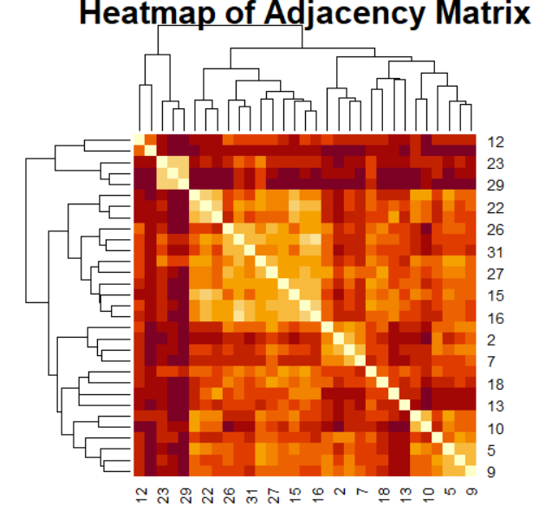
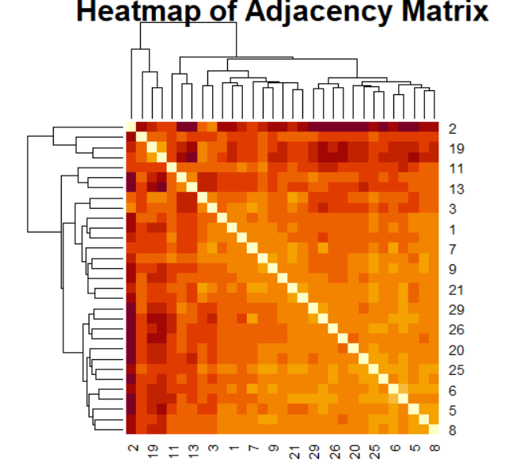
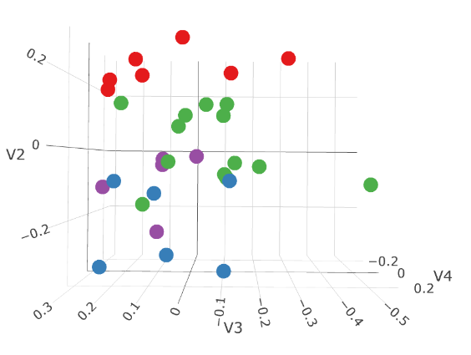
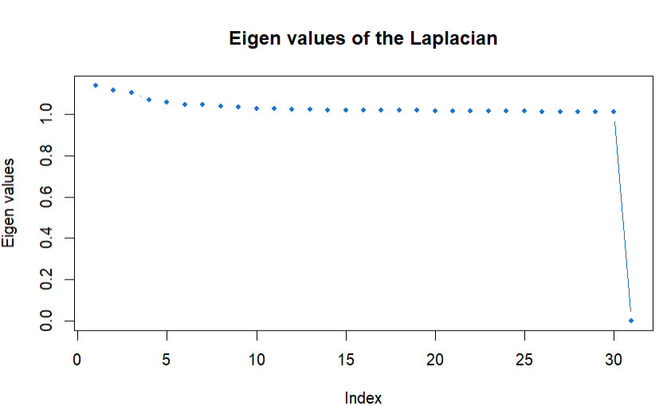
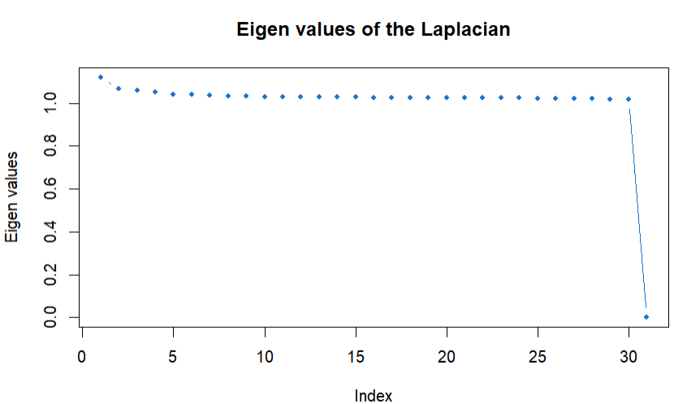
Alternative Distance Matrices - Hellinger
Microbiome: 3 clusters
Proteomics: 4 clusters
Joint: 4 clusters
Also tried: horn for both; only for microbiome
Notes:
Mathematically like Hellinger (densities are nice objects
No clusters for proteomics, microbiome Kirk could believe 9
Blood is systemic
Probably some weighting to balance 4000 vs 70 (standardizing matrix by trace?)
Diff numbers of features in distances
Hellinger bounded 0-1 by definition compresses the eigen values (by definition no variation)
Downweight the Laplacian
CLR skews things (never use robust CLR). What do you do with 0s for the CLR?
Include 2 different metrics and a consensus clustering
How well do the clusters line up with each other?
What is common across clusters -> most stable findings (robust to different assumptions => more likely to be real)
Only keep the people who have maintained clusters across algorithms (may be really small, changes downstream).
Ability to comment on stability of clustering
Biological interpretation is hard because it is too reductionist (what does average pseudomonas actually mean biologically)
Plan – horn for microbiome, Euclidian for proteome and transform it. Use Euclidian for MMOC clustering assignments as on the distances.
Merge everything with the same name (look for other ones – fermicutes (enfusobacterium)

Slide 36
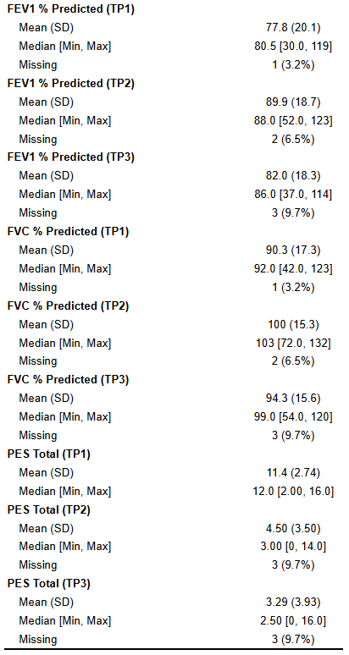
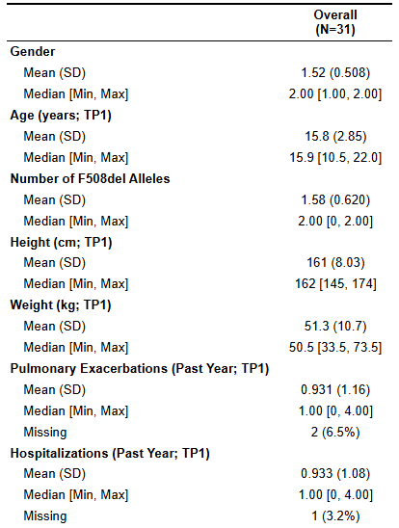
Dataset Overview
31 subjects (ages 10–22) hospitalized at a single site for CF pulmonary exacerbation
Samples collected at admission (Time 1) with relevant clinical data
Notes:
Can look at baseline % recovered (don’t have for this dataset, happened after this dataset)

Slide 37
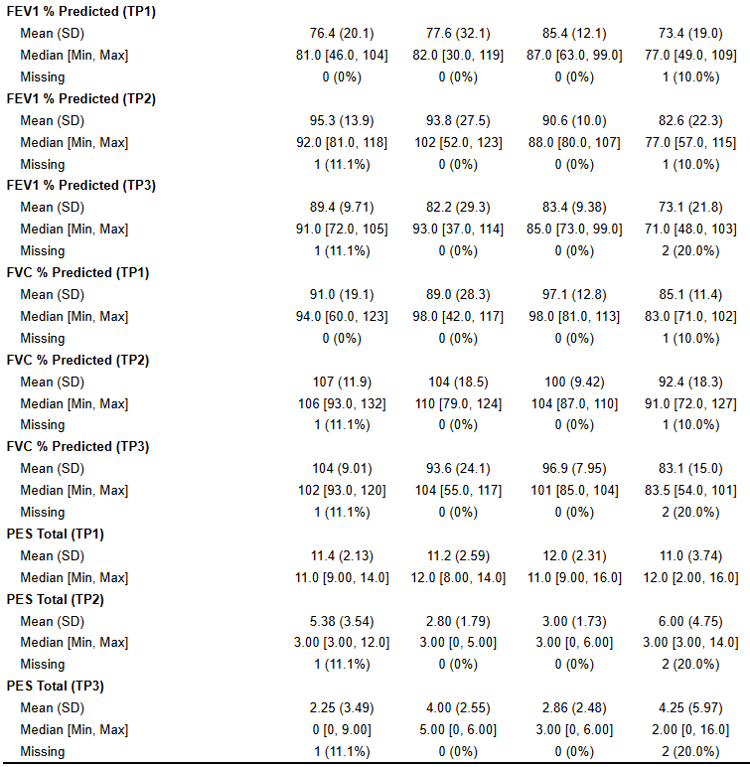
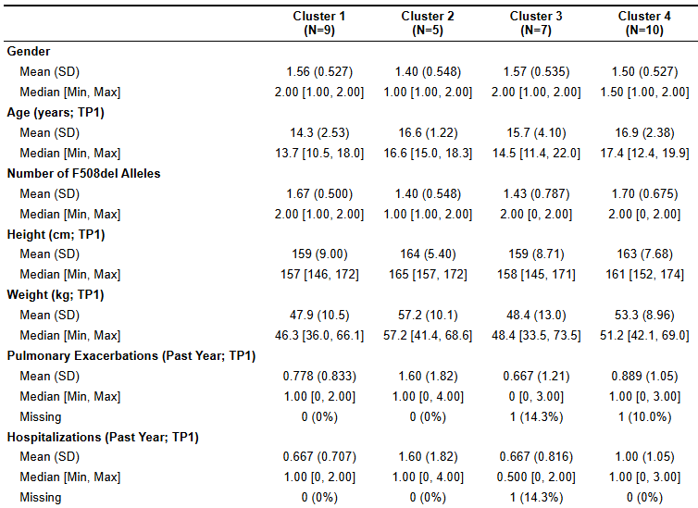
Cluster Demographic and Clinical Descriptions
No significant associations were found between missing data and cluster assignment (all p > 0.38)
Notes:
Could use clinical data as another clustering view

