Slide 1
Conway’s Game of Life
Brad Green
Edwin Weill
MATH-8650 Final Project

Slide 2
Presentation Outline
Project Overview
Conway Rules
Algorithm Overview
Optimizations
Results
Demo

Slide 3
Project Overview
Cellular Automaton Zero-Player “Game”
Evolves through generations modeling life and death of organisms
Cells interact with immediate neighbors
2-dimensional grid of cells

Slide 4
Conway Rules (B3/S23)
Under-population: A living cell with fewer than 2 neighbors dies
Generation: A living cell with 2 or 3 living neighbors lives to next generation
Over-population: A living cell with more than 3 living neighbors dies
Reproduction: A dead cell with 3 neighbors becomes alive

Slide 5
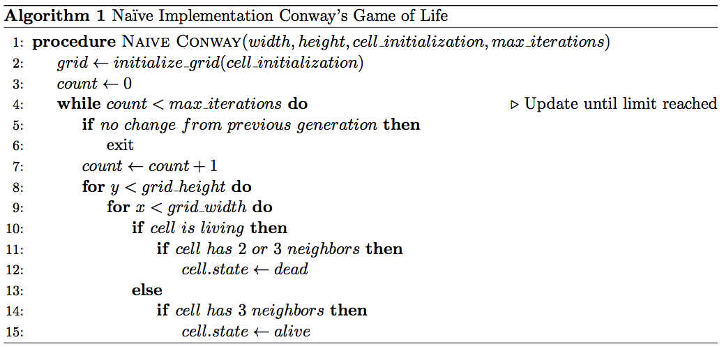
Algorithm Overview
Initialize Grid
Iterate to maximum iterations or until there are no living cells in the grid
“Visit” each cell in the grid
Determine if each cell is dead or alive in next generation
Optimized by using sets containing living cells
No need to check entire grid

Slide 6
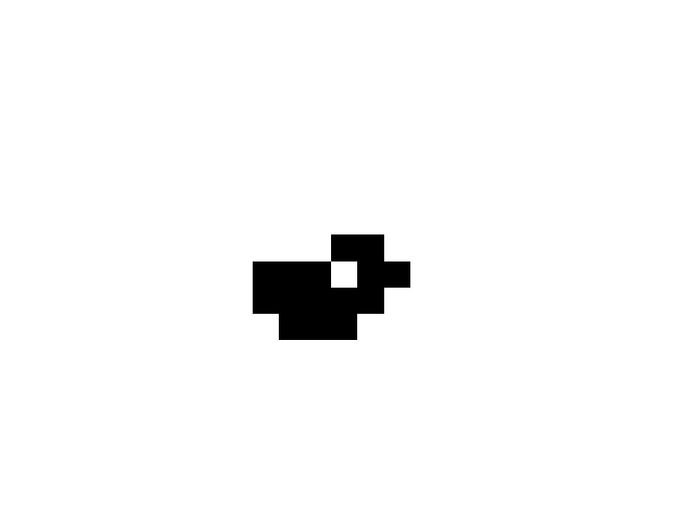
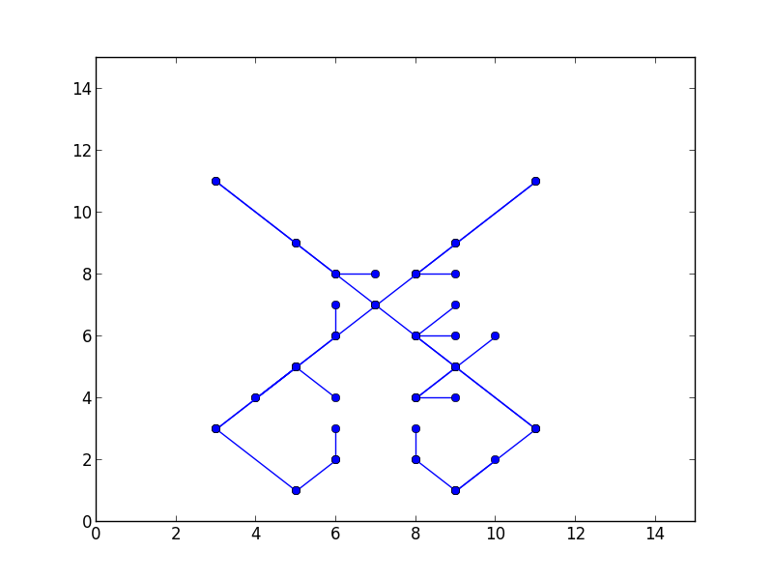
Optimizations (Quadtree)
Tree where each node meets the following
Has 4 Children
Or is a leaf
Every leaf is a live node
Only these paths are saved in the structure
Natural to represent spatial data

Slide 7
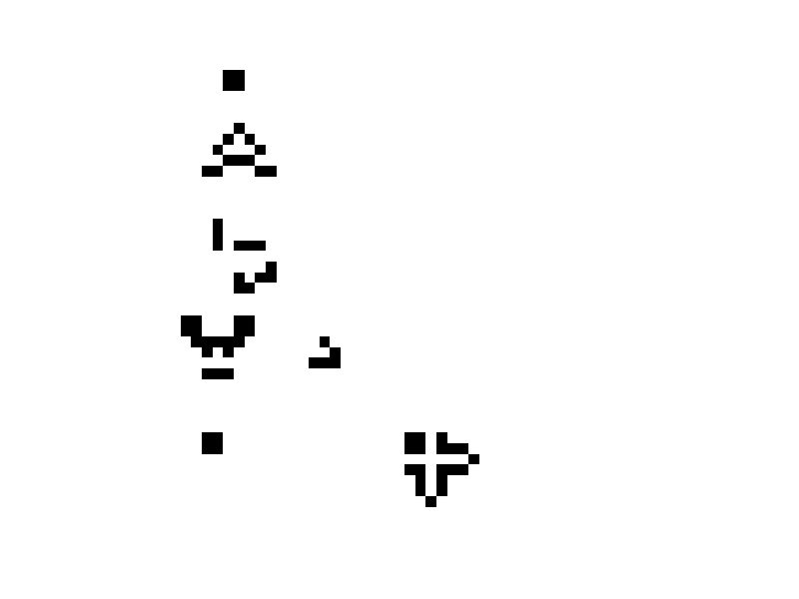
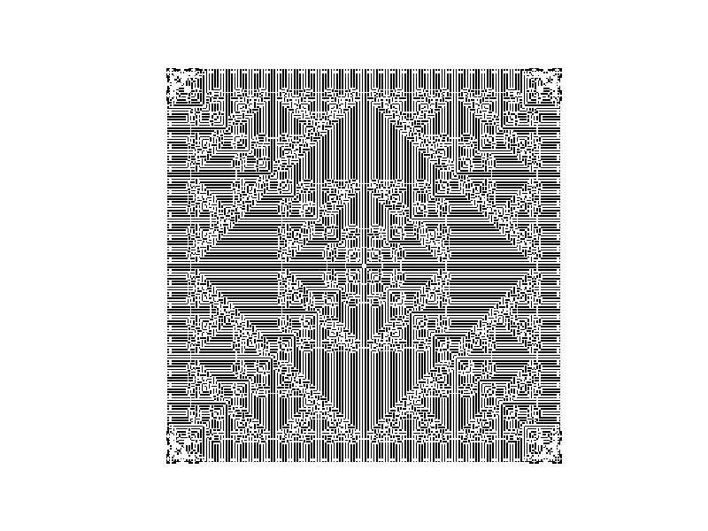
Results (Visualization)
Glider Gun Example
Sierpinski Triangle Example
Automaton: B3/S23
Automaton: B1/S12

Slide 8
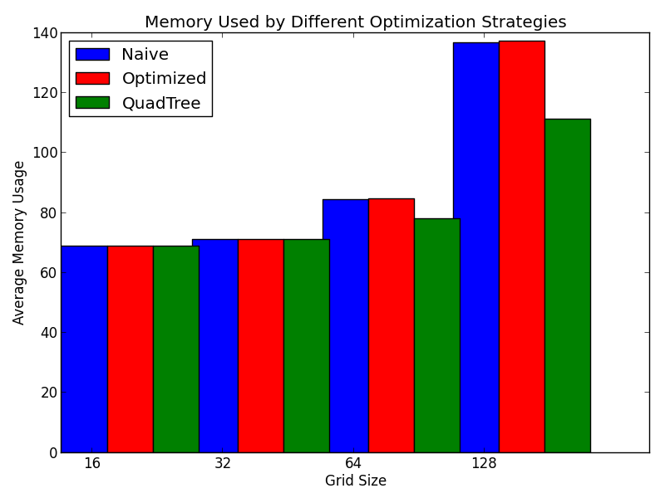
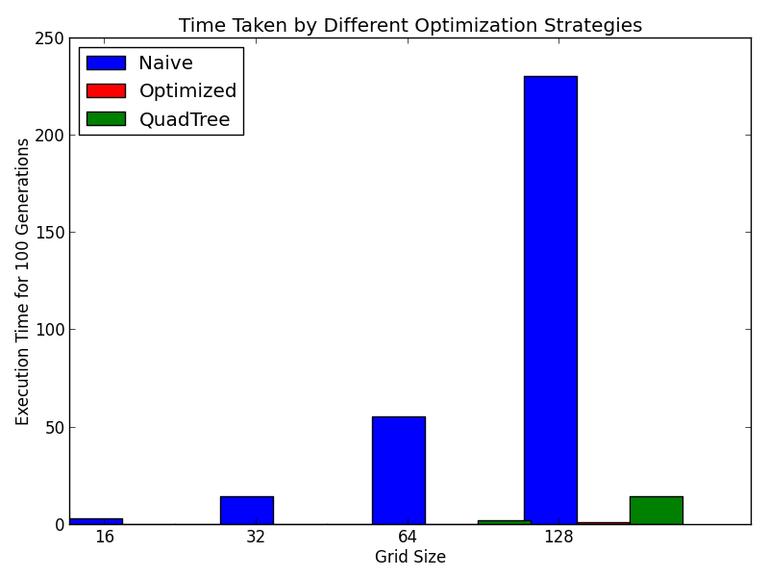
Results (Performance Analysis)

Slide 9
Demo

