Slide 1
Conway’s Game of Life
Brad Green
Edwin Weill
MATH-8650 Final Project

Slide 2
Presentation Outline
Project Overview
Conway Rules
Algorithm Overview
Optimizations
Results
Demo

Slide 3
Project Overview
Cellular Automaton Zero-Player “Game”
Evolves through generations modeling life and death of organisms
Cells interact with immediate neighbors
2-dimensional grid of cells
Notes:
GIFS: http://giphy.com/search/conways-game-of-life

Slide 4
Conway Rules (B2/S23)
Under-population: A living cell with fewer than 2 neighbors dies
Generation: A living cell with 2 or 3 living neighbors lives to next generation
Over-population: A living cell with more than 3 living neighbors dies
Reproduction: A dead cell with 3 neighbors becomes alive
Notes:
http://giphy.com/gifs/glider-game-of-life-conway-ThuVXkRrPUgCY

Slide 5
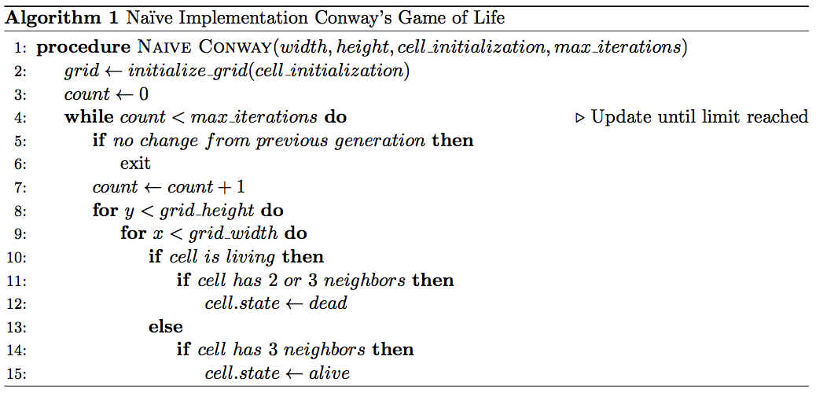
Algorithm Overview
Initialize Grid
Iterate to maximum iterations or until there are no living cells in the grid
“Visit” each cell in the grid
Determine if each cell is dead or alive in next generation

Slide 6
Optimizations (Living Set)

Slide 7
Optimizations (Quadtree)

Slide 8
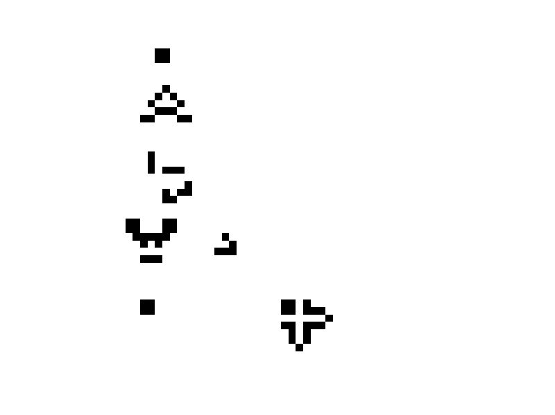
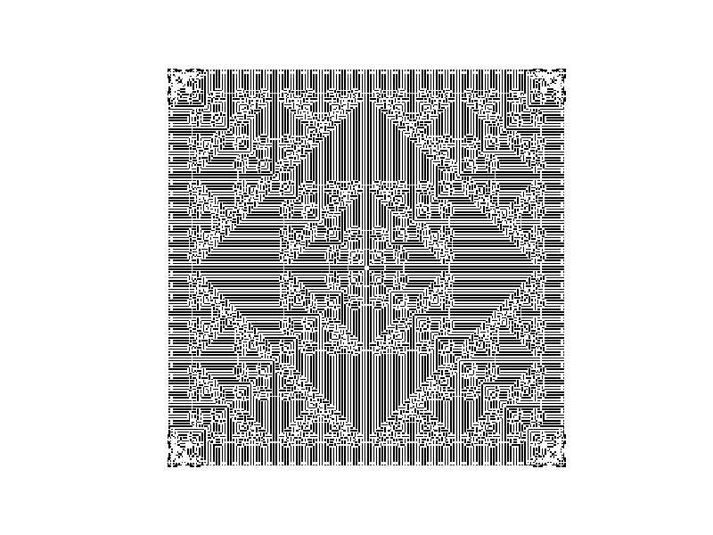
Results (Visualization)
Glider Gun Example
Sierpinski Triangle Example
Automaton: B3/S23
Automaton: B1/S12

Slide 9
Results (Performance Analysis)

Slide 10
Demo

