Slide 1
Example Coding PROJECT
Eric Weisbrod

Slide 2

Course Overview
High level discussion of pros / cons
Getting set up in RStudio and Github
Collect and save basic data from WRDS
Create basic tables and figures in Latex and Word
Peek down some further rabbit holes, if time

Slide 3




SAS vs R vs Stata
Data is generally on disk
Strongest WRDS integration
Some Git integration
Good for manipulating big data
Good for merging datasets
Not as easy for data viz and analysis
Multiple datasets in RAM
WRDS integration via Postgres
Strongest Git integration
Great IDE (RStudio)
Open source competitor to Python
Strong parallel processing tools
Smaller Accounting community
Single dataset in RAM
No WRDS integration (that I know)
No Git integration
Manipulating data can be clunky
Costly licensing
Good for point and click
Larger Accounting community

Slide 4
Github vs. Dropbox (or OneDrive, etc.)
Github Pros
Github Cons
More robust version control
There is “one” set of code for the project
Supports replicability
Robust approach to tracked changes
Powerful search functionality
Synergies with other coders
Can still use Dropbox for data, etc.
Syncing and backing up your code is a manual process
Github is only designed to manage code, not the rest of your research project
Your coauthor has never used Github
Something new to learn
Lots of new vocabulary
Git is built-in to some IDEs not others

Slide 5
Example Research Project Workflow
1
Start a new repo on Github
Data is stored in Dropbox
4
Output tables from R or Stata to MS Word/Excel (csv)/Latex (Overleaf)
Write some SAS and/or R code to collect data
2
Manage code on Github using RStudio
3
“Clone” the repo as a new project in RStudio
Define a Dropbox folder as the data path for your RStudio project

Slide 6
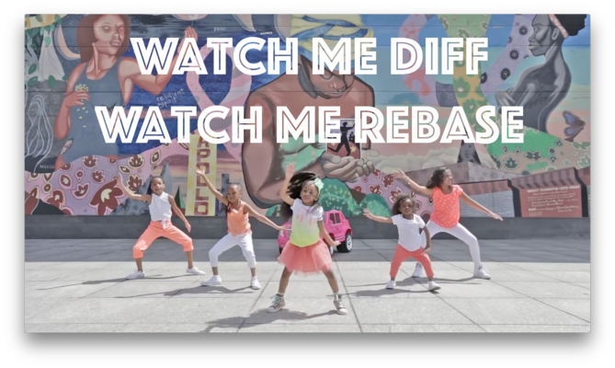
Getting started with Git / Github
https://happygitwithr.com/
“Repository”: A site that stores all of the files for your project. “Repo” for short. Can be public or private.
“Clone”: Copy a repository to your computer.
“Pull”: Pull down the latest changes from the github repository (“remote”) to your machine. Pull = download.
**Always pull before you push!!
“Commit”: Commit your changes to save a new local version of the code on your machine.
Must write a short note describing the changes.
“Push”: Push the changes you committed on your machine up to the remote repository. Push = upload.
“Fork”: Make your own copy of someone else’s repository so that you can edit your own version.
Fork me!

Slide 7
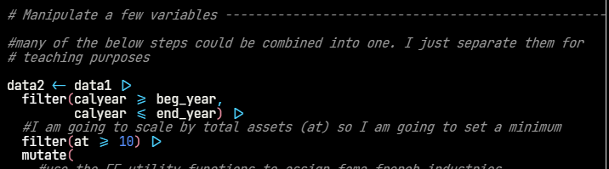
Getting started with R syntax
Tidyverse: “The tidyverse is an opinionated collection of R packages designed for data science. All packages share an underlying design philosophy, grammar, and data structures.” https://www.tidyverse.org/ https://r4ds.had.co.nz/tidy-data.html
Dplyr is the key data manipulation package https://dplyr.tidyverse.org/
“<-” : is an assignment operator, can also just use “=”
Keyboard shortcut is Alt + -
“%>%” or “|>” : Pipe operator = “and then”
Keyboard shortcut Ctrl + shift + M (MOST USED SHORTCUT!)
If you use the native R pipe with a “ligature” font, will make a prettier triangle

Slide 8
Getting started with R
Empirical Research In Accounting: great book with R and research-related examples: https://iangow.github.io/far_book/
Open Source Asset Pricing: Finance-focused, but several useful asset pricing examples and datasets in both R and Stata https://www.openassetpricing.com/
Forecasting: Principles and Practices: Open-source book for general (time-series) forecasting in R https://otexts.com/fpp3/

Slide 9
A few more R packages to highlight
Rpostgres / DBI: interface with remote databases
Haven: Read and write SAS and Stata data
fixest or lfe: R equivalents of the reghdfe package in Stata
Broom: very useful for extracting output from a regression / model
Modelsummary: format output tables for publication
Officer: interface R with Microsoft Office
Zoo/fable/tsibble: packages for time series data

Slide 10
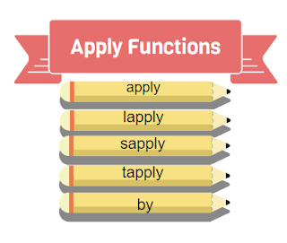
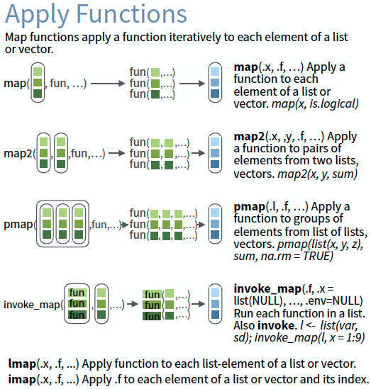
Advanced Rabbit Holes
http://adv-r.had.co.nz/Functionals.html

Slide 11
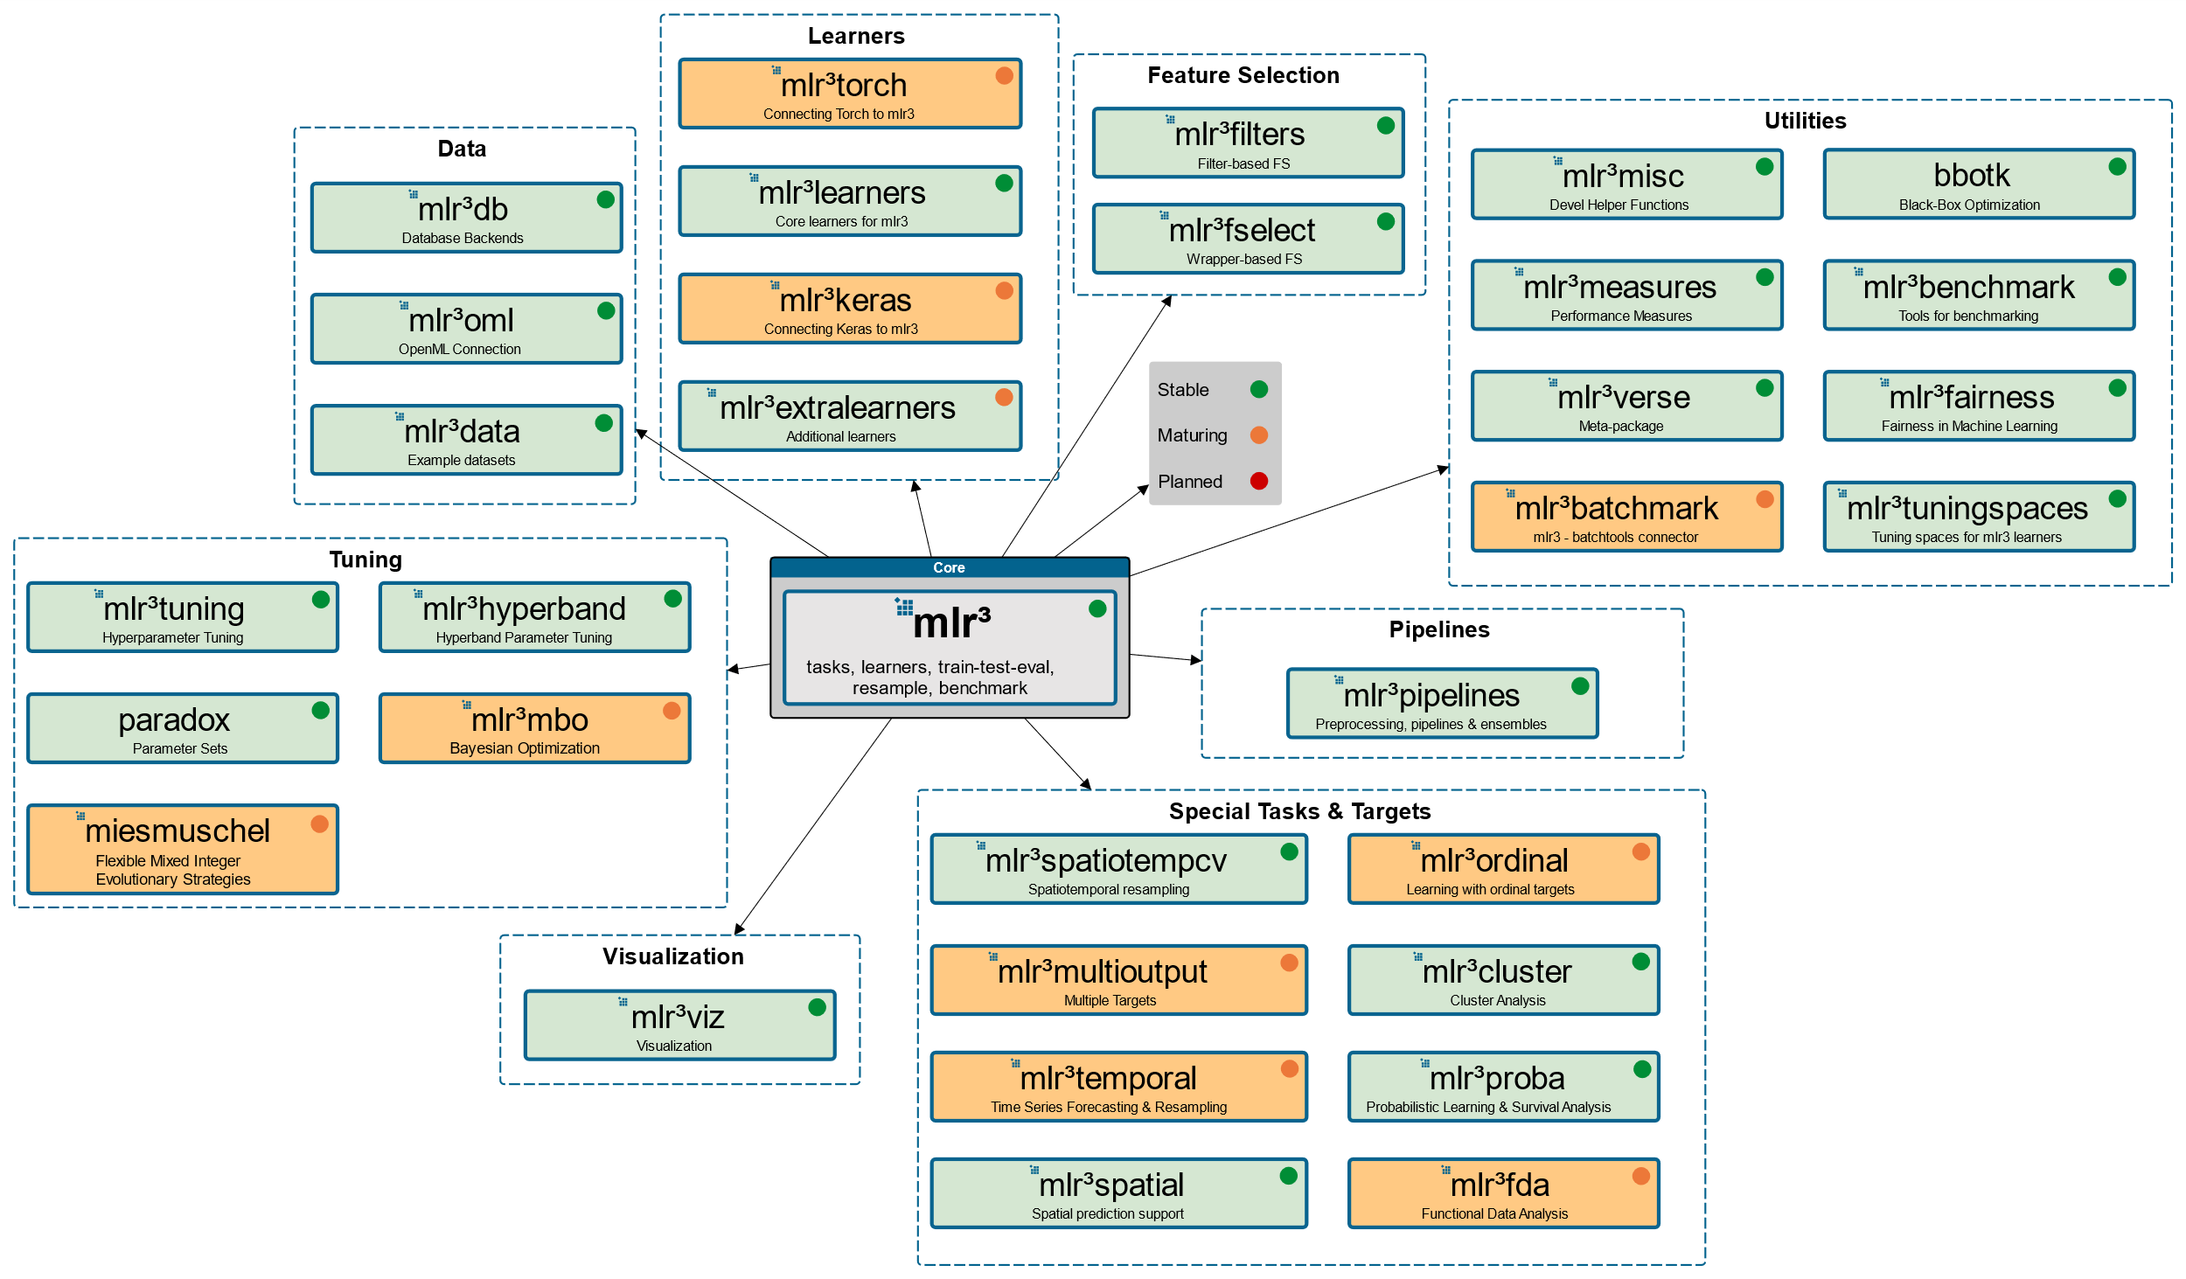
Advanced Rabbit Holes
https://mlr3.mlr-org.com/

Slide 12
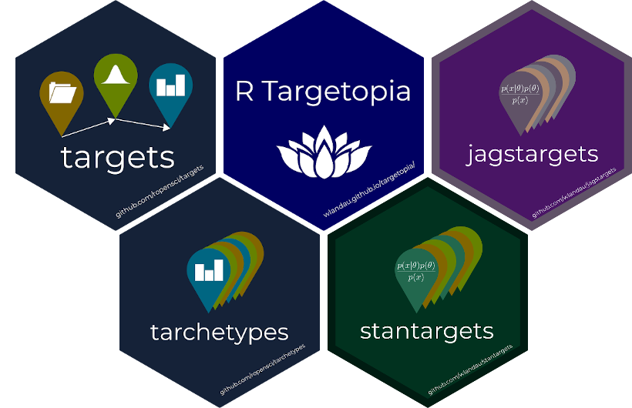
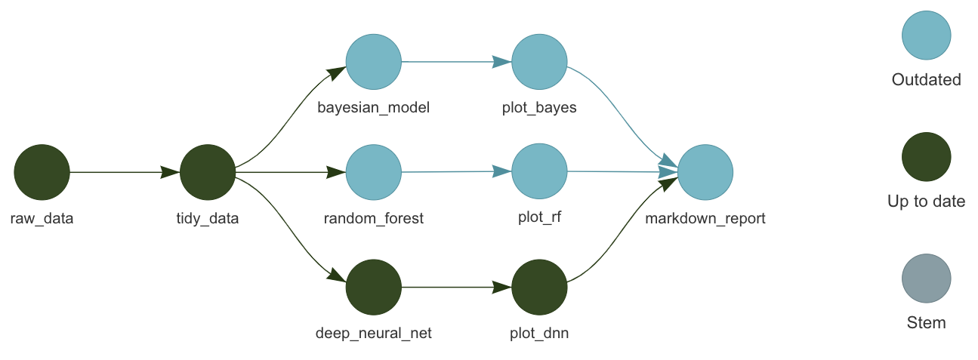
Advanced Rabbit Holes
https://wlandau.github.io/targets-tutorial/#1
https://docs.ropensci.org/targets/

Slide 13
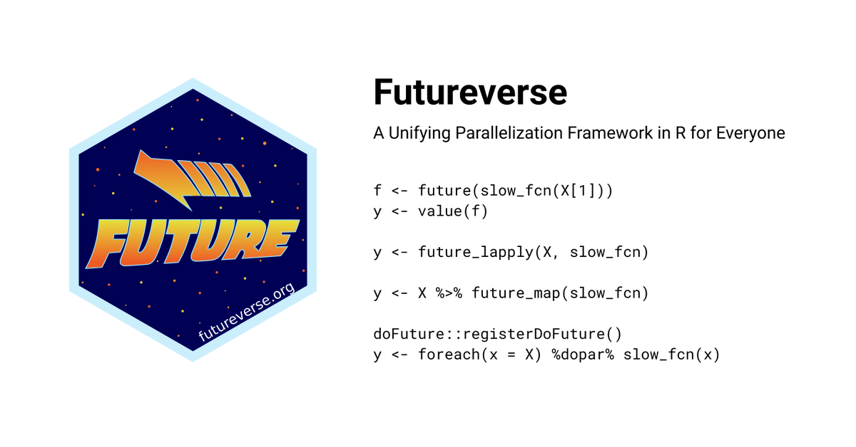
Advanced Rabbit Holes
https://www.futureverse.org/

