Slide 1
Reducing Time and Cost of Experiments
Ewen Wang & Brennan Klein

Slide 2
Time
nodeGame
Cost
Optimal design

Slide 3
nodeGame Framework
Implemented bot features
Added widgets and interface features
Transition to V4

Slide 4
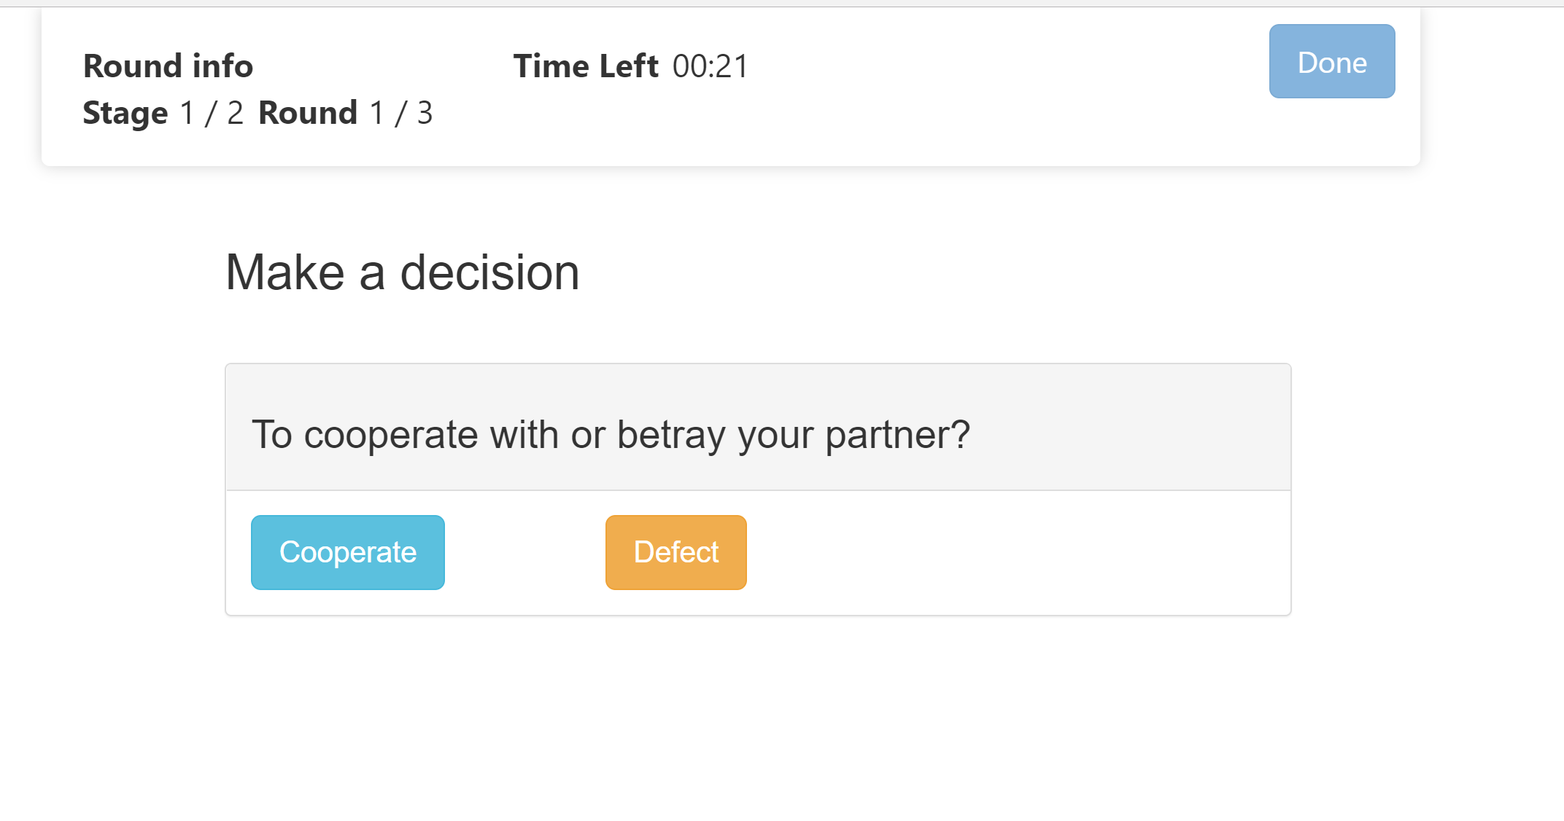
Prisoner’s Dilemma

Slide 5
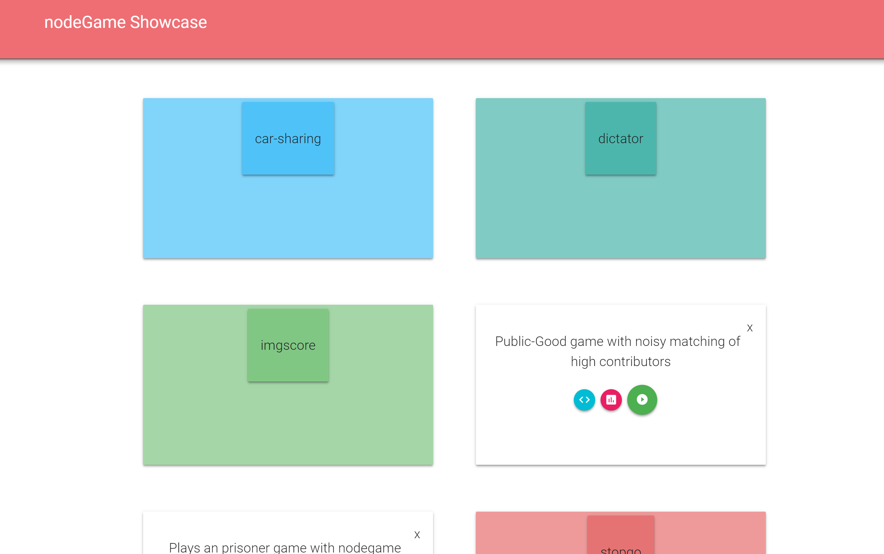
Showcase
nodeshowcase.herokuapp.com

Slide 6
Optimal Design
RISE 2018

Slide 7
Iterated Prisoner’s Dilemma
Two players
n Rounds
Cooperate or Defect

Slide 8
Experimental Variables
T: Temptation outcome (defect, cooperate)
R: Reward outcome (cooperate, cooperate)
P: Punishment outcome (defect, defect)
S: Sucker outcome (cooperate, defect)
Coefficient of risk (r) = (R–S) / [(R−S) + (T−P)]
Coefficient of cooperation (k) = (R−P) / (T−S)

Slide 9
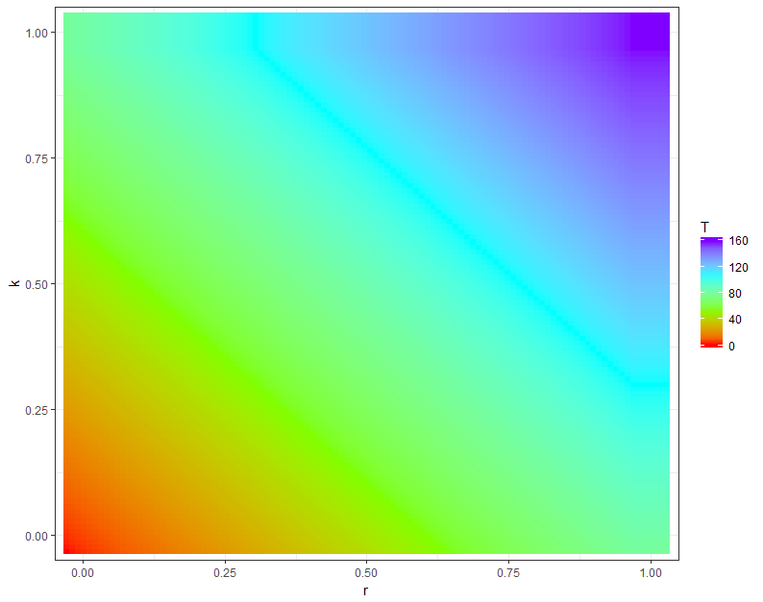
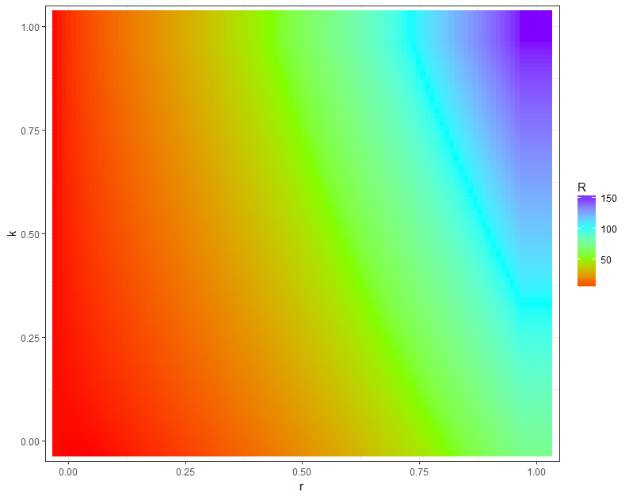
k
Temptation payoff
Reward
payoff
r

Slide 10
Behavior
Models
Tit for tat
Historical Average
Expectation (Gary Ng, Wing Au)
Adaptive Expectation
Greedy Expectation
Expectation with risk (Gary Ng, Wing Au)

Slide 11
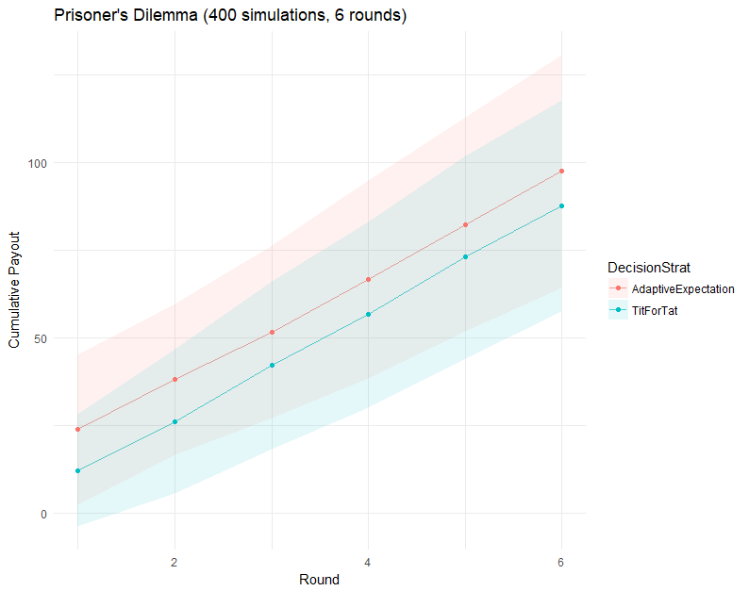
Adaptive Expectation vs TitForTat

Slide 12
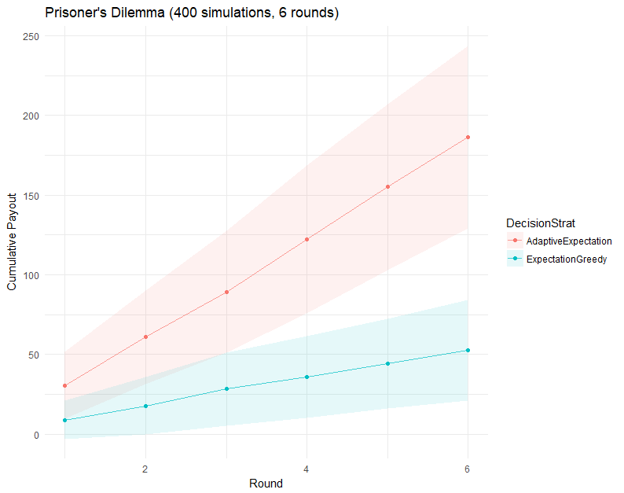
Adaptive Expectation vs Greedy Expectation

Slide 13
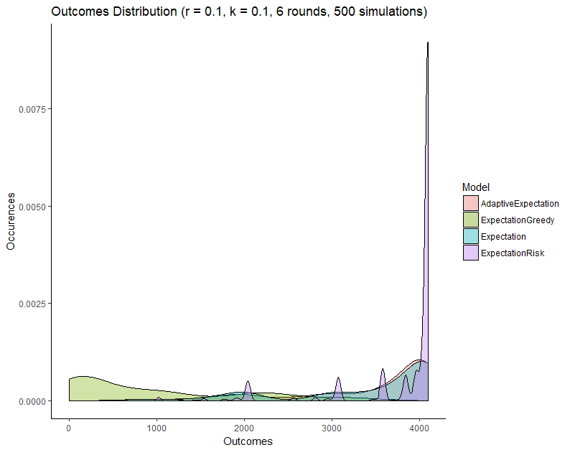

Slide 14
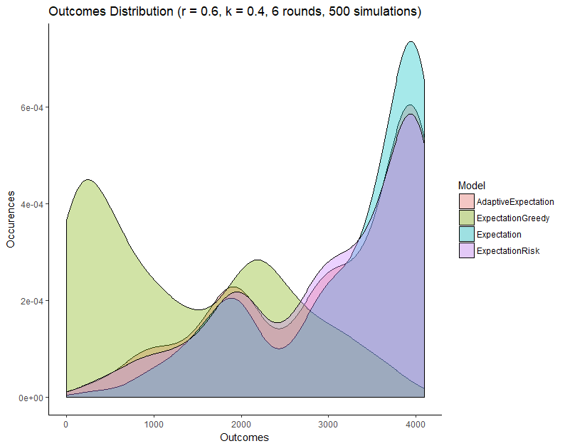

Slide 15
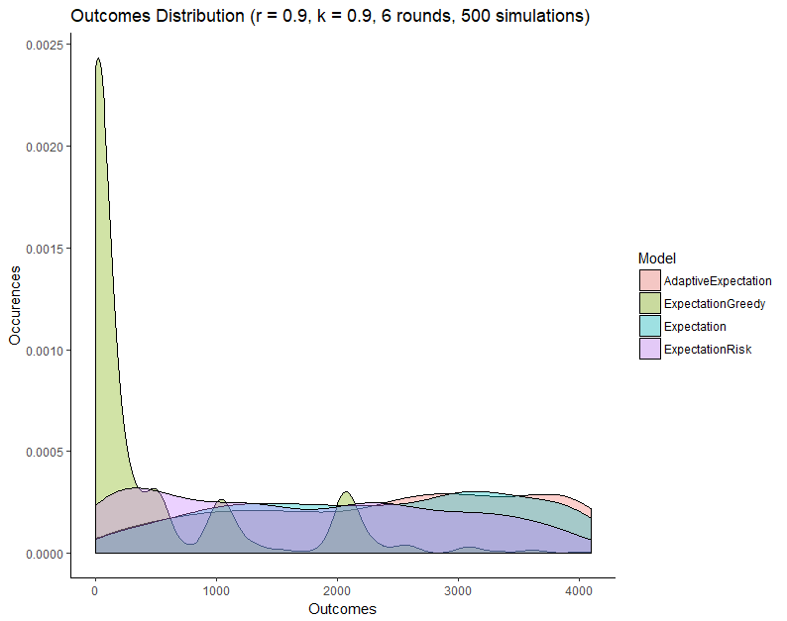

Slide 16
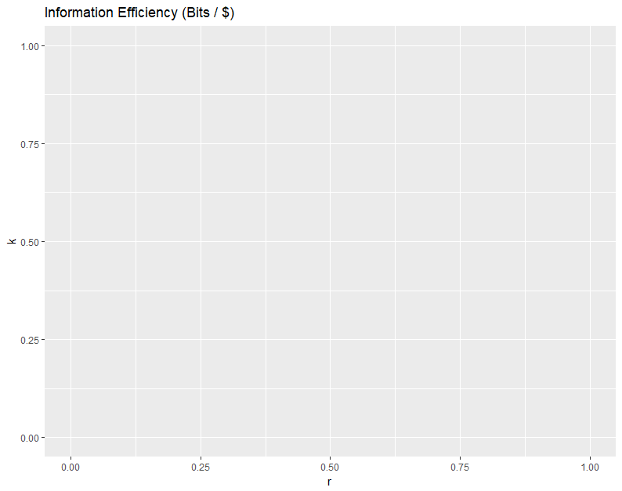
Fill this in

Slide 17
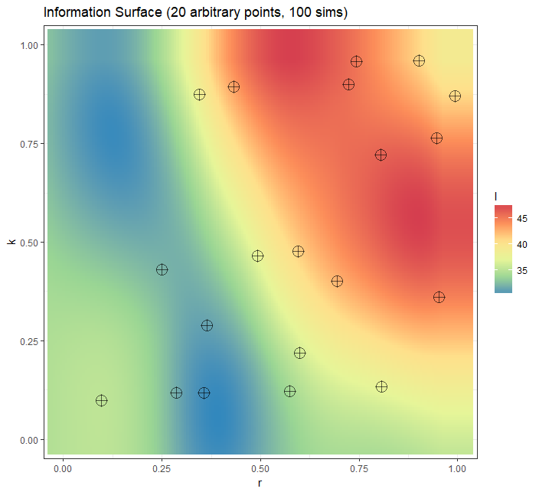
How much information can I get?

Slide 18
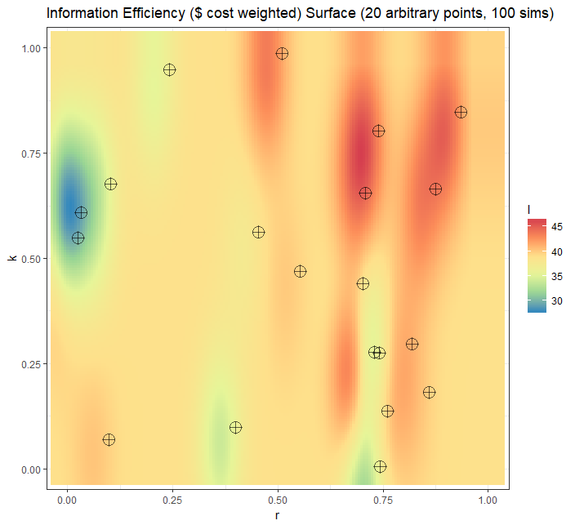
Best bang for the buck?

Slide 19
Next steps
GPUCB-PE search algorithm to make landscape
Finalize models
Collect data

Slide 20
Suggestions
Improvements?
Model ideas?

