Slide 1
AI Driven Entity Risk Analysis

Slide 2
01
Introduction to AI Driven Entity Risk Analysis
Table of Contents
02
Features and Functionalities
03
Technical Implementation
04
Test Results

Slide 3
Introduction to AI Driven Entity Risk Analysis
01

Slide 4
Problem Statement
Complexity in Entity Analysis
The analysis of multiple corporations, non-profits, and potential shell companies adds layers of complexity. Understanding the relationships and risks associated with various entities can be daunting, especially when data is unstructured.
Manual Process Challenges
Goal of the AI System
Data analysts face significant inefficiencies due to manual processes in analyzing transaction details. The reliance on manual reviews increases the risk of error and delays in identifying high-risk entities.
The aim of the AI-driven system is to automate the extraction and classification of entity names. This system will assign risk scores based on various attributes to facilitate better decision-making for analysts.

Slide 5
Benefits of Automation
O1
O2
O3
Time Efficiency
Enhanced Accuracy
Support in Decision-Making
Automation significantly reduces the time analysts spend on manual tasks, allowing them to focus on interpreting results and making strategic decisions quickly.
By leveraging AI, the likelihood of errors in entity identification and classification is reduced, leading to more reliable risk assessments and decision-making.
The system provides comprehensive analyses and supporting evidence, enhancing the decision-making process for analysts dealing with complex financial situations.

Slide 6
Features and Functionalities
02

Slide 7
Transaction Analysis
Entity Recognition and Identifying Suspicious Activities
Structured and Unstructred Data Processing
Risk Score Calculation
It employs algorithms to classify different entities such as corporations,NGO,shell companies,etc. and detect unusual patterns in transaction amounts and flows, flagging potential money laundering or fraud activities.
The system can process both structured data formats such as Excel and TXT, analyzing transaction details effectively to identify potential risks.
Risk scores are calculated using multiple parameters derived from transaction analyses, providing quantitative assessments of potential risks.
01
02
03

Slide 8
Entity Screening
Watchlists and Databases
The system screens entities against critical watchlists, including FATF high-risk jurisdictions and UN sanctions, ensuring compliance with regulatory standards.
Categorizing Transactions
Transactions are categorized based on the results of the screening process, which aids in swift risk identification and management.

Slide 9

Risk Reporting
Generating Risk Assessment Reports
Visualizing Risk Scores
Automated reports detail risk assessments, presenting essential findings that assist compliance officers in their evaluations.
The system provides visual representations of risk scores and patterns, making it easier for analysts to identify high-risk transactions that warrant further investigation.

Slide 10
Technical Implementation
03

Slide 11
Tech Stack Used
FastAPI for Backend
React + Vite for Frontend
Pandas for Data Processing
Spacy for ML Models
Wikidata,UN Sanctions List for External APIs

Slide 12
Backend Architecture
01
02
RESTful API Development
Key Data Processing Modules
The backend is built on a RESTful API using the FastAPI framework, allowing for high performance and the ability to handle asynchronous requests efficiently.
Key modules include entity extraction for automatic identification of relevant entities, data enrichment for augmenting transaction for additional context and maintaining local cache of external data, and risk scoring which assesses risks based on various transaction parameters.

Slide 13
Data Integration
External Data Sources
The system integrates with various external data sources to enhance its data enrichment capabilities, supporting more accurate assessments through real-time updates.
Maintaining Data Reliability
A local cache mechanism ensures that data retrieved from external sources is reliable and consistently available, improving the system's performance during operations.

Slide 14
Frontend Development
User Interface Design
Compliance Officer Interaction
A user-friendly interface is developed using React, enabling compliance officers to navigate the system easily and access essential features.
Designed with compliance officers in mind, the interface facilitates straightforward interaction, allowing users to generate reports and monitor transaction analyses effectively.

Slide 15
Obstacles Encountered
Data Quality Issues
Ensuring high-quality data input is a challenge, as inaccuracies can lead to erroneous assessments and risk calculations.
Scalability Concerns
As the volume of transactions increases, maintaining the system’s performance and responsiveness while scaling is a significant concern.

Slide 16
Test Results
04

Slide 17
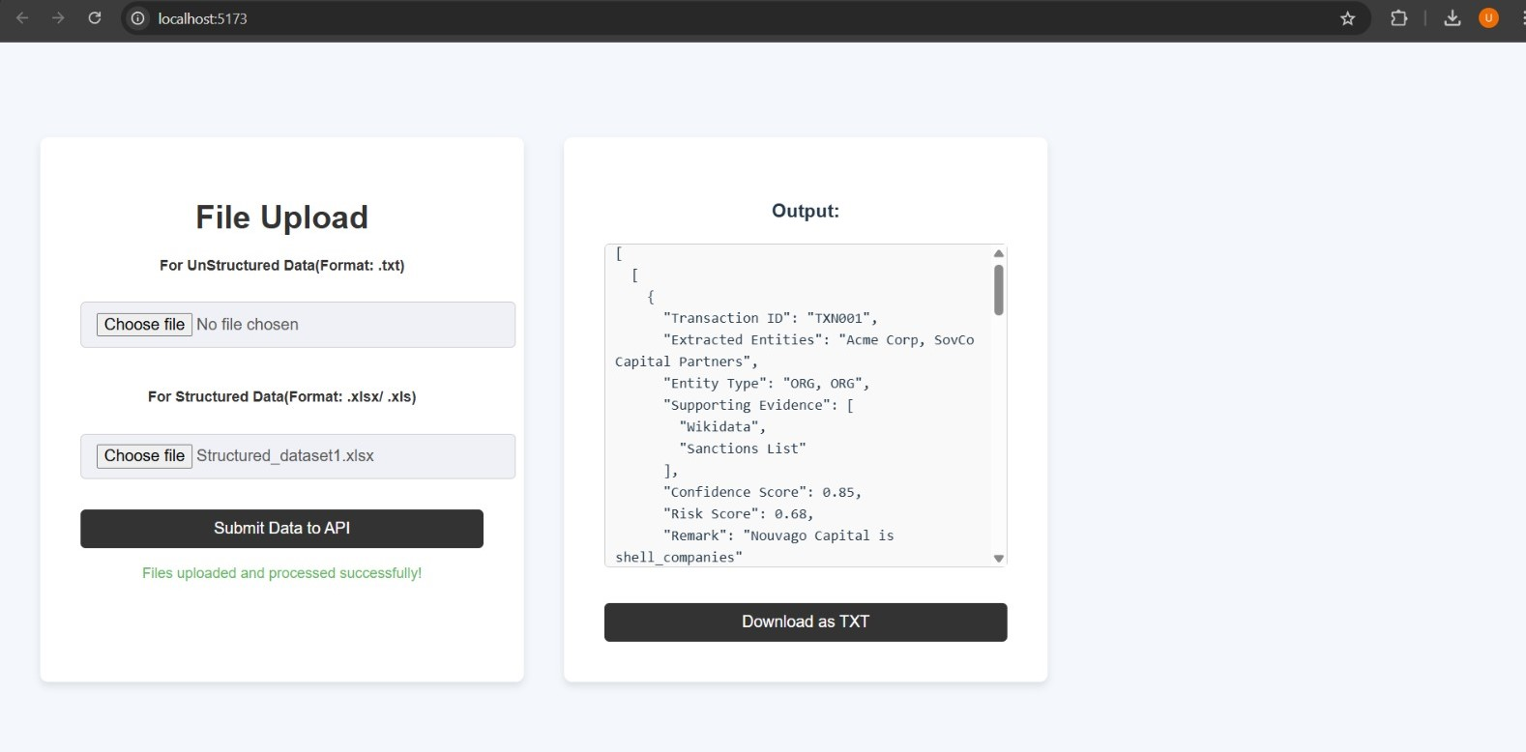
Structured Dataset

Slide 18
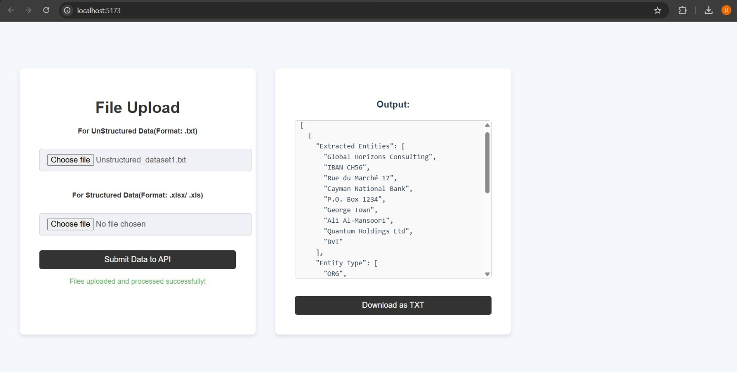
UnStructured Dataset

Slide 19
Thank you for watching.

