Slide 1
AI Driven Entity & Risk Analysis
Kapu Tirumala Sai Teja Sivakumar T Durgam Aditya Anjali A Vijayasanan A k
Team - Closed AI Wells Fargo

Slide 2

Introduction
Extracting Entity Risk is Challenging!
Massive Data Sources: Risk data is spread across offshore leaks, sanctions lists, Wikidata, and public records.
Entity Name Variations: "John Doe Ltd." ≠ "J. Doe Limited" – Matching is complex needs enrichment.
Complex Relationships: Risk isn’t just in an entity but its connections (officers, addresses, transactions).
False Positives & Negatives: Standard rules miss risky entities or flag harmless ones.
Unstructured Data: Risk signals hide in messy transaction notes, contracts, and reports.

Slide 3
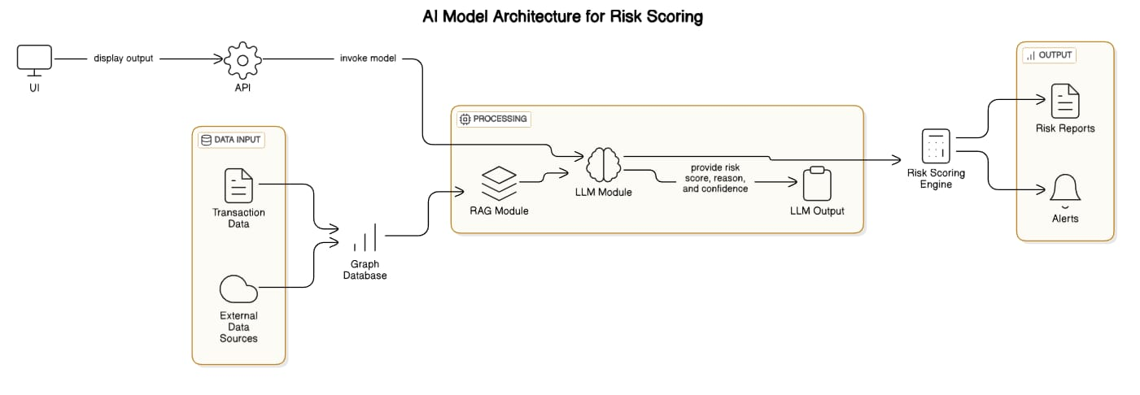
Architecture

Slide 4
Structured and Unstructured Data
The approach accommodates both structured data (such as CSV files) and unstructured data (containing detailed transaction information).
This flexibility enables the system to extract valuable insights from diverse sources, enhancing the data analyst's ability to generate actionable conclusions.

Slide 5
Entity extraction using LLM
Utilizing large language models (LLMs), the system auto-extracts entities from transaction data. This advanced processing technique ensures accuracy and efficiency in identifying relevant entities.
LLM Processes transaction data to extract key entities
Key Entities include Sender, Receiver, Amount, Transaction Type
These Entities are used for Risk Analysis

Slide 6
Entity Enrichment
AI cross-references extracted entities with trusted databases to assess risk:
🌍 Offshore Leaks Database – Detects shell companies, tax havens, and offshore networks.
⚖️ OFAC Sanctions List – Flags entities involved in money laundering, terrorism, or fraud.
📊 Wikidata & News Sources – Evaluates reputation, controversies, and legal disputes.

Slide 7
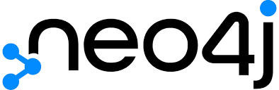

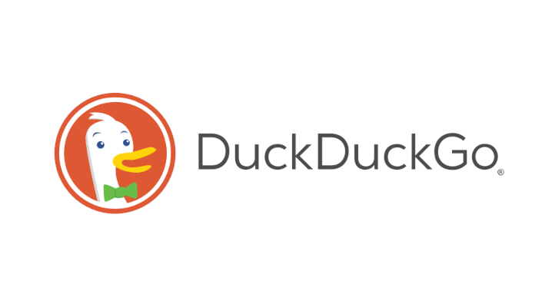

Neo4J Graph DB Integration
Sentiment Analysis
Agentic Search
Graph-Based Relationship Analysis – Finds hidden links between companies & people.
Traces indirect risks through multiple degrees of separation.
Quantifies public perception (Positive, Neutral, Negative).
Wikidata & Wikipedia – Checks history, industry, and past controversies.
Agentic search uncovers risks beyond static datasets.
Recursive Entity Expansion – Searches for aliases, subsidiaries, and hidden links.

Slide 8
Risk Score & Reasoning
We are taking 4 factors into consideration:
Risk score from Neo4j + OFAC Sanctions + Wiki Data API + Agentic RAG Search
Final Risk Score
(0.30 × Network_Score) +
(0.25 × OFAC_Score) +
(0.20 × Wiki_Score) +
(0.25 × Agent_Score)
Reasoning
LLM (context from all 4 sources)

Slide 9
PROS / CONS
✅ Pros:
Comprehensive Entity & Relationship Extraction – Leverages Agentic Retrieval-Augmented Generation (RAG) for real-time internet searches.
Graph-Based Risk Analysis – Builds network graphs from enriched datasets to uncover hidden connections.
Multi-Source Data Aggregation – Integrates insights from Wikidata, OFAC sanctions lists, Offshore Leaks, and real-time searches.
Enhanced Accuracy – By combining multiple data sources instead of relying on a single dataset, our model ensures more reliable risk scoring.
⚠️ Cons:
Increased Processing Time – Since the system retrieves and cross-verifies data from multiple sources, the analysis can take slightly longer.

Slide 10
Conclusions
Automated entity extraction, enrichment, and risk scoring, reducing manual effort by ~70%(est.).
Addresses naming inconsistencies, shell company detection, and fraud patterns
Key Innovations :
Multi-Source Intelligence: Combines Wikipedia, Real time search and public repos for evidence-backing scoring.
Dynamic Risk Model: Weighted scoring for controversies, location, news sentiment, and network ties.
Explainable AI: Clear risk breakdowns and evidence

Slide 11
Thank you!

