Slide 1

Technology Hackathon – 2025 AI-Driven Entity Intelligence Risk Analysis
Team – Code-302
Gauri Patil
Shriharsha Dhobe
Sampada Joshi

Slide 2
AI-Powered Entity Intelligence: Automating Risk Assessment & Verification for Financial Transactions
Why we need this system ?
Manual entity analysis is time-consuming.
High-risk entities (sanctioned individuals, shell companies) need detection.
Transactions involve structured & unstructured data, making risk assessment difficult.
Need to integrate real-time news & public financial sources.

Slide 3
AI-Driven Entity Intelligence Risk Analysis
Key Points:
Automates entity extraction from structured (CSV) and unstructured (JSON), data and normalizes it to a standard file.
Uses BERT-based NER & NLP to identify names, organizations, and ownership patterns.
Integrates sanctions lists (OFAC, SEC, World Bank PEP, etc.) for risk assessment.
Assigns risk scores based on entity behaviour & transactions using Random Forest

Slide 4
How we process data
Key Steps:
Extract Entities (Organizations, People, Locations) using BERT (NER).
Identify Ownership Links.
Risk Assessment (Sanctions List, Financial Crime Checks).
Generate Structured Output (CSV/XLSX) for further analysis.

Slide 5
Tech Stack
Libraries & Tools:
Python, Pandas, NumPy, Torch, sklearn, transformers, datasets, evaluate, json (Data Extraction and Processing)
Hugging Face Transformers, BERT (NER) (Entity Extraction and Classification)
Datasets: OFAC-SDN, Non-SDN, World Bank’s Debarred List (Sanctions Screening)
Random Forest Model (Risk Scoring based on Evidence)

Slide 6
Building the Model: Code Breakdown
Step 1: File Transmission from Frontend to Backend
The user uploads a structured (CSV) or unstructured (JSON/Text) file via a frontend dashboard.
The dashboard communicates with the backend using a REST API, sending the file name for processing.
The backend verifies the file type and triggers the data processing pipeline.
Step 2: Processing Structured & Unstructured Data
The model parses structured transaction data (CSV) to extract essential fields like Transaction ID, Sender, Receiver, Amount, and Country.
For unstructured data (JSON/Text), the system uses NLP techniques to extract ownership relationships, indirect connections, and hidden financial linkages.
Step 3: Data Standardization into a Unified Format
Both data sources are combined and normalized for uniformity

Slide 7
Building the Model: Code Breakdown
Step 4: Entity Identification Using NLP & NER (BERT)
BERT-based Named Entity Recognition (NER) Model is applied to identify:
People (PER) → Blocked individuals, politicians, known fraudsters.
Organizations (ORG) → Corporations, shell companies, financial intermediaries.
Locations (LOC) → Tax havens, offshore banking locations.
The model matches extracted entities with real-world registries (e.g., OpenCorporates, SEC Edgar).
Step 5: Screening Against Historical Datasets & Sanctions Lists
The extracted entities are cross-checked against global regulatory databases, including:
OFAC-SDN & Non-SDN → U.S. Treasury’s Specially Designated Nationals List.
World Bank Debarred List → Identifies entities banned from financial operations.
Other Financial Crime Databases → EU Sanctions List, Interpol Red Notices.
If an entity appears on a sanctions list, it is flagged as high-risk and marked for deeper investigation.

Slide 8
Building the Model: Code Breakdown
Step 6: Risk Scoring Algorithm & Risk Classification
A risk assessment model assigns a Risk Score (0-1) based on multiple factors:
Sanctions & Watch lists Presence → 1.0 (High Risk), 0.5 (Moderate Risk).
Ownership Complexity → Higher risk for indirect connections to blocked entities.
Transaction Patterns → Large, offshore, or frequent transactions trigger red flags.
Each transaction is classified into:
Low Risk → No known issues detected.
Medium Risk → Indirect connection to flagged entities.
High Risk → Directly linked to blacklisted individuals or entities.

Slide 9
Building the Model: Code Breakdown
Step 7: Sending Processed Output to the Frontend
The final risk-classified transactions are returned to the frontend dashboard.
The frontend displays:
Each transaction’s risk category (Low, Medium, High).
Reasons why a transaction is flagged (e.g., linked to a sanctioned entity).
Supporting Evidence (e.g., references to sanctions lists, entity relationships)

Slide 10
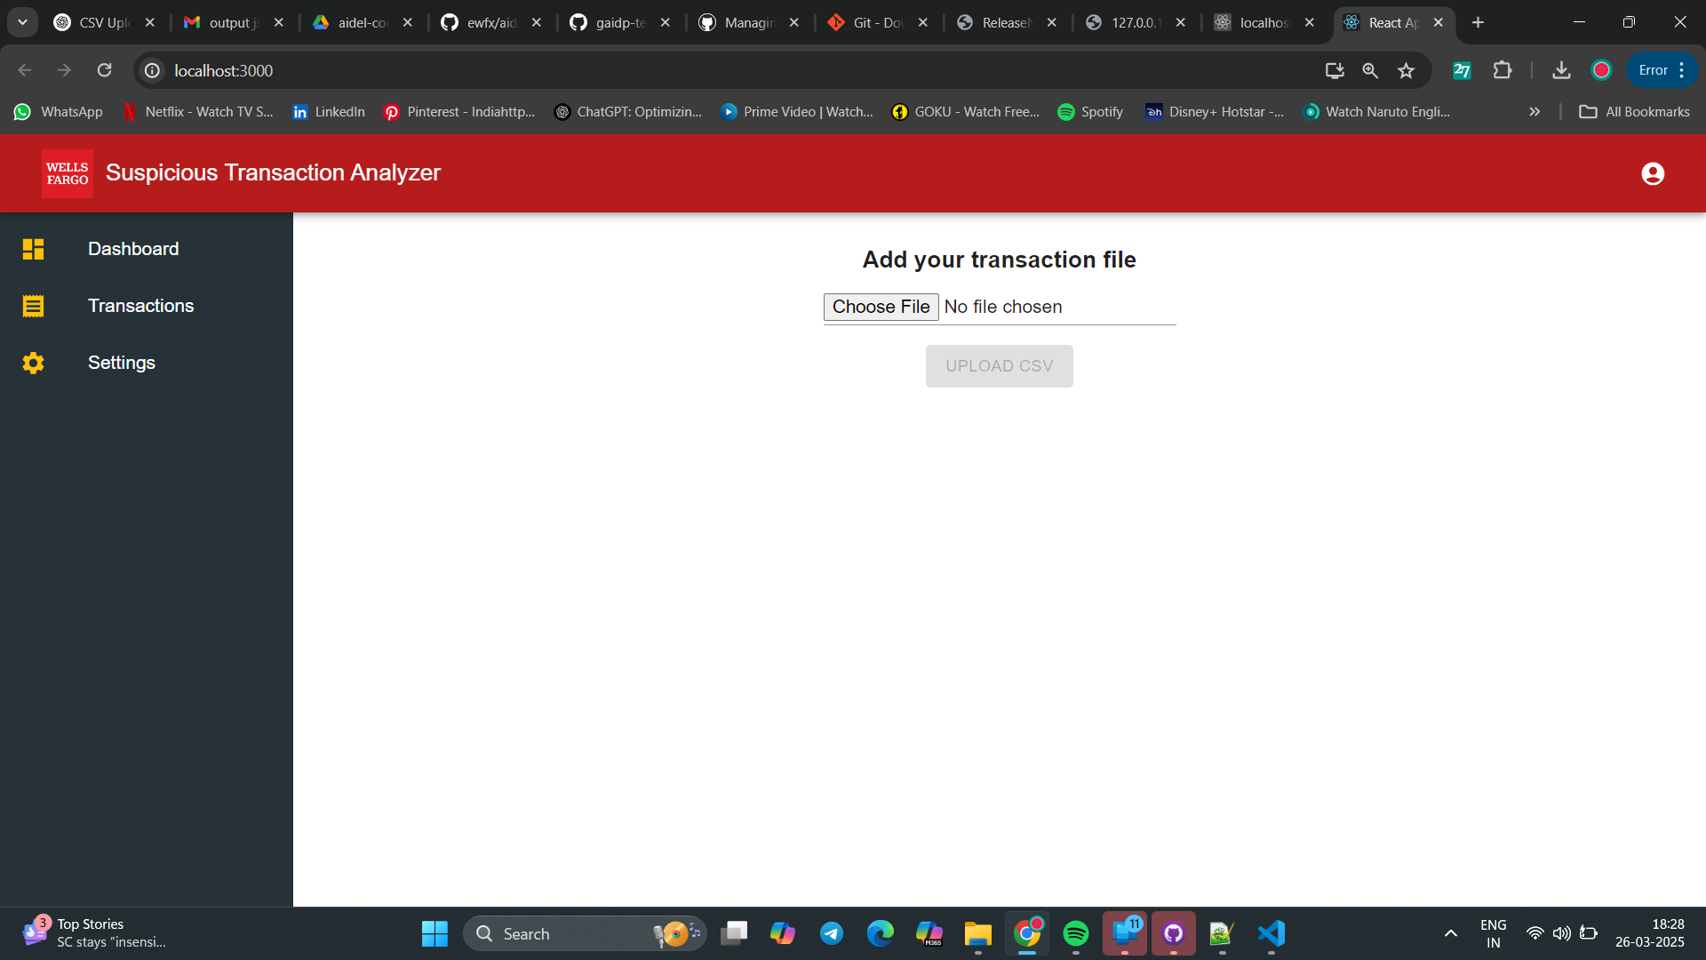
Results: Entity Risk Analysis in Action

Slide 11
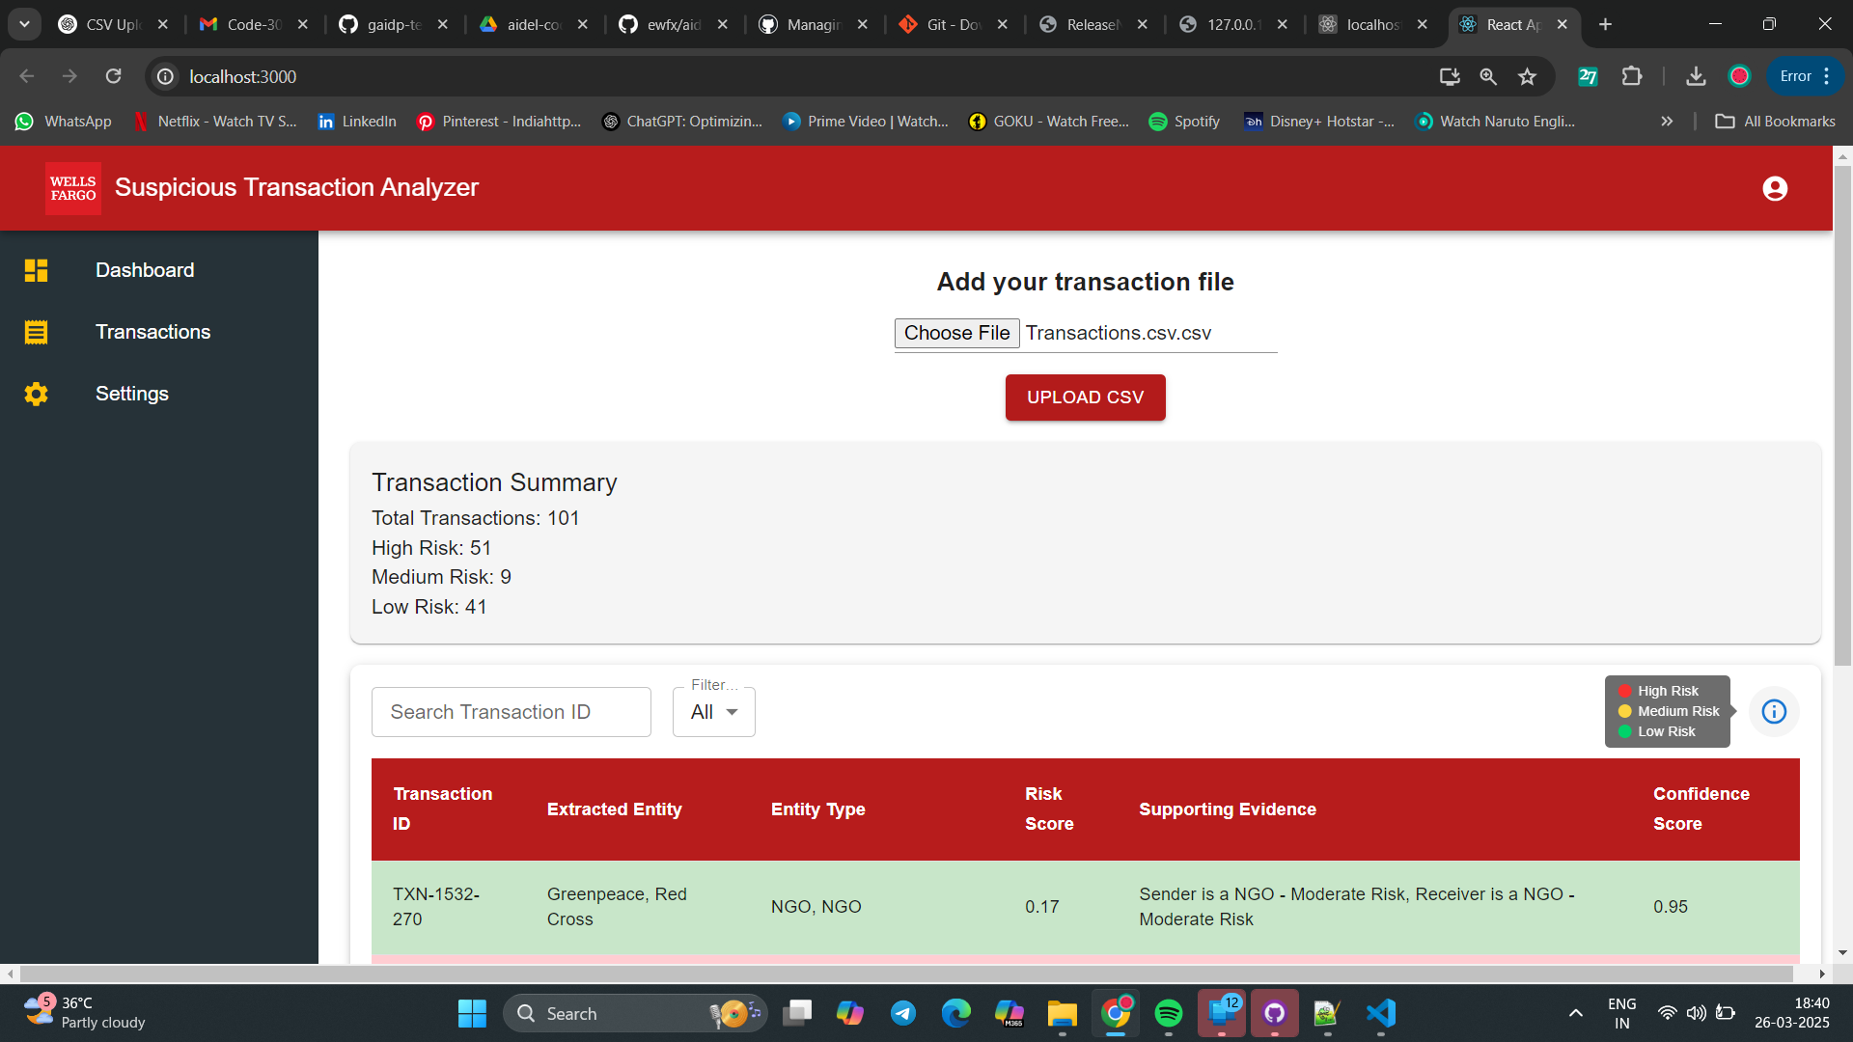
Results: Entity Risk Analysis in Action
The Transaction Summary displays the overall status of transactions in a file, categorizing them into high, medium, and low risk.

Slide 12
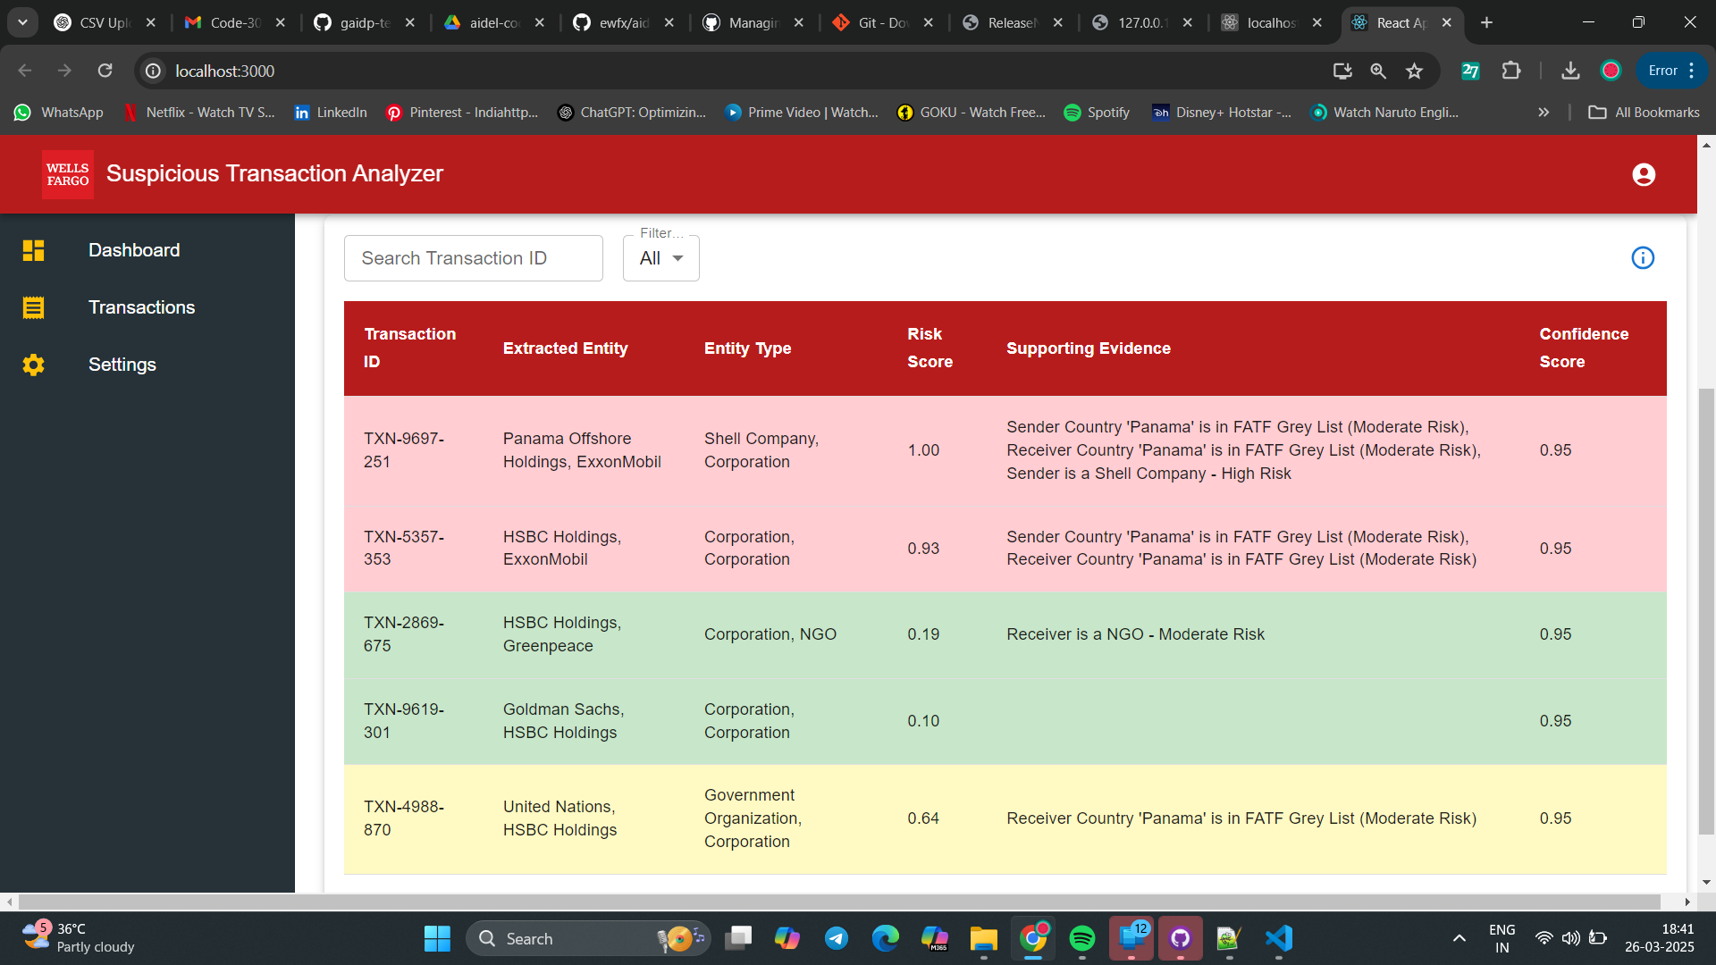
Results: Entity Risk Analysis in Action
Transactions are color-coded based on their risk level.

Slide 13
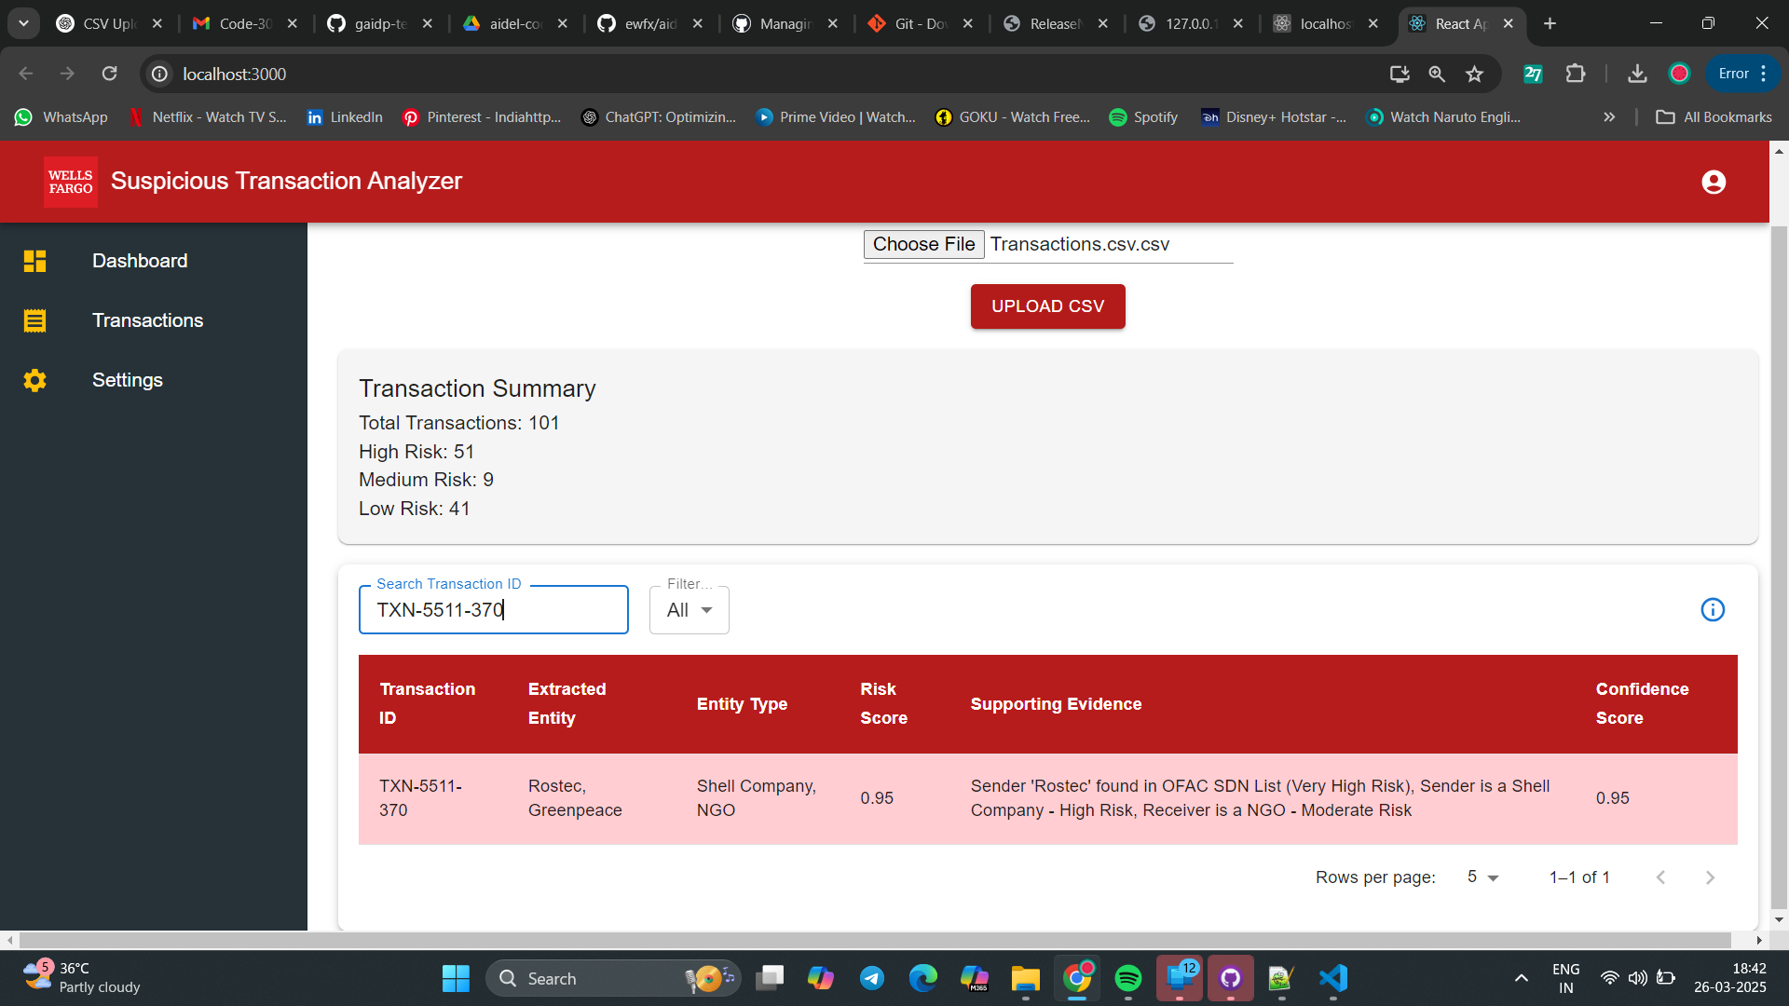
Results: Entity Risk Analysis in Action
You can look up a specific transaction within a transaction file.

Slide 14

Results: Entity Risk Analysis in Action

Slide 15
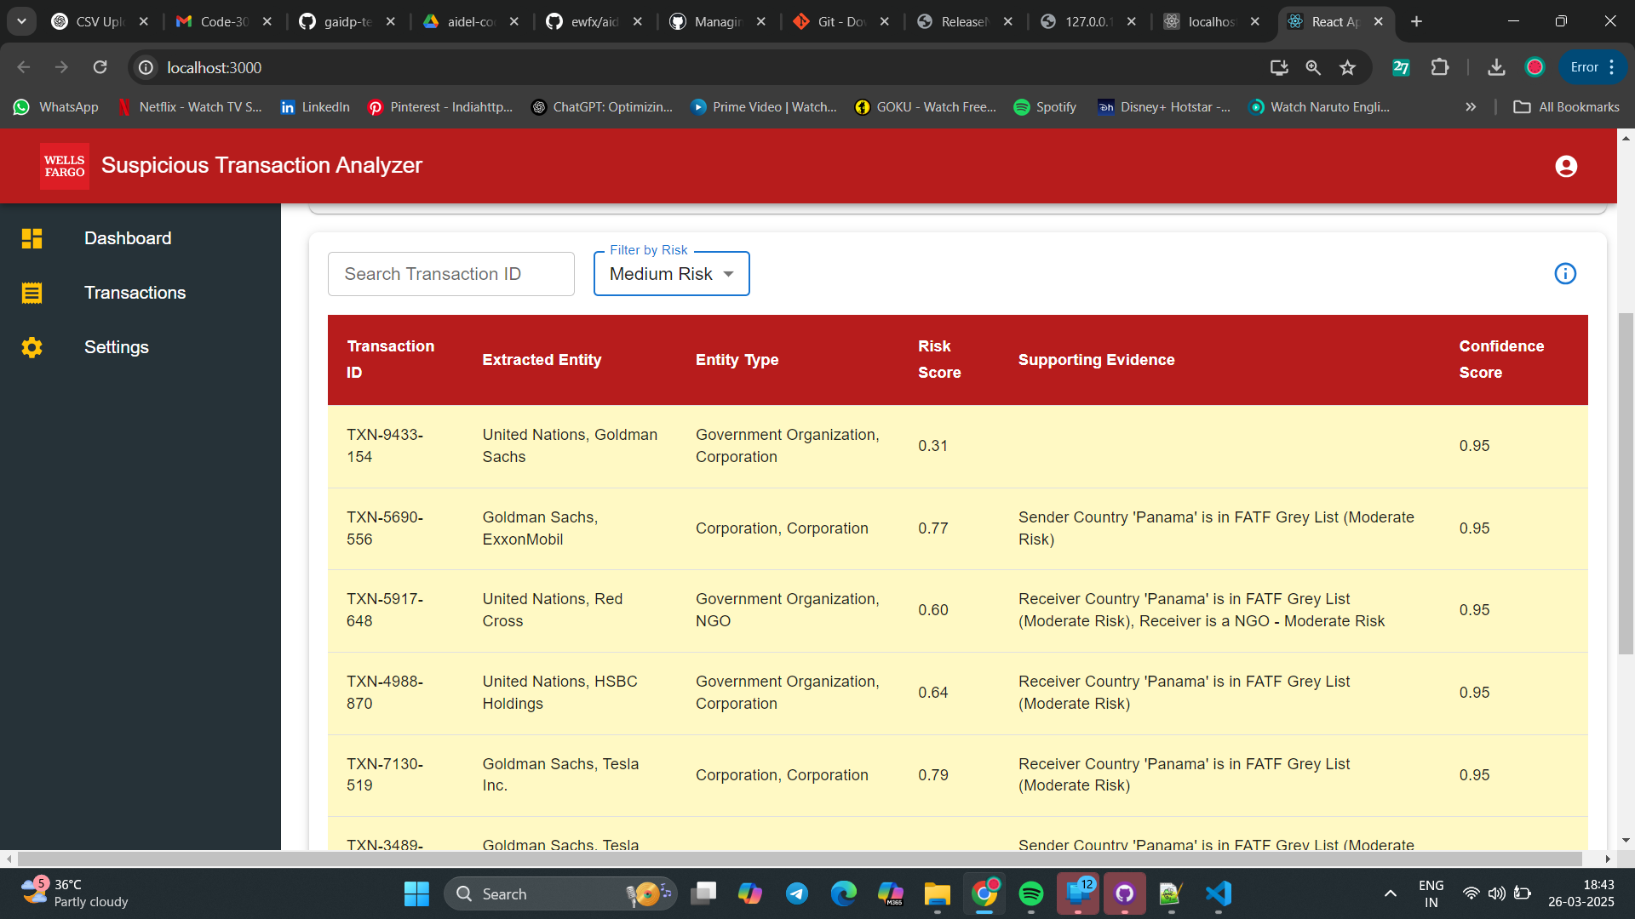
Results: Entity Risk Analysis in Action
Transactions can be sorted based on their risk level.

Slide 16
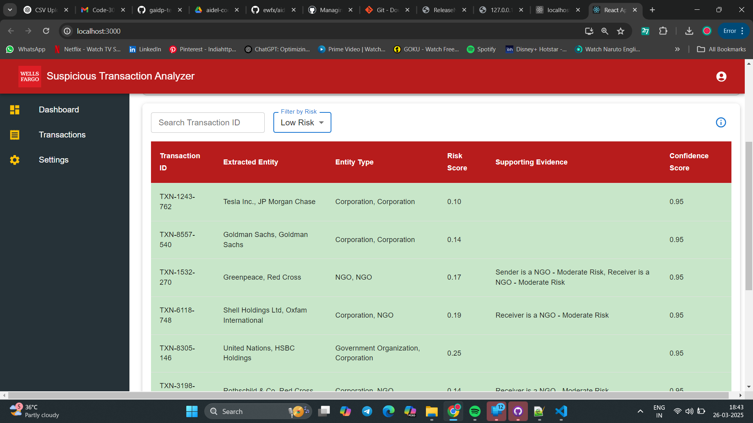
Results: Entity Risk Analysis in Action

Slide 17
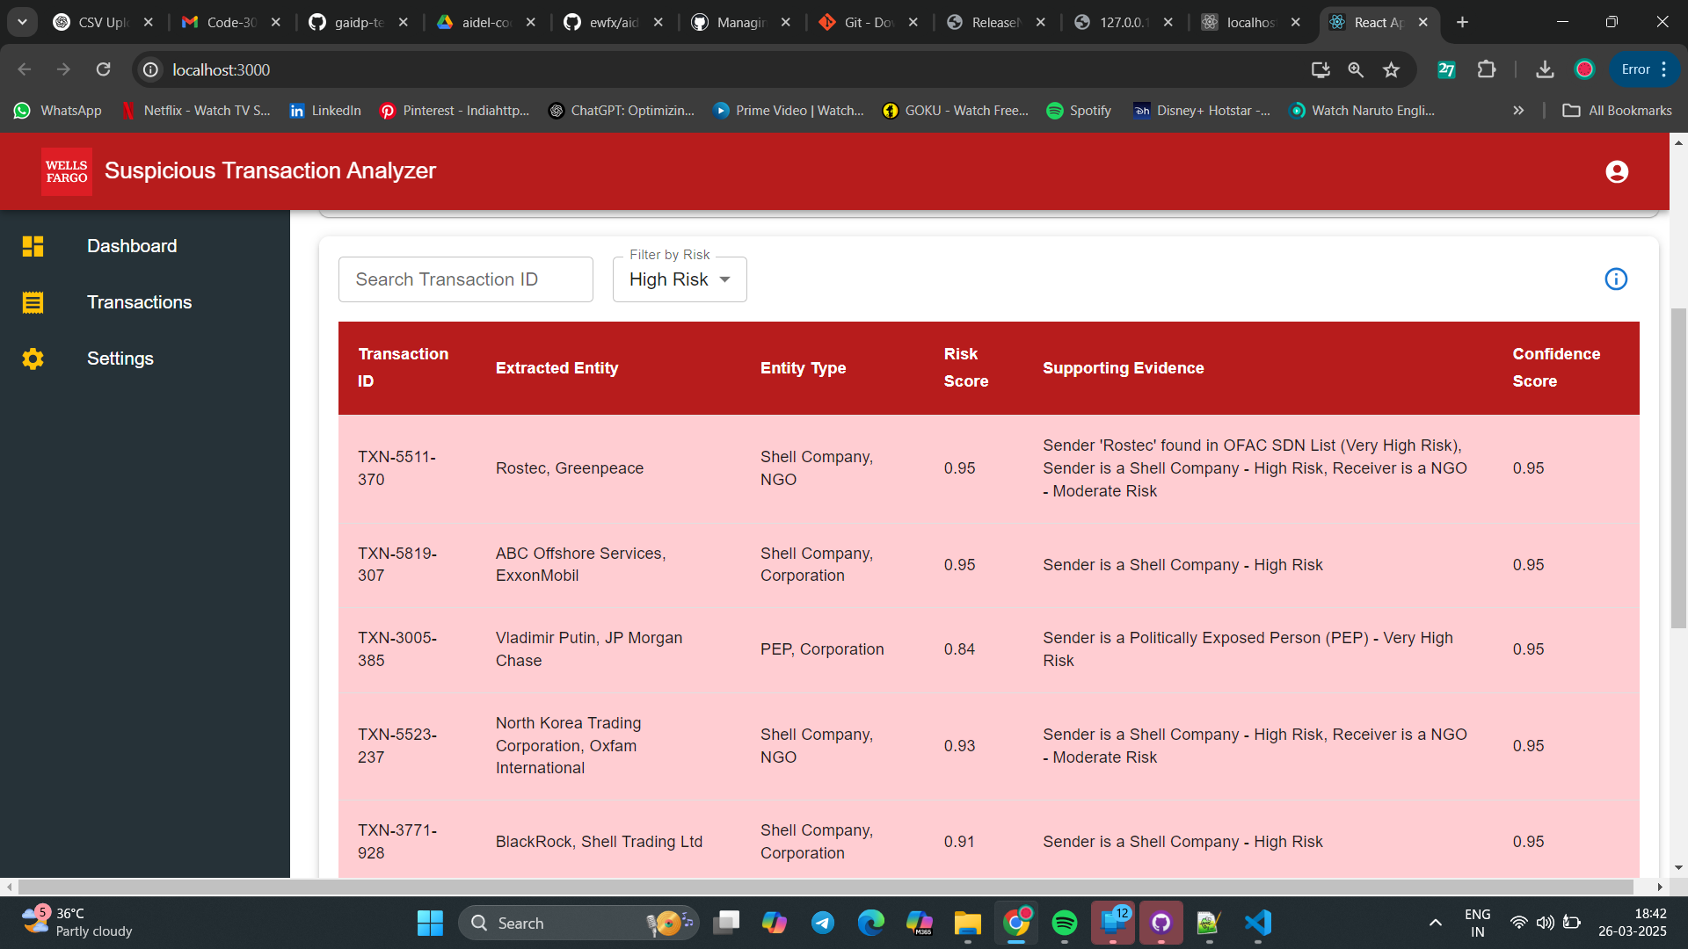
Results: Entity Risk Analysis in Action

Slide 18
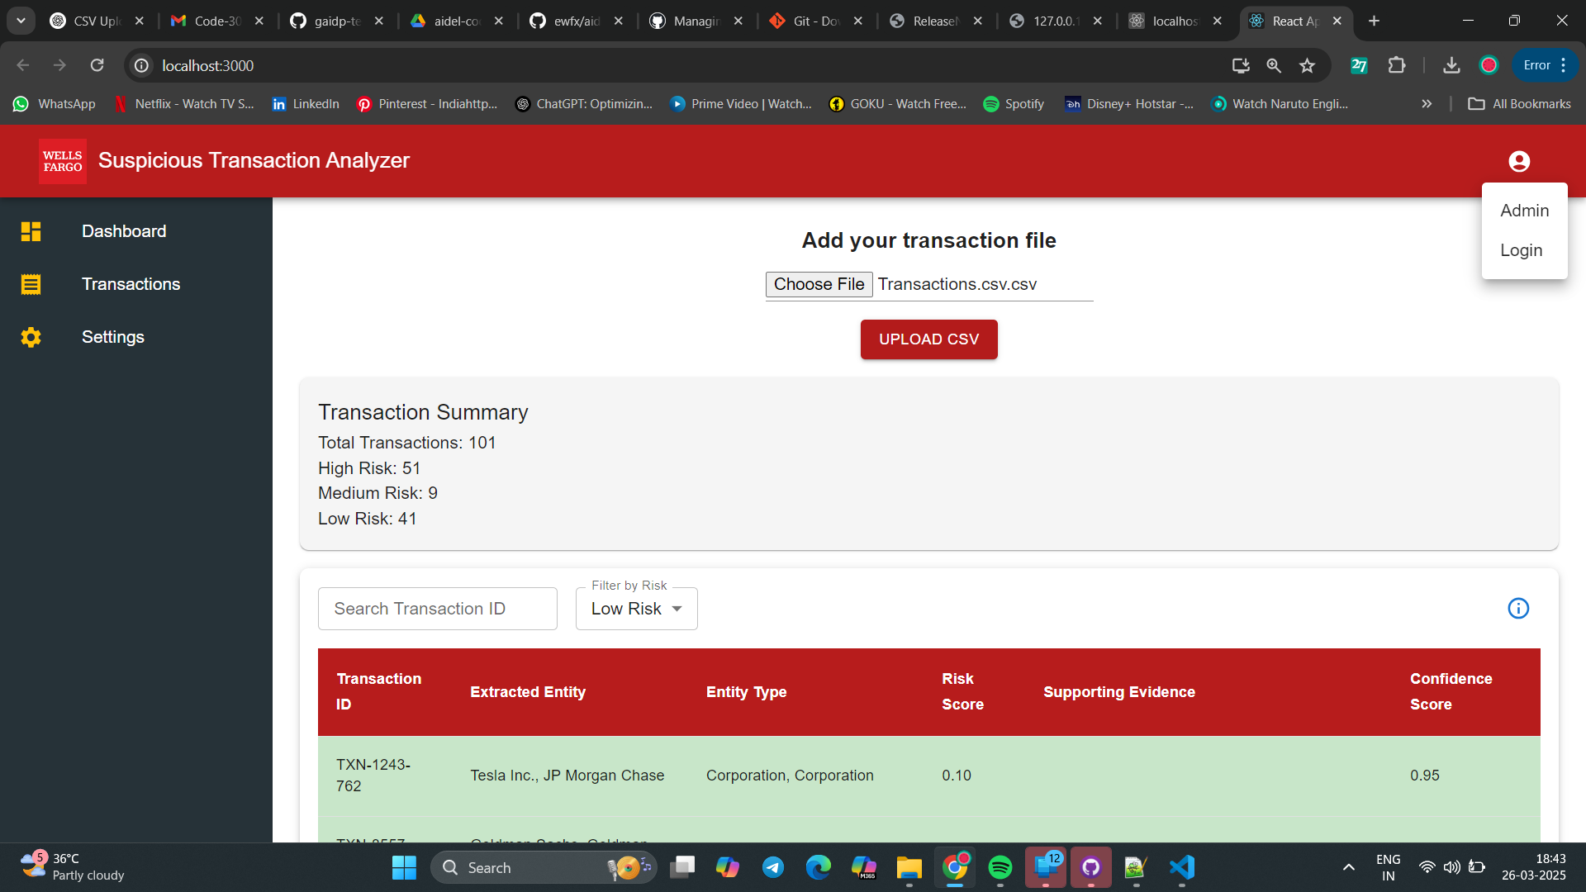
Results: Entity Risk Analysis in Action

Slide 19
What We Learned & Overcame
Challenges:
Processing highly unstructured text data efficiently.
Ensuring BERT’s NER model correctly detects organizations & people.
Integrating real-time sanctions databases & news sources.
Learnings:
Optimized regex patterns for ownership detection.
Improved NER entity merging for better accuracy.
Created a flexible model that works across CSV, JSON & text

Slide 20
Next Steps: Scaling the Model
Enhancements Planned:
Seamless real-time integration with news APIs (Google News, Bloomberg) and additional data sources.
Expand risk scoring to look at historical financial transactions.
Deploy as a Web Dashboard for instant entity lookup.

Slide 21
Final Thoughts & Impact
Our model automates risk detection, making financial compliance easier.
Reduces manual effort for analysts, improving fraud detection accuracy.

Slide 22
Thank You!

