Slide 1

Aegis - The Smart Intelligent Agentic Risk Analyst

Slide 2
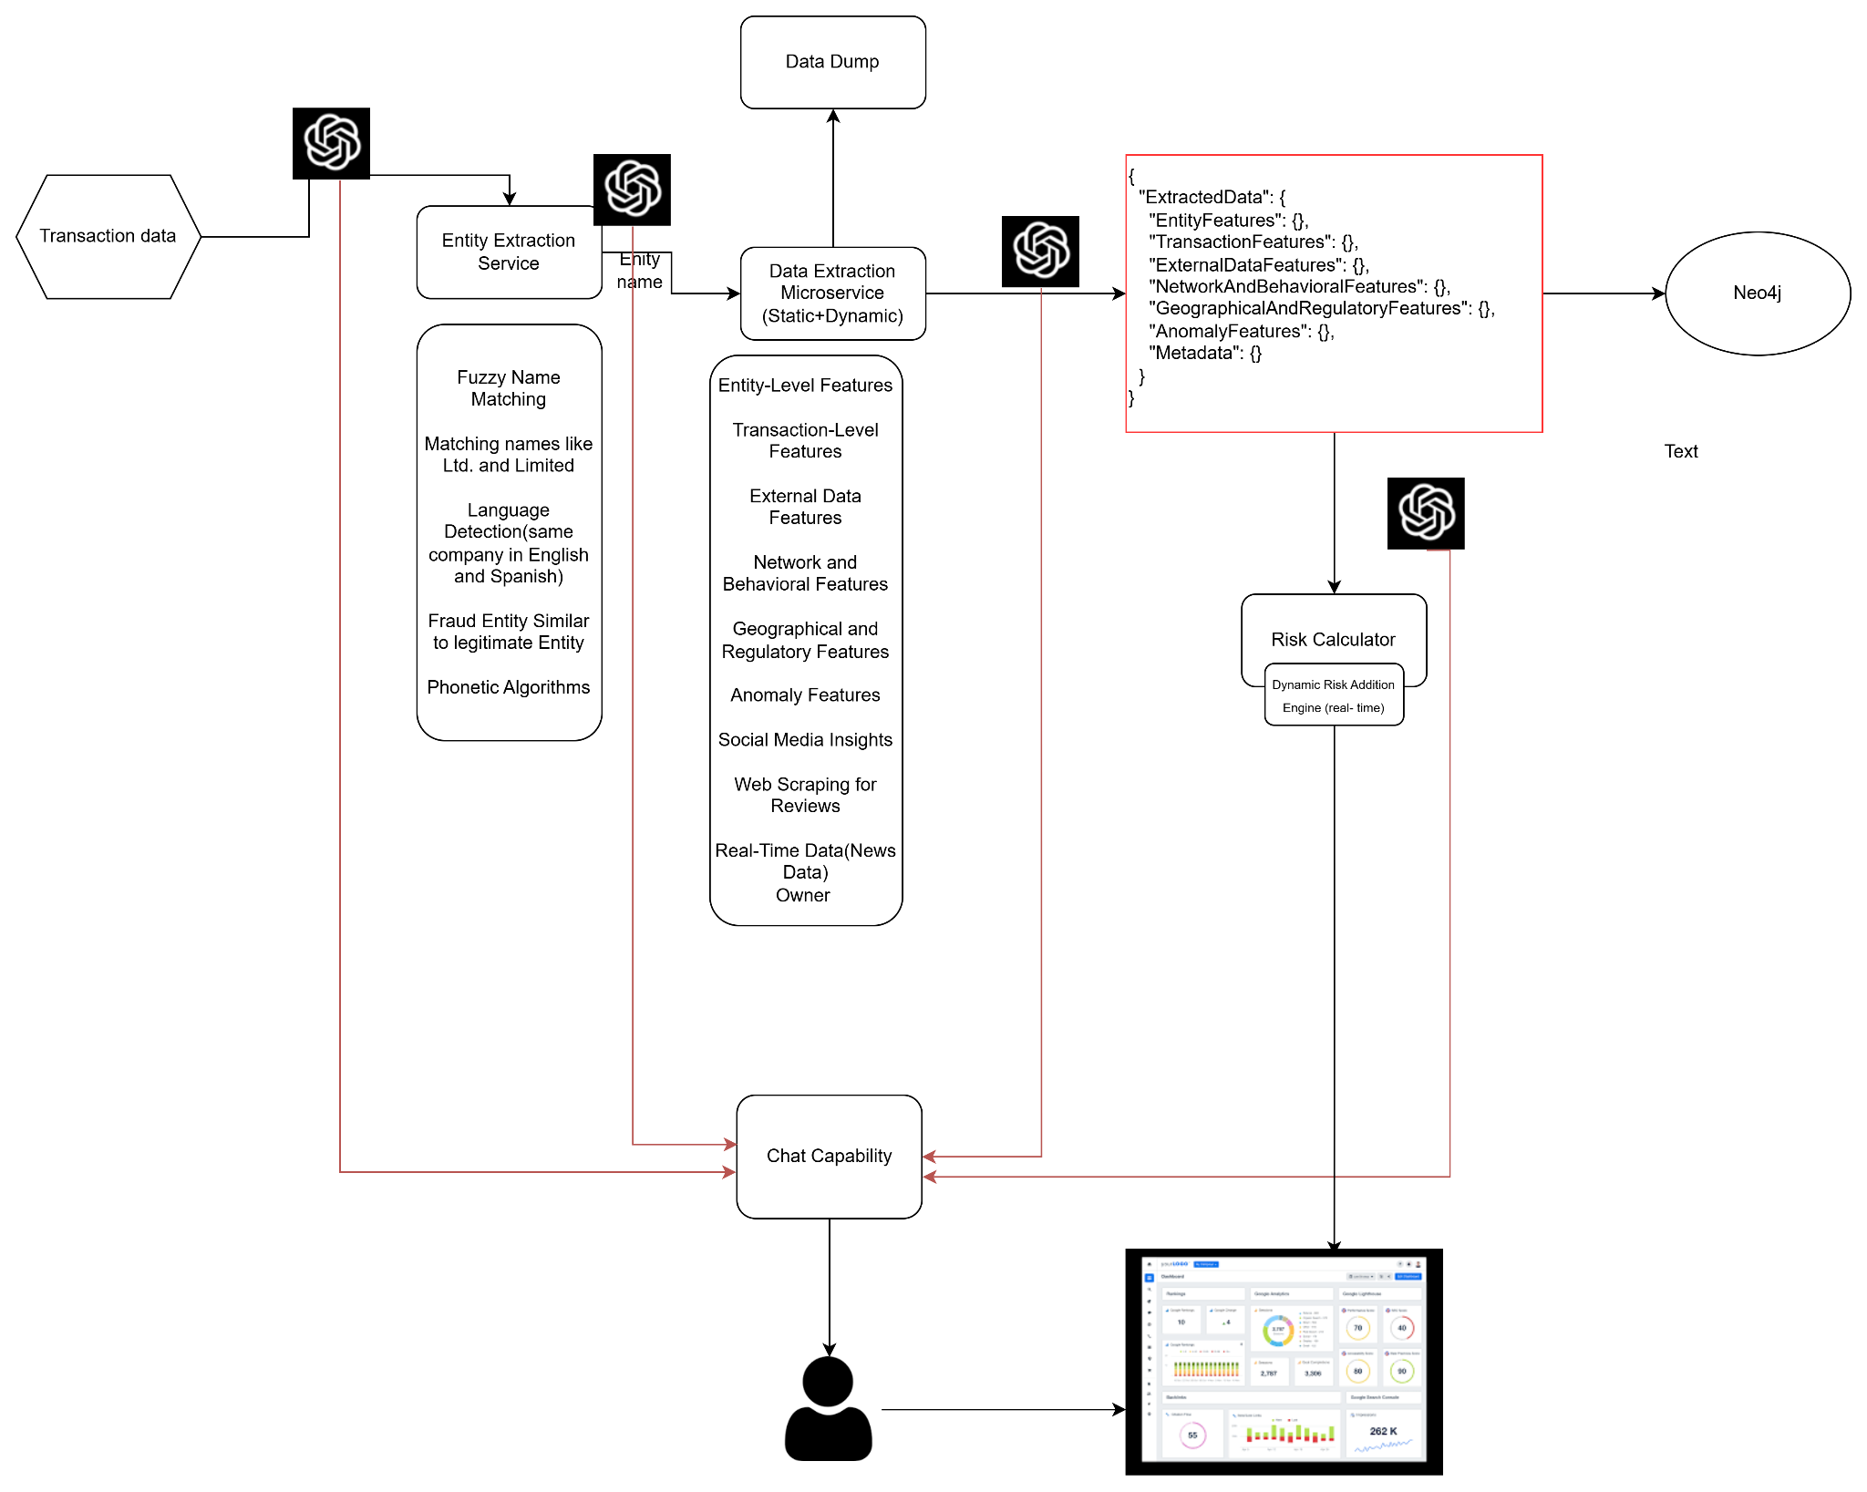
HIGH LEVEL ARCHITECTURE:

Slide 3
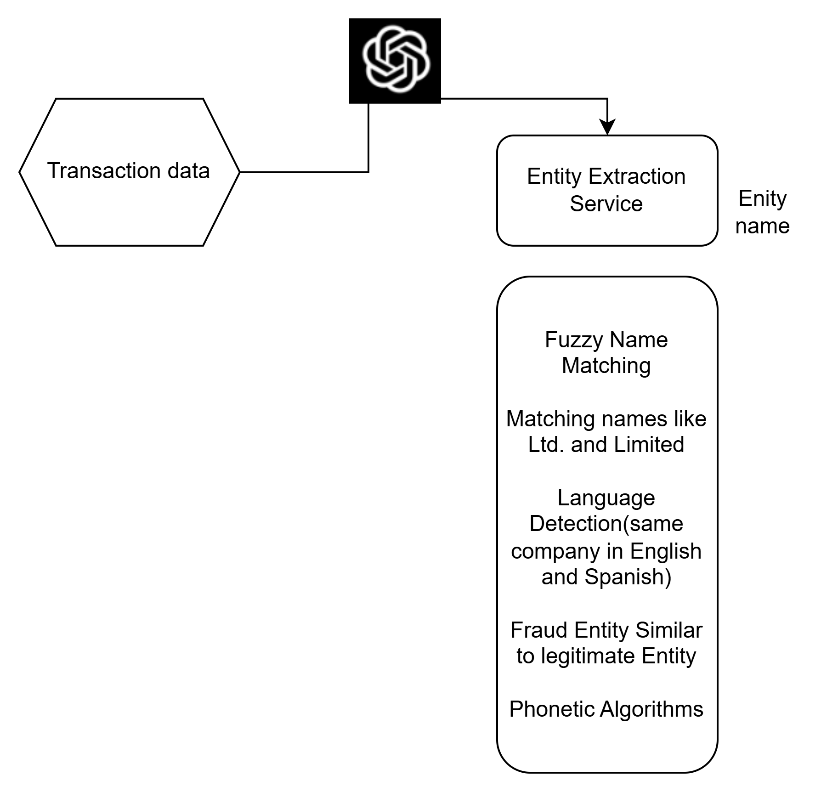
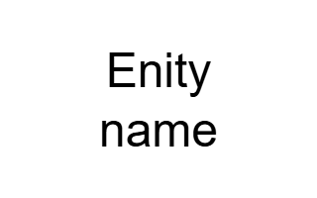
Entity Extraction Service:
Entity-Level Features:
Ownership
Legal status
Operational scope
Transaction-Level Features:
Amounts
Currencies
Dates
Transaction patterns
External Data Features:
Market analysis
Competitor insights
Industry trends
Network and Behavioral Features:
Frequent transactions between the same entities
Patterns suggesting potential collusion
Geographical and Regulatory Features:
Geographic locations of entities
Jurisdiction-based regulations
Compliance data
Anomaly Features:
Unusual transaction amounts
Atypical transaction frequency
Suspicious behavior

Slide 4

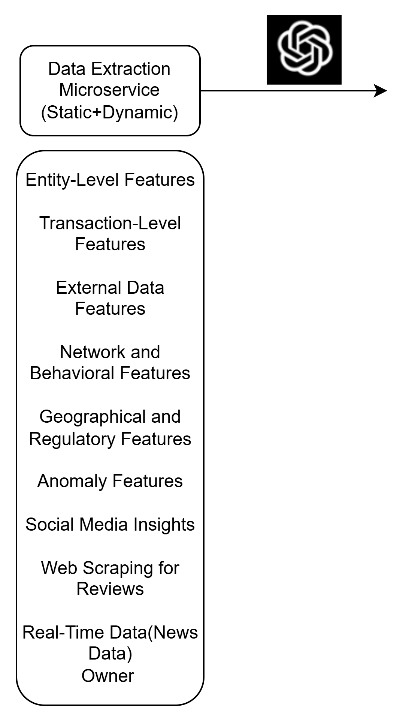
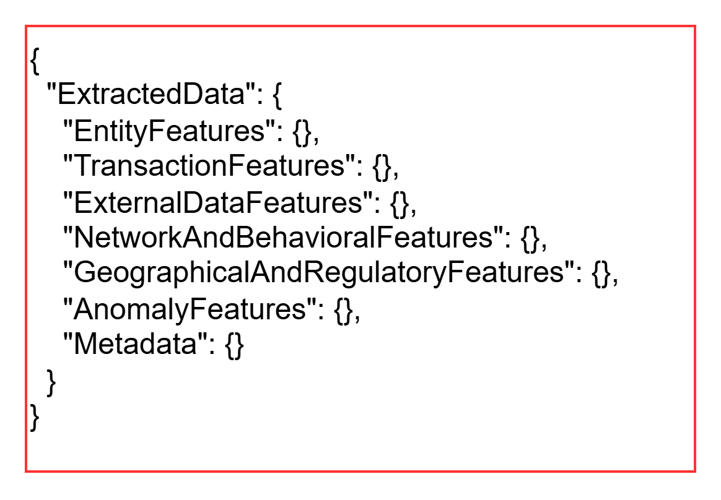
Data Extraction Service:
Unstructured Data Dump
Chat context
Methods Used for Data Extraction
Fuzzy Name Matching: Identifies variations of company names like "Ltd." and "Limited."
Language Detection: Handles multilingual entity names.
Phonetic Algorithms: Detects phonetic similarities to identify potential fraud.
Web Scraping: Retrieves insights from social media, reviews, and real-time news data.
Risk Calculator: Dynamically adjusts risk scores based on extracted features.
Data Dumping and Transparency
To enhance transparency and build trust, results from each phase of data extraction and analysis are systematically dumped for the user. This allows stakeholders to:
View intermediate results and understand each step of the analysis.
Access the reasoning behind final risk scores and anomaly detection.
Validate the data used for risk assessments, supporting compliance and audit requirements.
This approach ensures the system is not a "black box" but a transparent and accountable solution for financial risk management.
Entity List
Structured Data
Risk Calculator

Slide 5
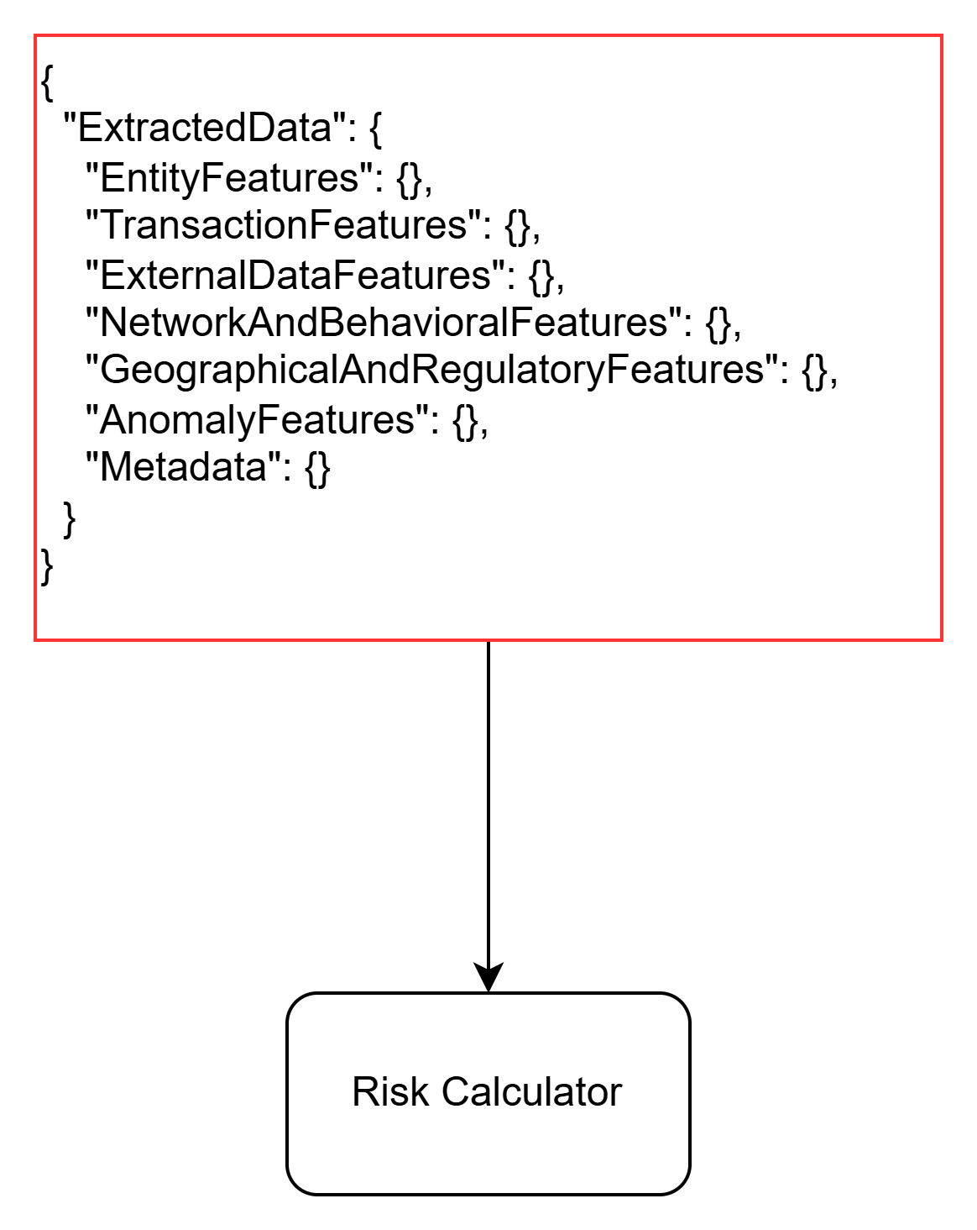
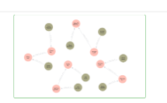
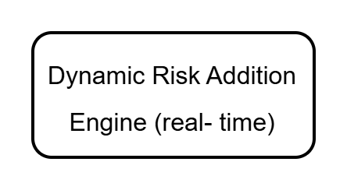

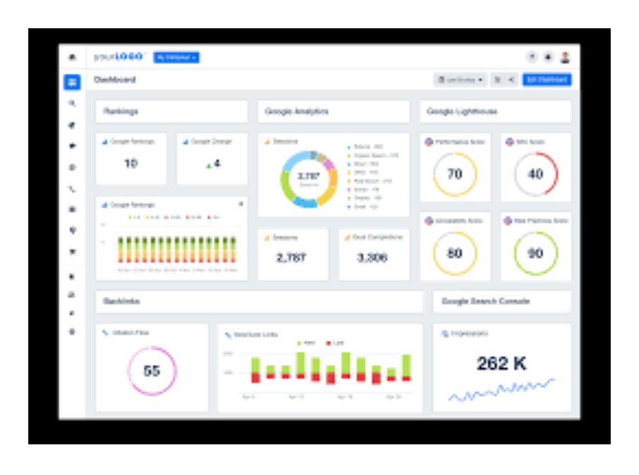
Risk Assessment Service:
Give more weightage to crypto risk while analysing
Neo4j Service
Dynamic Rule Addition

Slide 6
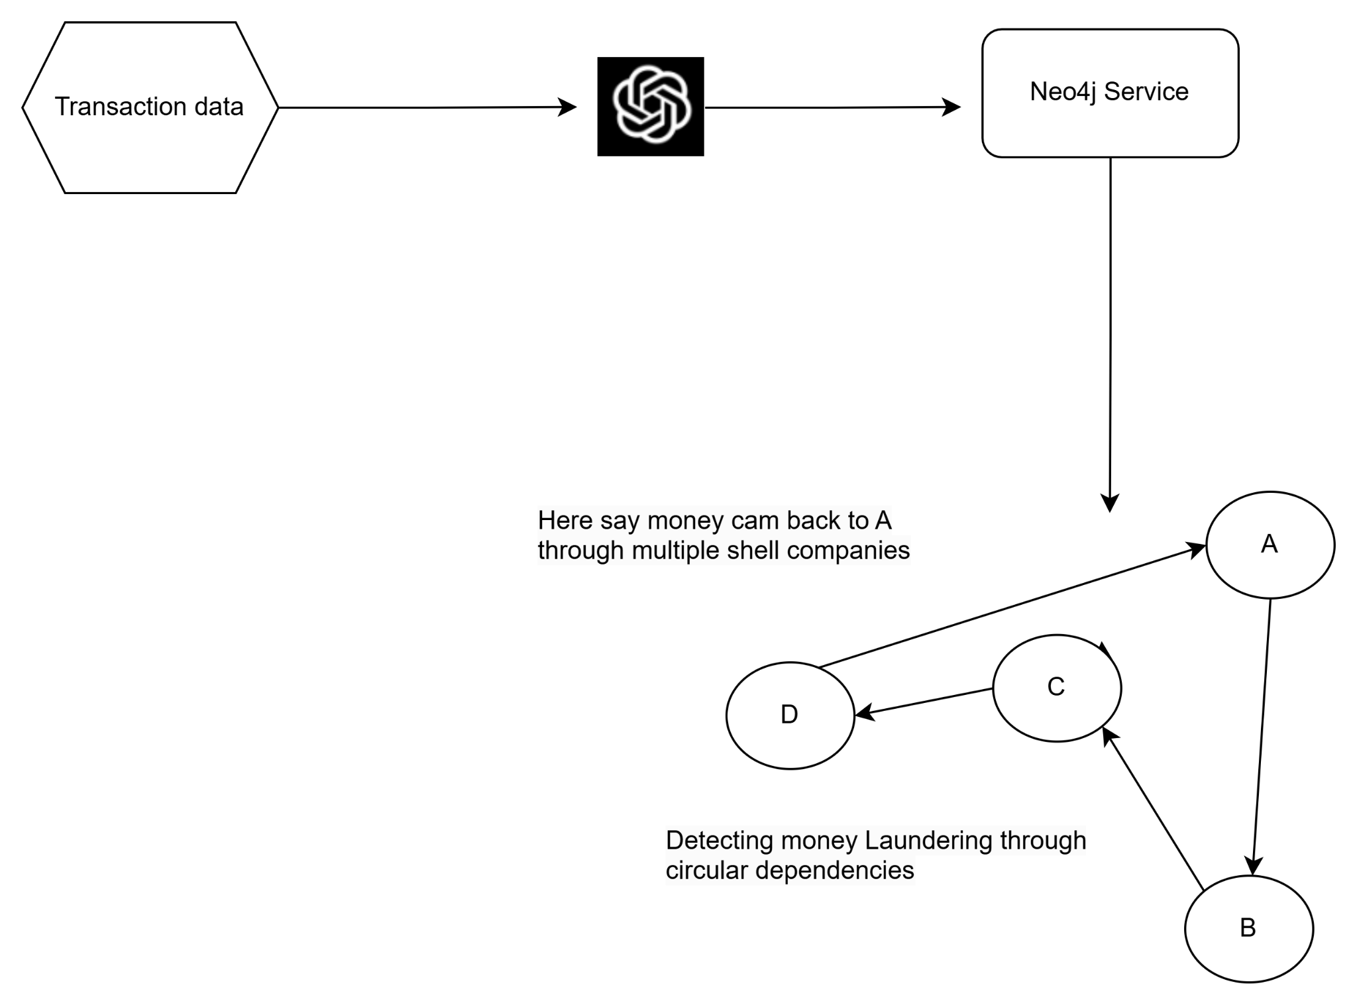
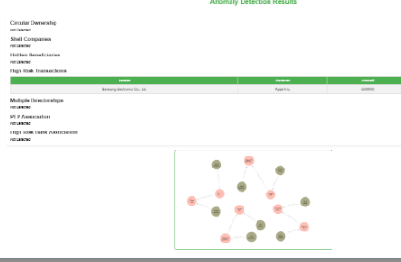
Neo4j Service

Slide 7
POC - Demo

