Slide 1
Hackathon Challenge AI Driven Hyper-personalization & Recommendations
Team: Amigos
Date: March 2025

Slide 2
Topics
Hackathon challenge
Team details
Problem statement
Proposed solution
High level architecture
Workflow
Tech stack
Key features and capabilities
Expected improvements
Future enhancements

Slide 3
Team name: Amigos
Members
Molanguri Sai Yashwanth
Ippili Vikranth
Manjunath
Goutham Reddy Anala

Slide 4
Problem Statement
Modern customers demand highly personalized experiences tailored to their unique preferences. However, businesses often struggle to meet these expectations due to limitations in data utilization, recommendation accuracy, and scalability.
Pain Points:
Lack of Data Integration:
Businesses fail to effectively integrate and analyze customer data from multiple sources, leading to incomplete customer profiles.
Low Recommendation Accuracy:
Recommendations are often generic and fail to align with individual customer preferences, reducing engagement and satisfaction.
Scalability Challenges:
Existing systems struggle to handle large datasets and provide real-time personalized recommendations at scale.
Inadequate Similarity Matching:
Poor algorithms for identifying similar transactions or preferences result in irrelevant suggestions.
Limited Context Awareness:
Recommendations lack contextual understanding, such as recent customer behavior or trends.
Customer Frustration:
Generic or irrelevant recommendations lead to customer dissatisfaction and reduced loyalty.
High Development Complexity:
Building and maintaining personalized recommendation systems require significant technical expertise and resources.
Privacy Concerns:
Customers are increasingly concerned about how their data is collected and used, creating trust issues.

Slide 5
Proposed Solution
Objective:
AI-Powered Recommendation System:
Leverage machine learning models (e.g., collaborative filtering, content-based filtering, or deep learning) to generate personalized recommendations.
Use vector similarity (as seen in your code) to find and rank similar transactions or products.
How:
An AI-powered recommendation system using Astra DB and NV-Embed-QA leverages Astra DB's scalability and low-latency vector search to store and query customer profiles and embeddings. NV-Embed-QA generates high-quality semantic embeddings for customer preferences and transactions, enabling accurate, real-time personalized recommendations.

Slide 6
High-Level Architecture
Architecture Overview
Data Storage:
Use Astra DB to store customer profiles, transaction data, and vector embeddings.
Embedding Generation:
Use NV-Embed-QA to generate embeddings for customer preferences, transactions, and products.
Vector Similarity Search:
Perform similarity searches in Astra DB to find relevant recommendations.
Frontend Integration:
Use frameworks like React.js to display recommendations dynamically.

Slide 7
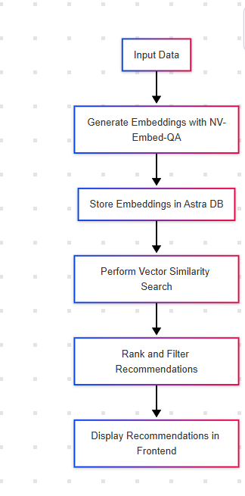
WorkFlow

Slide 8
Technology Stack
GenAI Model: NV-Embed-QA
Dimensions: 1024
Similarity: Cosine
Languages: Typescript
UI Library: React, Next JS
Backend: Node.js, Astra DB, Open AI

Slide 9
Key Features & Capabilities
Scalable Data Storage:
Astra DB efficiently stores large volumes of customer profiles, transaction histories, and vector embeddings.
Semantic Embedding Generation:
NV-Embed-QA generates high-quality vector embeddings for customer preferences, transactions, and product metadata.
Vector Similarity Search:
Perform fast and accurate similarity searches in Astra DB to find relevant recommendations.
Real-Time Recommendations:
Low-latency queries in Astra DB enable instant delivery of personalized recommendations.
Context-Aware Personalization:
Recommendations are tailored based on semantic understanding of customer preferences and transaction context.
Integration with AI Models:
Seamlessly integrates with machine learning frameworks for embedding generation and recommendation logic.
Dynamic Frontend Display:
Recommendations are dynamically displayed in the user interface (e.g., "Cards you may like").
Scalability and Performance:
Handles millions of users and transactions without performance degradation.
Flexibility in Data Modeling:
Astra DB's schema-less design supports evolving data structures for customer and product data.
Continuous Learning:
Embeddings and recommendations can be updated as customer preferences and behaviors evolve.

Slide 10
Expected Improvements
Enhanced Personalization:
Deliver highly relevant and context-aware recommendations by leveraging semantic embeddings from NV-Embed-QA.
Improved Recommendation Accuracy:
Use vector similarity search to provide more precise matches based on customer preferences and transaction history.
Real-Time Performance:
Achieve faster response times for recommendations with Astra DB's low-latency queries.
Scalability:
Handle growing datasets and user bases without compromising performance or reliability.
Dynamic Adaptability:
Continuously update recommendations as customer preferences and behaviors evolve.
Seamless Integration:
Easily integrate with existing AI models and frameworks for embedding generation and recommendation logic.
Increased Customer Engagement:
Provide personalized experiences that boost customer satisfaction, retention, and loyalty.
Operational Efficiency:
Reduce infrastructure complexity with Astra DB's serverless architecture and NV-Embed-QA's pre-trained capabilities.
Contextual Recommendations:
Incorporate contextual factors (e.g., time, location, recent activity) for more meaningful suggestions.
Business Growth:
Drive higher conversion rates and revenue through better-targeted recommendations.

Slide 11
Future enhancements
Multi-Modal Recommendations:
Incorporate additional data types like images, audio, and video metadata to improve recommendation diversity and accuracy.
Behavioral Analytics Integration:
Use real-time behavioral data (e.g., clicks, time spent, and navigation patterns) to refine recommendations dynamically.
Explainable AI (XAI):
Provide transparency by explaining why specific recommendations were made, increasing user trust.
Advanced Context Awareness:
Leverage contextual factors like location, time, and seasonal trends for more relevant recommendations.
A/B Testing and Continuous Optimization:
Implement automated A/B testing to evaluate and optimize recommendation strategies.
Cross-Platform Personalization:
Synchronize recommendations across multiple platforms (e.g., web, mobile, and IoT devices) for a seamless user experience.
Federated Learning:
Use federated learning to train recommendation models on decentralized data while preserving user privacy.
Enhanced Privacy and Security:
Implement advanced encryption and anonymization techniques to ensure compliance with data privacy regulations.
Hybrid Recommendation Models:
Combine collaborative filtering, content-based filtering, and deep learning for a more robust recommendation engine.
Gamification and Rewards:
Introduce gamified elements (e.g., badges, points) to encourage user interaction and feedback on recommendations.

Slide 12
Thank you

