Slide 1
AI-Driven Hyper-Personalization & Recommendations
By,
Rakesh Roushan.
Team: Banzai.

Slide 2
Contents
1. AI-Driven Hyper-Personalization & Recommendations
2. Introduction to AI-Driven Hyper-Personalization
3. Key Concepts
4. How AI Powers Hyper-Personalization
5. Real-Time Personalization
6. Examples of AI-Driven Hyper-Personalization
7. Benefits of AI-Driven Hyper-Personalization
8. Challenges and Considerations
9. Future of AI-Driven Hyper-Personalization
10. Conclusion
11. Questions

Slide 3
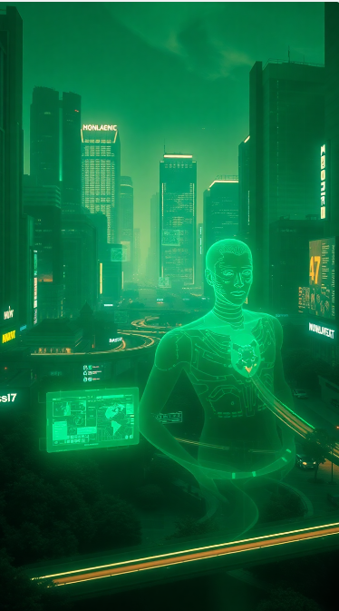
AI-Driven Hyper-Personalization & Recommendations
Transforming User Experience with Advanced AI .

Slide 4
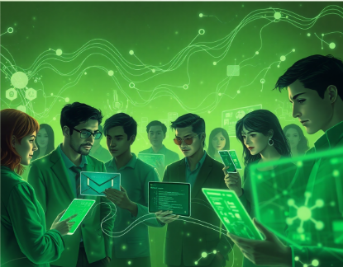
Introduction to AI-Driven Hyper-Personalization
AI-driven hyper-personalization refers to using advanced AI algorithms to deliver highly tailored experiences to individual users based on their data, preferences, and behaviours. The goal is to enhance user satisfaction, engagement, and conversion by providing dynamic and real-time personalized experiences.

Slide 5
Key Concepts
Personalization vs Hyper-Personalization
Personalization
Tailoring experiences based on historical data.
Hyper-Personalization
Adapting to real-time behaviors and contextual factors, creating a more granular and dynamic experience.
AI's Role
AI uses data analysis, machine learning, and real-time decision-making to predict and recommend content, products, or services.

Slide 6

How AI Powers Hyper-Personalization
Data Collection & Integration
Aggregates data from multiple sources (browsing history, transactions, social media, etc.) and uses this data to build a profile of user preferences.
Machine Learning Algorithms
Includes collaborative filtering, content-based filtering, hybrid models, and reinforcement learning to continuously improve recommendations.

Slide 7
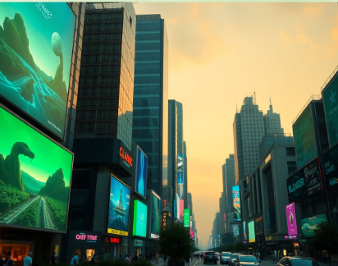
Real-Time Personalization
Dynamic Adjustments
Adjusts recommendations based on real-time actions, location, and contextual data. Example: Personalized discounts or content based on user activity (time of day, location, etc.).
Context-Aware Experiences
Uses environmental factors, like weather or ongoing events, to refine user experience.

Slide 8
Examples of AI-Driven Hyper-Personalization
E-commerce & Social Media
Streaming Services & Healthcare
Amazon uses AI to suggest products based on browsing history and purchase behavior.
Facebook, Instagram, and TikTok personalize feeds based on user interactions, likes, and shares.
Netflix and Spotify recommend movies or songs based on previous preferences and viewing/listening patterns.
Personalized health recommendations based on an individual's data (e.g., fitness trackers, medical history).

Slide 9
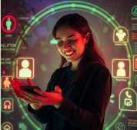
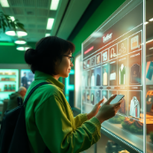
Benefits of AI-Driven Hyper-Personalization
Improved User Engagement
Higher Conversion Rates
Offers content/products users are likely to enjoy, increasing interaction.
Tailored experiences lead to increased sales or desired actions.

Slide 10


Benefits of AI-Driven Hyper-Personalization
Enhanced Customer Satisfaction
Better Retention
Users feel understood and valued, fostering brand loyalty.
Personalized experiences increase customer retention by making users more likely to return.

Slide 11
Challenges and Considerations
Privacy Concerns
Ethical issues related to data collection and user privacy.
Bias in Algorithms
AI recommendations could reinforce bias or misinterpret user preferences.
Data Overload
Too many recommendations may overwhelm users.
Technical Complexity
Implementing and maintaining AI systems can be resource-intensive.

Slide 12
Future of AI-Driven Hyper-Personalization
AI Advancements
Integration with IoT Devices
Natural Language Processing (NLP) and computer vision for deeper understanding of preferences.
Emotion Recognition
AI may gauge user emotions for more accurate personalization.
Personalized experiences extending across smart devices (wearables, smart home assistants).
AR/VR
Personalized experiences in immersive environments (virtual stores, interactive learning, etc.).

Slide 13

Conclusion
AI-driven hyper-personalization is revolutionizing how businesses engage with their customers by delivering real-time, dynamic, and highly relevant experiences. By utilizing AI, businesses can increase engagement, boost conversions, and foster long-term customer loyalty, while also navigating challenges such as privacy concerns and algorithmic bias. With continuous AI improvements, hyper-personalization will become even more sophisticated, creating seamless, immersive user experiences.

Slide 14
Questions
Questions & Discussion Invite questions and discussion from your audience.

Slide 15
Thank you.

