Slide 1

Hyper-Personalization - Tailored experiences at Scale.
Team- Black panthers

Slide 2
Agenda
Problem Statement
Hyper Personalization Vs Personalization
Architecture & Flow Diagram
Insights
UI walkthrough
Live Demo
Future Scope

Slide 3
Problem Statement: While digital transformation has progressed in banking, customer engagement remains outdated, relying heavily on rule-based personalization and broad segmentation.
Key Issues with Traditional Personalization:
One-size-fits-all campaigns that ignore unique customer behavior and intent
Low customer engagement due to irrelevant offers and messages
Missed revenue opportunities from poor cross-sell and upsell targeting
High churn risk among tech-savvy and digitally native customers
No real-time adaptability to changing customer context or sentiment.

Slide 4












Personalization vs Hyper Personalization
Hyper-personalization means using real-time data, AI, and machine learning to understand each customer’s behavior, preferences, and needs — and then giving them the right product, message, or service at the right time, just for them.
HYPER-CUSTOMIZED OFFERS
NON-TARGETED CUSTOMERS
TARGETED CUSTOMERS
HYPER-CUSTOMIZED OFFERS

Slide 5
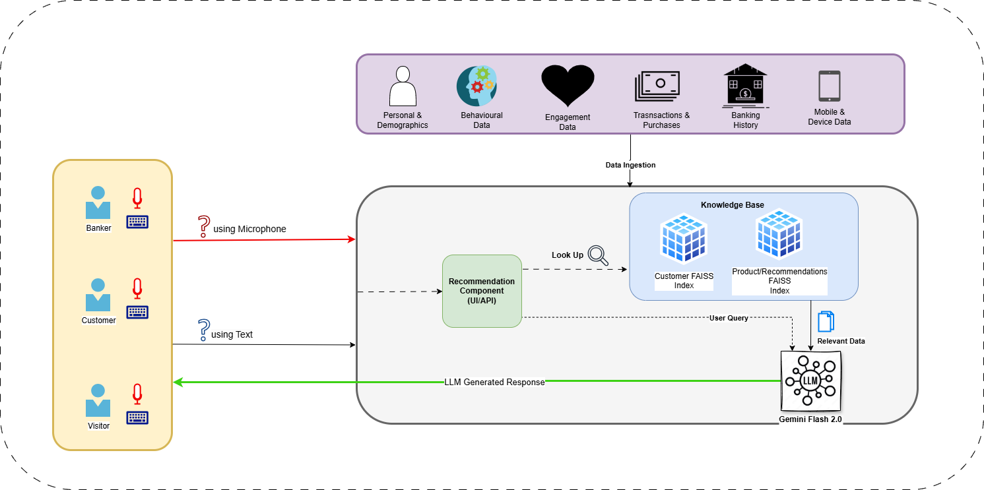
Architecture

Slide 6
Tech Stack
Python 3.12
BAAI/bge-small-en – to create embeddings.
FAISS Vector DB – for indexing.
Google Flash 2.0 – LLM
Streamlit - UI

Slide 7
Insights
AI suggesting the right investment plans.
Analyze customer sentiment over time to improve the customer satisfaction.
Suggest banking products based on data. E.g. Loans/Credit Cards with personalized interest rates.
Personalized financial recommendation dashboard.
AI-driven product matching with customer transaction behavior.
With AI-driven fraud detection, banks can stay ahead of potential risks and protect customers.

Slide 8
UI Walkthrough

Slide 9
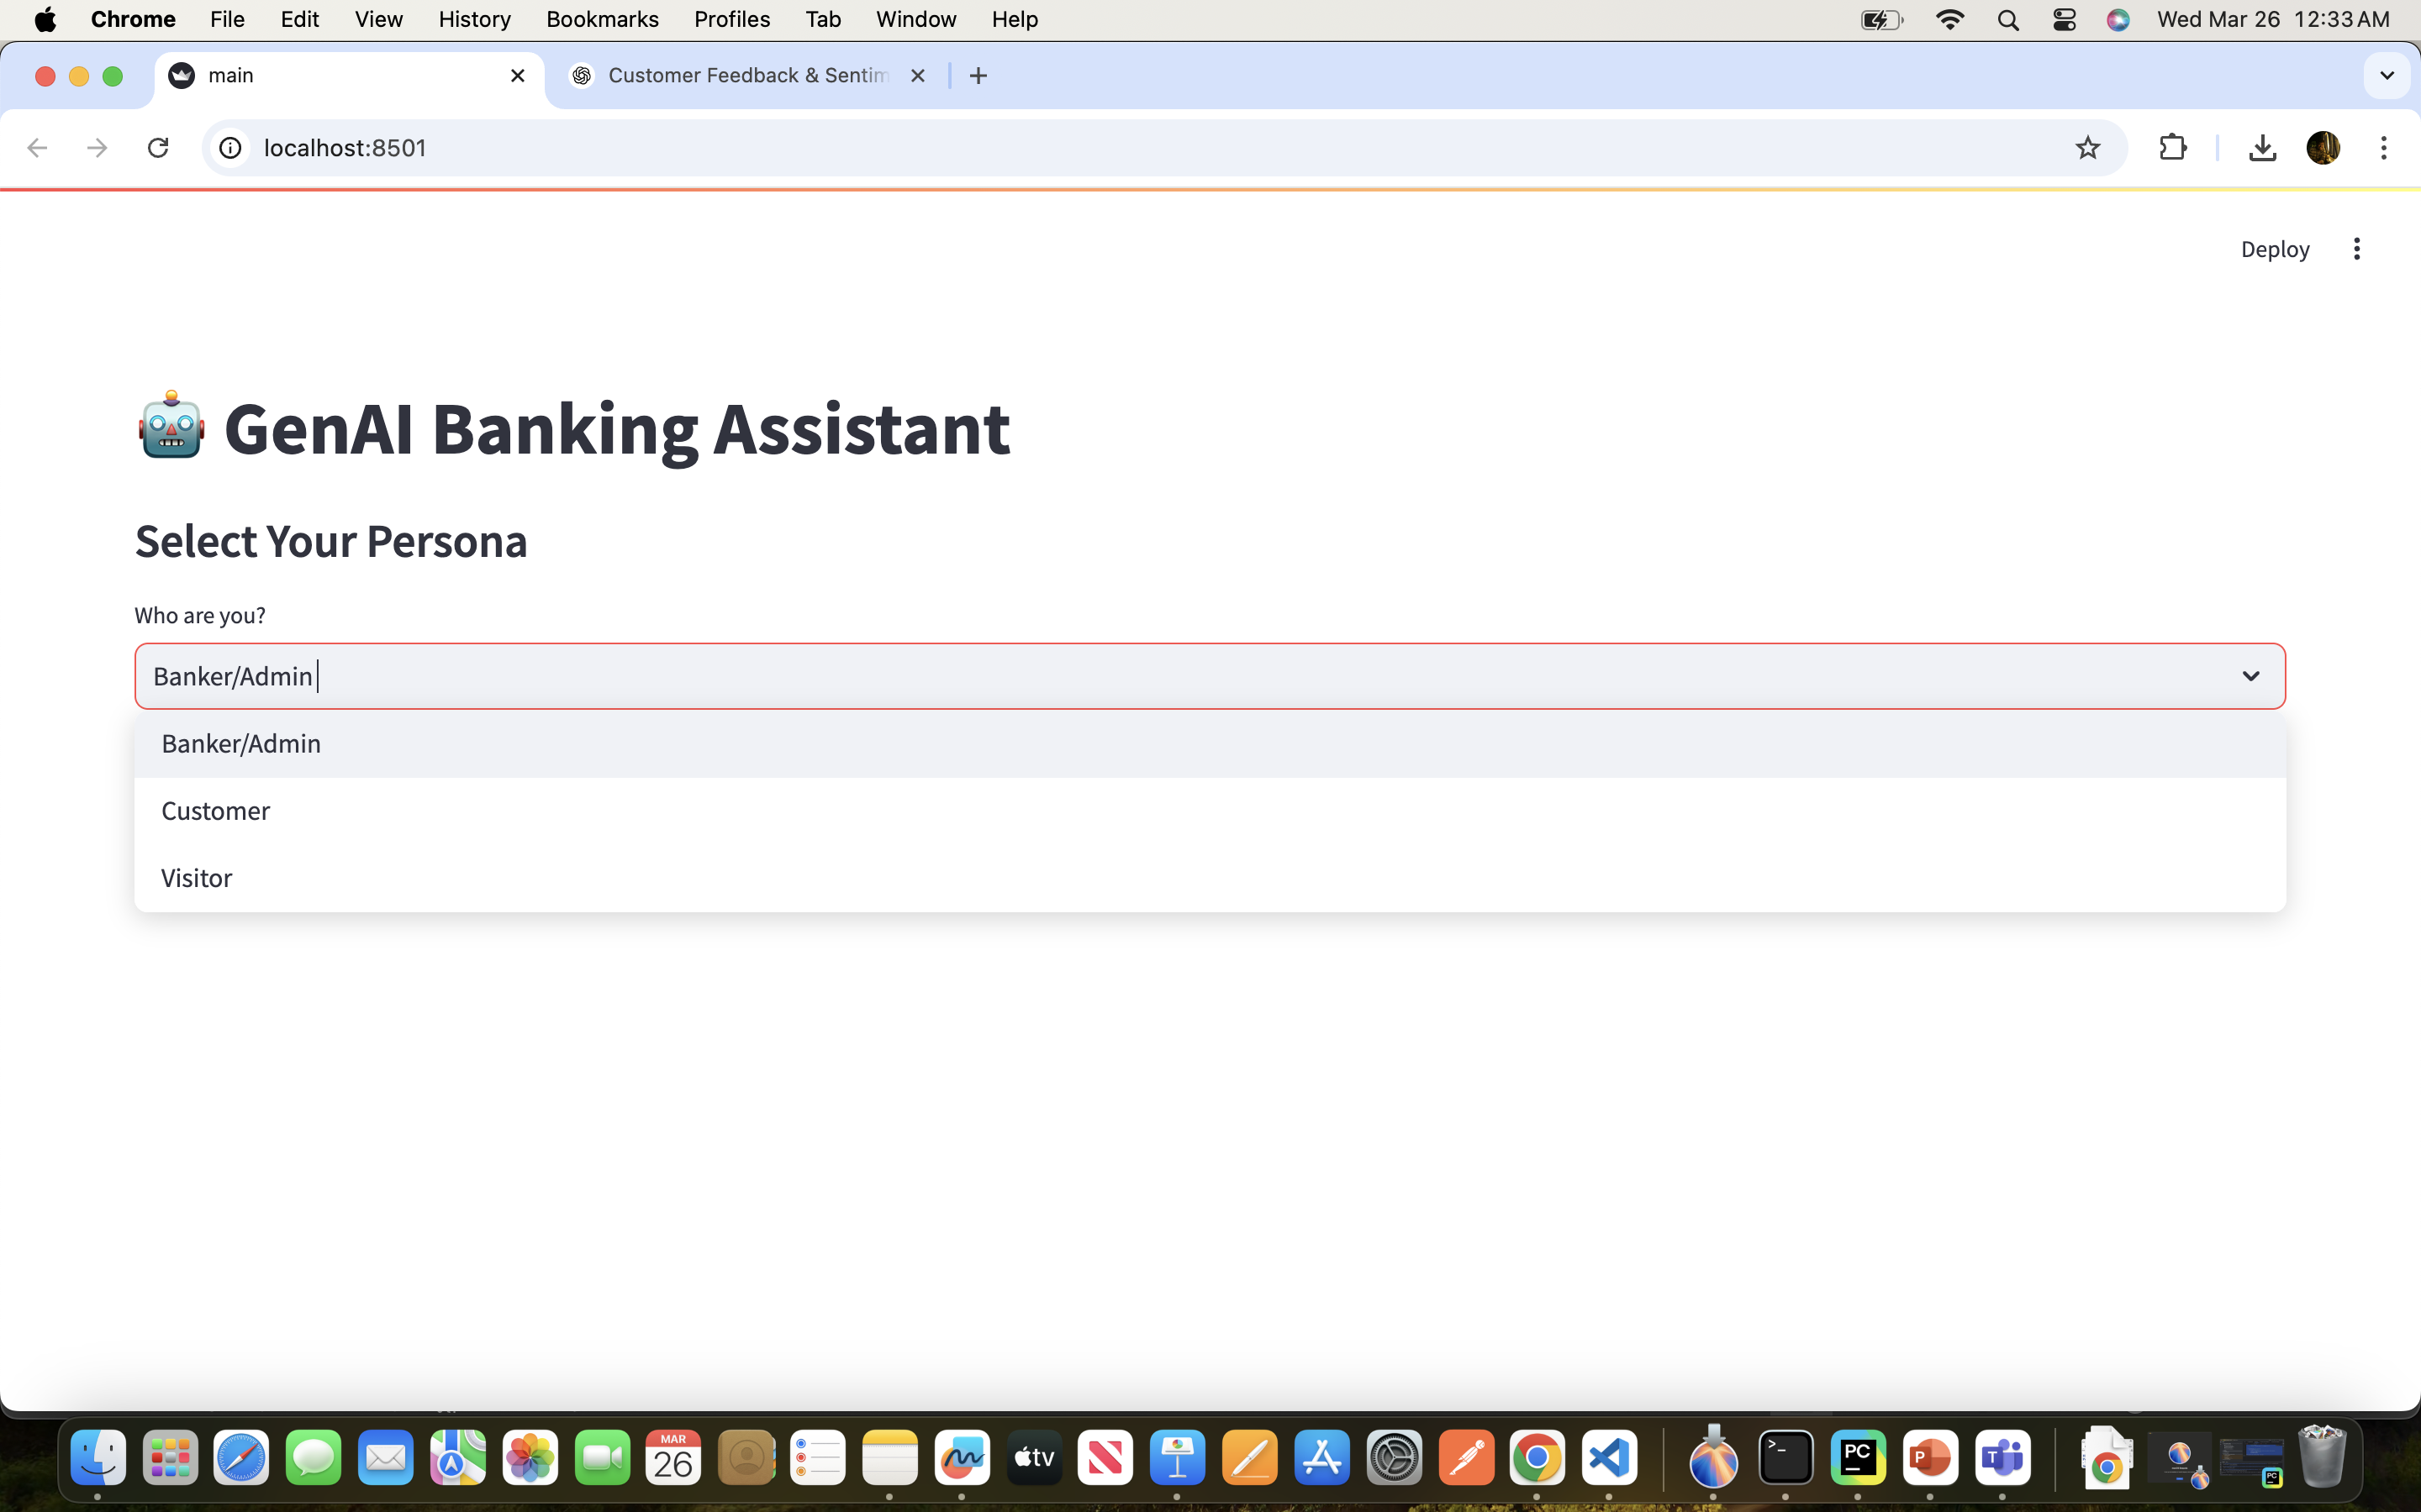
AI based hyper personalized Assistant with Personas

Slide 10
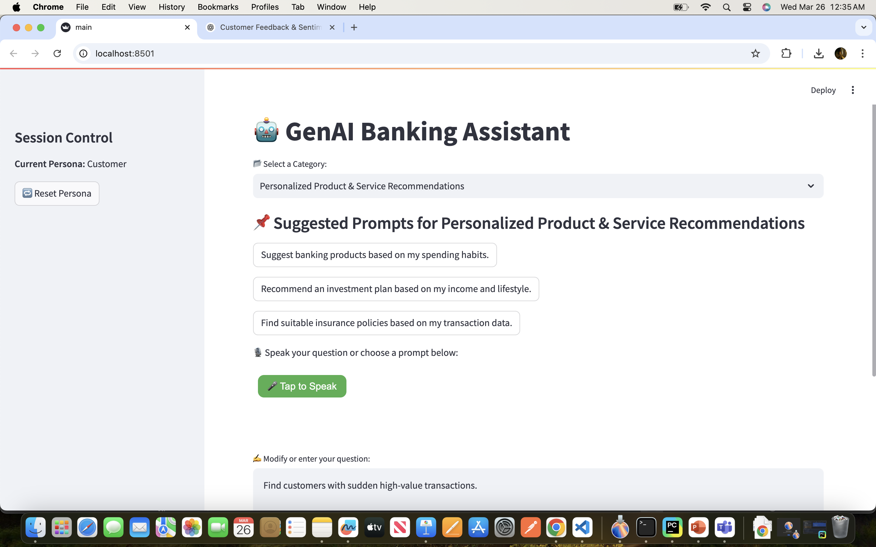
Pre-populated Suggested Categories and related prompts

Slide 11
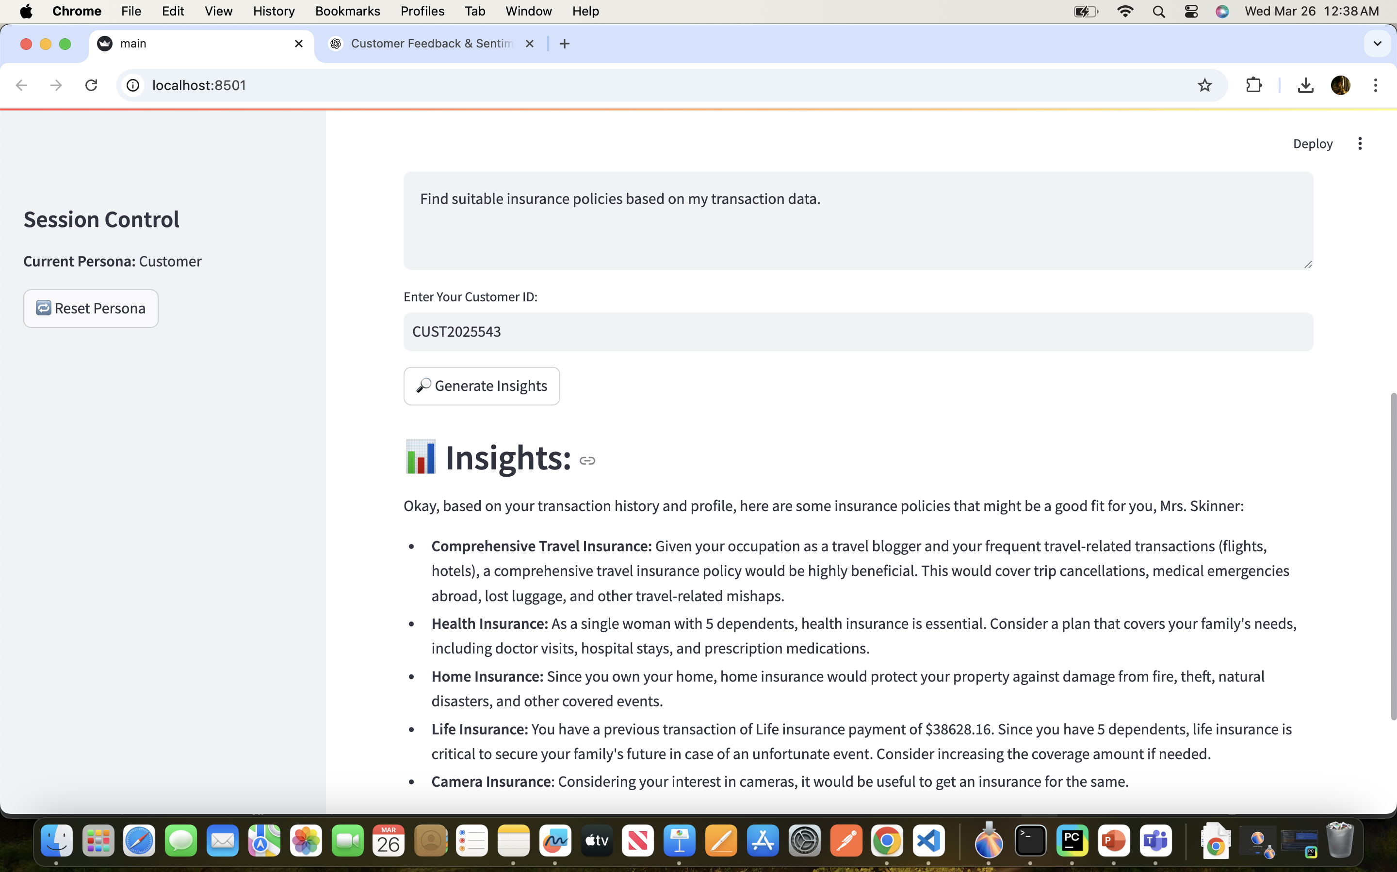
Personalized Insights based on customer behavior pattern /sentiment analysis

Slide 12
Live Demo

Slide 13
Future Scope
Target wide range of customers including organizations.
AI-powered personal financial assistants with conversational capacity.
Implement personalized notifications implementation to send responses via preferred channel (WhatsApp, Email)

Slide 14
Thank You

