Slide 1
Hyper Personalization Recommendation System
Authors:
Bibhudatta Mishra
Abinash Prusty
Zabir Akram
Deepak Kumar Kar

Slide 2
Introduction
Objective:
• Build an AI-powered recommendation system for personalized product suggestions.
• Improve customer engagement and enhance banking product sales.
Key Features:
• Personalized product recommendations.
• Banker dashboard to manage customer recommendations.
• Integration with multiple AI models for better accuracy.

Slide 3
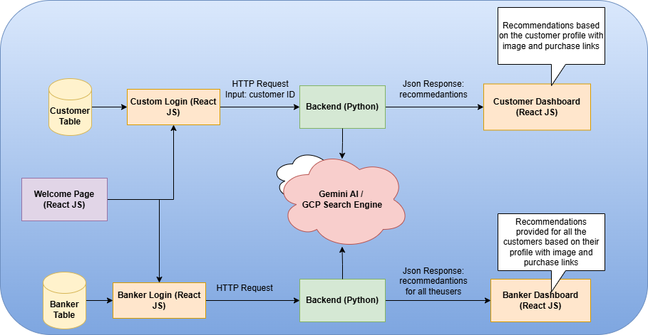
System Overview

Slide 4
Tech Stack
Frontend: React
Backend: Flask API (Python)
AI Models Used:
• Gemini: Generates product recommendations
• Hugging Face T5: Summarizes recommendations
• CLIP: Multimodal matching (images & text)
• SBERT: Semantic similarity between user and product embeddings
• GCP Custom Search API: Fetches purchase links

Slide 5
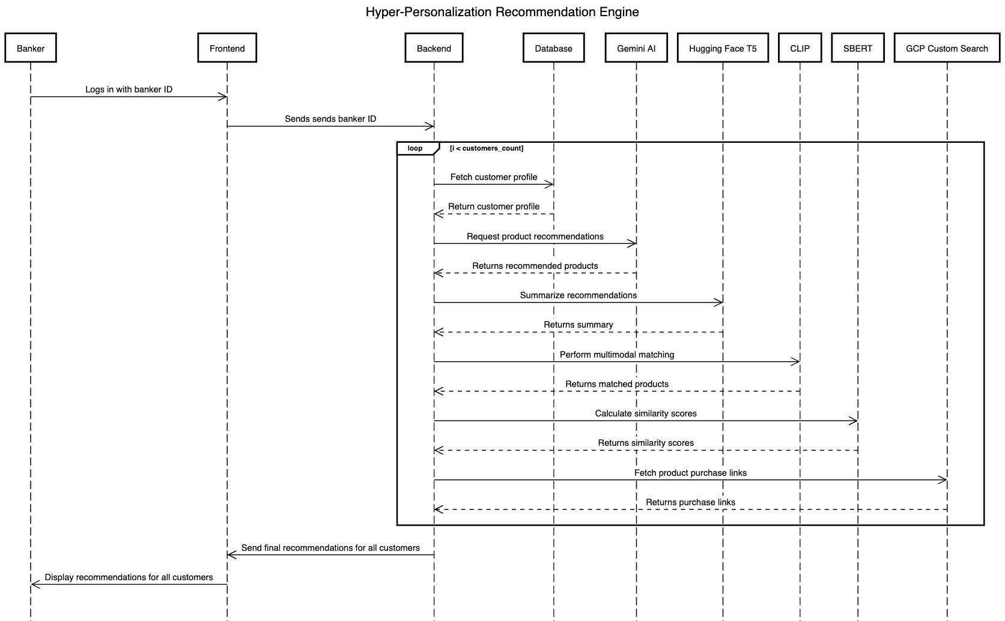
Sequence Diagram (Banker Flow)

Slide 6
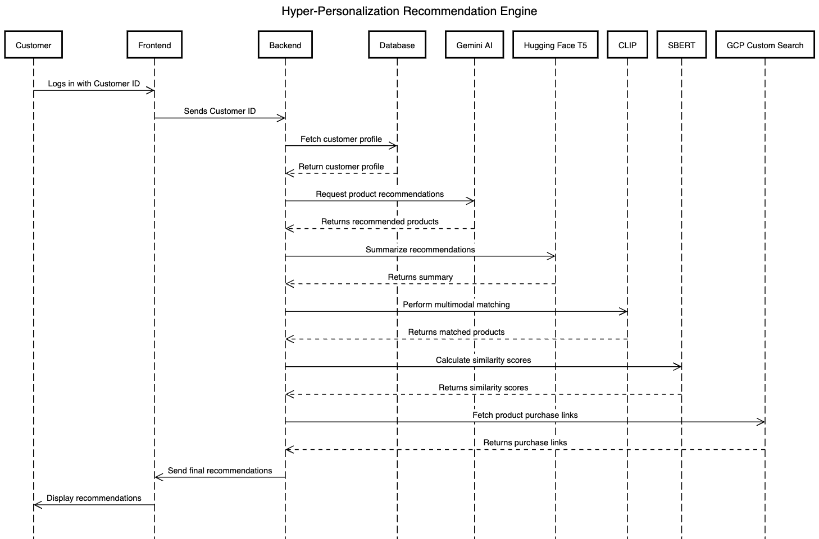
Sequence Diagram (Customer Flow)

Slide 7
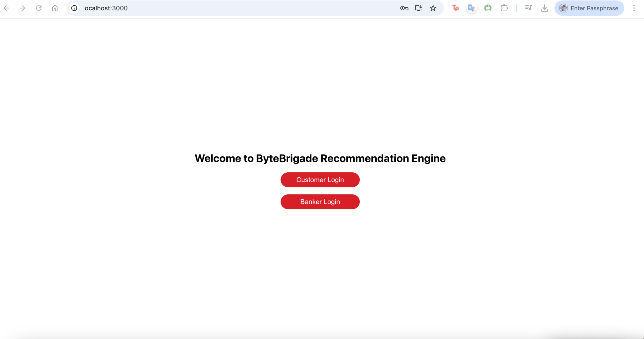
Home Page

Slide 8
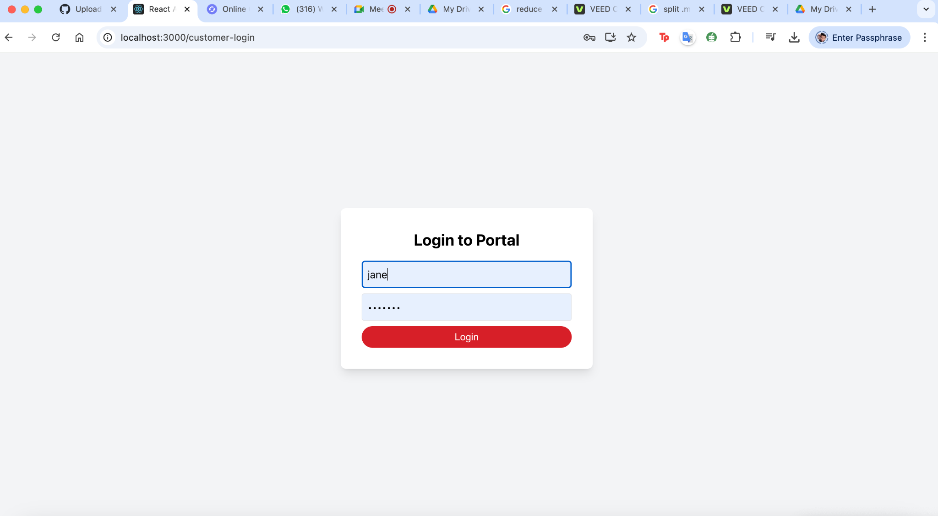
Customer Login

Slide 9
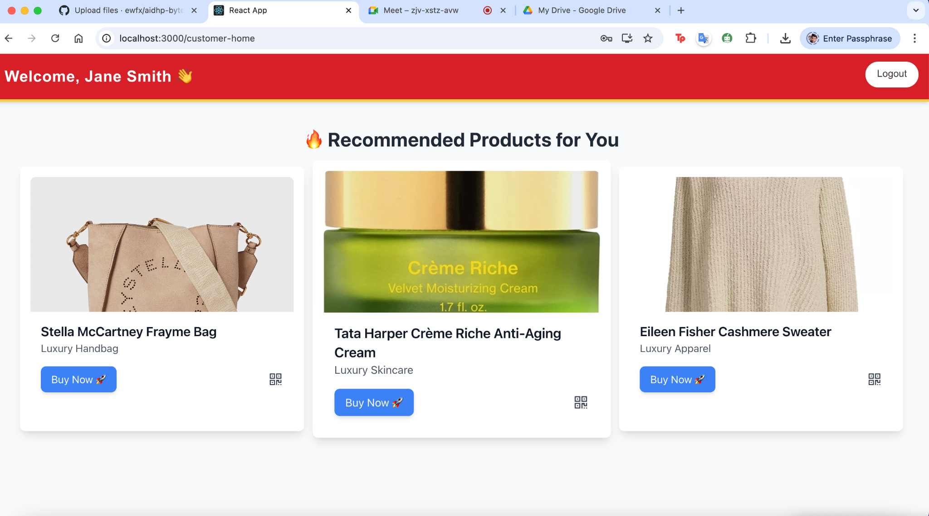
Customer Dashboard

Slide 10
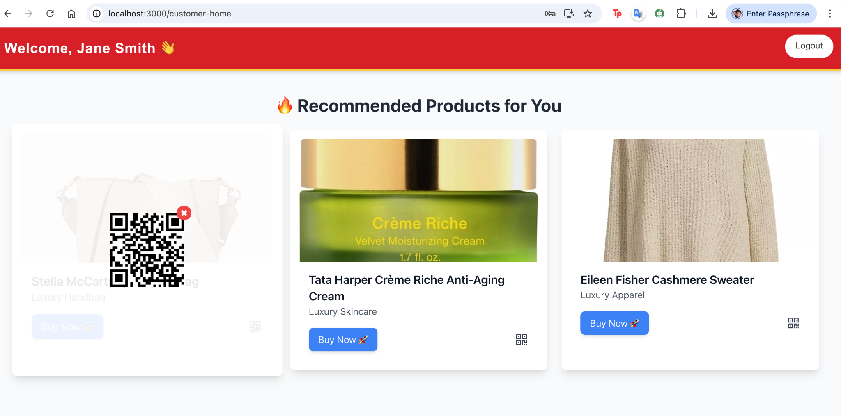
Customer Dashboard (QR Code)

Slide 11
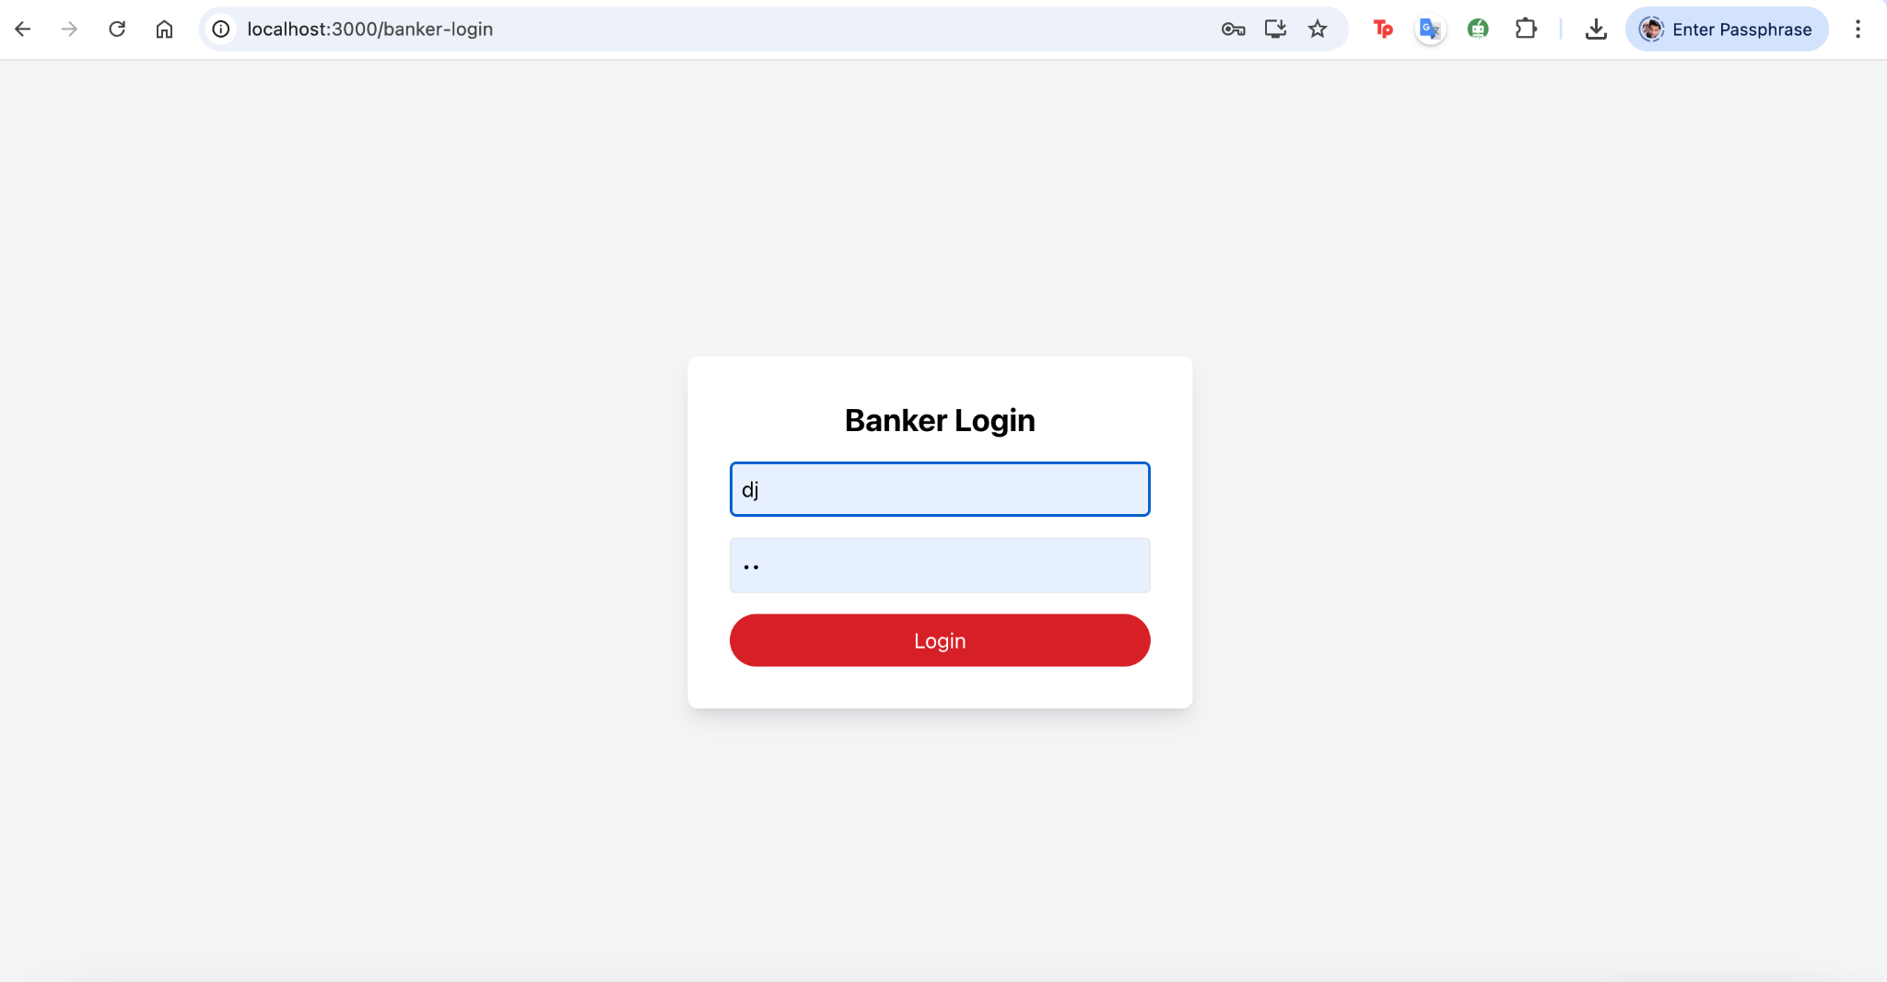
Banker Login

Slide 12
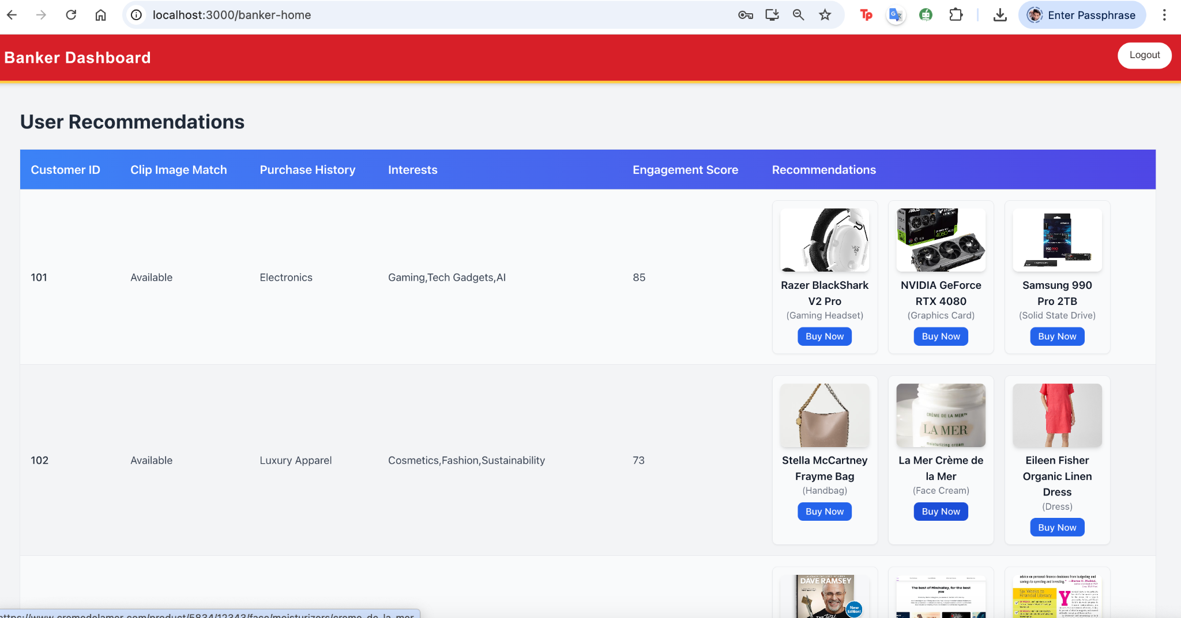
Banker Dashbaord

