Slide 1
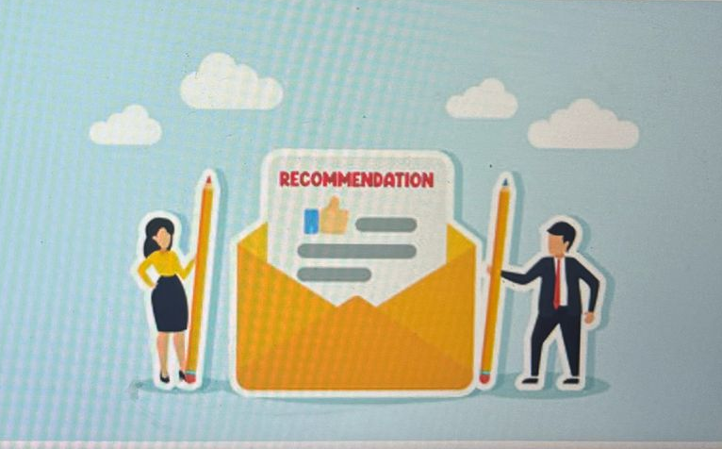
SuggestorX – Your Style, Your Way – Smart Picks Just for You!
Theme: AI-Driven Hyper-Personalization & Recommendations
Technology Hackathon 2025
Code_Sinners Team Members: Nikitha M Ashutosh Kumar Chandan Kumar Himani Negi
Isha Gupta

Slide 2



Problem Statement
Let’s see Bank Side
Let’s see Cusomer Side
Can there be a Platform which can suggest me the right services and , products?

Slide 3
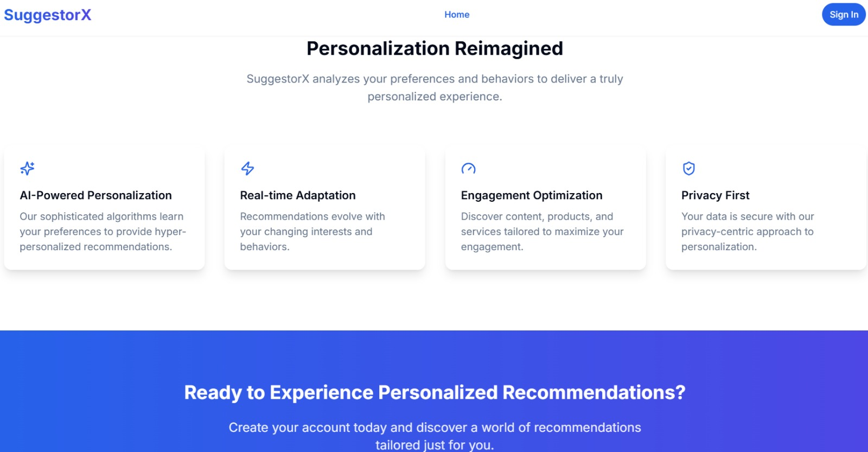
Solution: SuggestorX
A personalized AI Recommendation platform that provides smart picks tailored to individual users

Slide 4

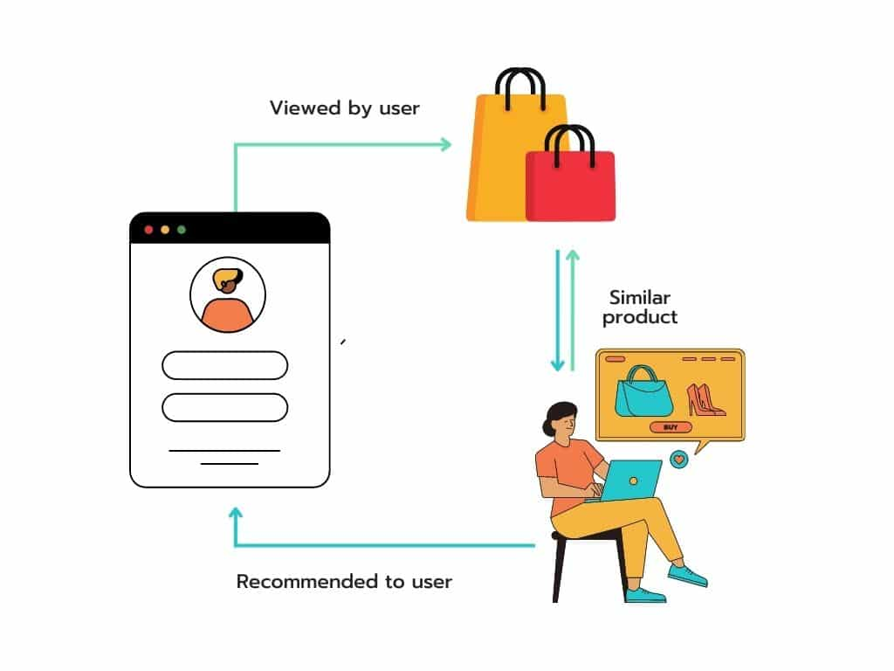

FEATURES
OUTCOME
Smart picks tailored to individual users
Personalized Financial Product Recommendations
Easy profile customization
Recommendations with rewards aligned to spending categories
Engagement and sentiment scoring
Category and preference matching
Transaction history analysis
Multi-factor relevance scoring
Responsive design approach
Real-time adaptation to user behavior and preferences
Cross selling premium financial products
Brand loyalty through anticipatory customer needs
Position is the “Smart Bank” with AI-powered guidance.
FUTURE SCOPE
AI Expansion Opportunities
API for Third-Party Integration
Scalable Recommendation Engine
VALUE ADDS
Increased User Engagement
Higher Conversion Rates
Improved Customer Satisfaction
SuggestorX
Into Market
Loyal Customers

Slide 5
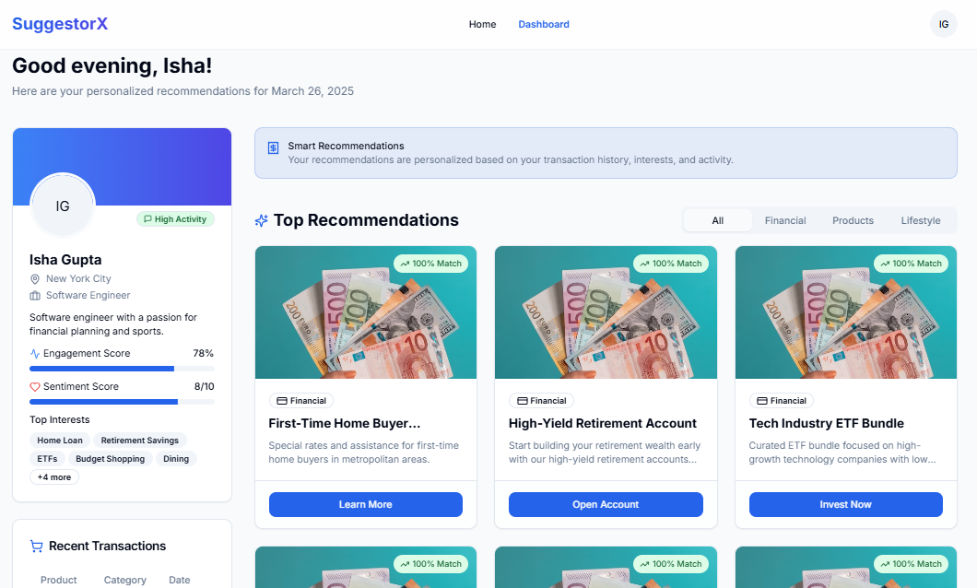
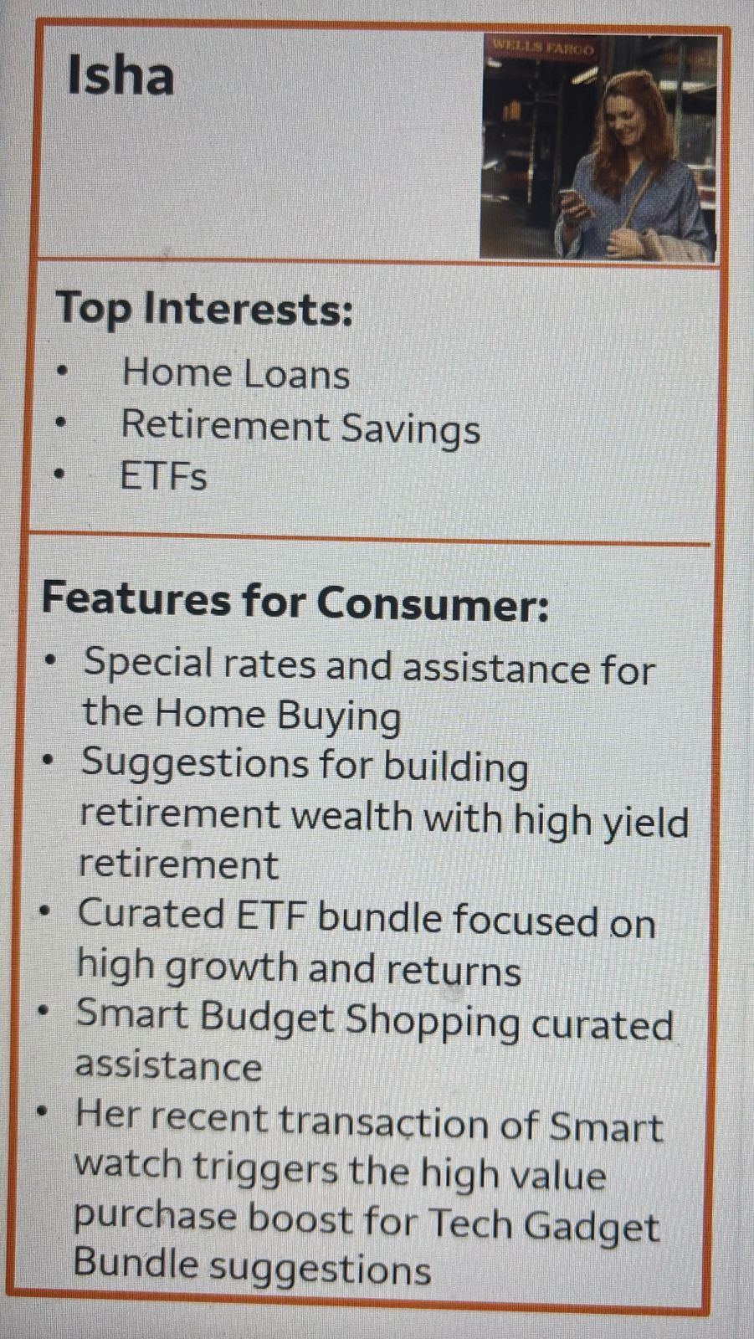
SuggestorX Consumer1

Slide 6
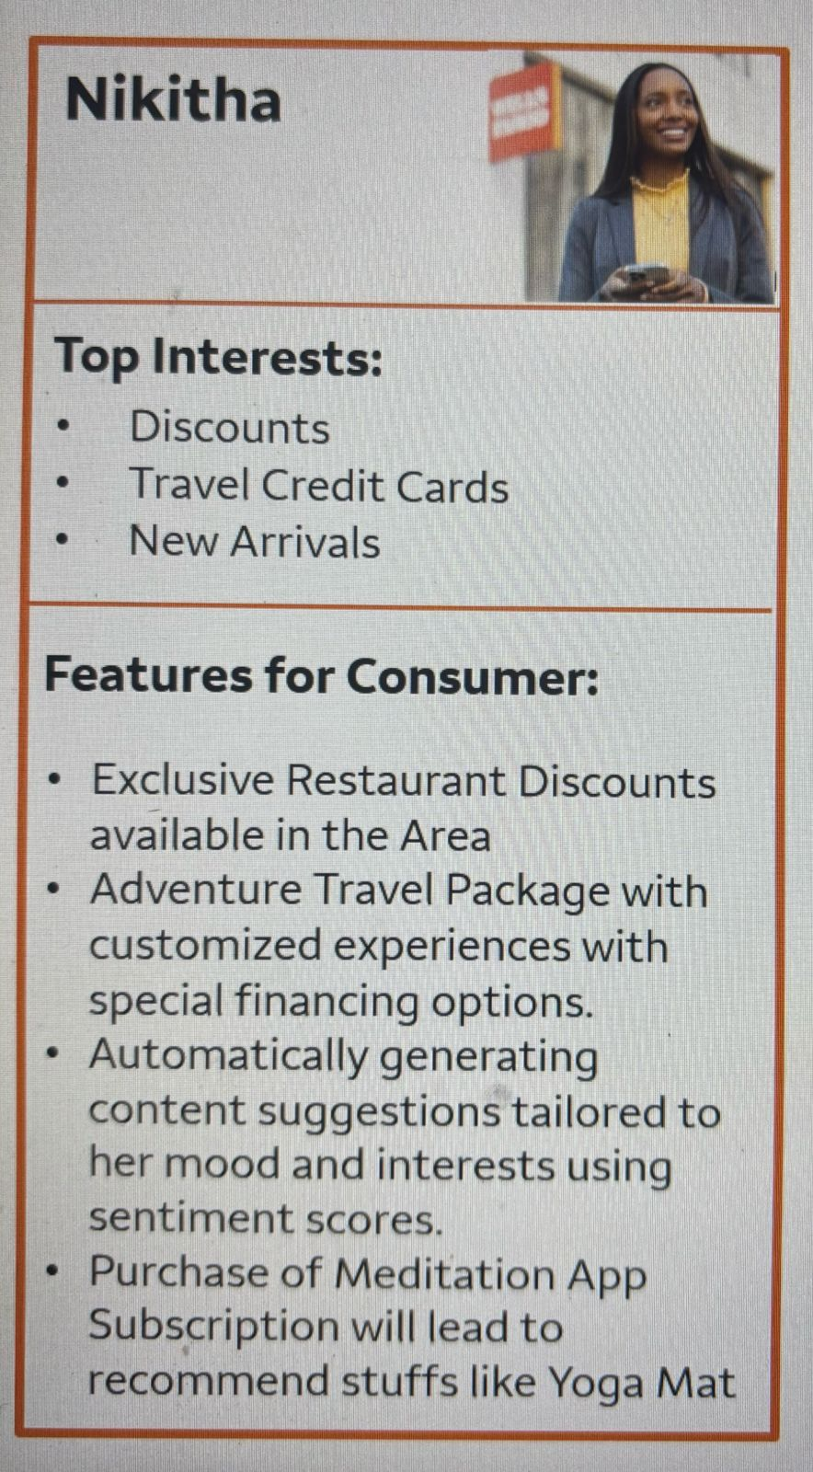
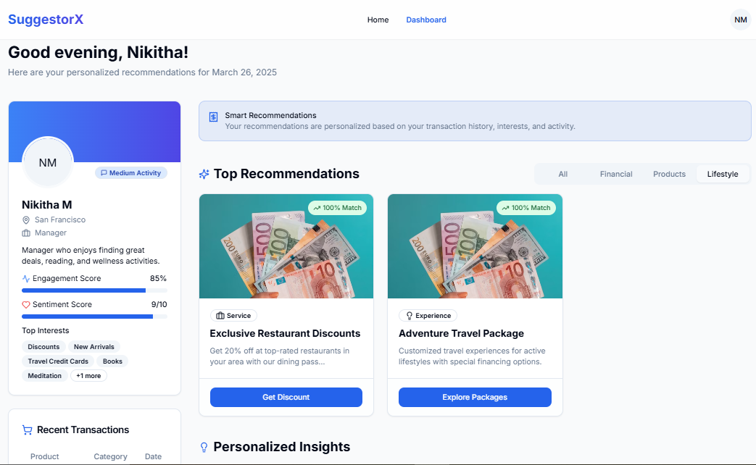
SuggestorX Consumer 2

Slide 7
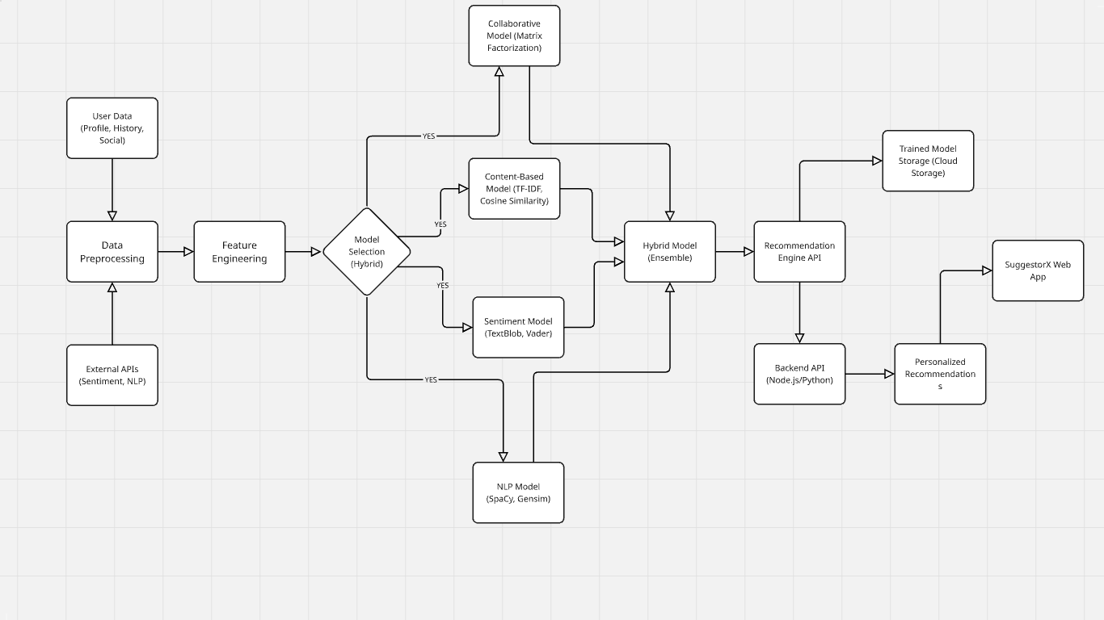
Recommendation Model Architecture
LLM + Knowledge Graph based RAG Real Time Recommendation

Slide 8


