Slide 1
AI-Based Customer Engagement and Personalization System
Technology Hackathon 2025
Team Name – Code Warriors
Veerabhadra Dharmapuri
Mounika Boorugu
Phaninder Pathri
Siva Prasad V Pakala
Vinaya R

Slide 2

Problem Statement
Analyse customer demographics, transactions & social media.
Generate personalized product/service suggestions.
Support new and existing customers.
Enable multimodal (voice, image) input-based Q&A.
Provide actionable insights for businesses.
Notes:
We can remove the right side image. Focus from the problem statement is moved to image. Image is not helping to enhance the problem statement

Slide 3
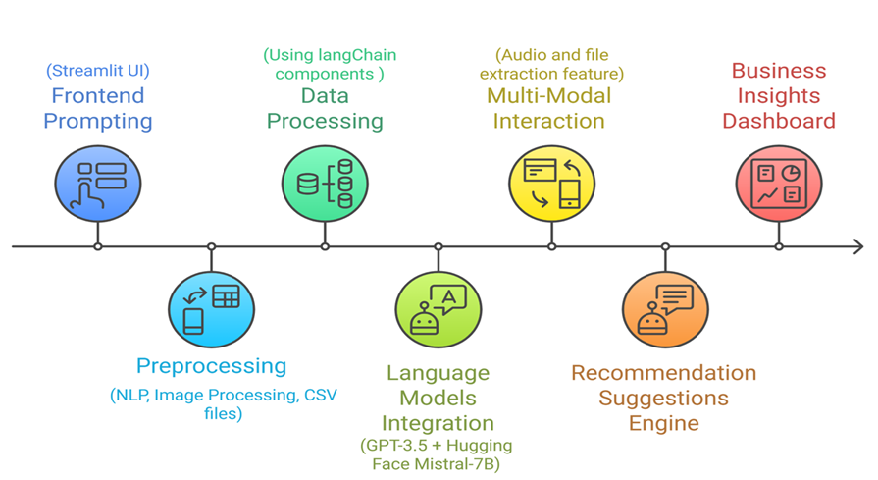
Workflow

Slide 4
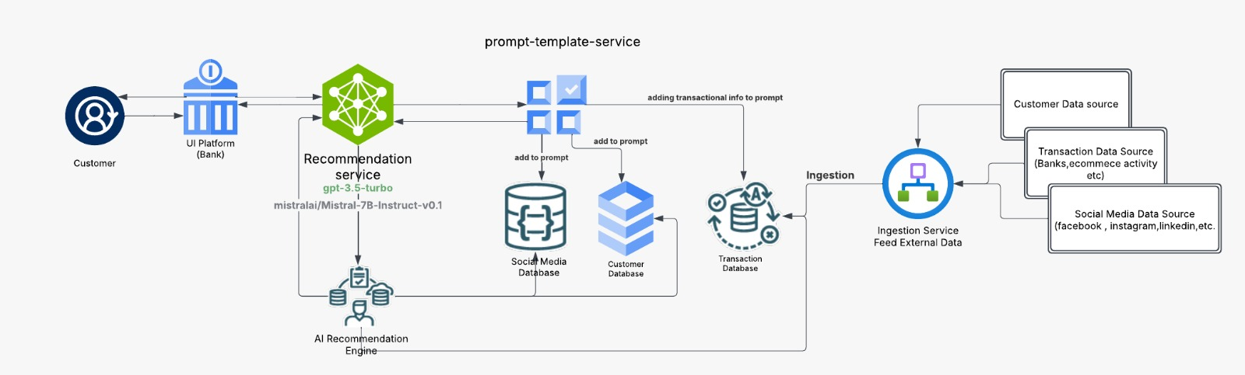
Architecture

Slide 5

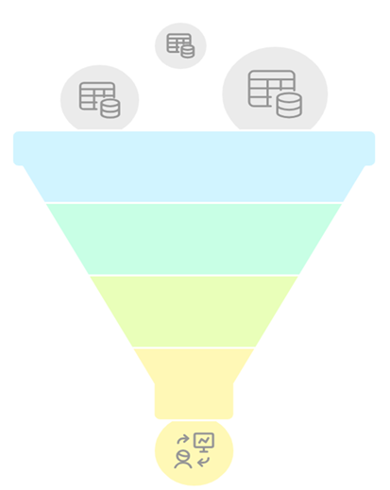



Approach
Data gathering and Processing
Gather customer data from various sources Transactions, Demographics, Social media activities and sentiment data.
Process structured and unstructured data for analysis.
AI-driven understanding
Utilize Generative AI (LangChain + GPT-3.5) to analyze customer behavior.
Extract insights using Natural Language Processing (NLP) and analysis.
Personalized Recommendations
Generate product/service suggestions based on customer profiles.
Ensure multimodal support (text, voice, image inputs).
Actionable insights for businesses to optimize customer engagement.
Insight Implementation
Real-time APIs integration for live recommendations. Iterative model improvement.

Slide 6
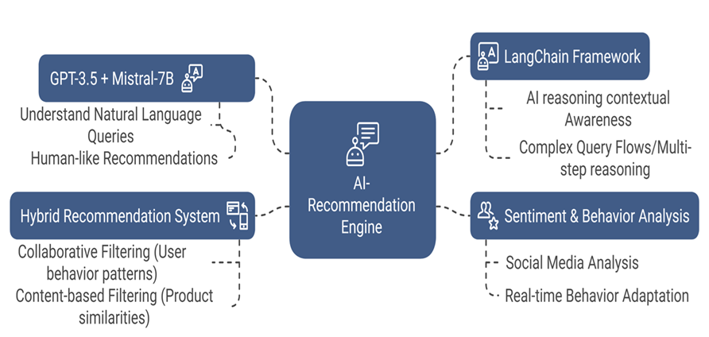
Model Selection
Notes:
This need to be linked for our solution over view
We can add the tech stack slide before this one., as in this slide we are talking about the technologies

Slide 7
Model Benchmarking
Feature | Mistral-7B | GPT-3.5
Model Size | 7B parameters | Larger (exact size proprietary)
Context Length | 8,000 tokens | 16,385 tokens (GPT-3.5 Turbo)
Inference Speed | Faster due to optimized attention mechanisms | Slower due to larger model size
Commonsense Reasoning (MMLU) | Outperforms LLaMA 2 13B | 70%
Reading Comprehension | Strong performance | High-level comprehension
Code Generation (HumanEval) | Close to CodeLlama 7B | Not available
MATH Benchmark | Not available | 43.1%
Operational Cost | $2.67 per ~15.2M tokens (NVIDIA A100 40GB) | Higher computational cost
Availability | Open-source (Apache 2.0) | Proprietary (API access only)
Best Use Cases | Cost-efficient, high-speed inference, scalable workloads | Complex language understanding, high-quality output

Slide 8
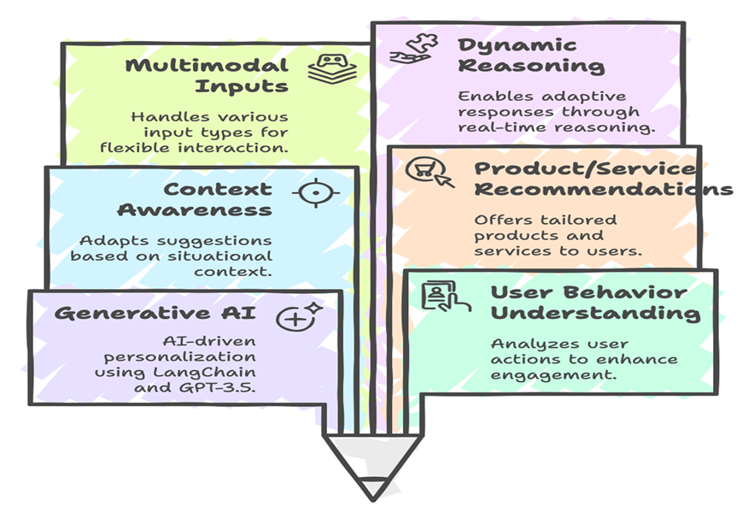
Solution Highlights

Slide 9
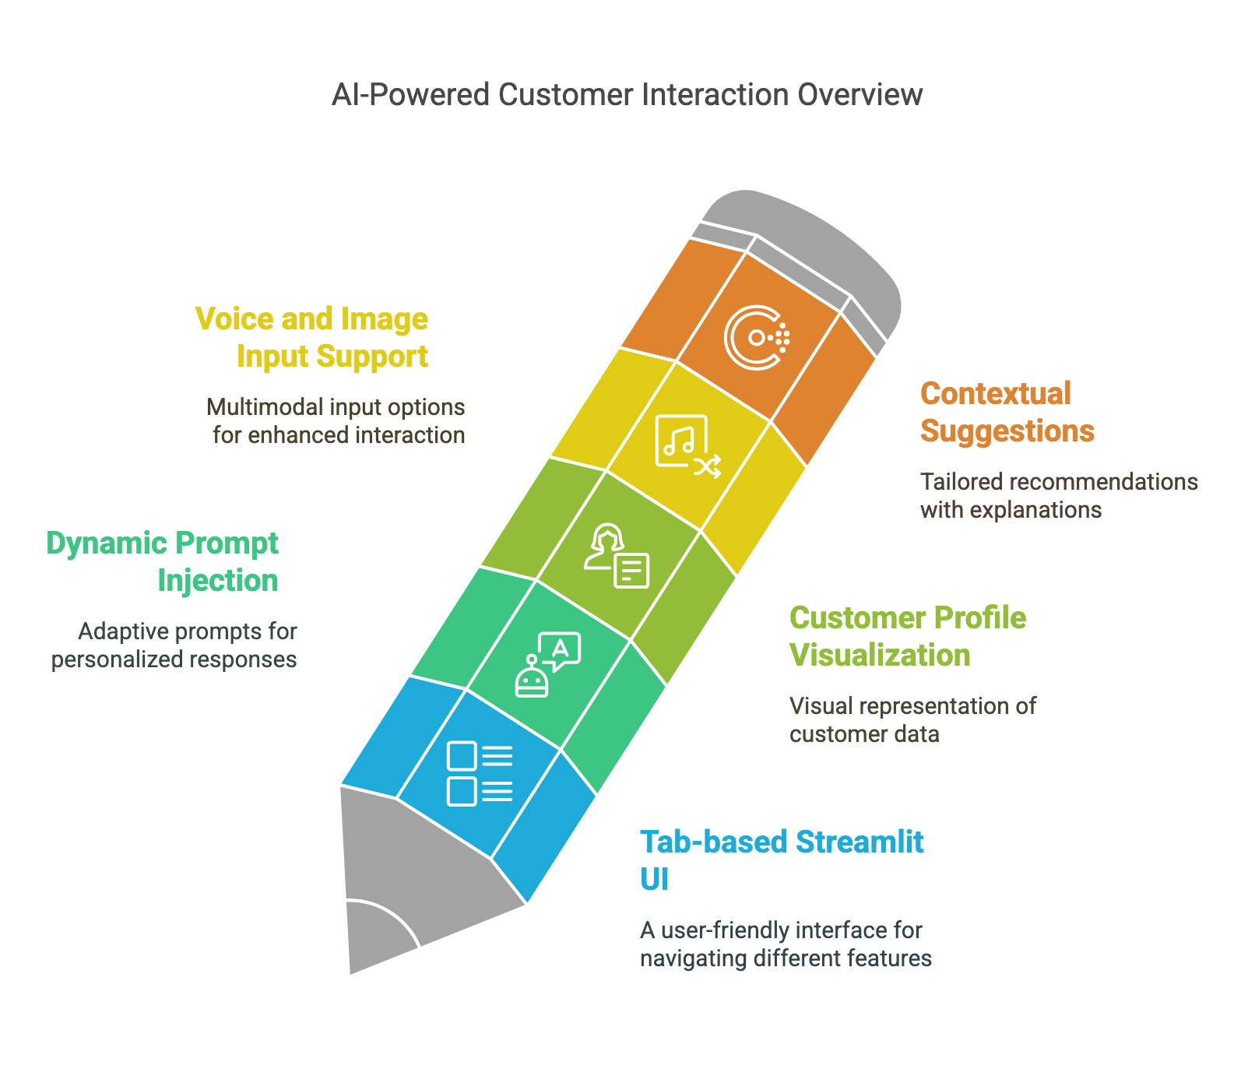
Key Features

Slide 10
Solution Key Features
Fully Completed live running solution hosted on GCP
Multilingual support
User friendly light weight UI
Mobile Interface friendly UI Design
More Accurate with Recommendation
Enabled for all verities of input types text, Audio, image, pdf, docx file input.
Pluggable solution with any platform ( Banking, E-Commerce, Social Media)

Slide 11
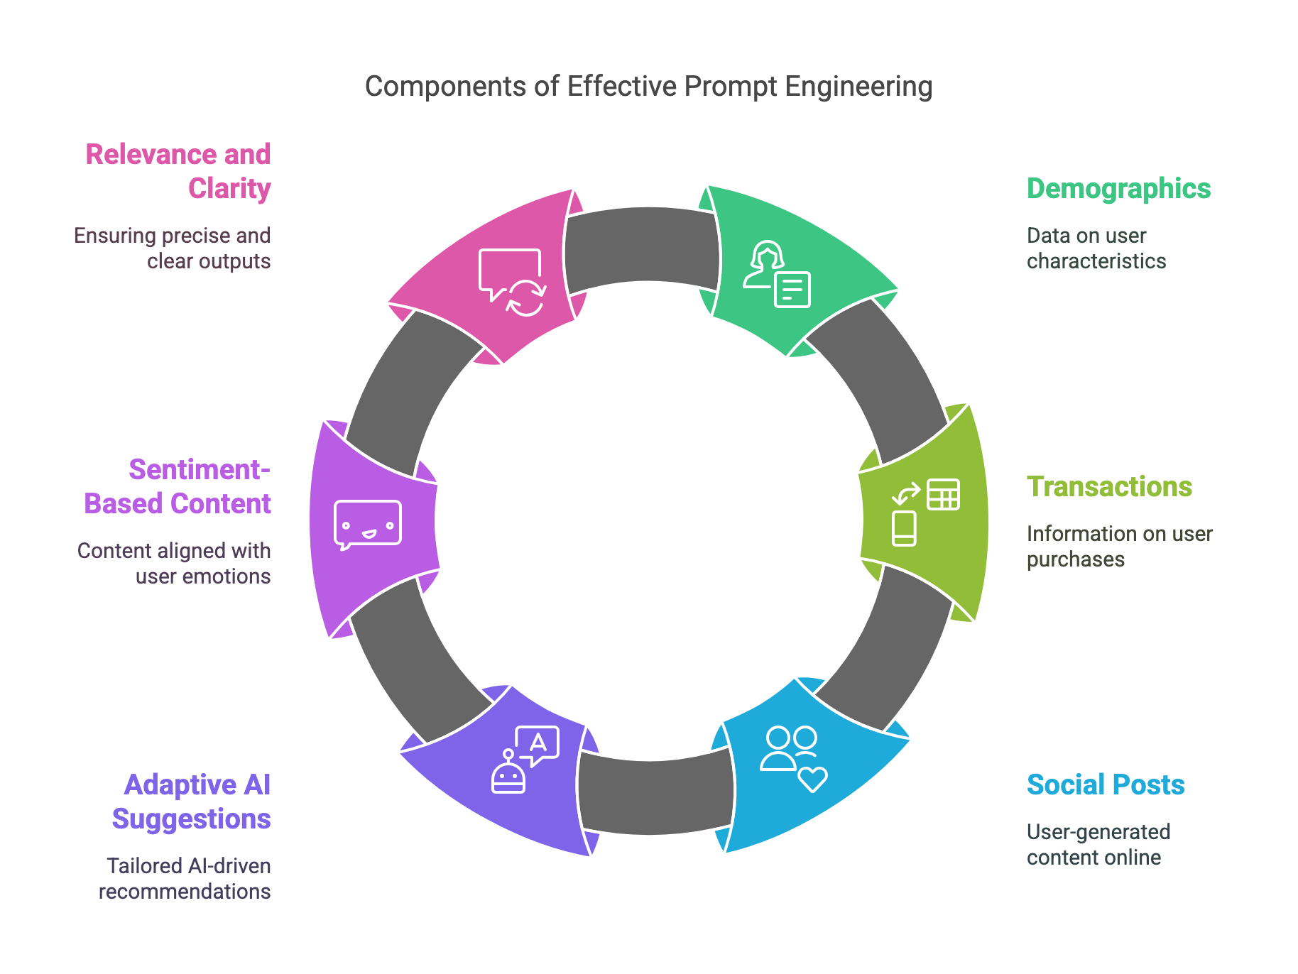

Slide 12
Tech Stack
Layer | Tools Used
LLM Integration | LangChain, OpenAI GPT-3.5, Mistral-7B (Hugging Face)
Frontend | Streamlit
Backend | FastAPI
Data Processing | Pandas, JSON, Sentence Transformers
Audio Input | SpeechRecognition, SoundDevice
OCR Input | PaddleOCR

Slide 13
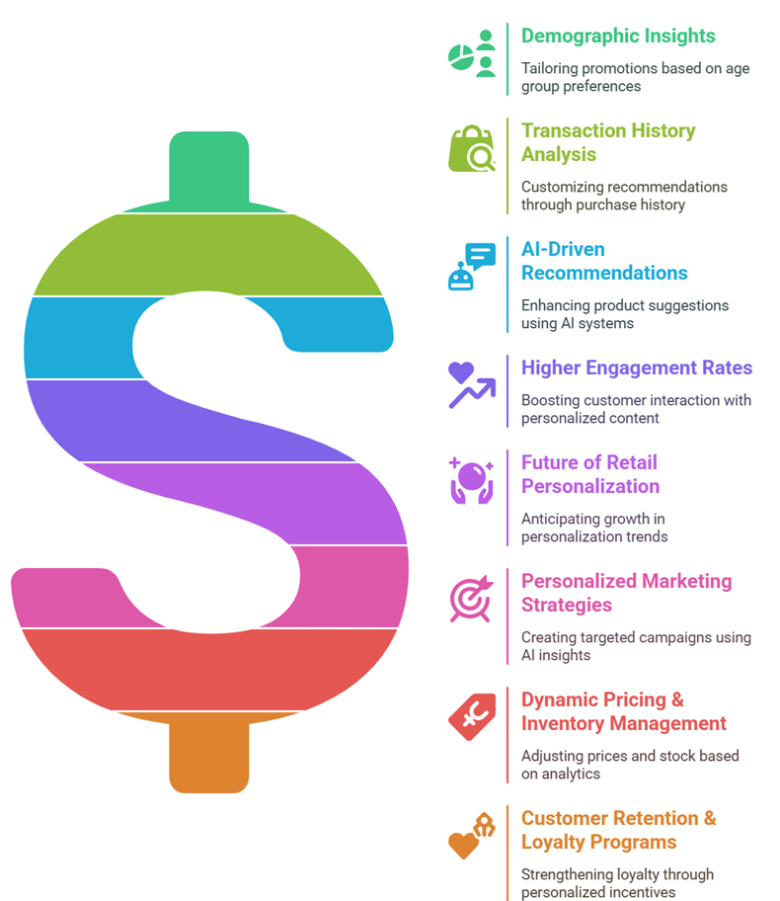
Benefits

Slide 14
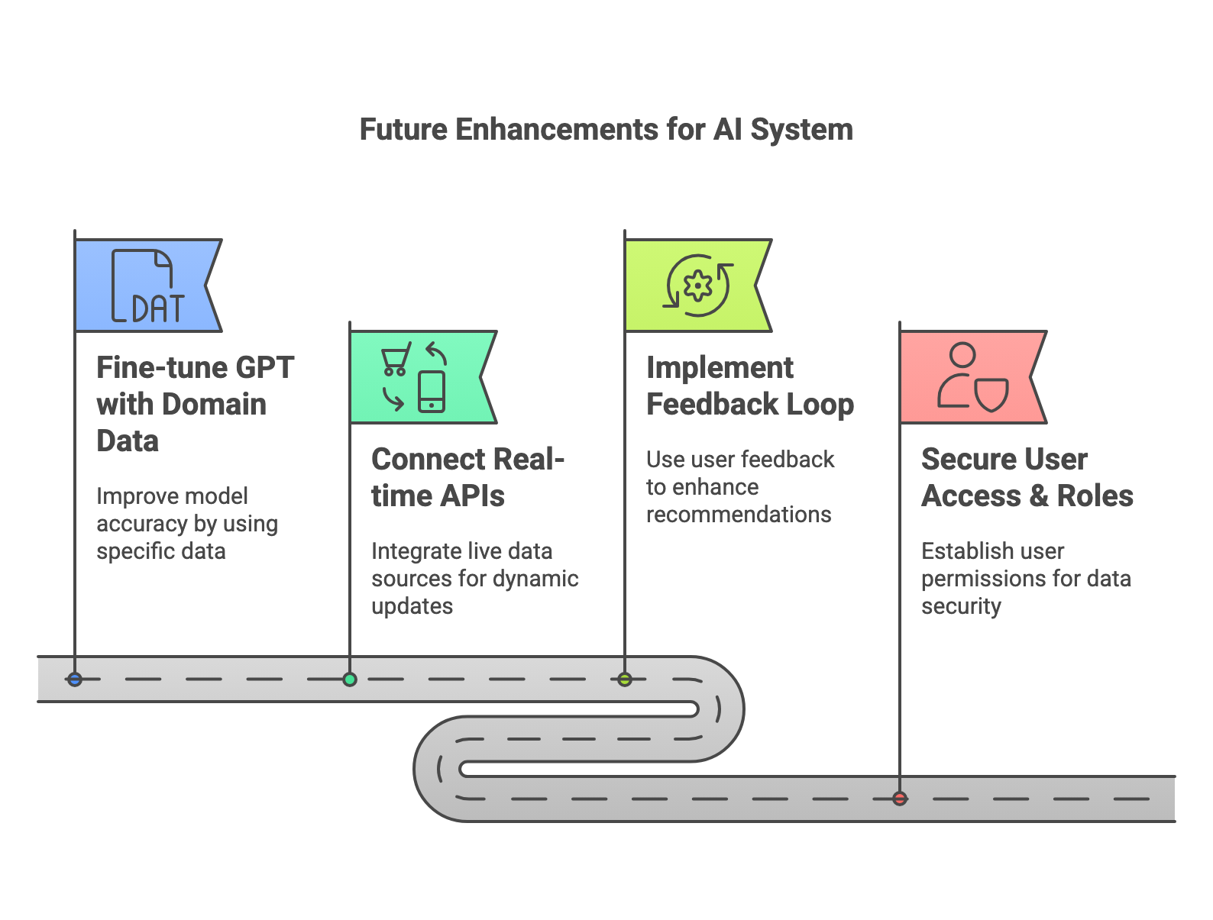
Future Enhancements

Slide 15
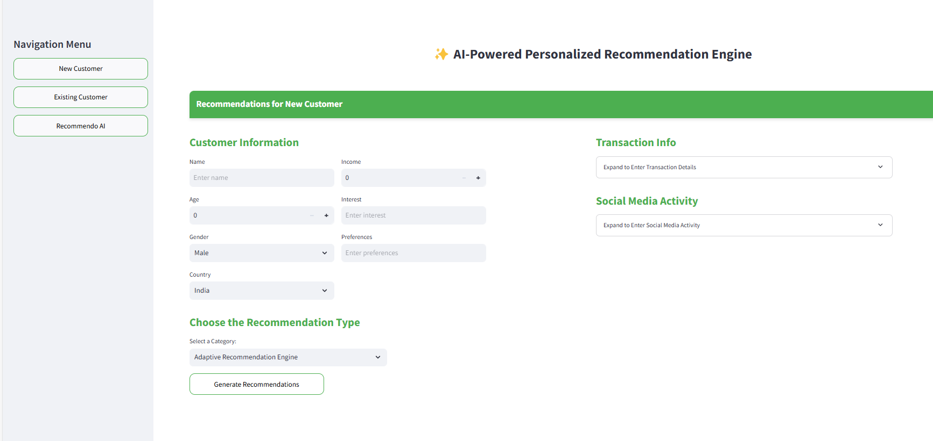
Application - Home Page

Slide 16
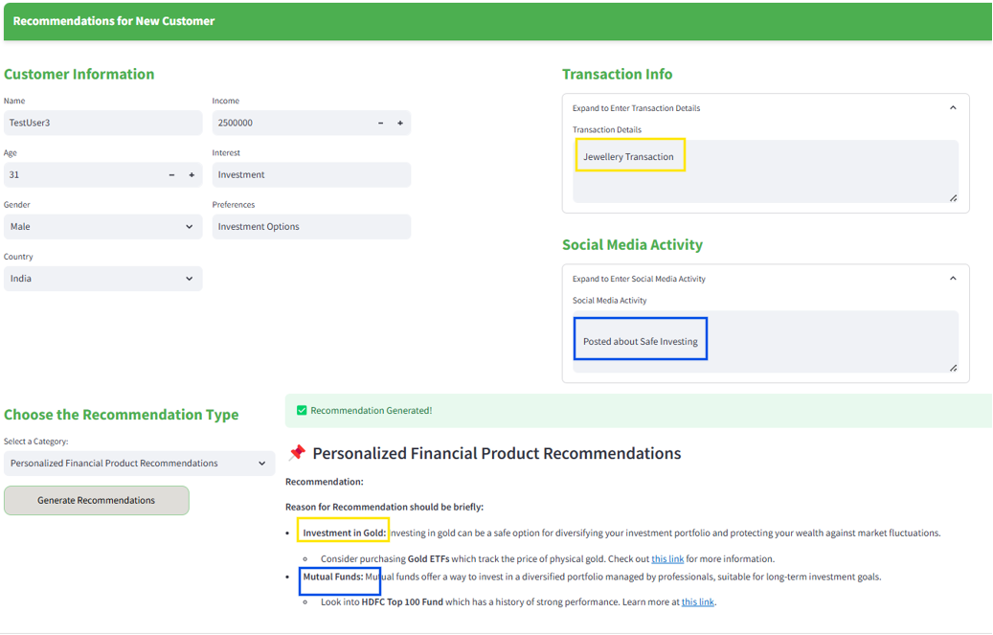
Recommendations for New Customer

Slide 17
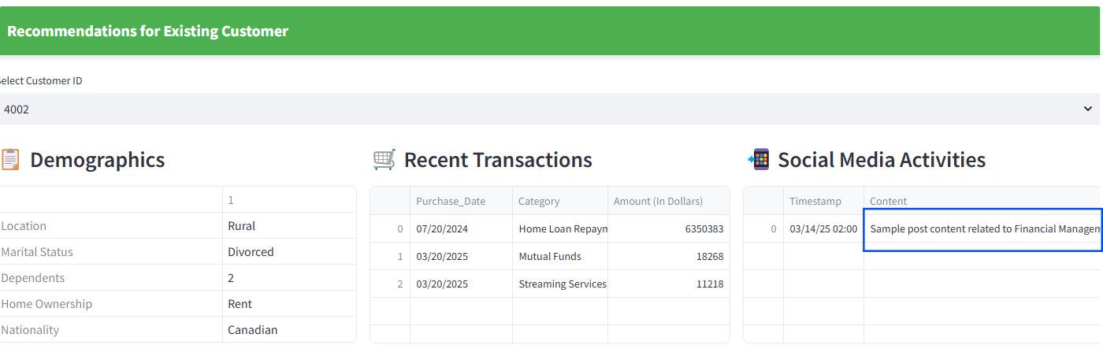
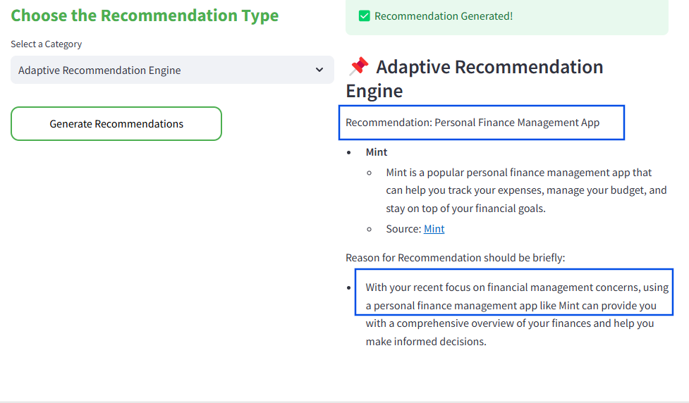
Recommendations for Existing Customer

Slide 18
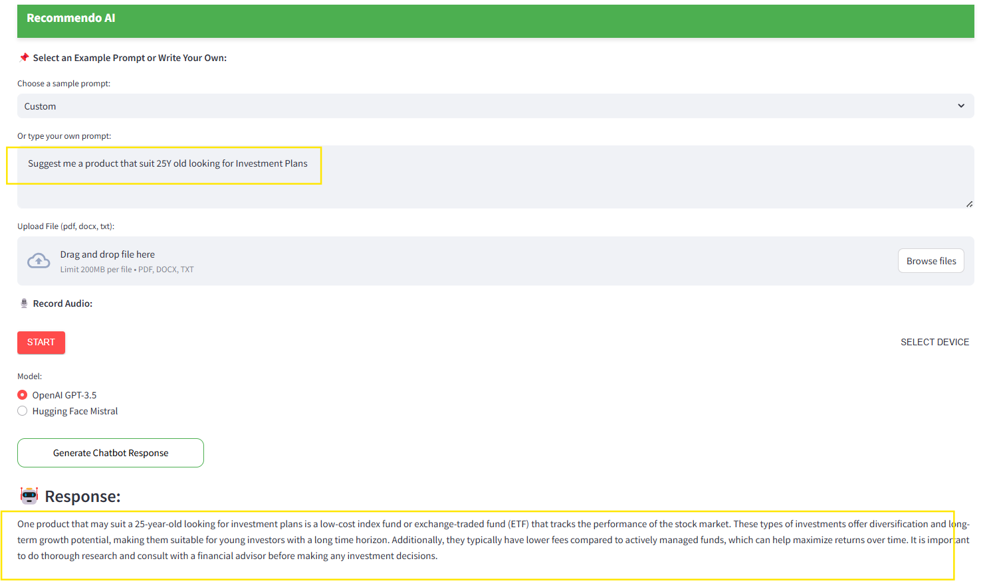
Recommendo AI

