Slide 1

AI-Based Customer Engagement and Personalization System
Technology Hackathon 2025
Team Name – Code Warriors
Veerabhadra Dharmapuri
Mounika Boorugu
Phaninder Pathri
Siva Prasad V Pakala
Vinaya R

Slide 2

Challenge Statement
Analyse customer demographics, transactions & social media.
Generate personalized product/service suggestions.
Support new and existing customers.
Enable multimodal (voice, image) input-based Q&A.
Provide actionable insights for businesses.

Slide 3
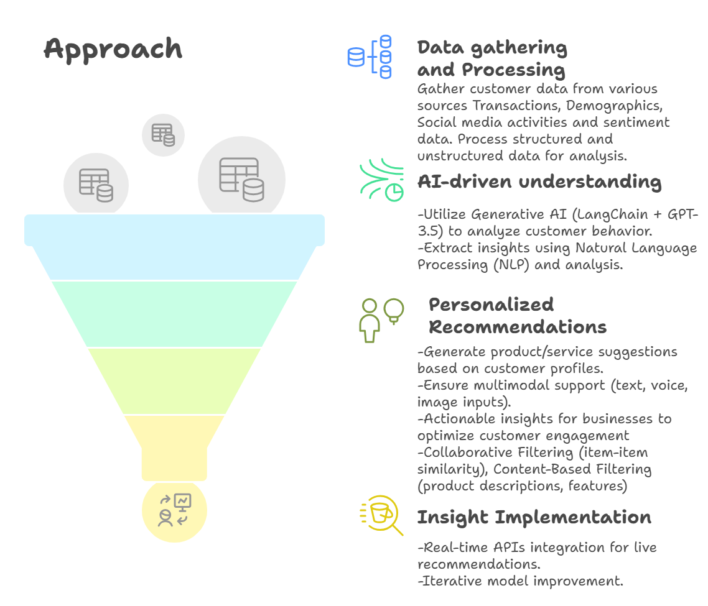

Slide 4
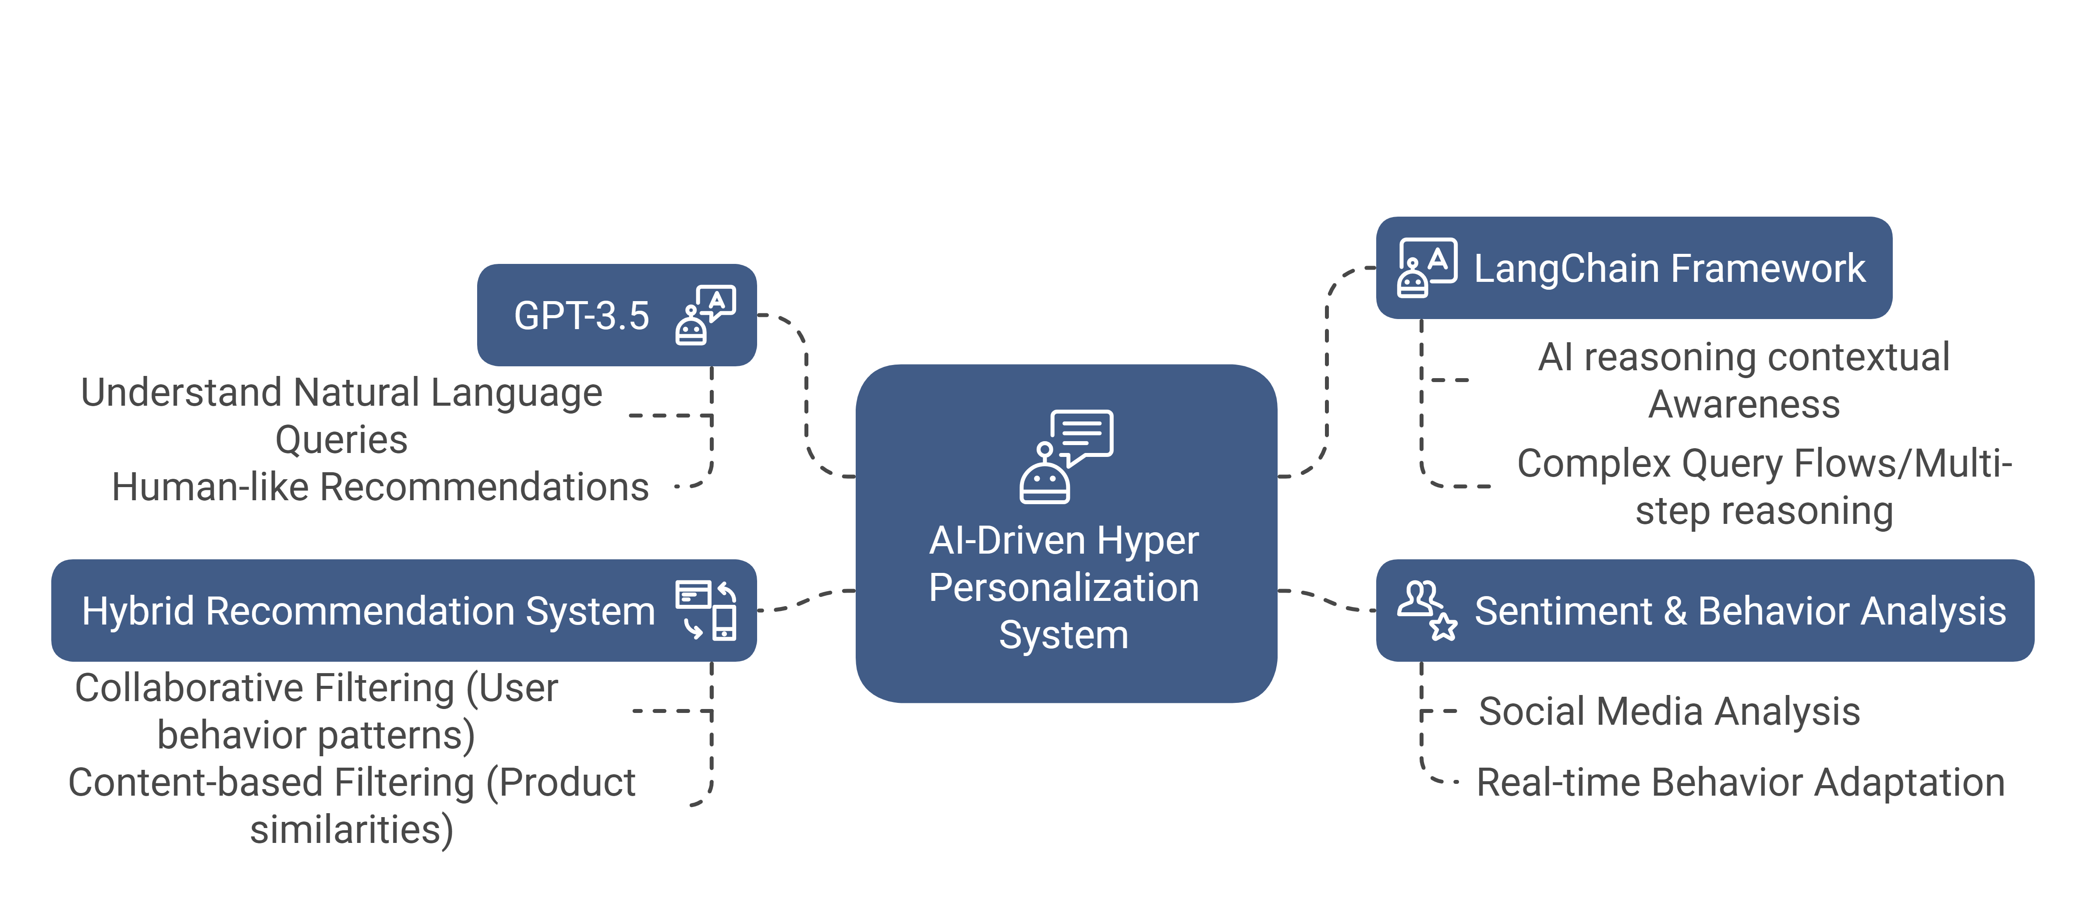
Model Selection

Slide 5
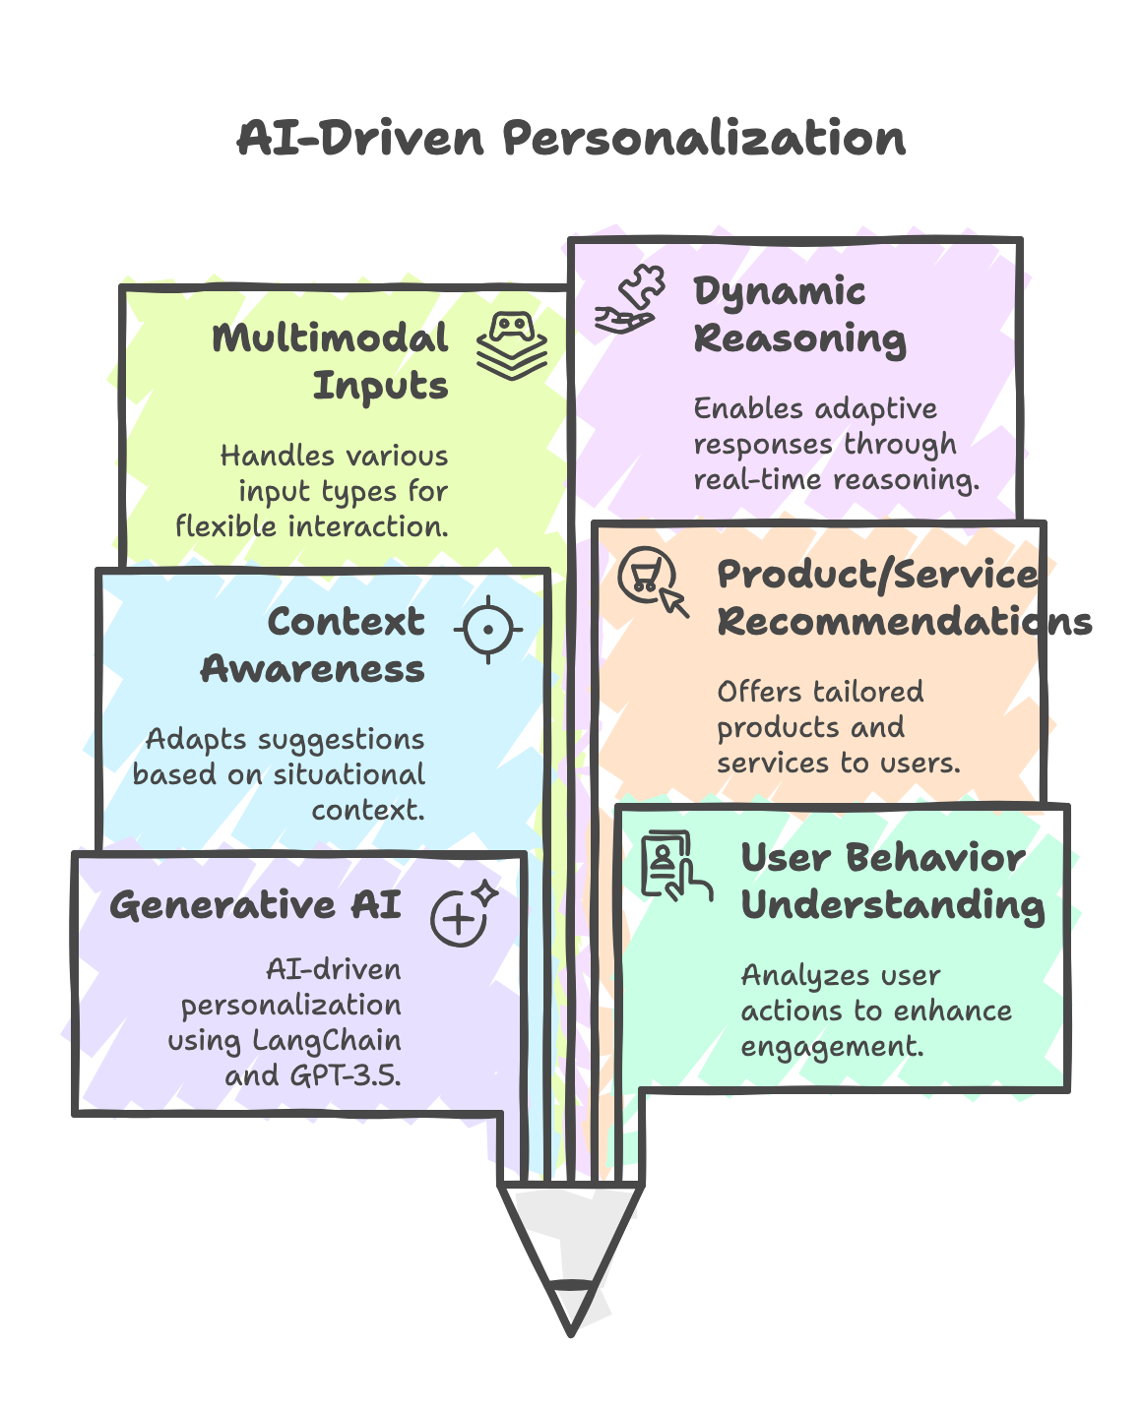
Solution Overview
• Built using Generative AI (LangChain + GPT-3.5).
• Understands user behavior & context.
• Suggests relevant products/services & content.
• Supports multimodal inputs and dynamic reasoning.

Slide 6
Tech Stack
Layer | Tools Used
LLM Integration | LangChain, OpenAI GPT-3.5
UI | Streamlit
Data Processing | Pandas, JSON, Sentence Transformers
Audio Input | SpeechRecognition, SoundDevice
OCR Input | PaddleOCR

Slide 7
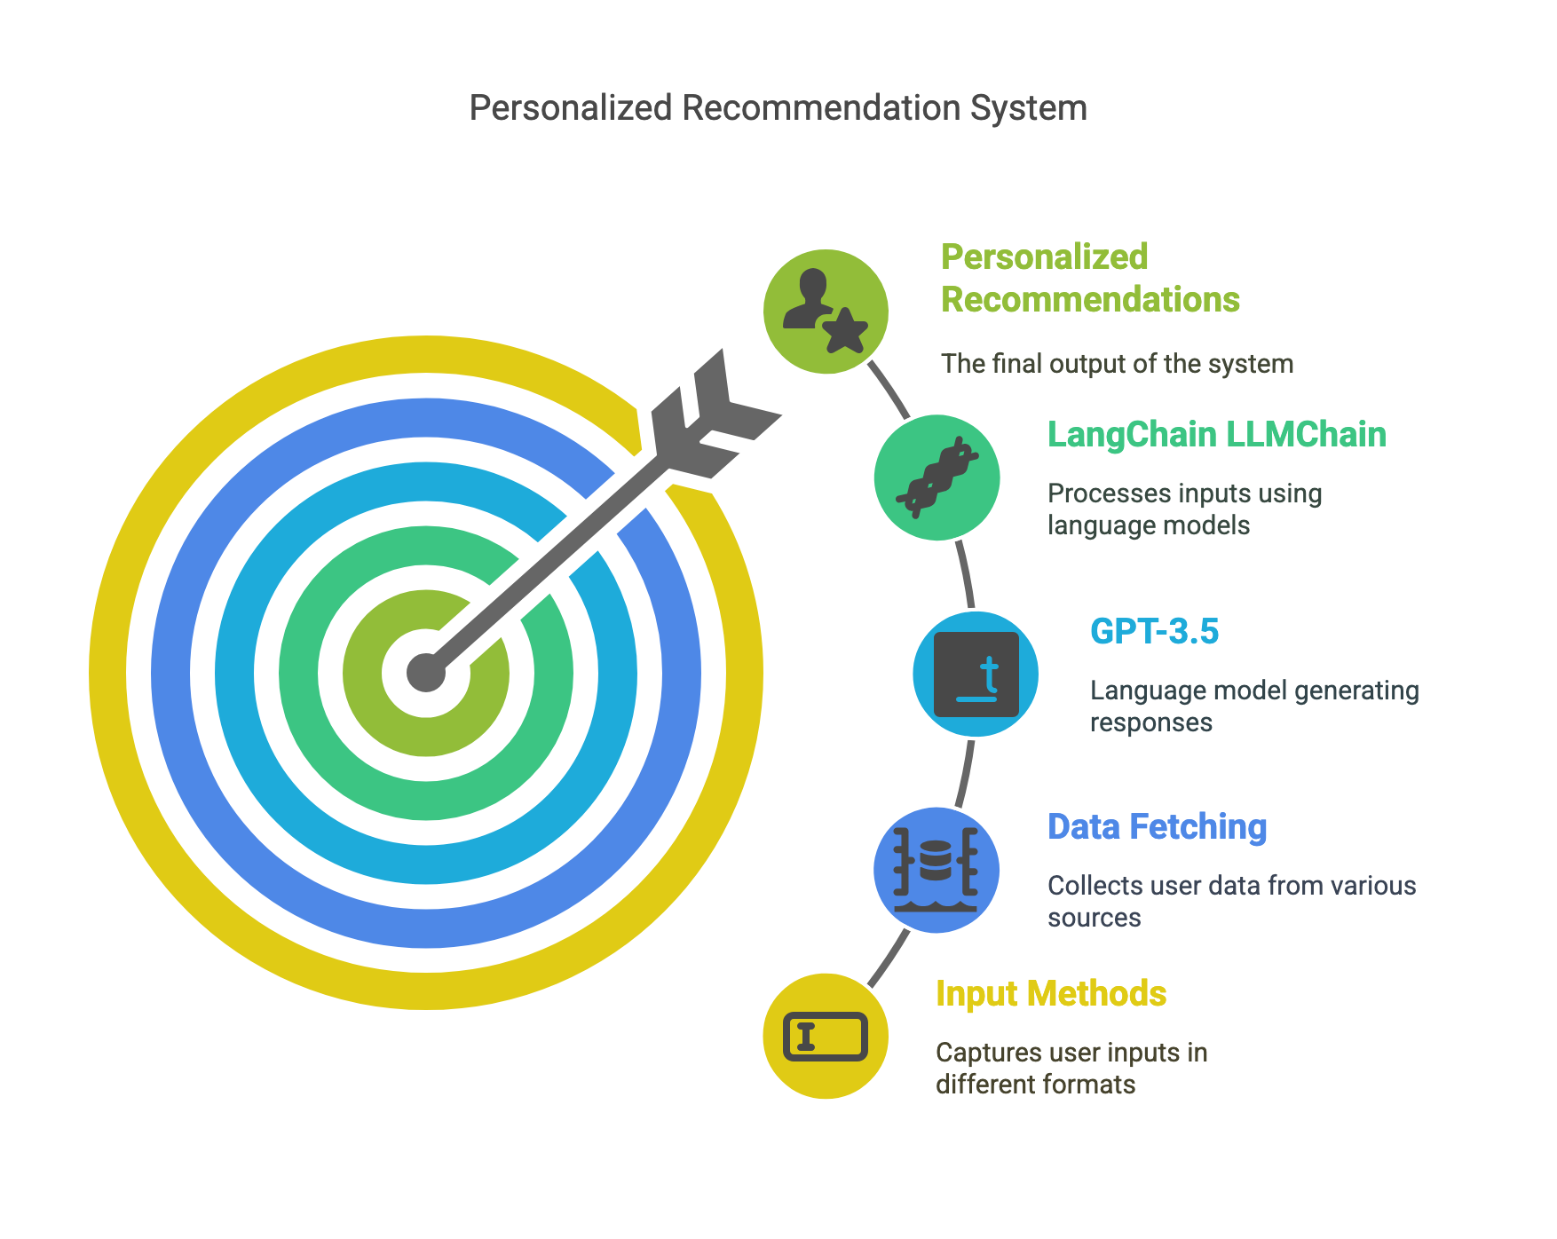
How it works ?

Slide 8
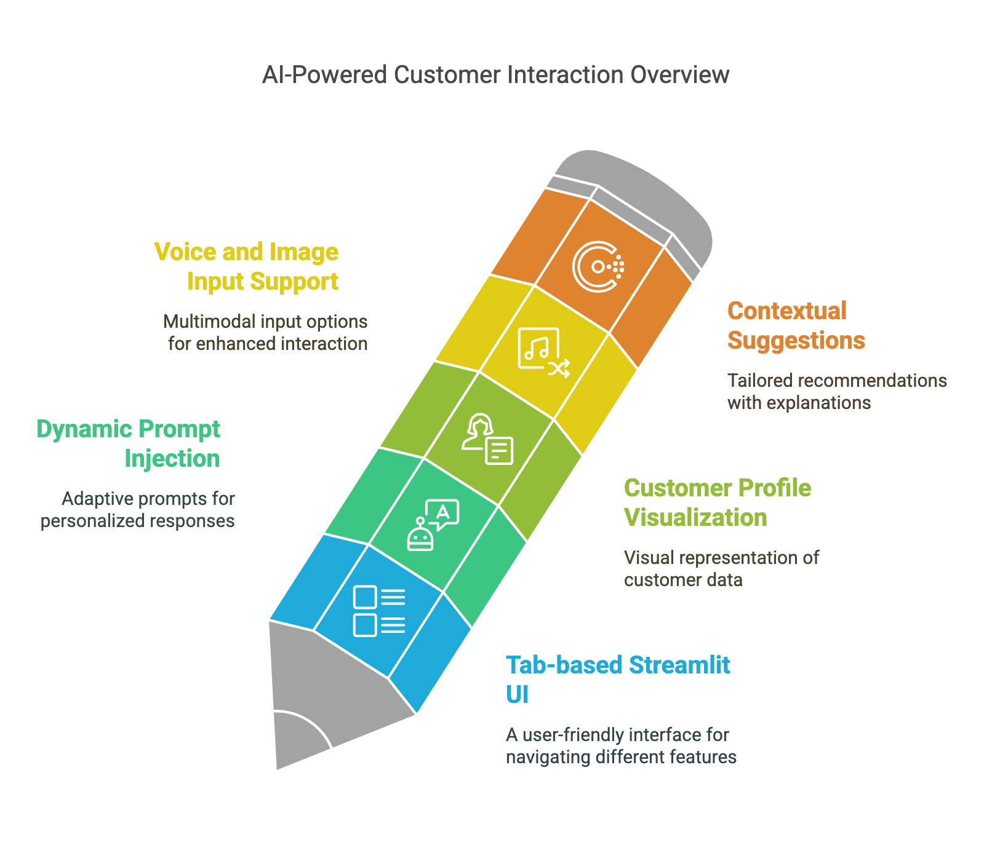
Key Features

Slide 9
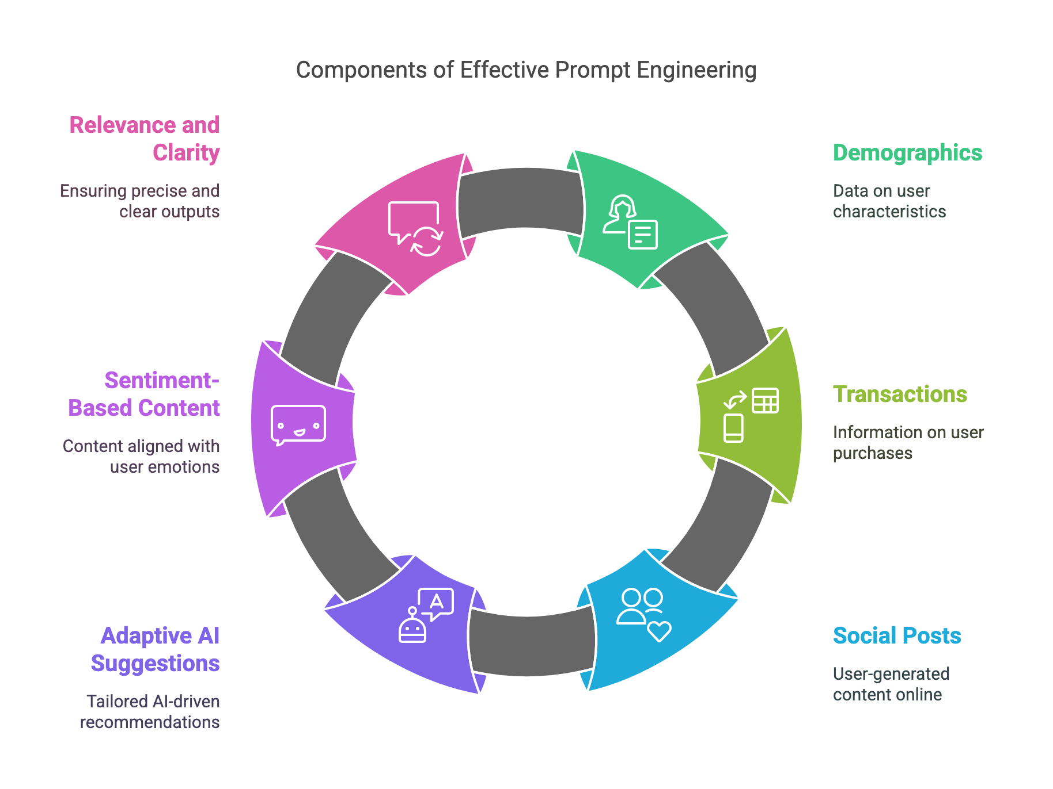

Slide 10
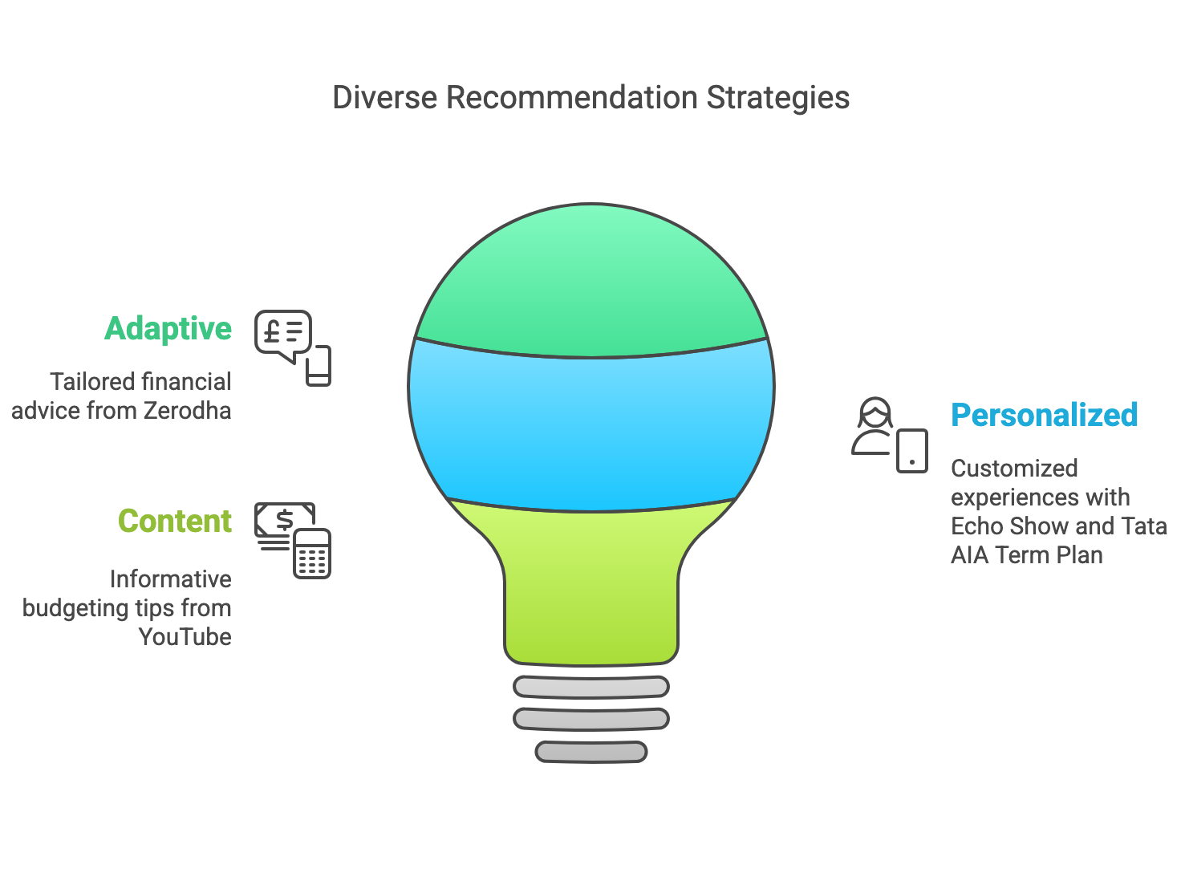

Slide 11
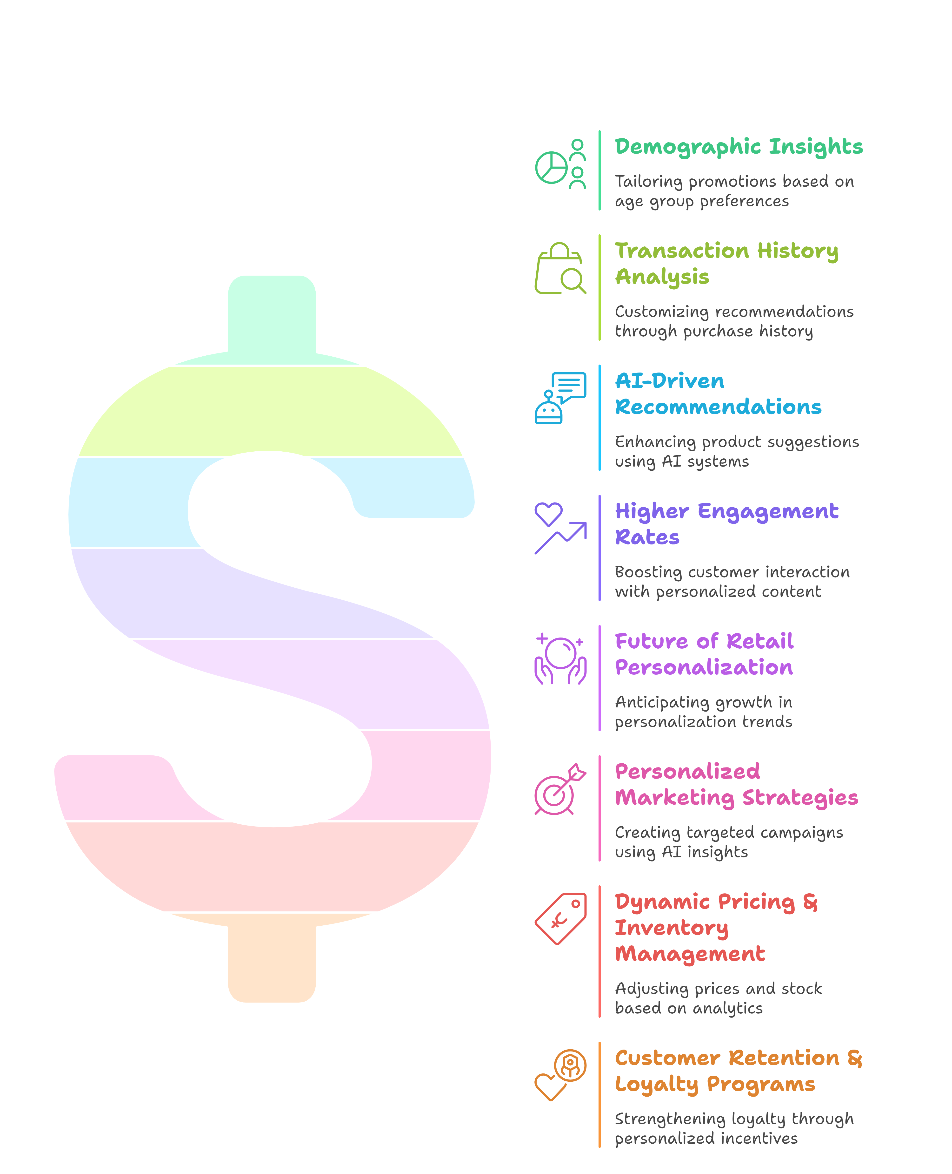
Business Recommendations on AI Findings

Slide 12
Challenges & Solutions
Challenge | Solution
Prompt tuning | Structured LangChain template
Structured rendering | Markdown + HTML in Streamlit
Voice & OCR input | Used SpeechRecognition & PaddleOCR
Token limits | Summarized fields and reduced payload

Slide 13
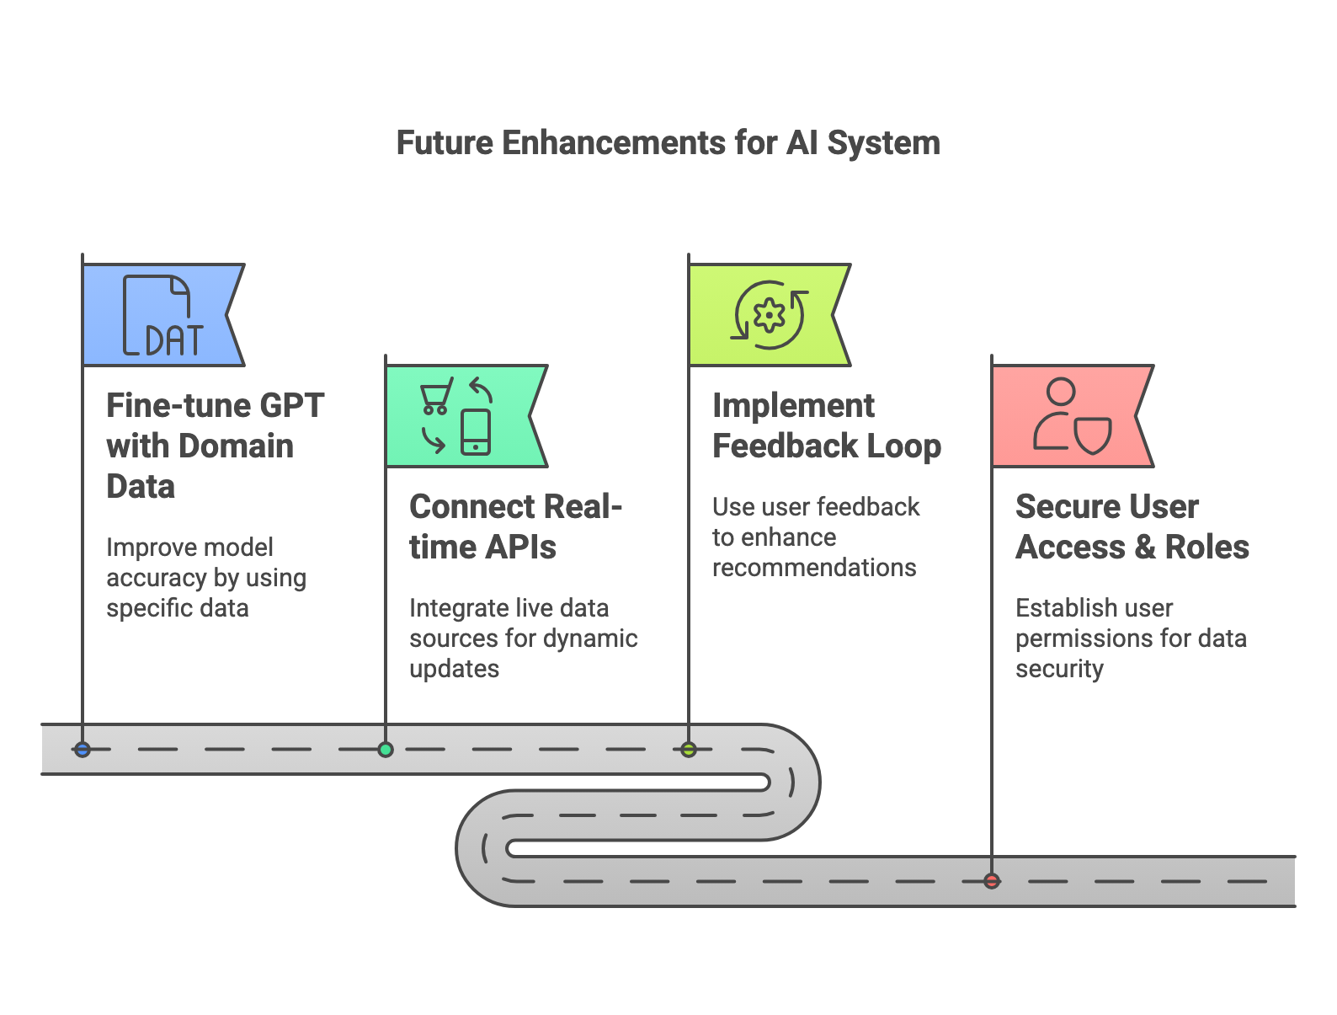
Future Enhancements

