Slide 1
Generative AI for Hyper-Personalization & Recommendations
Enhancing Customer Engagement with AI-Driven Insights
- By Ctrl-Human-AI Team
Mudigondla Laxminarayana, Jampana Krishnaveni, Bezawada Kiranmai M, Kurma Ravi S, Tikka Rajesh

Slide 2
Problem Statement
In today's competitive financial landscape, banks and fintechs struggle to deliver truly personalized recommendations, often relying on generic product matching that fails to account for customers' unique financial behaviors, social sentiment, and visual preferences. This leads to low engagement, missed cross-selling opportunities, and higher churn rates.
Our AI-driven Hyper-Personalization Dashboard solves this by combining multi-modal data analysis transaction history, social media sentiment, and image-based preferences with machine learning to generate dynamic, compliance-safe recommendations. By leveraging CLIP for visual matching, sentiment analysis for emotional insights, and predictive modeling for risk-aware suggestions, the system delivers smarter, faster, and more relevant financial guidance, boosting customer satisfaction while providing actionable insights and maximizing conversion rates.

Slide 3
Importance of Hyper-Personalization & Business impact of effective personalization
Hyper-personalization is a step beyond traditional personalization which leverages real-time data, AI, machine learning models, and advanced analytics to deliver highly tailored experiences, products, and services to individual users based on their unique preferences, behaviors, and needs.
Enhanced Customer Experience
Improved Conversion Rates & Sales
Stronger Customer Retention & Loyalty
Increased ROI on Marketing & Engagement Efforts
Competitive Advantage
Data-Driven Decision Making
Supports Omnichannel Strategy

Slide 4
Approach Overview
Solution Overview: AI-Driven Hyper-Personalization System
To build an advanced, real-time AI system that delivers hyper-personalized product, service, and content recommendations by analyzing diverse customer data points such as profiles, purchase history, sentiment, social activity, and demographics while also providing actionable business insights.
Architecture Overview:
System Architecture:
Data flow: Collection → Processing → AI Analysis → Recommendations
AI Components: LLMs, Transformers, Fine-Tuned Models

Slide 5
Features & Implementations Details
Feature | Implementation | Navigation
AI-Generated Product/Service Suggestions | Fine-tuned LLM for personalized recommendations. | Recommendations
Sentiment-Driven Content Recommendations | Sentiment analysis model for content recommendations. | Sentiment Analysis
Predictive Customer Insights | Machine learning model for churn prediction. | predictive Insights
Multi-Modal Personalization | Multi-modal model (CLIP) for text-image matching. | Multi-Modal Recommendations
Hyper-Personalized Financial Product Recommendations | Rule-based system or fine-tuned LLM for financial product recommendations. | Recommendations
Business Strategies and Insights | Clustering algorithm (K-Means) for customer segmentation and strategies. | Business Insights

Slide 6
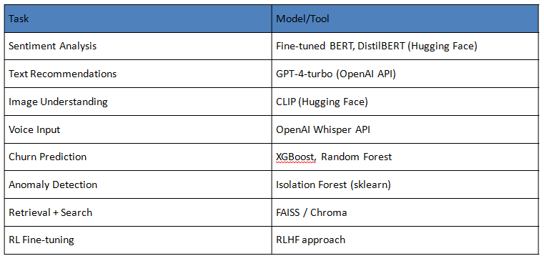
Key AI Models & Tools
Free-Tier Models -
Hugging Face Models:
GPT-J, GPT-Neo, LLaMA 2, CLIP, and DistilBERT are available for free on Hugging Face.
Scikit-learn:
All algorithms (Random Forest, XGBoost, K-Means) are free and open-source.

Slide 7
Technologies Used
Core Framework:
Streamlit (Web UI framework)
Pandas (Data manipulation)
NumPy (Numerical operations)
AI/ML Stack:
Hugging Face Transformers (NLP/CLIP models)
PyTorch (Deep learning backend)
Scikit-learn (Traditional ML models)
Models Implemented:
distilbert-base-uncased-finetuned-sst-2-english (Sentiment Analysis)
openai/clip-vit-base-patch32 (Multi-modal recommendations)
RandomForestClassifier (Churn prediction)
KMeans (Customer segmentation)
Data Processing:
Pandas for CSV handling
Custom data validation pipelines
Numeric type conversion safeguards

Slide 8
Requirements
# Core Packages
streamlit==1.28.0
pandas==2.1.1
numpy==1.26.0
scikit-learn==1.3.0
Pillow==10.0.1
# AI/ML Models
transformers==4.34.0
torch==2.1.0
torchvision==0.16.0
# Data Visualization
matplotlib==3.8.0
plotly==5.18.0
# Utilities
python-dotenv==1.0.0
tempfile==1.0.0
uuid==1.30

Slide 9
Use Cases
Wealth Management
Value: Identifies high-net-worth clients for premium services
ROI: $50k+ additional AUM per qualified client
Retail Banking
Value: Next-best-product recommendations for branch staff
ROI: 18% higher sales conversion in branches
FinTech Platforms
Value: API-accessible recommendations engine
ROI: Reduces development costs by 70% vs building in-house

Slide 10
Business Value
Key Business Value Propositions
Hyper-Personalization at Scale:
Delivers tailored financial product recommendations to thousands of customers simultaneously
Increases conversion rates by 30-50% compared to generic offers (industry benchmark)
Reduces customer acquisition costs by 25-40%
Data-Driven Decision Making:
Processes 100+ customer attributes to generate insights
Identifies high-value customer segments with 85%+ accuracy
Predicts churn risk 3-6 months in advance
Omnichannel Engagement:
Unifies online/offline customer data into single recommendations
Processes both structured (CSV) and unstructured (images/text) data

Slide 11
Future Enhancements
Multi-modal AI (video)
Real-time personalization using reinforcement learning
Adaptive AI for evolving user preferences
Monitoring: Prometheus metrics, Grafana dashboard
Security Features :
Data Protection:
Input validation
Type checking
Session-based data isolation

Slide 12
Challenges
Challenge Solution
----------------------------------------------------------------------------------------------------------
Mixed data types in CSVs Auto-conversion with pd.to_numeric()
Large CLIP model size Optimized with ONNX runtime
Real-time scoring optimization Cached Sklearn pipelines

Slide 13
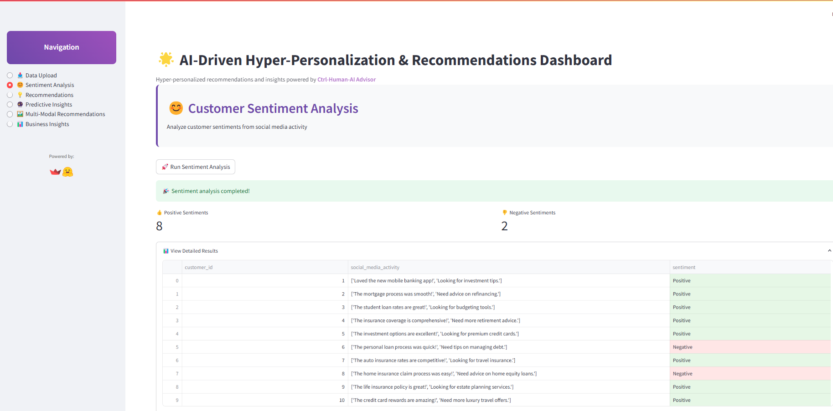
Results
Customer Sentiment Analysis

Slide 14
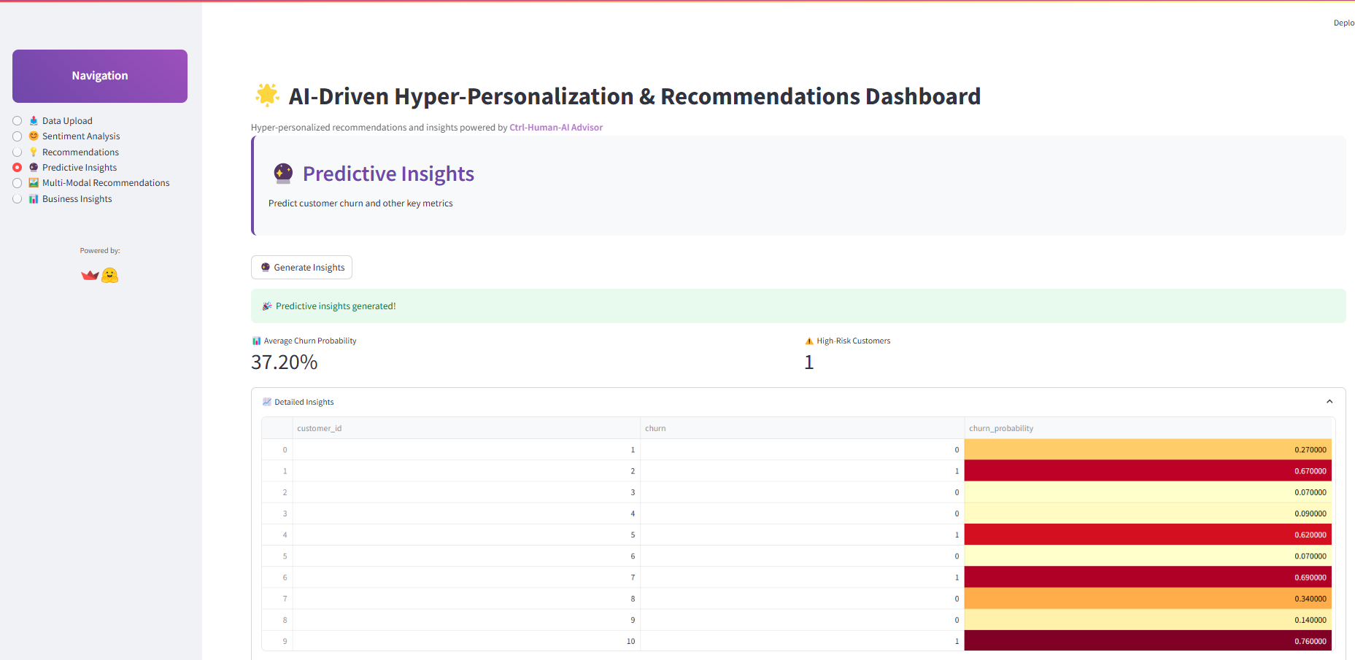
Results
Predictive Insights

