Slide 1
Empowering Customers with AI-Driven Insights
Take control of your spending, optimize subscriptions, and achieve smarter financial savings effortlessly.

Slide 2
Why We Are Doing This
In today's fast-paced financial world, customers often struggle to track and manage their expenses effectively. Our AI-driven solution empowers users by providing real-time insights, categorizing spending, and offering cost-saving recommendations. By leveraging artificial intelligence, we help users optimize their finances effortlessly.

Slide 3

Overview of the Solution
Our AI-powered solution provides customers with personalized spending
insights by analyzing transaction data. It identifies discretionary spending
and suggests ways to save costs on subscriptions and daily expenses.

Slide 4
How It Works
1. Machine learning analyzes transaction data.
2. AI categorizes expenses and identifies high spending areas.
3. Generates personalized cost-saving recommendations.
4. Provides insights on discretionary and subscription-based
expenses.

Slide 5
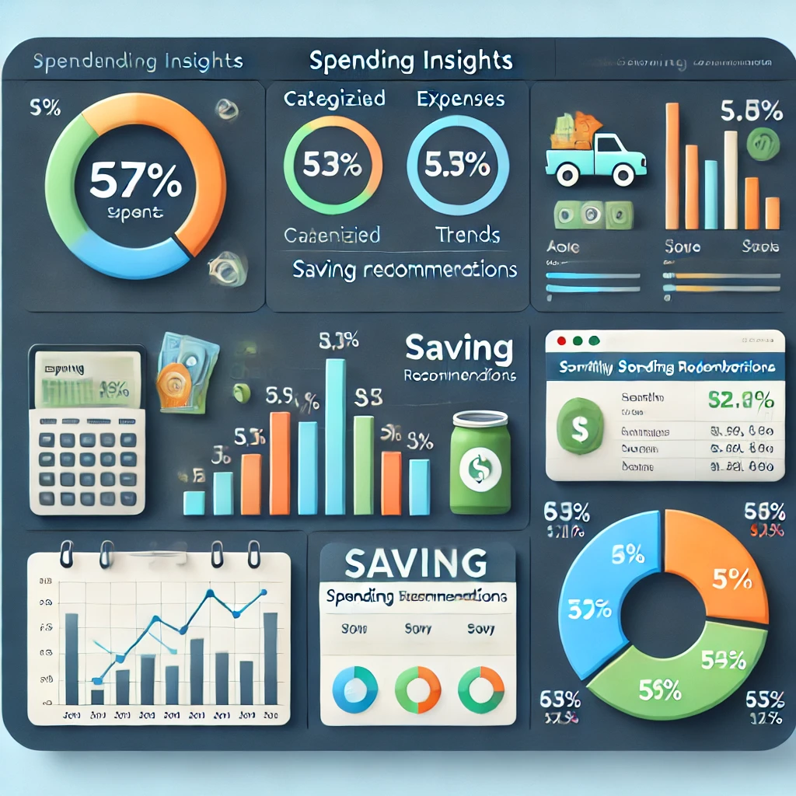
Customer Spending Insights
Our AI calculates the average spending per category and detects overspending
Trends. Example: Average spending per category: $312.28

