Slide 1
HyperFin AI
“Hyper-Personalized Financial Intelligence
That Understands You”
Wells Fargo Hackathon 2025
Team Name: `Git Rekt`
1) Neeraj Mirji
2) Eshaan Amin
3) Charan R
4) Ramesh Valluripalli
5) Samiksha
.

Slide 2
🎯 The Problem
“Banking Feels Generic. Customers Feel Forgotten.”
Outdated targeting is still the norm : Most banks group customers by age, gender, or zip code — but completely overlook real behaviour, preferences, or intent.
Irrelevant offers = lost opportunities : Users are bombarded with promotions for credit cards they don’t need or can’t qualify for. The result? Frustration and erosion of trust.
Banks are missing what customers are saying — and feeling: Negative reviews, complaint forms, and even positive feedback hold emotional signals that go unanalysed and unused.
Personalization in finance hasn’t caught up to tech: Netflix knows your taste in movies. Spotify knows your vibe. Your bank? Still offering “Platinum” cards to students.
(71% of customers say impersonal service drives them to switch banks.)

Slide 3
🎯 Our Solution – HyperFin AI
“We don’t just recommend. We understand — and adapt.”
HyperFin AI is an intelligent, modular platform built to deliver truly personalized banking experiences — not just based on who a customer is, but on how they feel, what they do, and what they need.
1) Smart Product Recommendations : HyperFin AI analyses each customer's profile — including income, spending patterns, interests, and lifestyle — to recommend the most suitable banking products .Every recommendation is personalized, eligibility-checked, and backed by reasoning that makes sense to both users and advisors.
2) Retention-Driven Offer Engine : When a customer shows signs of dissatisfaction or churn risk, HyperFin AI doesn't wait. It actively evaluates their sentiment, past feedback, reviews, and tone.
⚠️ If frustration is detected → A retention offer is instantly triggered (e.g., rate match, premium support).
🌟 If satisfaction is detected → A loyalty reward is proactively delivered (e.g., cashback, upgrades).

Slide 4
🎯 Our Solution – HyperFin AI
“We don’t just recommend. We understand — and adapt.”
3) LLM-Powered Financial Q&A Assistant : This module identifies questions or confusion within customer comments on social media and responds with concise, trivia-style explanations that promote financial literacy. Alongside each explanation, it recommends a relevant product tailored to the user’s need — transforming feedback into personalized and educational engagement.
4) Fraud Detection with Explainability : Every transaction is evaluated not only for financial validity but also behavioural consistency. This module detects anomalies in spending amount, payment methods, or merchant category — such as a sudden wire transfer to a luxury store after months of grocery transactions. If flagged, the system provides a detailed risk score, a human-readable explanation, and a recommended action (e.g., request verification). This approach builds trust by ensuring that fraud alerts are transparent and easy to understand — not just automated flags.

Slide 5
🎯 Our Solution – HyperFin AI
5) Knowledge: This module analyses customer comments from social media to detect questions or confusion around banking concepts or services. When such a query is identified, the system responds with a short, informative trivia-style explanation related to the topic, enhancing financial literacy. Alongside the trivia, it recommends a relevant product that addresses the customer’s concern, creating a personalized and engaging experience.
6) ML-Based Fall-back Engine (XGBoost + KNN): In scenarios where the LLM fails, times out, or lacks sufficient context, the system seamlessly falls back to robust ML models. XGBoost classifies churn risk using behavioural signals, while KNN identifies similar users for product recommendations. This ensures continuity, reliability, and intelligent outcomes — even in edge cases.
7) Real-Time Behavior Update via Fund Transfers: Every fund transfer initiated by a customer is logged instantly and used to update their transaction profile. This enables the system to dynamically adjust product recommendations, churn risk, and reward strategies based on new financial behavior.It ensures personalization is not static — it evolves in real-time with every user action.

Slide 6
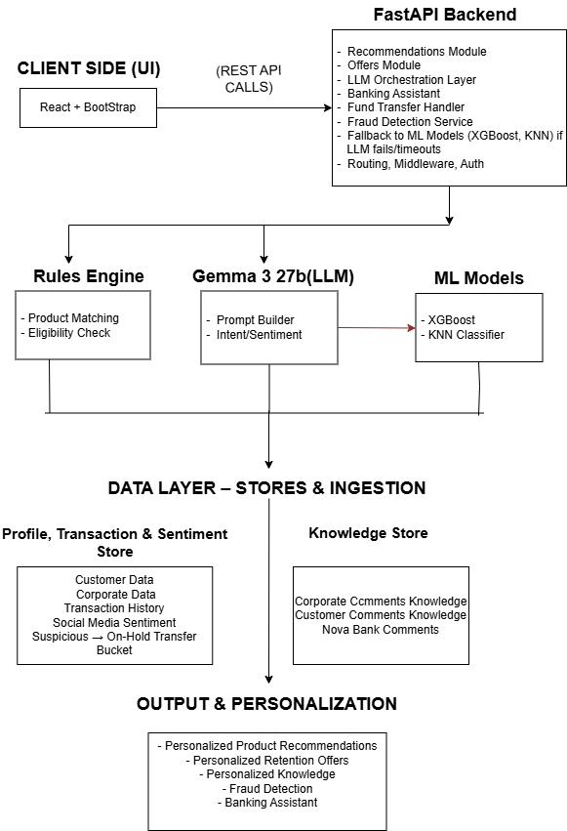
High Level System Architecture

Slide 7
Data That Powers It All
“Multiple Data Streams - Designed with LLM Precision.”
HyperFin AI is fuelled by a rich, multi-dimensional dataset created and curated using LLMs to simulate real-world banking behaviour and diversity. We've designed this synthetic dataset to mirror realistic user profiles, transaction behaviour, feedback sentiment, and product logic — enabling powerful downstream AI decisions.
Data Layers
Individual Customer Profiles : Generated using LLMs to reflect variations in: Age, gender, income level, Credit score ranges, Education backgrounds, Transaction history. These profiles were structured to match real-world segmentation logic used by retail banks.
Organizational / Business Profiles: Created for commercial banking use cases. Each profile includes: Company revenue (LLM-generated in realistic bands), Industry sector (Finance, Healthcare, Tech, etc.), Number of employees, Transaction history, Company growth. These were modelled to reflect B2B use cases for product recommendation.

Slide 8
Data Layers
Transaction Histories : Simulated based on inferred behaviour using GPT-generated rules: Categories: (Travel, Dining, Groceries, Utilities, etc.), Frequency & recency metrics, Max spend and monthly aggregates. These were key to identifying interests and deriving top 3 categories per user.
Social Sentiment Data : Customer comments were generated with varying tone, depth, and emotion using prompt-tuned LLM calls. We created both Retail and Commercial feedback threads covering: Complaints, Praise, Suggestions, Emotional intensity. This was used to train/test the sentiment-based offer engine.
Product Eligibility & Rules : Built a structured, tiered product catalogue (credit cards, debit cards, services) with Benefit mapping, Eligibility conditions (income, age, credit score).

Slide 9
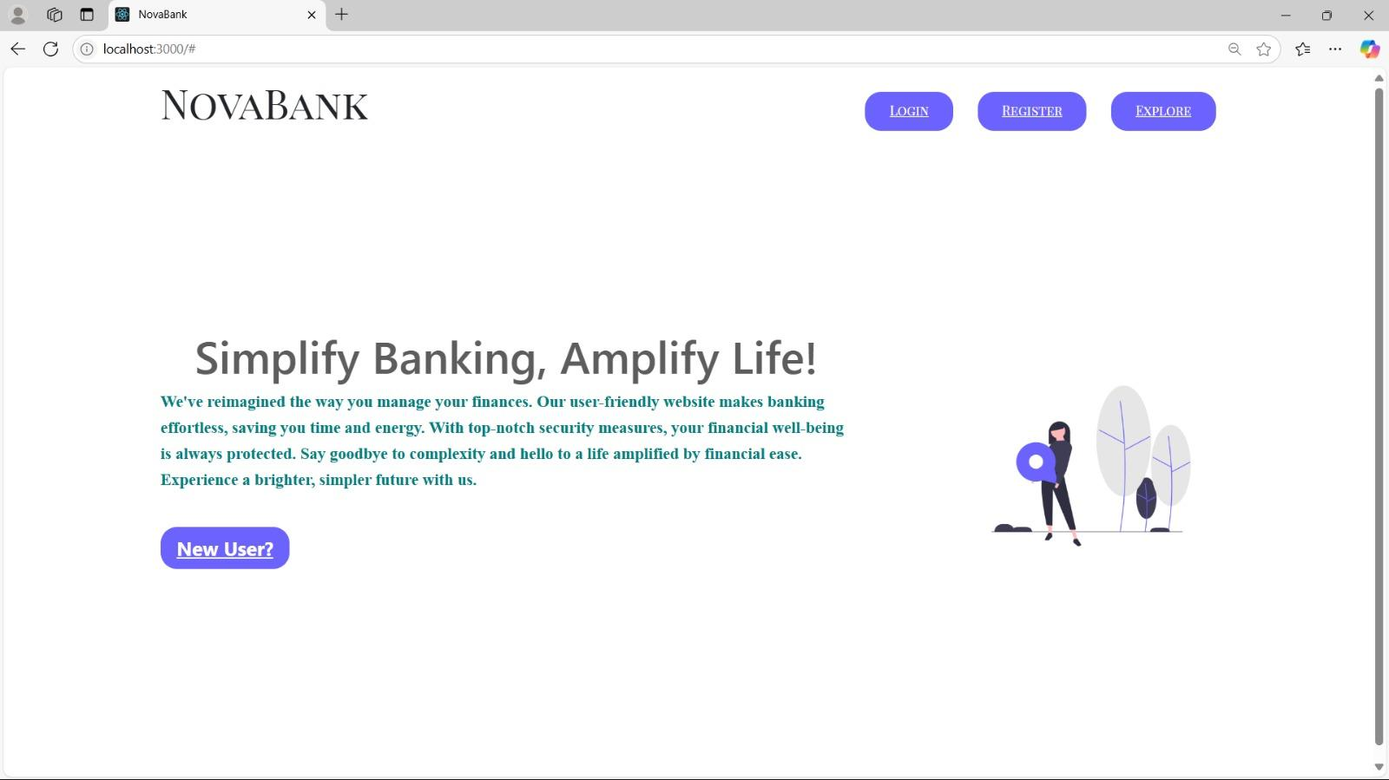
HyperFin AI in Action

Slide 10
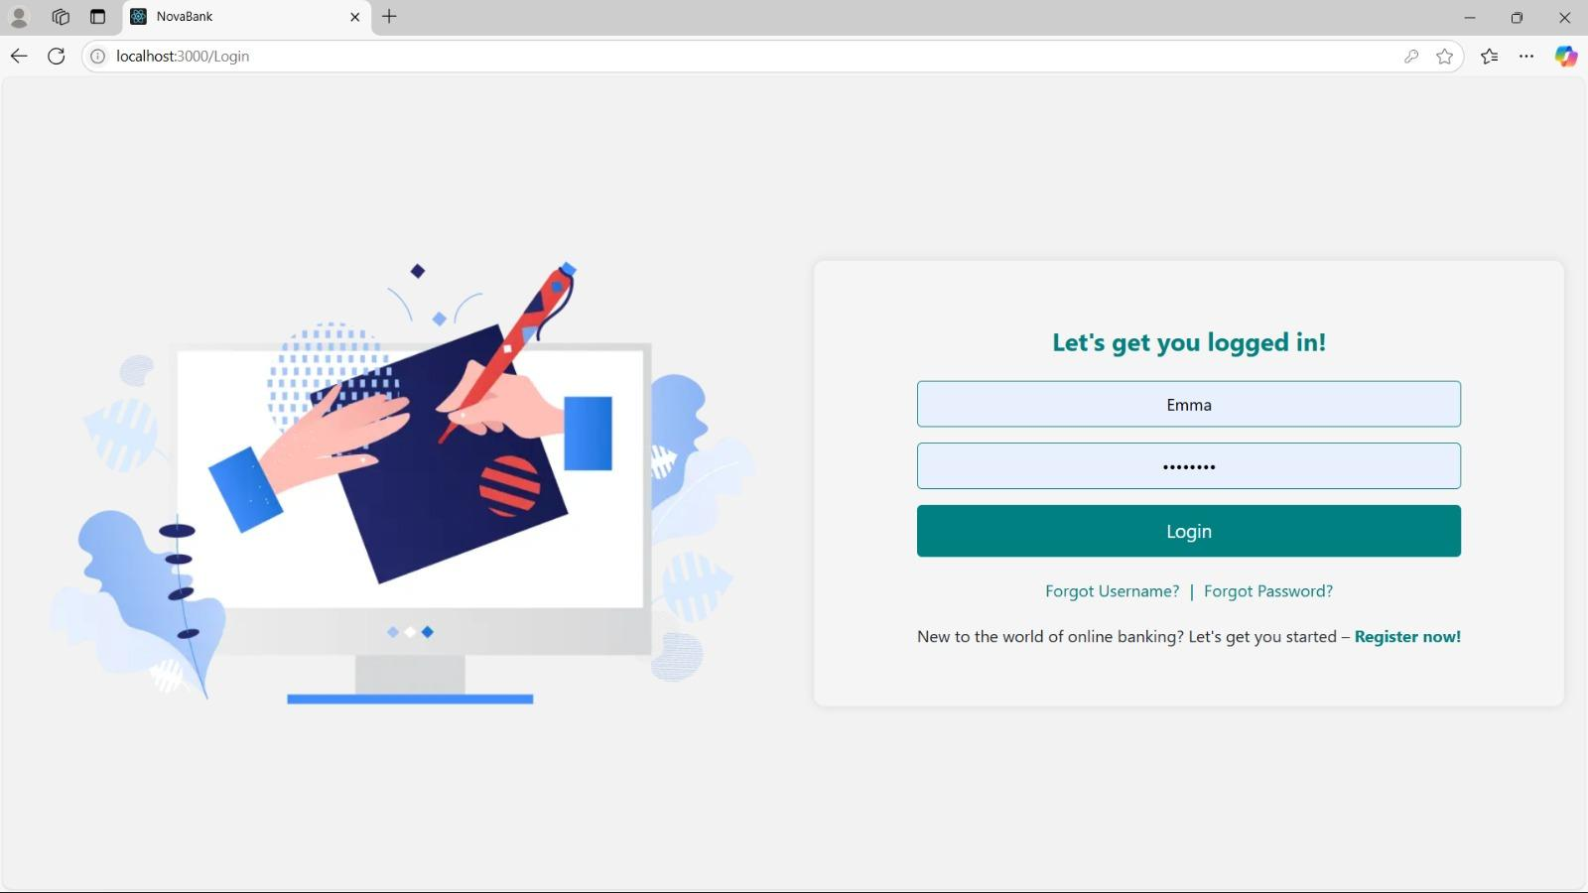
Login Page

Slide 11
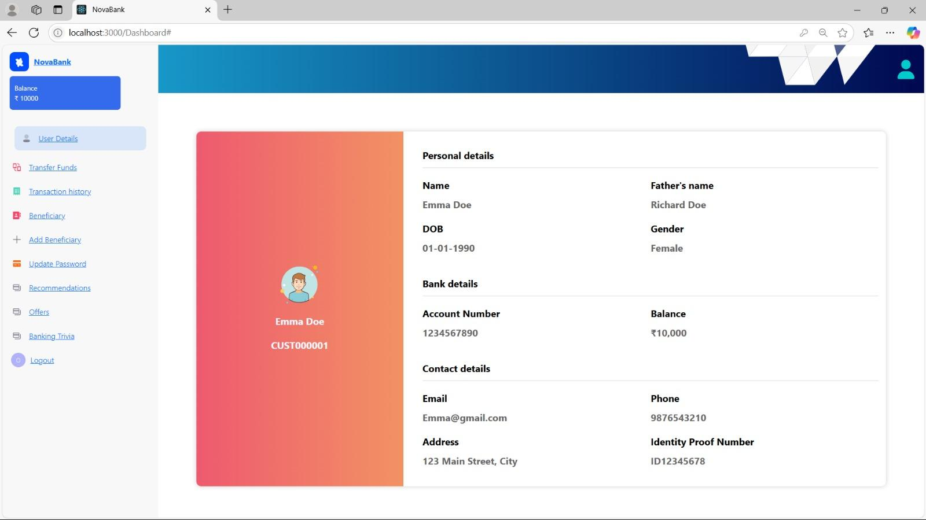
User Dashboard

Slide 12
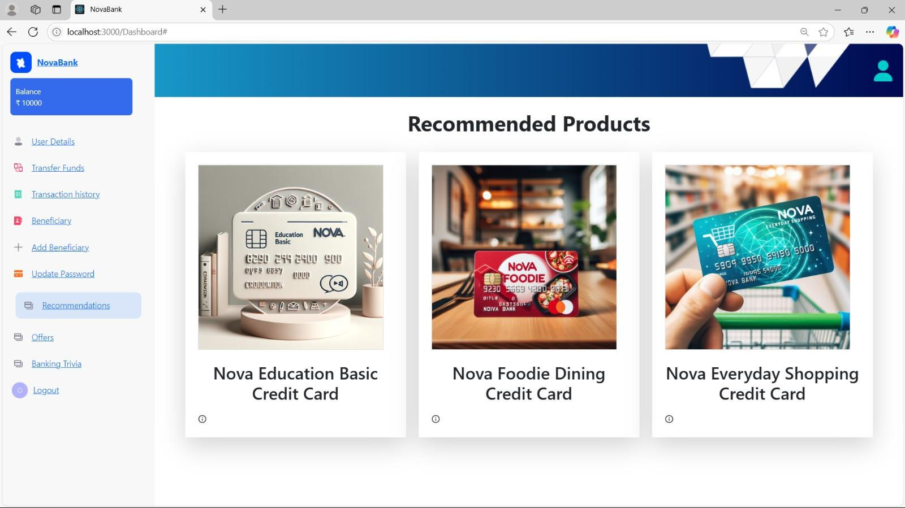
Recommended Products

Slide 13
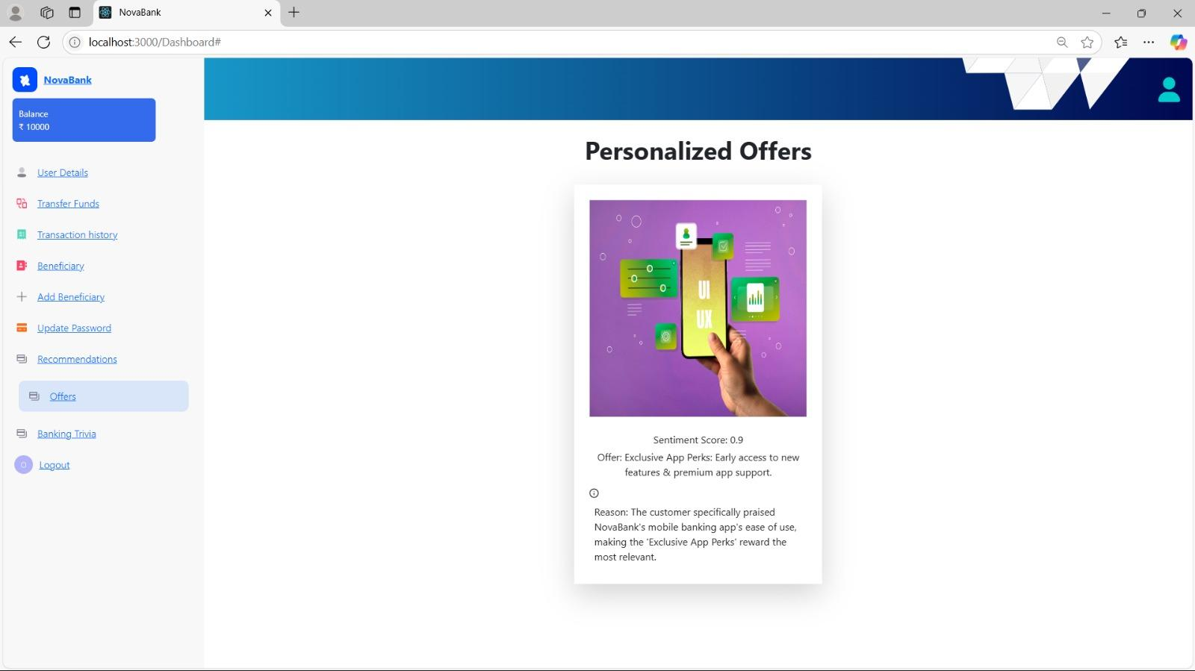
Personalised Offers

Slide 14
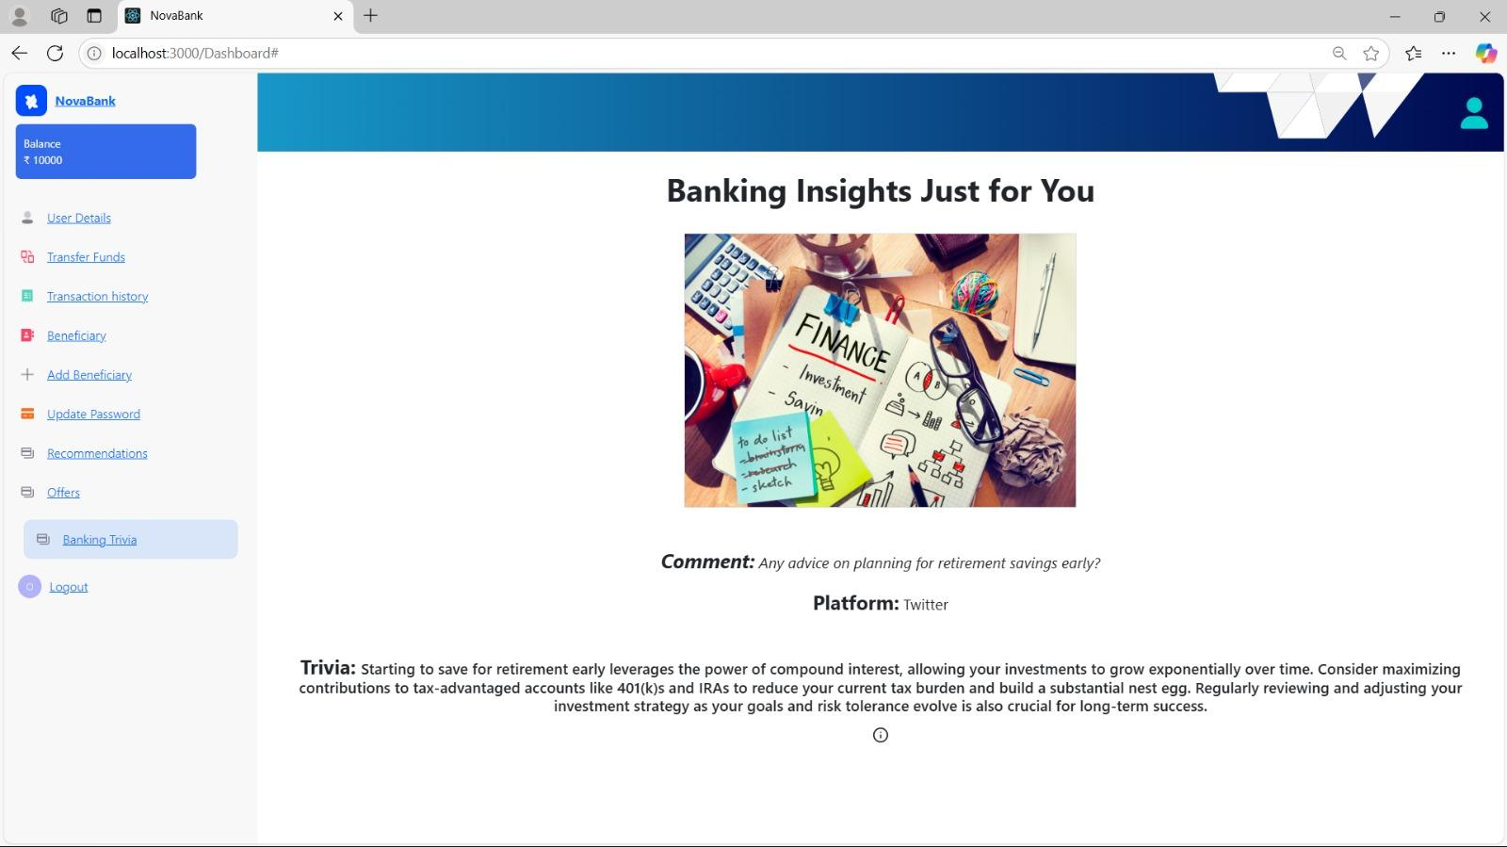
Banking Trivia

Slide 15
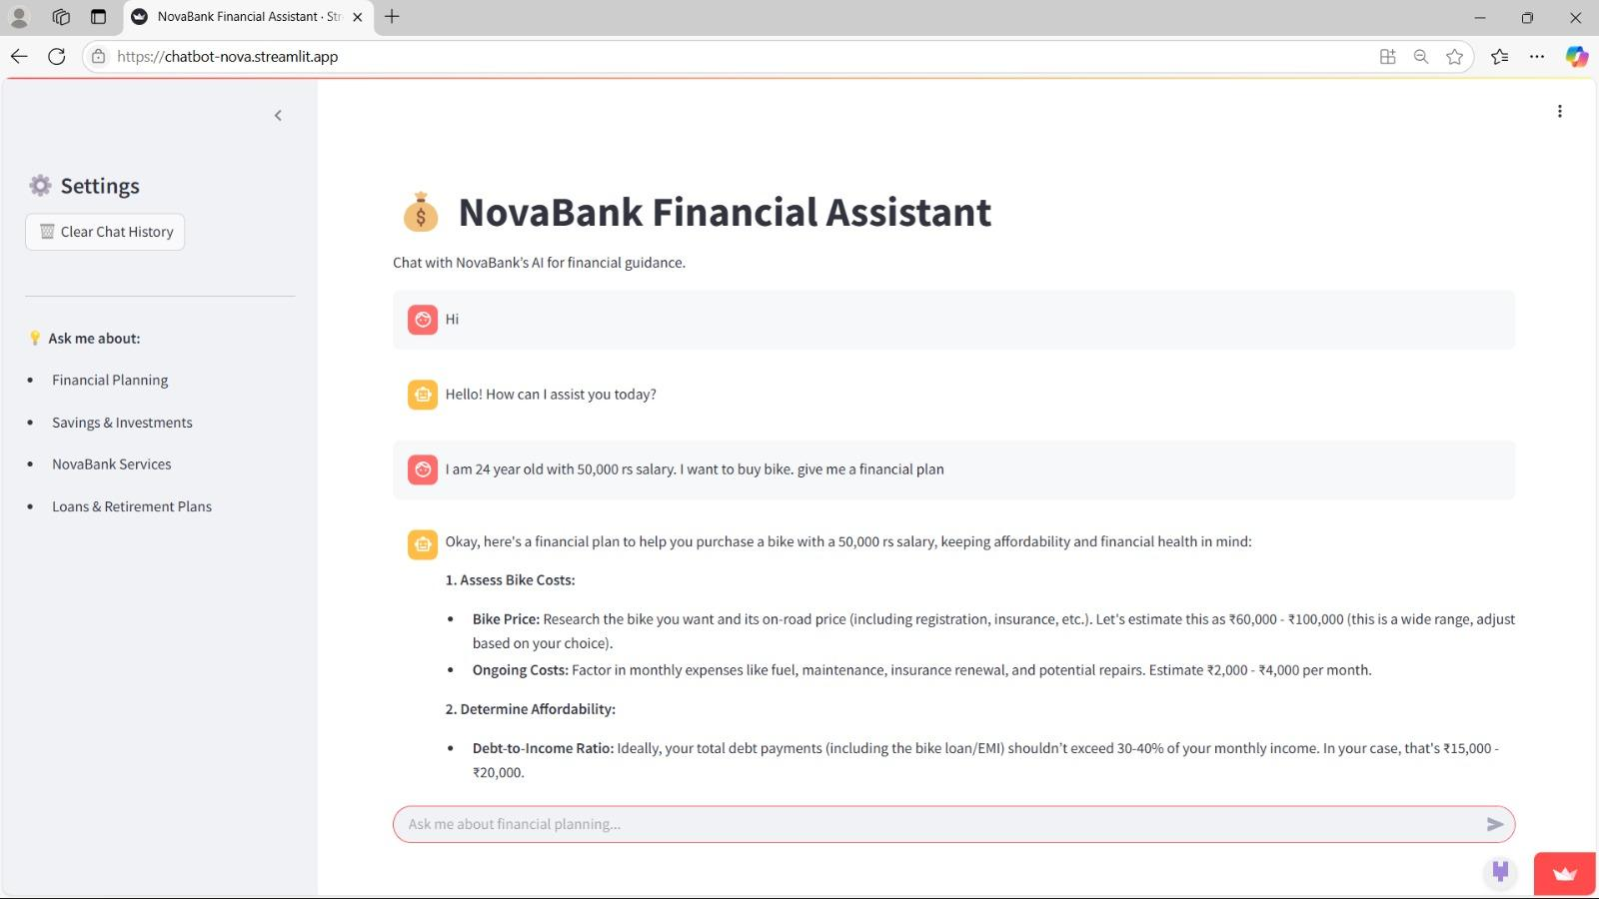
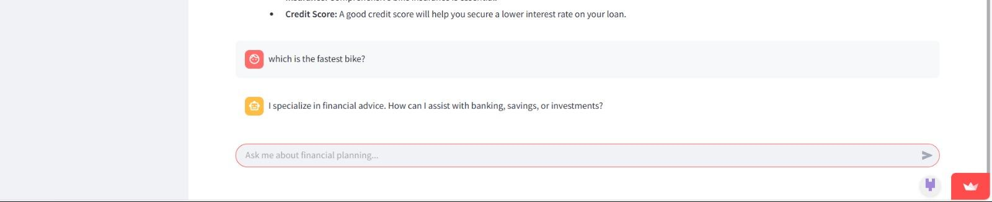
Banking Assistant

Slide 16
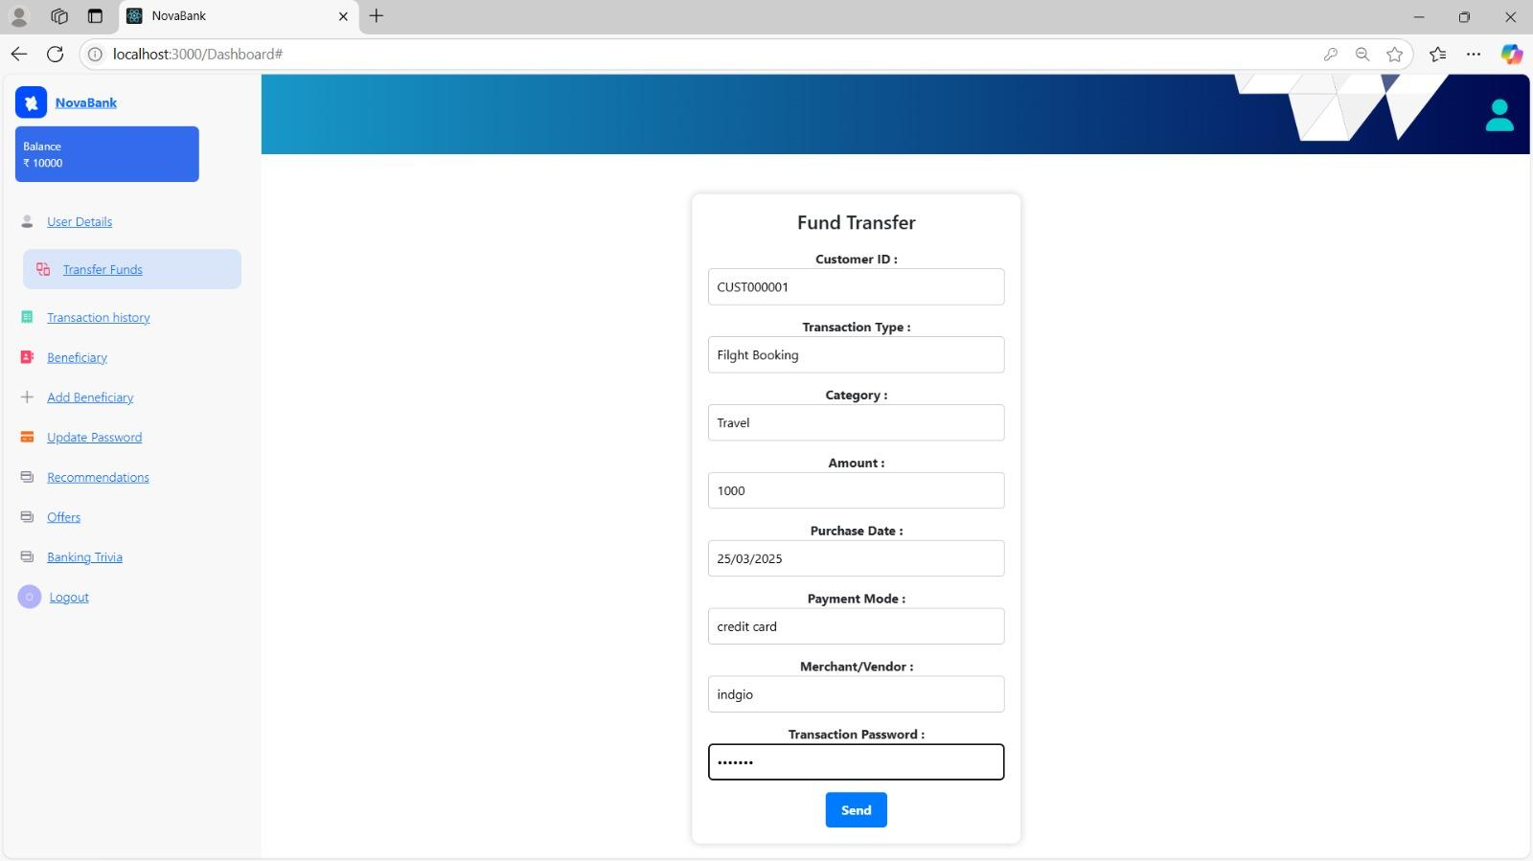
Transaction Page

Slide 17
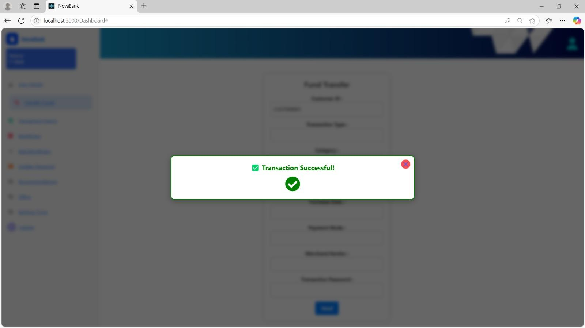
Transaction if Successful

Slide 18
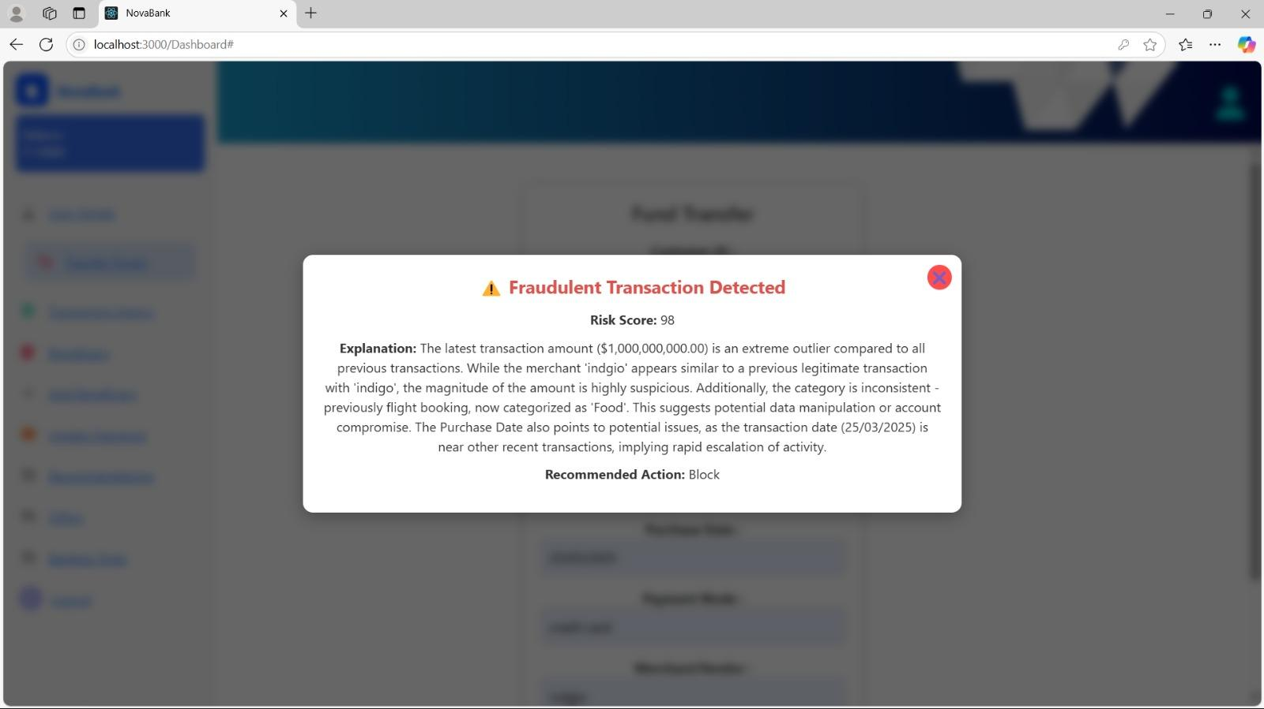
Fraud Detection(Transaction if flagged)

Slide 19
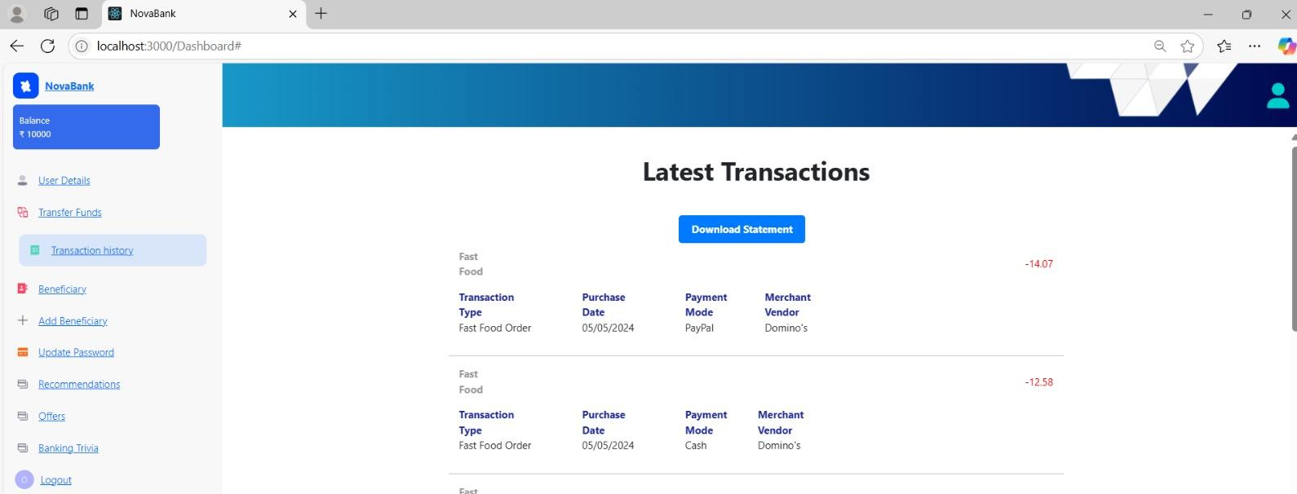
Latest Transactions

Slide 20
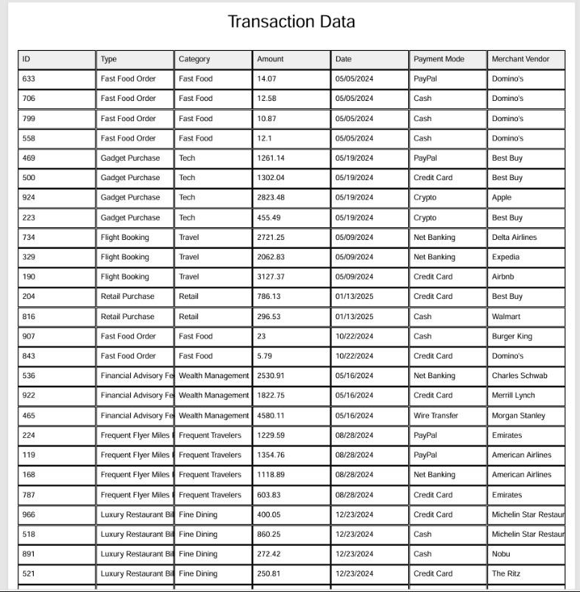
Transaction Data

Slide 21
Conclusion
HyperFin AI demonstrates the powerful synergy between LLMs and traditional ML in solving real-world banking challenges. From enhancing product personalization to reducing churn and increasing customer trust, the system provides a scalable and explainable solution aligned with Nova Bank’s customer-first philosophy. With modularity, real-time adaptability, and ethical safeguards built-in, HyperFin AI is both future-ready and practical for deployment. This project serves as a strong foundation for next-gen banking experiences powered by AI.

Slide 22
Thank You

