Slide 1
Technology Hackathon -2025
AI-Driven Hyper-Personalization & Recommendations
Team Name: Himalayas
Ashish Agarwal
Priyanshu Mittal
Rakesh Gurushanthappa
Hema Venkataramana
Vishwas Basavaraj

Slide 2
How it works
Analyze customer data like transaction history, sentiment data, social media data, demographic data after obtaining consent from customer
A webpage for Financial advisor to enter customer , Review prompt
Select from multiple Wellsfargo lines of businesses
Generate Text and Audio Visual Recommendation

Slide 3
Key Benefits
Highly personalized
Recommendations are generated based on real time customer data and sentiment
Operational Cost Saving
Suggestions which would take weeks earlier can be generated in seconds with less human involvement
Quick Response
In case of request by customer, this tool can immediately generate and suggest best suitable product or service
Web based UI with fee clicks to derive recommendation
Ease of use

Slide 4
Data Flow Diagram
Render a web page for advisor with prompt , input customer id , product categories
Product Categories:
1. Consumer and Small Business Banking
2. Consumer Lending
3. Corporate and Investment Banking
4. Wealth and Investment Management
5. Commercial Banking
Customer Transaction data
Customer consent received?
YES
Customer Demographic data
Customer consent received?
Analyze data using open AI
YES
Generate recommendations
Customer Social media data
Customer consent received?
YES
Display the tailored products and services in webpage along with link to the Audio Video file with recommendations

Slide 5
Approach
Modular Structure: Independent functions (data loading, recommendation, video) for maintainability.
Dual Interface: CLI for simplicity, web app for interactive use with real-time updates.
Data-Driven: Merges customer data (pandas) into OpenAI prompts for personalized recommendations.
Multimedia Output: Combines narration (pyttsx3), YouTube video (pytubefix), and text overlays (MoviePy).
Secure & Robust: Encrypted files (msoffcrypto), consent checks, logging, and cleanup.
Iterative Build: Python-based prototype with flexibility for future enhancements.
Focus: Simple core, user-friendly experience, scalable foundation.

Slide 6
The AI Powerhouse: Key Technical Considerations
Data Security: Encrypted Excel files (msoffcrypto), consent checks for privacy compliance.
AI Integration: OpenAI gpt-4o-mini for personalized recommendations (220-word limit).
Web App: Flask + SocketIO for real-time UI updates (logs, results, video).
Video Generation: MoviePy for text overlays, pyttsx3 for narration, YouTube background via pytubefix.
Logging: Real-time feedback via custom SocketIO handler.
File Management: Pathlib for cross-platform paths, static video serving.

Slide 7
Technologies used
Backend: Flask, Flask-Socket IO
Frontend: HTML, CSS, JavaScript
APIs: OpenAI GPT, Twitter
APIData Processing: Pandas, OpenPyXL, msoffcrypto
Logging: Python Logging Module
Video Generation: MoviePy, ImageMagick
Audio Generation: pyttsx3
Sentiment Analysis: TextBlob
YouTube Integration: pytubefix
Environment Management: Python Dotenv

Slide 8




Implementation Strategies Key considerations
Data Privacy and Security
Ethical AI
Customer Personas
Used only consented data, and password protect input data
Recommendations generated by using data passed in real time to avoid historical bias
Integrated with twitter data to generate sentiment-based recommendations
Prompt Engineering
Combination of best in class prompt engineering
And user input

Slide 9
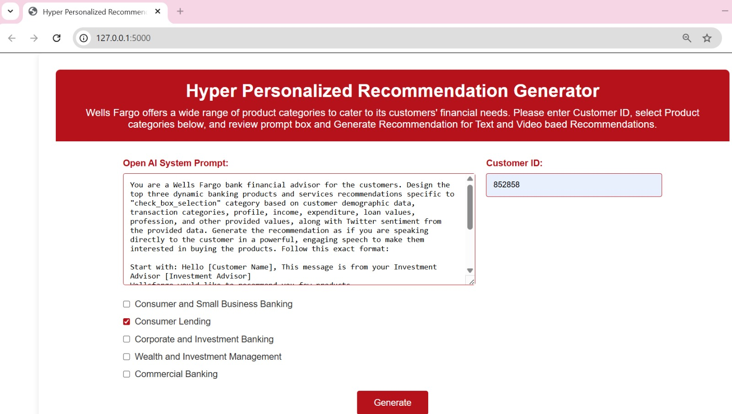
Input Screen
Webpage for input and output
Field to enter the customer id for whom the recommendation is required
Prompt for the advisor
List of product domains to be chosen by advisor for customer for tailored recommendation
Click on this to see recommendations

Slide 10
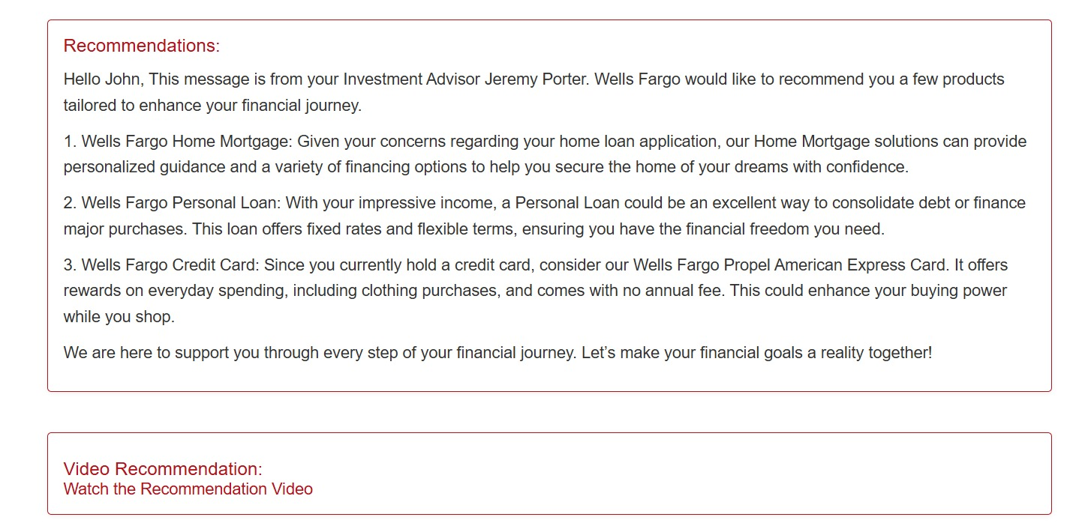
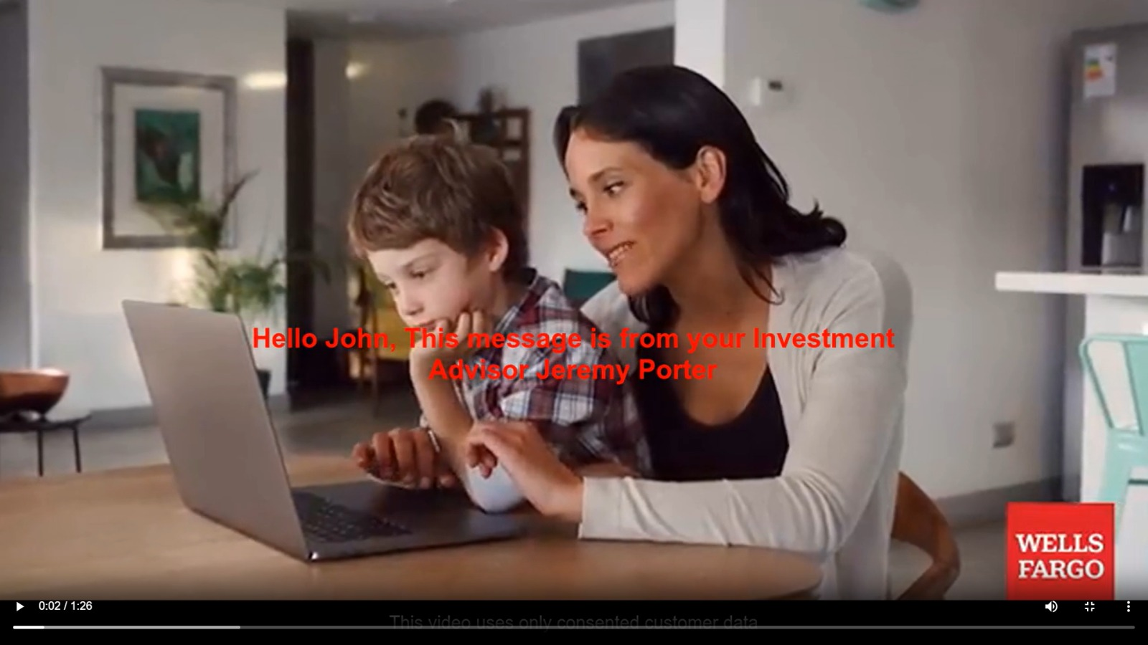
Output Screen
Recommendation of Product for Customer that is generated and displayed on web page
Recommendation video from the link that is generated

Slide 11
Conclusion: Embracing the AI Revolution
Summary: This script delivers hyper-personalized banking recommendations by integrating customer data,
AI, and multimedia output, enhancing customer engagement for Wells Fargo.
Strengths:
Secure data handling with encryption and consent checks.
Real-time web interface via Flask and SocketIO.
Dynamic text and video generation using OpenAI and MoviePy.
Value: Combines advanced analytics, natural language processing, and visual storytelling to drive product adoption.
Future Potential:
Scale with async processing for multiple customers.
Enhance with configurable settings and robust error handling.
Explore local AI models for cost efficiency.
Takeaway: A powerful proof-of-concept showcasing Python’s versatility in financial services innovation.

Slide 12
Thank You

