Slide 1
Technology Hackathon -2025
AI-Driven Hyper-Personalization & Recommendations
Team Name: Himalayas
Ashish Agarwal
Priyanshu Mittal
Rakesh Gurushanthappa
Hema Venkataramana
Vishwas Basavaraj

Slide 2
How it works
Analyze customer data like transaction history, sentiment data, social media data, demographic data after obtaining consent from customer
A webpage for Financial advisor to input customer id, Review prompt
Select from multiple Wellsfargo lines of businesses
Generate Text and Audio Visual Recommendation

Slide 3
Key Benefits
Highly personalized
Recommendations are generated based on real time customer data and sentiment
Operational Cost Saving
Suggestions which would take weeks earlier can be generated in seconds with less human involvement
Quick Response
In case of request by customer, this tool can immediately generate and suggest best suitable product or service
Web based UI with fee clicks to derive recommendation
Ease of use

Slide 4
Data Flow Diagram
Render a web page for advisor with prompt , input customer id , product categories
Product Categories:
1. Consumer and Small Business Banking
2. Consumer Lending
3. Corporate and Investment Banking
4. Wealth and Investment Management
5. Commercial Banking
Customer Transaction data
Customer consent received?
YES
Customer Demographic data
Customer consent received?
Analyze data using open AI
YES
Generate recommendations
Customer Social media data
Customer consent received?
YES
Display the tailored products and services in webpage along with link to the Audio Video file with recommendations

Slide 5


Approach
1
2
3
4
5
Obtain consent and use customer data
Based on consent perform social media sentiment analysis
Conduct Sentiment Analysis
Create prompts to select WF products and services
Generate Recommendations
Transaction history, customer profile, demographic and social media data
Uses TextBlob for sentiment evaluation.
creates prompt for advisor , list the categories of product domains to be select by advisor for recommendation generation.
Leverages OpenAI API for tailored suggestions.
6
Generate Text and visual Recommendations
Use pyttsx3 and Moviepy for final media output.

Slide 6

The AI Powerhouse: Key Technologies
Key technologies driving AI advancements include machine learning models, Python programming, prompt engineering, OpenAI API, predictive analytics, and real-time data for enhanced engagement.
1
OpenAI API
2
Python
Generative AI for personalized recommendations
Versatile language for AI development
3
Real-Time Data
4
Predictive Analytics
React instantly for optimal engagement
Anticipate needs with proactive solutions
5
Audio Visual Output
Recommend tailored products via Audio Video

Slide 7
Technologies used
Backend: Flask, Flask-Socket IO
Frontend: HTML, CSS, JavaScript
APIs: OpenAI GPT, Twitter
APIData Processing: Pandas, OpenPyXL, msoffcrypto
Logging: Python Logging Module
Video Generation: MoviePy, ImageMagick
Audio Generation: pyttsx3
Sentiment Analysis: TextBlob
YouTube Integration: pytubefix
Environment Management: Python Dotenv

Slide 8




Implementation Strategies Key considerations
Data Privacy and Security
Ethical AI
Customer Personas
Used only consented data, and password protect input data
Recommendations generated by using data passed in real time to avoid historical bias
Integrated with twitter data to generate sentiment-based recommendations
Prompt Engineering
Combination of best in class prompt engineering
And user input

Slide 9
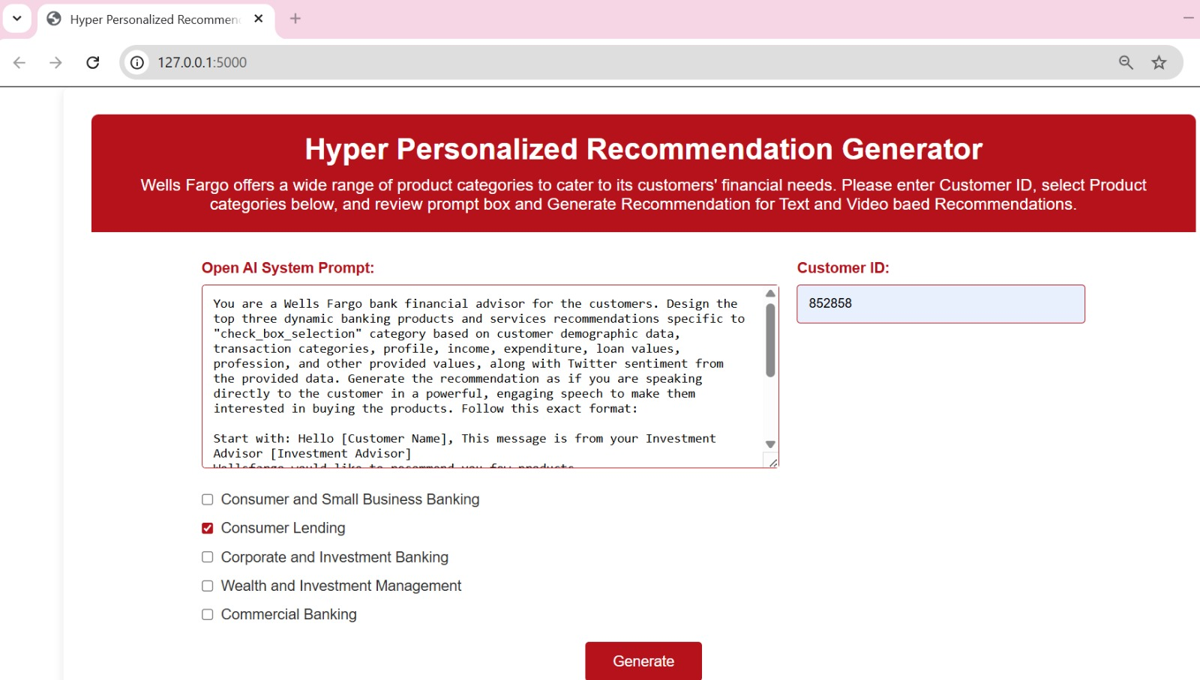
Input Screen
Webpage for input and output
Field to enter the customer id for whom the recommendation is required
Prompt for the advisor
List of product domains to be chosen by advisor for customer for tailored recommendation
Click on this to see recommendations

Slide 10
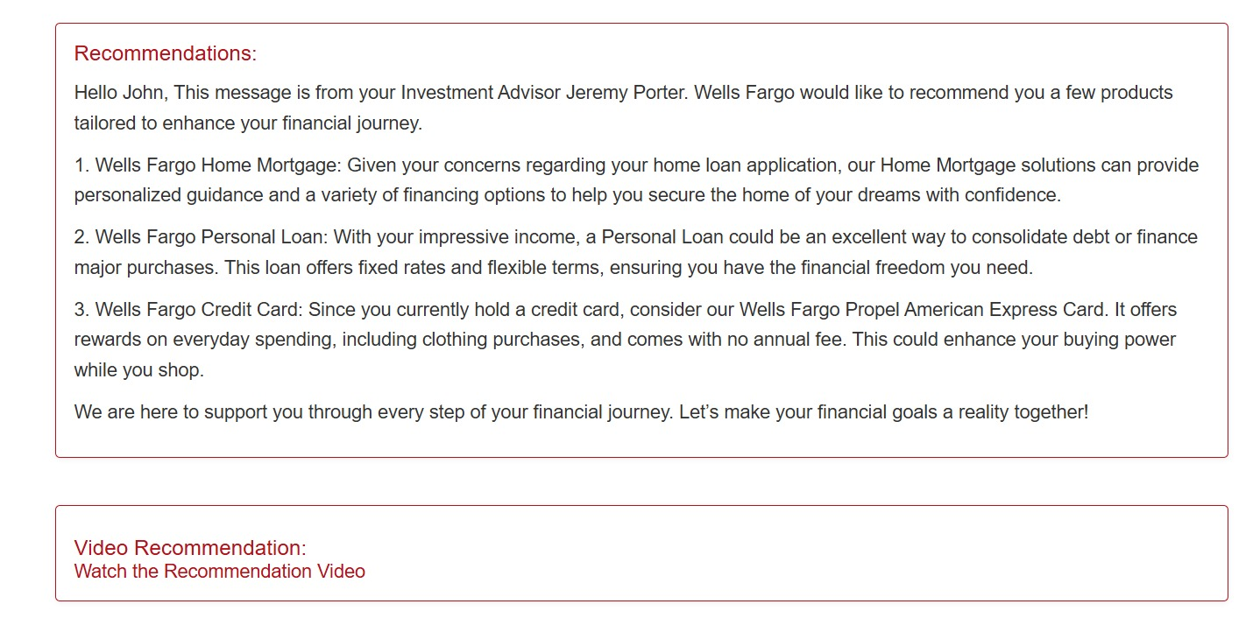
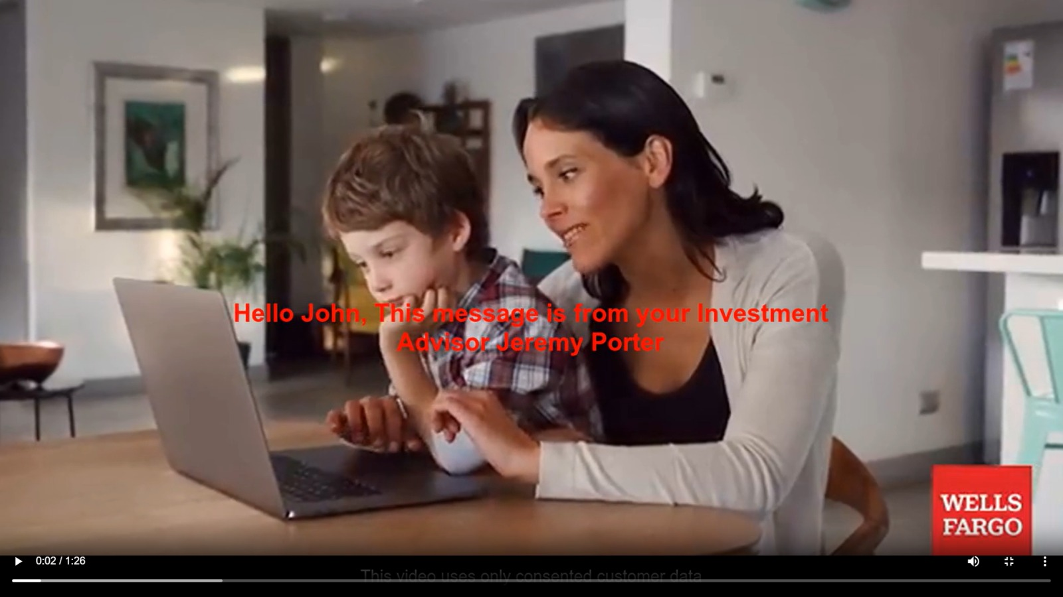
Output Screen
Recommendation of Product for Customer that is generated and displayed on web page
Recommendation video from the link that is generated

Slide 11
Conclusion: Embracing the AI Revolution
Transforming Banking
Improved Experience
Lead the Future
AI-driven hyper-personalization tool for future
Build stronger relationships and increased profitability.
Embrace AI to drive financial services.

Slide 12
Thank You

