Slide 1
AI-Powered Hyper- Personalization Engine
A Comprehensive Financial Personalization Platform
By Team - Neon Ninja (Mragya Rao, Puspanjali Dash)

Slide 2
Problem Statement
The problem lies in the growing expectation for deeply personalized experiences—modern customers want products, services, and content tailored exactly to their unique preferences, behavior, and emotions.
Traditional rule-based systems struggle to keep up with this demand, especially across multiple channels and data types like text, voice, and images. Businesses also face challenges in interpreting vast, unstructured data and acting on it in real time.
This gap has led to the need for Generative AI-powered systems that can intelligently analyze complex customer data and generate dynamic, personalized recommendations and insights at scale.

Slide 3
Solution Approach
The solution is a Stream lit-based AI engine that delivers hyper-personalized financial insights using multimodal inputs.
It processes structured data (Excel), voice (via Whisper), and images (via EasyOCR & BLIP) to build enriched customer profiles. Sentiment analysis guides tone, while Groq’s LLaMA-3.3-70B generates personalized recommendations, offers, and behavioural insights.
A financial health engine scores users based on transactions and sentiment. Sentence embeddings enable product matching via cosine similarity. A feedback loop (simulated RLHF) refines recommendations based on user ratings

Slide 4
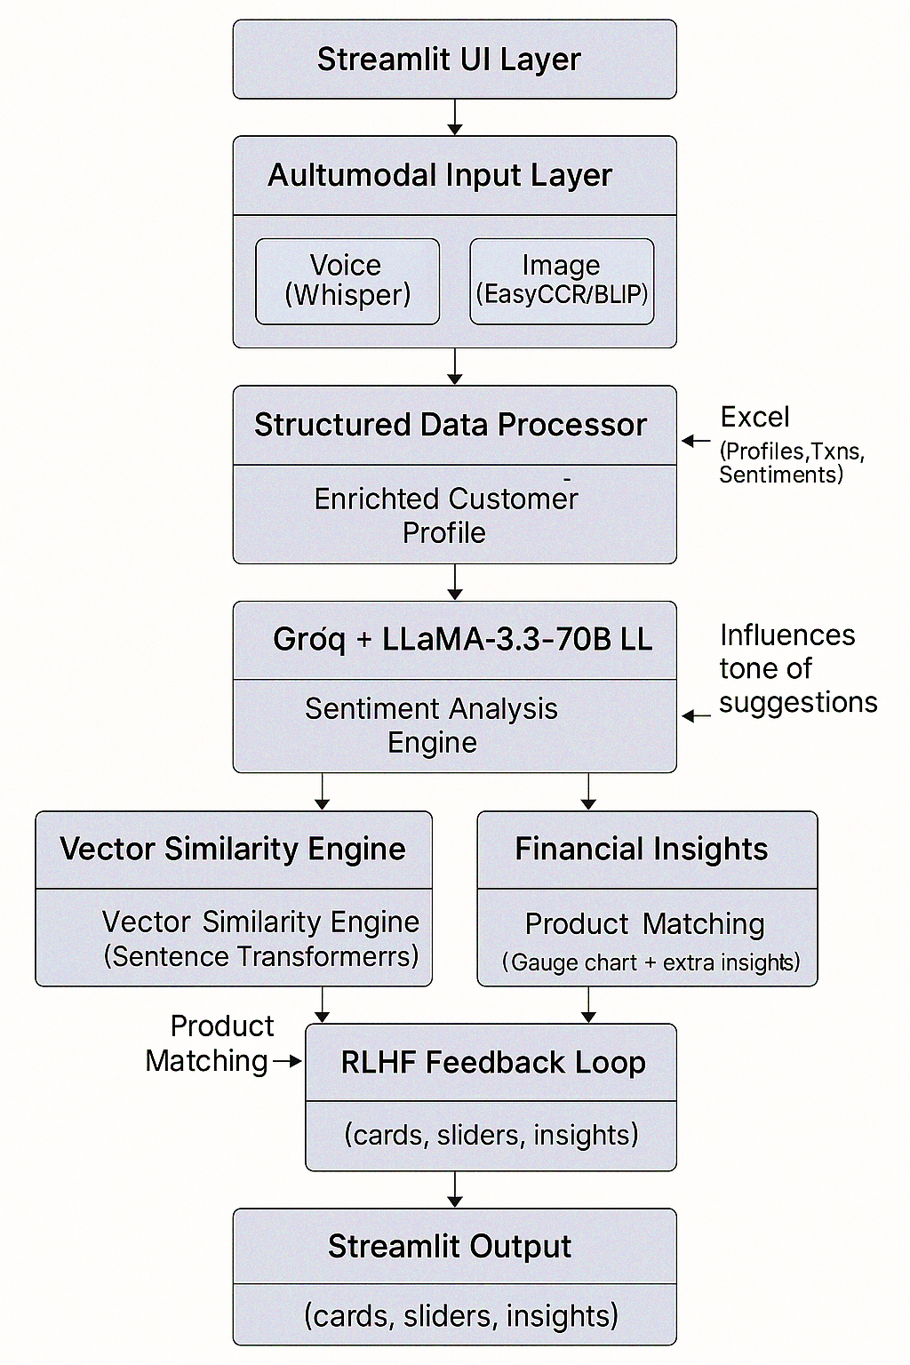
Architecture

Slide 5
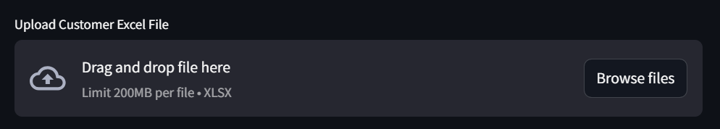
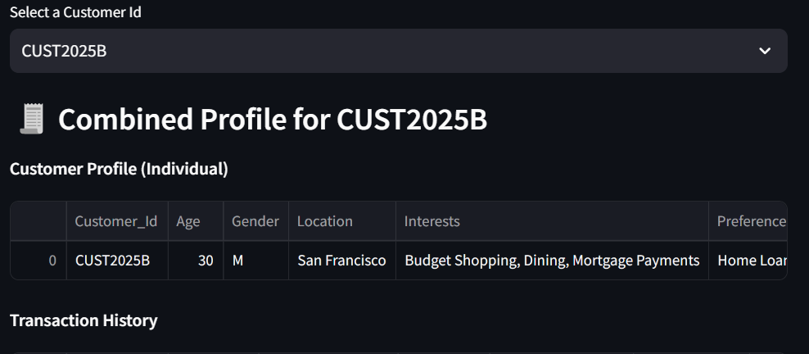
Multi-Modal Input
The solution uses multimodal inputs—structured Excel data, voice, and images—to enrich customer profiles. Voice inputs are transcribed using OpenAI Whisper, while image insights are extracted using EasyOCR and BLIP. These inputs are combined with demographic and behavioral data to create a unified profile that drives more personalized and context-aware recommendations. It takes customer_id to keep track about each customer.

Slide 6
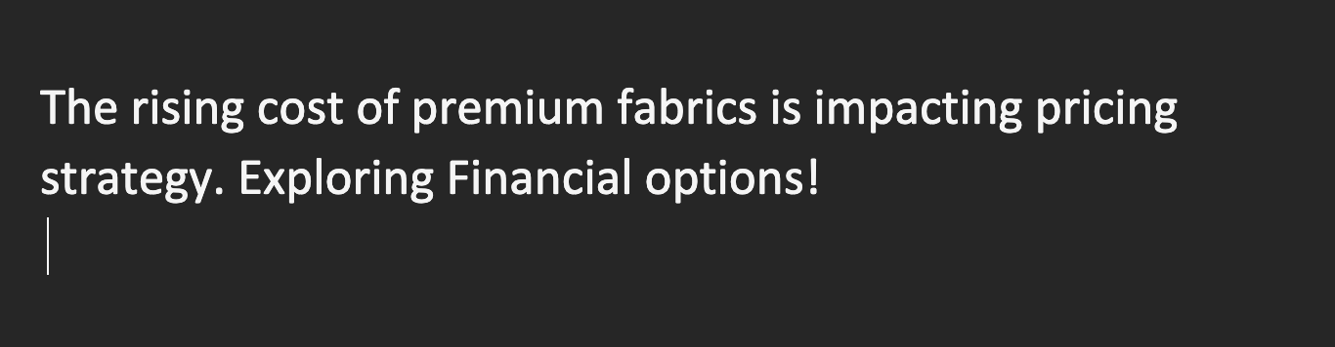

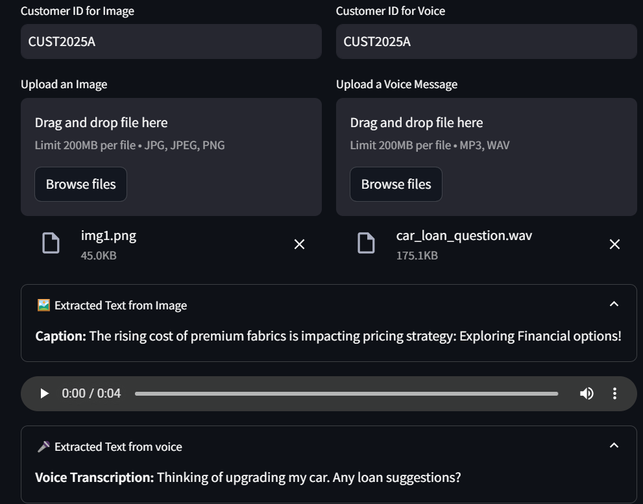
Image Input & Output
Voice Input & Output
Play Voice Input

Slide 7
Recommendation Engine Features
Choose the customer_id to view the personalized features tailored for each of them.
📊 Generate Recommendations - Generates 3 short, actionable financial recommendations tailored to the customer's profile. 🎯 Product/Service Suggestions - Suggests 3 financial products or services based on the customer's sentiment and profile 🎁 Promotion Offers for you! - Predicts customer preferences, churn risk, and purchasing potential, and provides 3 personalized retention offers.
🧾 Show Financial Health Score - Calculates a financial health score (out of 100) based on transaction behavior, spending diversity, and sentiment.
💡 Personalized Product Suggestions - Displays top 3 matched products with benefits in an interactive flip-card UI

Slide 8
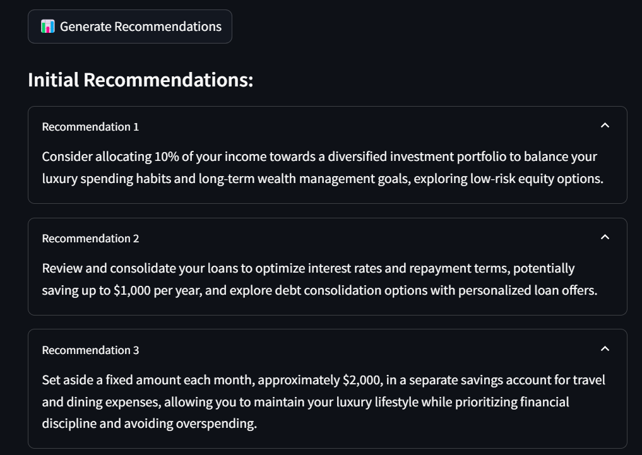
1. Generate Recommendations
Uses generate_recommendations() which builds a custom prompt from the enriched customer profile and sends it to Groq’s LLaMA-3.3-70B via llama_model.complete(), which generate 3 financial recommendation.

Slide 9
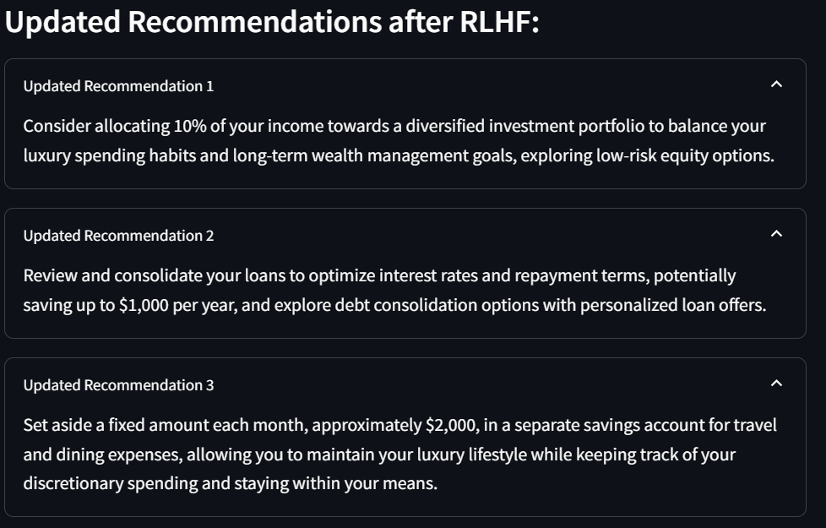
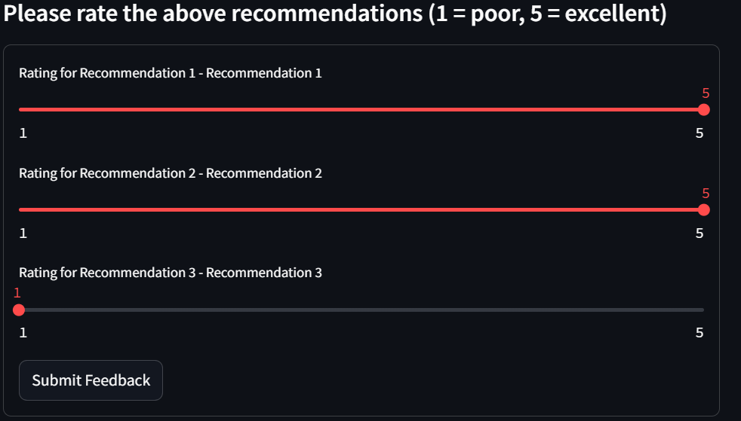
RLHF retraining
The response is parsed into bullet points and displayed with rating sliders; ratings are optionally used in simulated RLHF retraining.

Slide 10
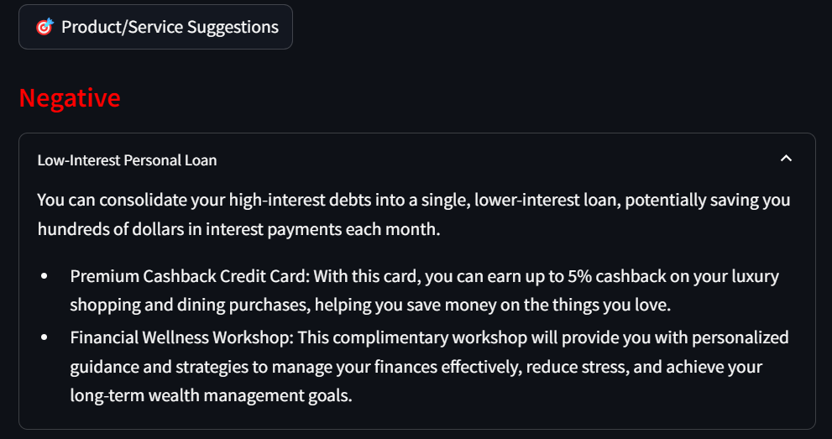
2. Product/Service Suggestions
Analyzes customer sentiment from social media text using Hugging Face’s pipeline("sentiment-analysis"), then modifies prompt tone accordingly.
The function generate_product_suggestions() formats the prompt, and Groq LLM returns 3 user-facing suggestions based on both profile and sentiment.

Slide 11
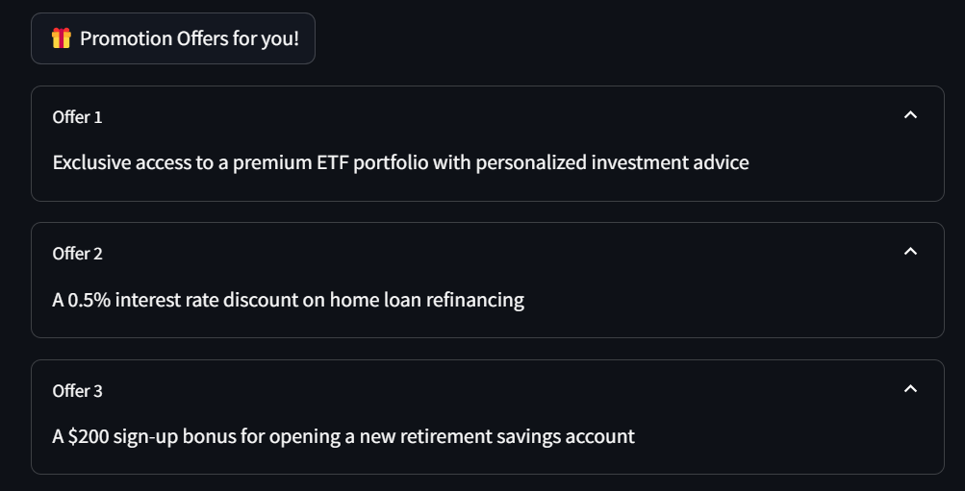
3. Promotion Offers
Runs predict_customer_behavior_text() which sends a structured prompt with specific formatting instructions (for JSON output) to the LLaMA model.
Extracts keys like preferences, purchasing_potential, and retention_offers using regex from the model’s triple-backtick-wrapped JSON response.

Slide 12
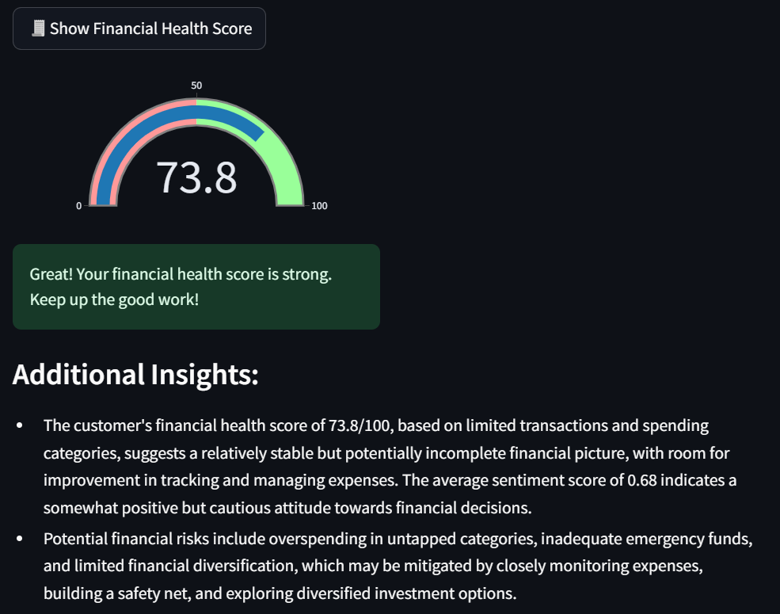
4. Show Financial Health Score
Calculates a numeric score from using the formula below:
Financial Health Score=(num_txn×4)+(unique_categories×6)+(avg_sentiment×50)
Displays score using Plotly’s Gauge Chart, then uses the LLM in extract_additional_insights() to explain what the score means and highlight risks

Slide 13
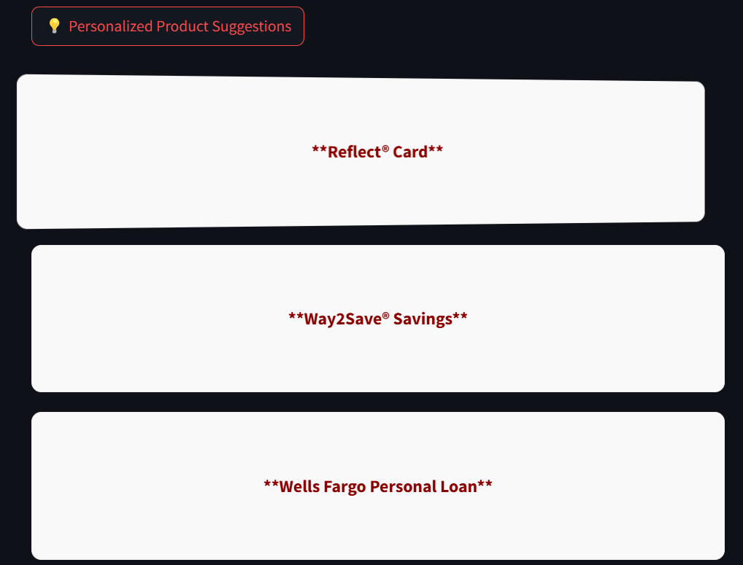
5. Personalized Product Suggestions
Uses SentenceTransformer to embed the customer profile and compare it to a list of predefined financial products using cosine similarity.
Top 3 matched products are sent to the LLM with a prompt asking for customer-friendly suggestions; output is rendered as interactive flip cards with bullet points.

Slide 14
Conclusion
By intelligently combining structured data with voice, image, and behavioral insights, it sets the foundation for real-time, adaptive customer engagement.
The integration of Groq’s LLaMA-3.3, Whisper, BLIP, and Sentence Transformers ensures contextual accuracy and adaptability. With sentiment-aware responses, vector-based product matching, and a simulated feedback loop, the system demonstrates real-time, customer-centric engagement.
As AI models evolve and integration deepens, such systems will become central to delivering truly human-like financial guidance at scale. This solution not only reimagines personalization today but paves the way for emotionally intelligent, proactive banking of tomorrow.

Slide 15
Thank you

