Slide 1


Hackathon 2025
Team: RecomMind
Theme: AI Driven Hyper-Personalized Financial Guidance
Team Members:
Rajesh Mishra
Sunil Behera
Sudeb Kar
Bhabesh Barik
Manoj Pallai
Mar 26th 2025

Slide 2
Challenge Description
Modern customers expect highly personalized experiences that cater to their unique preferences. In this hackathon, participants will develop a Generative AI-driven solution that enhances hyper-personalization by analyzing customer profiles, social media activity, purchase history, sentiment data, and demographic details. The challenge is to design a system that generates personalized recommendations for products, services, or content while also providing actionable insights for businesses to optimize customer engagement.

Slide 3
Solution Overview
The product name is called “HyperFin”
HyperFin is an AI-driven virtual financial guru designed to provide hyper-personalized financial guidance to individuals and businesses. Leveraging cutting-edge technologies like Large Language Models (LLMs), sentiment analysis, and causal inference, HyperFinLocal goes beyond generic financial advice to understand users' emotional relationship with money and connect them with relevant financial resources.
Unique Selling Proposition (USP):
HyperFinLocal is the financial recommendation system to combine AI-driven emotional intelligence with causal analysis and comprehensive resource integration, providing a truly holistic and personalized financial experience for both individuals and businesses.

Slide 4
Use Cases
Personalized Financial Guidance via Chat/Voice:
Users interact with FinSight Local through text or voice to ask questions about budgeting, saving, investing, debt management, and general financial planning.
FinSight Local provides personalized answers and recommendations based on user data and financial insights.
Emotional Sentiment Analysis and Empathetic Responses:
FinSight Local analyzes user input for emotional cues (e.g., anxiety, stress, joy) related to financial topics.
The system provides empathetic responses and tailors advice to address the user's emotional state.
Causal Insight Generation and Actionable Recommendations:
FinSight Local identifies causal relationships between user actions and financial outcomes (e.g., frequent dining out leads to higher spending).
The system provides actionable recommendations based on these causal insights, helping users understand the "why" behind their financial patterns.
Resource Integration and Recommendations:
FinSight Local connects users with relevant financial resources, such as banks, credit unions, financial workshops, and investment opportunities.
The system provides recommendations based on user needs and interests.
Proactive Financial Monitoring and Notifications:
FinSight Local monitors user financial data and relevant events, proactively pushing personalized insights and opportunities.
The system alerts users to potential financial risks, upcoming events, and relevant offers.

Slide 5
Use Cases (contd..)
Personalized Budgeting and Savings Advice:
HyperFin analyzes user spending patterns and provides personalized budgeting recommendations.
The system helps users set savings goals and track their progress.
Investment Recommendations and Risk Assessment:
HyperFin assesses user risk tolerance and recommends suitable investment options.
The system provides insights into market trends and investment opportunities.
Financial Goal Setting and Progress Tracking:
HyperFin helps users set financial goals and track their progress over time.
The system provides visual representations of goal progress and motivates users to stay on track.
Financial Education and Literacy:
HyperFin provides educational content and resources to improve financial literacy.
The system explains complex financial concepts in a clear and understandable way.

Slide 6
Key Features
Intelligent Conversational Interface: Users can interact with HyperFin via text or voice, asking questions and receiving personalized financial advice.
Emotional Sentiment Analysis: HyperFin understands users' emotional states related to their finances, providing empathetic and supportive guidance.
Causal Insight Generation: The system identifies the "why" behind financial patterns, offering actionable recommendations based on causal relationships, not just correlations.
Resource Integration: HyperFin connects users with relevant financial resources, including banks, credit unions, workshops, and investment opportunities, and provides businesses with insights into customer financial behavior.
Proactive Recommendations: The system monitors user data and relevant events, pushing personalized insights and opportunities before users even ask, and offers businesses targeted marketing and customer engagement strategies.

Slide 7
How HyperFin Benefits Individuals
Personalized Financial Planning: Tailored advice based on individual financial situations and goals.
Emotional Support: Empathetic guidance that acknowledges the emotional aspects of financial management.
Resource Discovery: Easy access to relevant financial services and opportunities.
Informed Decision-Making: Actionable insights based on causal relationships and real-time data.
Financial Empowerment: Proactive guidance and education to improve financial literacy and well-being.

Slide 8
How HyperFin Benefits Business Providers
Targeted Marketing: Businesses can leverage insights into customer financial behavior to create targeted marketing campaigns.
Customer Engagement: HyperFin facilitates personalized customer interactions, fostering stronger relationships.
Financial Product Placement: Businesses can promote financial products and services to relevant customer segments.
Market Analysis: HyperFin provides businesses with data-driven insights into market trends.
Risk Assessment: Businesses can use HyperFin to assess customer creditworthiness and reduce financial risk.

Slide 9
Techcnical Overview
Following are the components in the solution:
Conversational Engine
Acts as the entry point for user interactions (text or voice). It manages conversation context, routes requests to appropriate services, and synthesizes responses.
OpenAPI gpt 4.0 mini has been leveraged here. Data has been fed into the same and appropriate responses are generated
Sentiment Analysis Service
Performs real-time sentiment analysis on user input to detect emotional states related to financial topics.
Social media activities data has been leveraged and fed into BERT based model (SamLowe/roberta-base-go_emotions)
Proactive Recommendation Engine
Monitors user data and triggers proactive notifications based on predefined rules and learned patterns.
Statistically matched data between resources and customer profile, transactions are fed into HuggingFaceH4/zephyr-7b-beta model by building appropriate prompt.
Resource Integration Service
Retrieves and aggregates data from heterogeneous sources, including customer related data, local businesses, financial events, and market data.

Slide 10
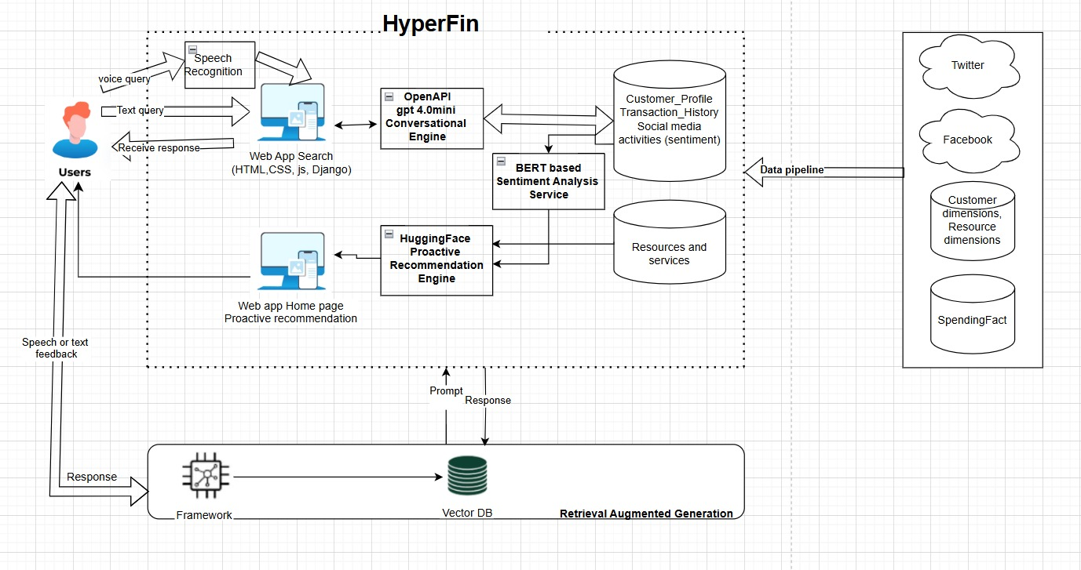
Architecture

Slide 11
Technical Stack
Backend: Django (Python)
Frontend: HTML, CSS, JavaScript
Database: Pandas for data manipulation (Excel files)
APIs: Hugging Face zephyr-7b-beta API, OpenAI API, SamLowe/roberta-base-go_emotions
Large Language Models (LLMs):
Hugging Face Models: Used for sentiment analysis and text classification
OpenAI GPT-4: Used for generating empathetic financial advice
Data Loading and Processing:
Data Loader: Loads customer data, transactions, social media posts, and provider information from Excel files
Pandas: Used for data manipulation and analysis
Sentiment Analysis:
Hugging BERT based model API: Analyzes social media posts to determine the customer's emotional state
Sentiment Scores: Aggregates sentiment scores and identifies primary emotions

Slide 12
Technical Stack(Contd..)
Service Matching:
Keyword Expansion: Expands customer interests and financial needs with emotional context
Fuzzy Matching: Matches expanded keywords with provider services using fuzzy matching algorithms
Message Generation:
Prompt Building: Constructs a prompt with customer details, spending behavior, and sentiment analysis
OpenAI GPT-4: Generates a personalized, empathetic message based on the prompt
Voice Integration:
Speech Recognition: Uses the Web Speech API for voice input
Voice Search: Converts voice input to text and processes it similarly to text search
Frontend Implementation:
HTML/CSS: Provides the structure and styling for the web application
JavaScript: Handles user interactions, fetches data from the backend, and updates the UI
Markdown Parsing: Uses the marked library to render Markdown responses as HTML
Security:
CSRF Protection: Ensures secure communication between frontend and backend using CSRF tokens
Deployment:
Hosting: Deployed on a web server with Django handling the backend and static files served for the frontend

Slide 13
Future Scope
Implement a data extraction as an automated pipeline. Robust data pipeline should be implemented for maintaining latest data relevant for each customers.
Automate real time model training and trigger it based on events like when the user posts on social media.
Currently, we used excel files as the data source. We would like to use a database to store data and recommendations history.
The business provider side of implementation to provide insights for targeted marketing, customer engagement, etc mentioned in previous slides.
Integrated RAG approach for further curating response
Implementing security and privacy features when it comes to web application
Further advancement to support organizations to meet their financial goals

Slide 14
Challanges We Faced
Free LLMs or Libraries available often comes with a limit. Balancing the computational demands of LLMs and sentiment analysis with the need for quick and responsive user interactions.
Combining customer profile data, spending history, and social media sentiment into a cohesive and usable format was complex.
We could have explored some cloud platform like Google Cloud or Azure Open AI, so that infrastructure set up would have taken less time and it would have been easier to switch models to test optimum results.
We understand the models we used for proptotype are very basic and will need fine tuning to optimize recommendations.

