Slide 1
AI Driven Hyper-personalization - By Tech Spiders

Slide 2
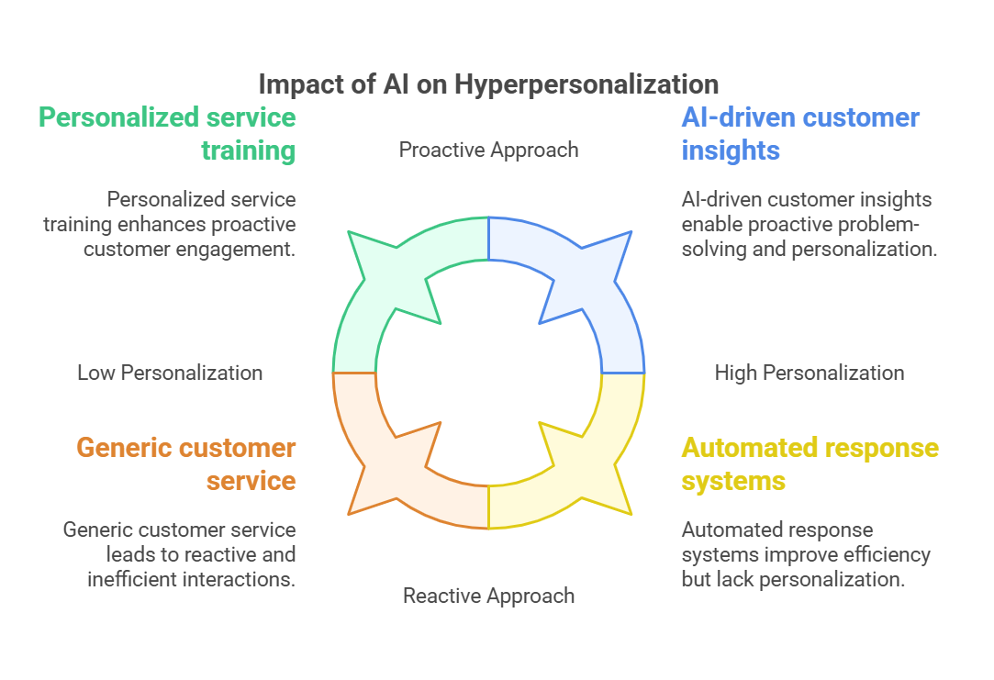

Slide 3
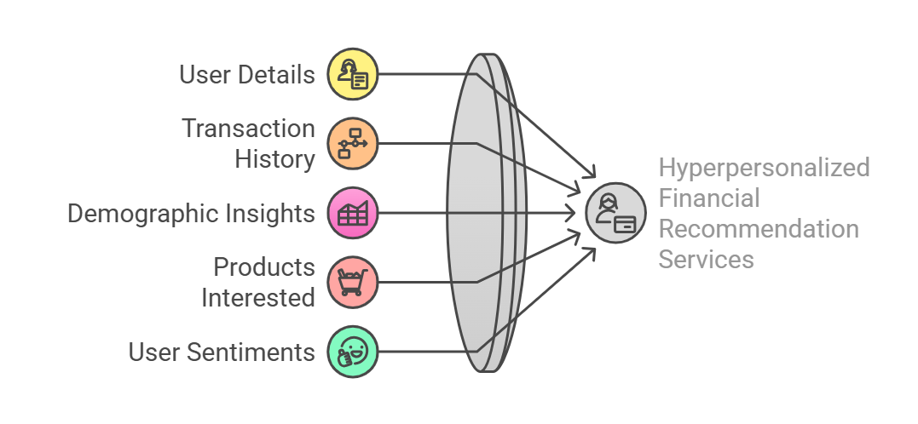
Challenges in Data Consolidation

Slide 4
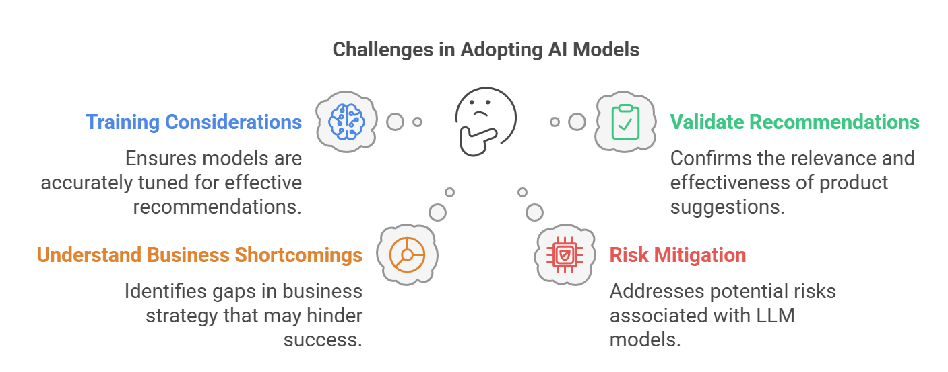
Challenges in Model Adoption

Slide 5
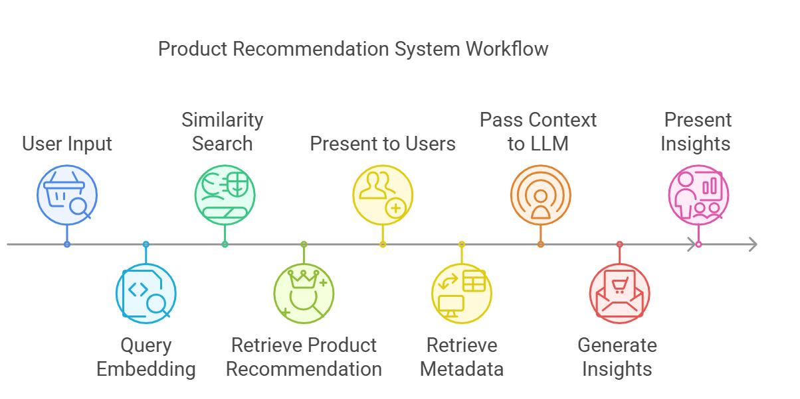
Solution Approach

Slide 6
Key Consideration
RAG based Approach : We have used Lang chain RAG approach to send the recommendations with LLM model and understand the reasoning why the products/services were offered This will help us define the successful recommendation and shortcoming of the products.
Adaptive Learning: We will use the reasoning from LLM as evaluation metrics to understand shortcoming of the products . This will be used as input to derive the metrics for the business users.
FAAIS – Vector Database : An open-source library developed by Facebook AI Research for efficient similarity search and clustering of dense vectors. Supports a variety of indexing methods and similarity metrics. This database was used to search the recommendations from banking products.

Slide 7
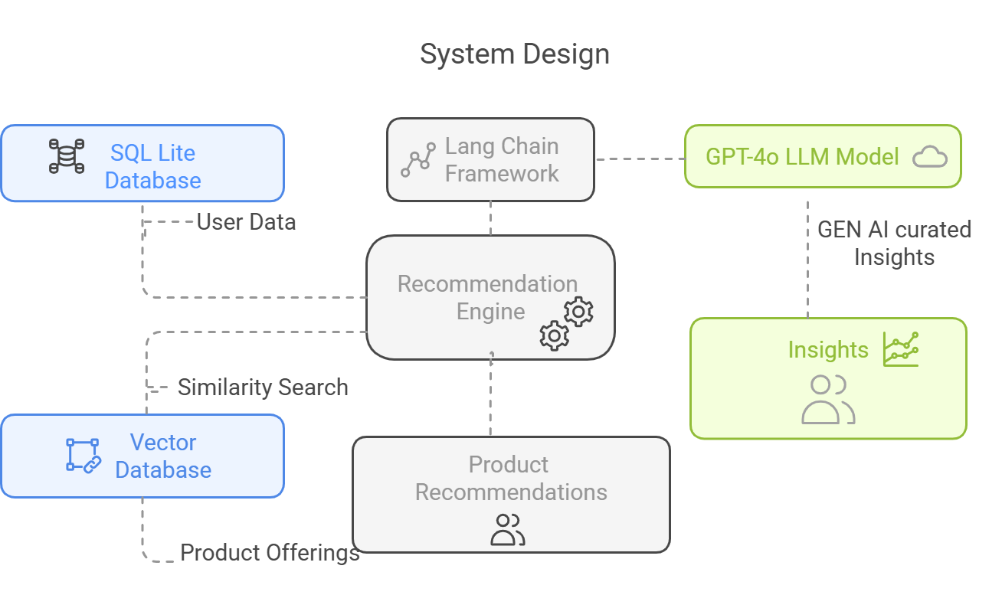
Technical Architecture

Slide 8
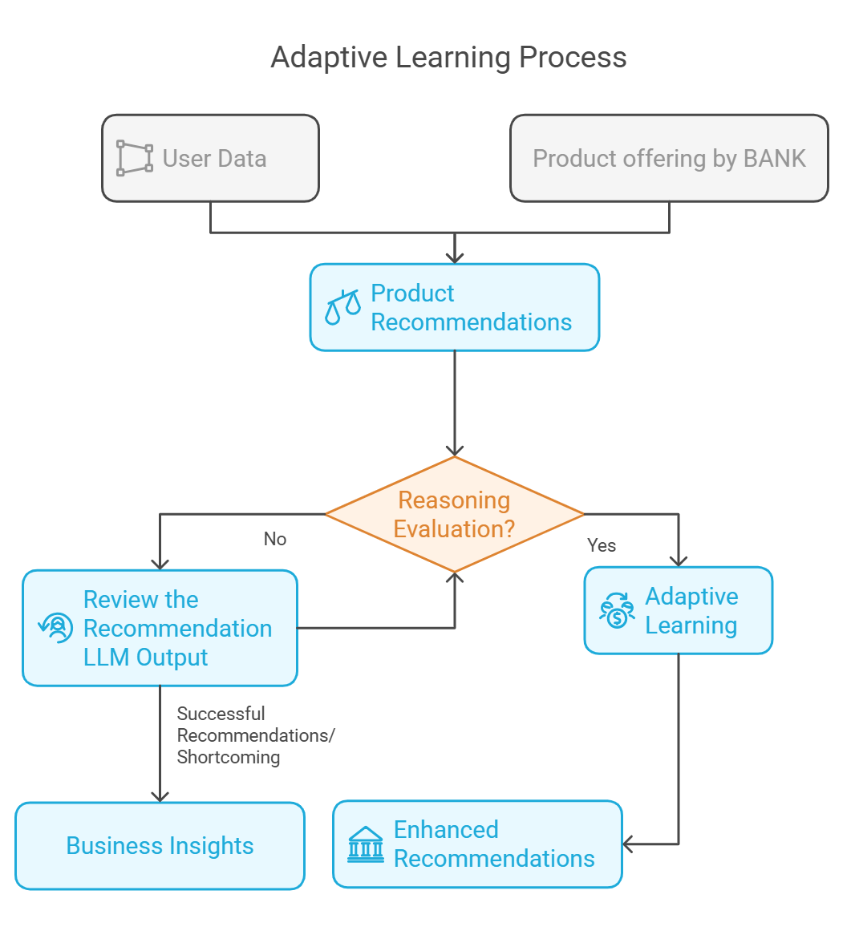
Adaptive Learning Workflow

Slide 9
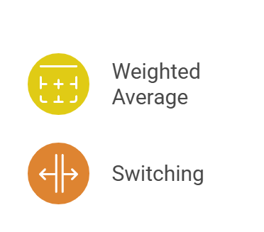
Recommendation Approach
Hyper parameter Tuning : Assign weights to the recommendations from each method and combine them.
Dynamic Query : The query used to filter the user data will be based on the weightage that is assigned to different parameters based on the learnings.
Hybrid Approach: Combination of collaborative filtering and content-based filtering for recommendation
Switching: Use collaborative filtering when you have sufficient user data, and content-based filtering for new users or products.

Slide 10
Q & A

