Slide 1
AI-Driven Hyper-Personalization
&
Recommendations
Team Name: Thugs_of_AI
Vikas Chandra
Ramesh Nandipalli
Madhucchand Darbha
Krishna P. Duvvur

Slide 2
PROBLEM STATEMENT
We are trying to solve the issue of modern customers wanting personal treatment. This is a complex problem that requires developing a system that goes beyond simply providing offerings, but also helps businesses identify ways to better engage with customers, forecast behaviors, and implements strategic decisions all while using AI ethically and safeguarding data privacy.

Slide 3
DATA DETAILS
01
CustomerProfile
10000 rows
02
OrganizationProfile
10000 rows
DATA
03
Social Media Sentiments
20000 rows
04
Transactions
20000 rows
05
Different Wellsfargo Products
Products

Slide 4
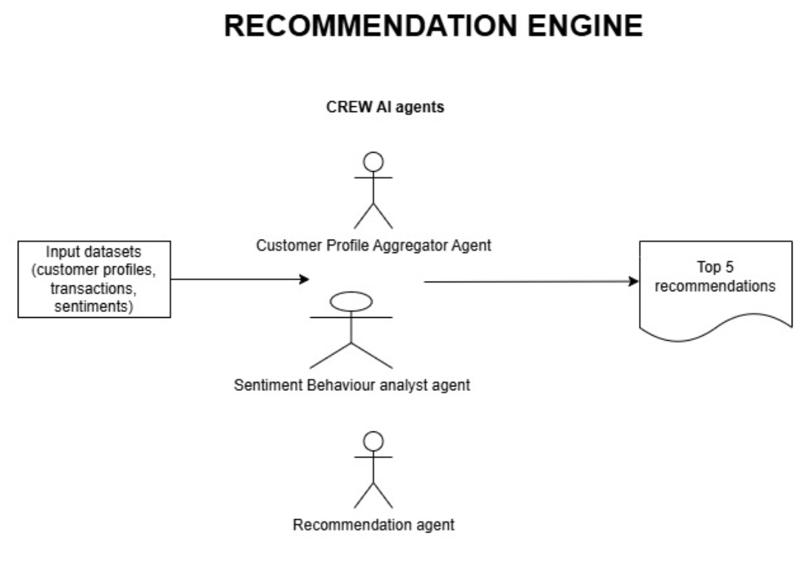
Architecture

Slide 5
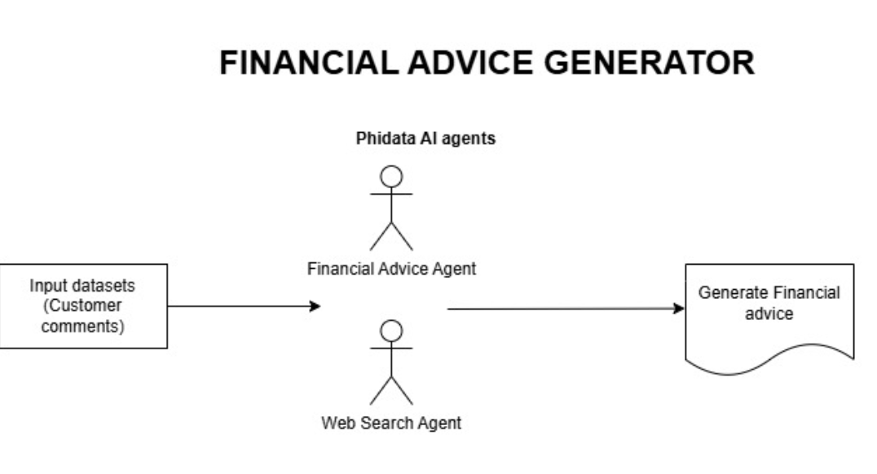
Architecture

Slide 6
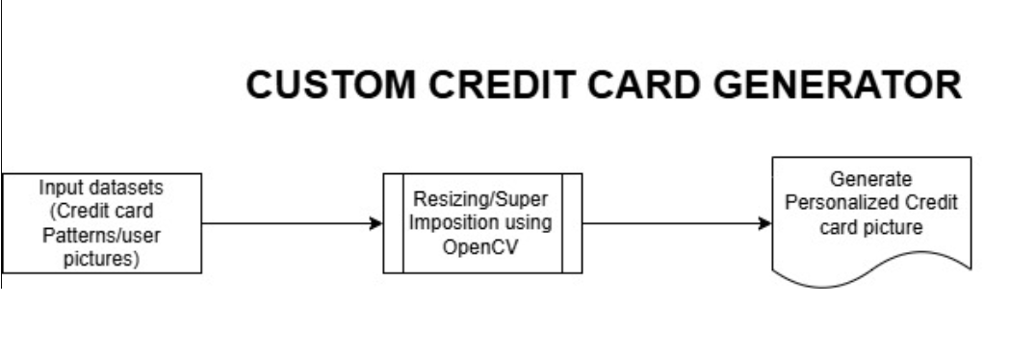
Architecture

Slide 7
Key Features
Two-Mode Financial Advice System
Agentic AI Architecture
LLM-Powered Recommendation Engine
Voice Input Support
Interactive Streamlit UI
Real-Time Information Retrieval
Sentiment Prediction

Slide 8
Tech Stack
Frontend: Streamlit/Gradio
Backend: Python, FastAPI, Transformers, crewAI, phiData, opencv, groq, llama, OpenAI/vaderSentiment

Slide 9
Screenshots

Slide 10
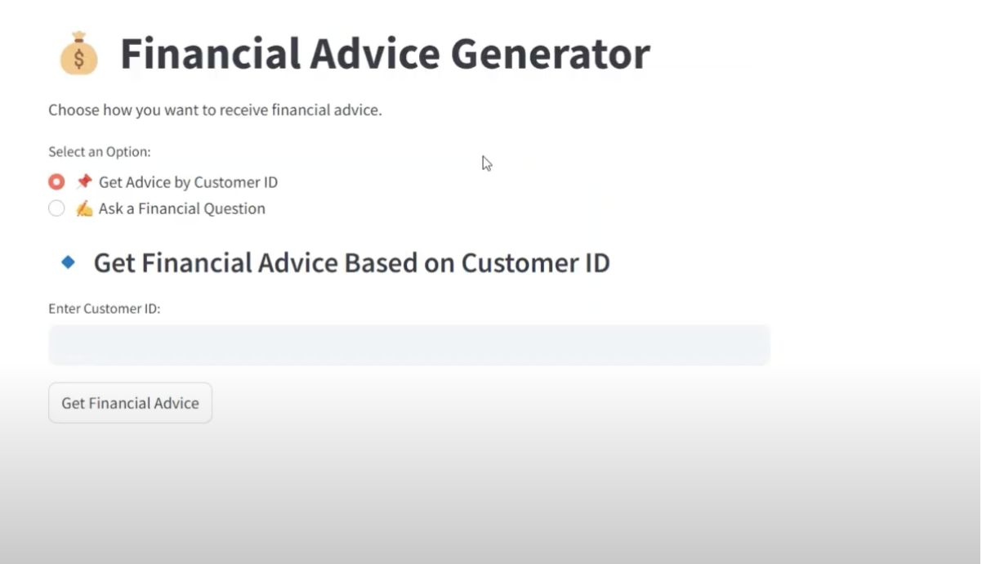

Slide 11
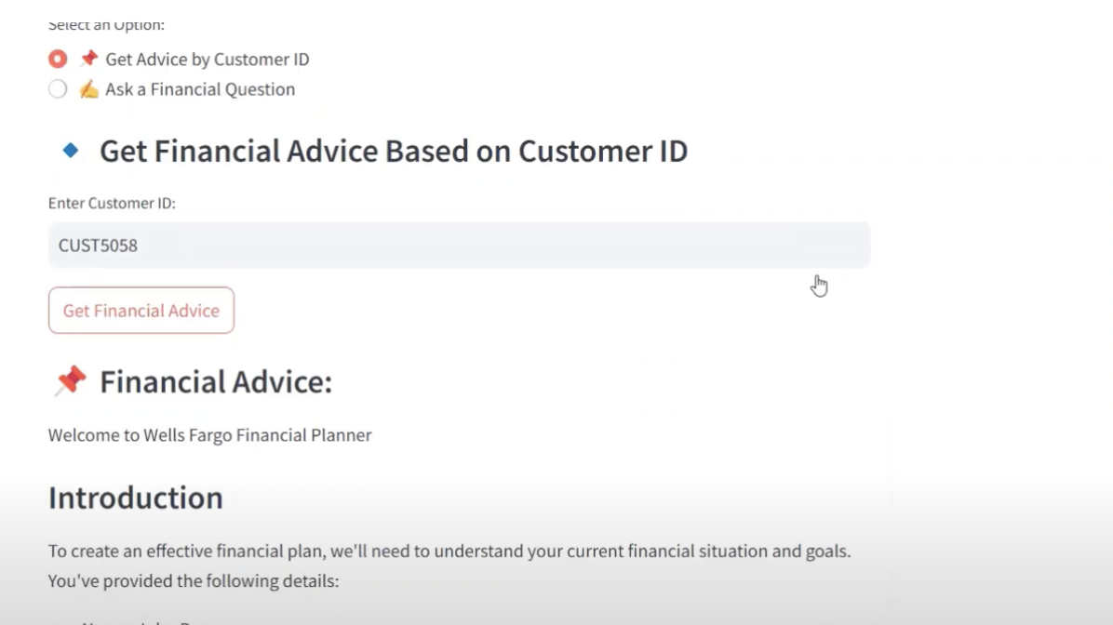

Slide 12
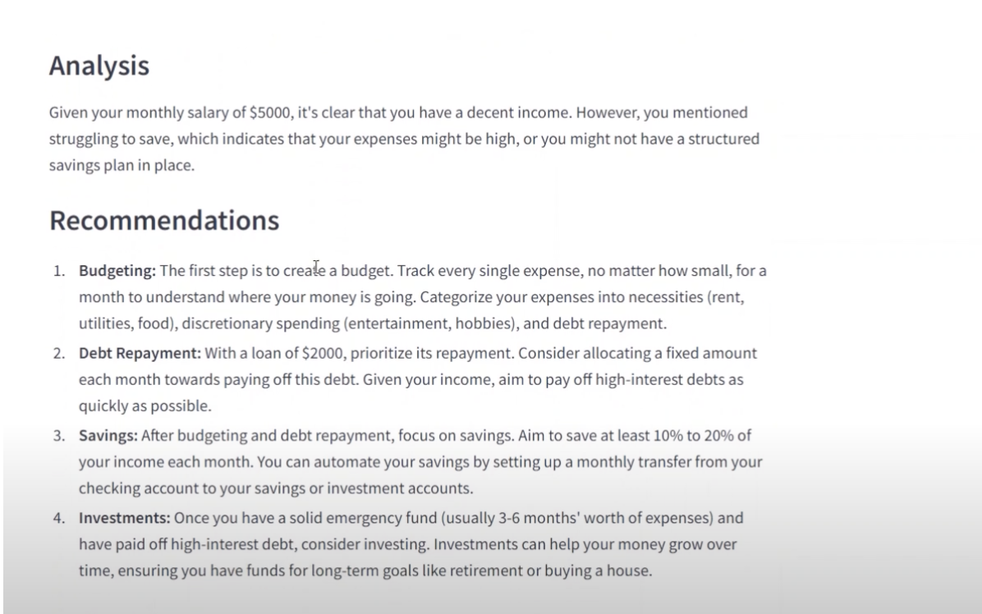

Slide 13
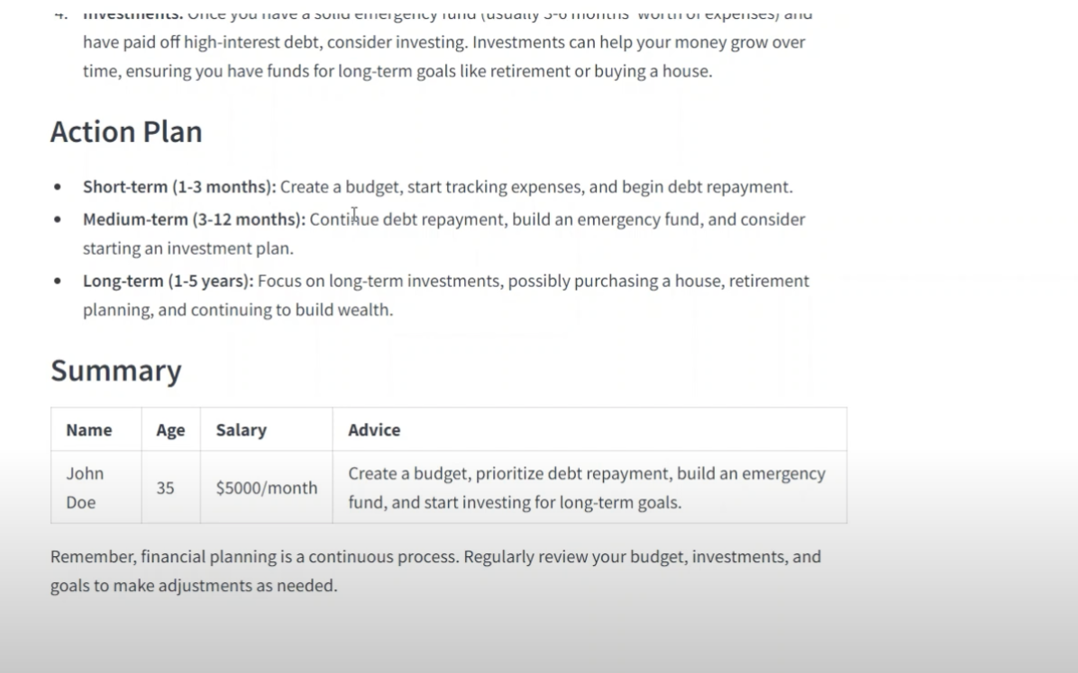

Slide 14
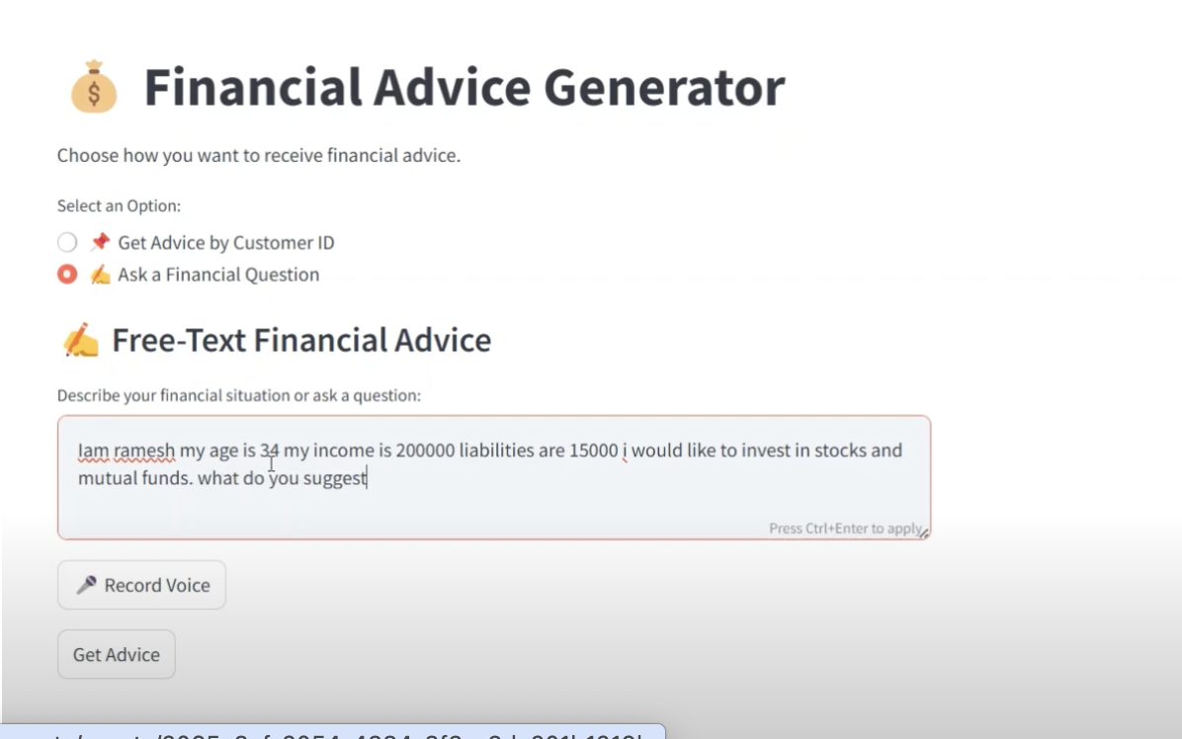

Slide 15
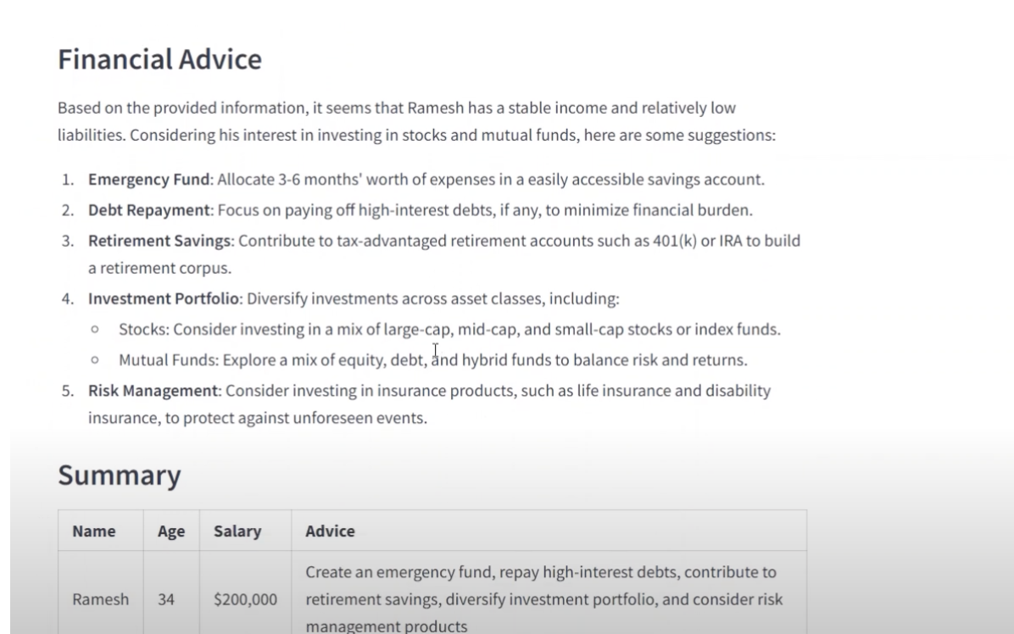

Slide 16
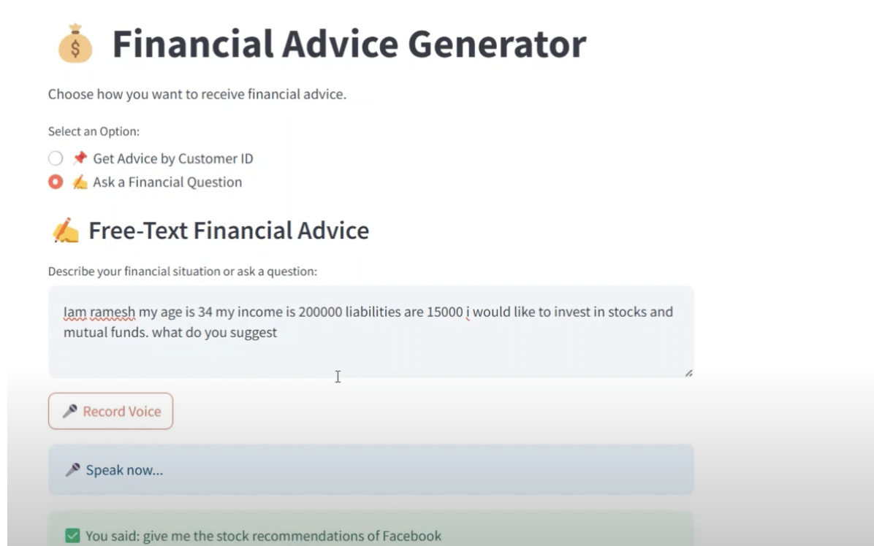

Slide 17
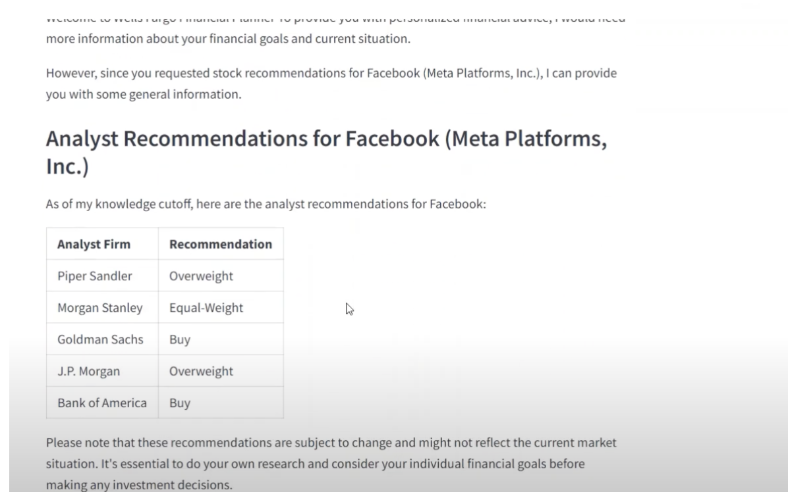

Slide 18
