Slide 1
AI Driven Hyper-Personalization Recommendations
Traiging Titans
March 2025

Slide 2
Solution Outline
Solution Approach
Key Features
Current Implementation Details
High Level Diagram(MVP)
High Level Diagram(Vision for Future)

Slide 3
Key Features
Create Hyper Personalization Agent: Agentic Approach
Langchain used for LLM based Orchestration
LLMs can be changed easily
Personalized Video generation with SORA AI
Different Personas created: Unique insights
e.g. A persona will be Delinquent Customer, who would get Push Notification on a proposed Loan Modification recommended by this Agent

Slide 4
Solution Approach
Core Objectives
Deliver personalized experiences based on User preferences, behaviors, and real-time interactions
Continuously learn and adapt to improve recommendations and interactions
Maintain privacy and security while processing user data
Data Collection & Processing
User Profile Data – Preferences, demographics, past interactions
Behavioral Data – Clicks, purchase types, engagement patterns.
Contextual Data – Social media analytics, Bank Engagement analysis

Slide 5
Solution Approach
User Interface & Experience
Omnichannel Support – Web, Mobile, Voice Assistants, Smart Devices.
Adaptive UI/UX – Interfaces dynamically adjusting to user behavior.
Conversational AI – Chatbots & voice assistants for engagement.
Personalization Strategies
Predictive Analytics – Anticipate user needs before they express them.
Content Customization – Personalized Videos, Feeds, emails, push notifications..
Persona Based Segmentation – Grouping similar users for better targeting
Responsible AI Considerations
Explainable AI (XAI) – Ensure users understand recommendations.
Consent-Based Personalization – Users control their data preferences.
Bias Mitigation – Regular audits to ensure fairness.

Slide 6



Architecture
Emails
Push Notification
Personalized Videos
WhatsApp Messaging
Recommendation Engine
ChatGPT Turbo 3.5
Derived Features:
Persona
Churn Score
Customer Context
Social Media Analytics
Twitter API
LinkedIn Knowledge Graph
Customer Contact Apps
IVR, Call Center, Chatbots etc.
Personalization Engine
ChatGPT Turbo 3.5
Vertex AI
Operational Data Store
Audio Transcript, Call Summaries
MongoDB Atlas
NLTK
Text preprocessing
Data Cleaning
Lemmatization
TF-IDF Vectorization
PreProcessing
Customer_Interactions
Transaction_history
Customer_Profile

Slide 7
Architecture & Technology Stack
Data Ingestion & Processing
🔹 Data Sources
Customer Interaction records: Chat Transcripts, Call Summaries, Complaints, Surveys
Transactional data: Type of transactions e.g. Credit Card purchase, loan repayment, E-Commerce Purchases
Behavioral data: Frequency of Transactions, Social Media Activity(Twitter Api, LinkedIn Knowledge Graph), recent Travel
External knowledge bases (FAQs, financial regulations)
Store all this in a Mongo DB Operational Data Store and Pinecode Vector DB
🔹 Data Processing
Apache Kafka– Data streaming & workflow automation
Pandas – Data transformation & preprocessing
NLP Pipelines – NLTK (for processing unstructured complaints)
🔹 Messaging & Channels
WhatsApp API – Conversational banking support
Voice AI: Vertex AI

Slide 8
Architecture & Technology Stack
AI & Model Pipeline
🔹 LLM
ChatGPT-4 Turbo (via OpenAI API) – Core NLP engine
SORA AI: Personalized Videos
LangChain – Orchestrating LLM workflows
LlamaIndex – Indexing & retrieval optimization

Slide 9

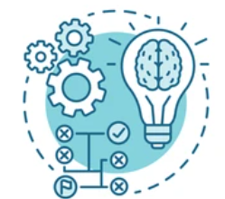



Insights Flow
Customer Complaints
Social Media
Survey Scores
Behaviour Data
Processing Logic
Derived Insights
Churn Score
Persona
Transaction History
Age
Location
Loans Data
Interaction Sentiment Analysis
Key Concern
ChatGPT Turbo 3.5
Communication Preference
Demographic Data

Slide 10




Personas
Segmentation of User Profiles into these Personas
Frequent Delinquent
High Net Worth Individual
Recently Disengaged
Retiree
Credit Seeker
Gen Z: Digital Native
Small Business Owner

Slide 11
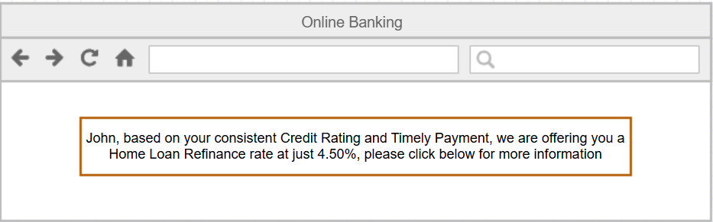




Recommendation/Offer Communication Modes
Personalized Banners:
For Rate Refinance, New Credit Cards, BNPL Offers etc.
Push Notification:
For urgent tasks like:
1. Act on Delinquency
2. Payment Due
Personalized Videos:
Explain Documents
Increase Application Pull through rate
WhatsApp Messaging:
New Offers
Complaint Resolution reassurance
Email Campaigns:
Festive Discounts
Social Media offers

