Slide 1
Context-Aware Testing System for Financial Applications
Automated Test Case Generation, Synthetic Data Integration & Execution

Slide 2
Problem Statement
Financial applications involve complex workflows (Payments, Customer Onboarding, Loan Processing).
Manual test case creation is time-consuming, inconsistent, and lacks adaptability to dynamic scenarios.
Lack of quality test data results in inadequate test coverage.
Testing data and execution is not automated, leading to delays and inefficiencies.

Slide 3
Context & Need for Automation
AI-driven testing ensures faster, more adaptive test creation.
Context-aware systems generate business-relevant test cases dynamically.
Synthetic data enables realistic test execution without exposing real customer data.
Automating execution increases efficiency and test coverage.

Slide 4
Business Benefits
Accelerated Testing Cycles: Automated test case and data generation reduce time-to-market.
Improved Accuracy & Coverage: AI ensures comprehensive scenario coverage.
Reduced Costs: Eliminates the need for manual test scripting and data creation.
Enhanced Security: Synthetic data protects sensitive financial data.
Scalability: Easily adapts to new financial workflows and compliance changes.

Slide 5
Solution Overview
User Input: User provides context (e.g., Payment, Customer Onboarding scenarios).
AI-Based Test Case Generation: LangChain agent creates test cases dynamically.
Synthetic Data Generation: Context-aware financial data creation.
Test Execution: Runs test cases in financial applications.
Dashboard & Reporting: Logs results and provides insights.

Slide 6
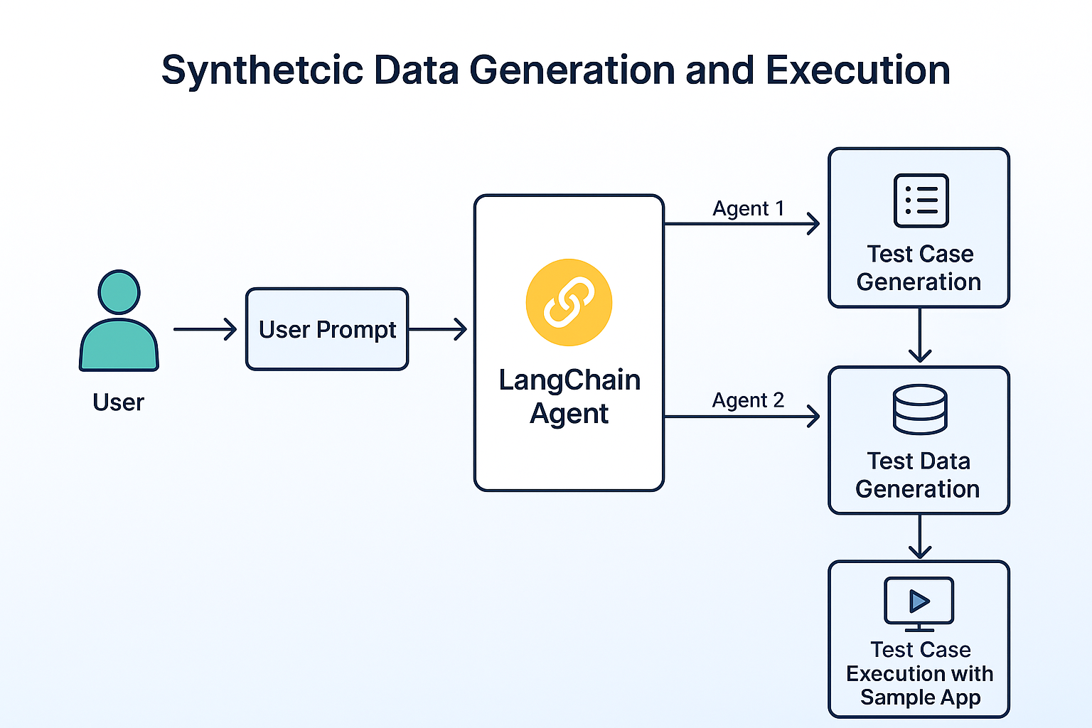
Technical Architecture Diagram
A detailed architecture diagram illustrating system components.

Slide 7
Key Components
User Interface (UI): Web-based input, test case review, and execution management.
LangChain Test Case Generator: AI-driven dynamic test case creation.
Synthetic Data Generator: Creates test data matching financial workflows.
Test Execution Engine: Executes test cases in payment/onboarding apps.
Dashboard & Reports: Real-time insights and analytics.

Slide 8
Demo Flow - End-to-End Process
1. User enters a financial scenario (e.g., Failed Payment, Fraud Check).
2. AI generates business-relevant test cases.
3. Synthetic data is created for execution.
4. Tests are executed in financial applications.
5. Results are displayed in dashboards for analysis.

Slide 9
Conclusion & Next Steps
Automates financial application testing with AI.
Reduces testing time & improves accuracy.
Enhances security by using synthetic data.
Next Steps: Expand integrations, optimize execution, integrate with CI/CD pipelines.

Slide 10
Thank you

