Slide 1

Context-Aware Testing System for Financial Ecosystems
Team Name: AITesters
Chaitanya, Ande
Lalit Basrani
Sweety, Kumari
Kumari Harsha
Punam Chandra

Slide 2

PROBLEM STATEMENT
Challenge Description
Design an innovative solution which can dynamically generate test cases for payments , customer onboarding , fraud detection , regulatory compliance and risk assessment. The goal is to develop a framework capable of self-updating test cases based on system changes , reducing maintenance efforts
This will help the Financial institutions which operate within complex ecosystems comprising multiple interconnected systems , applications and API’s , to reduce manual effort on generating & modifying test scenarios and a t the same time increase the test coverage.

Slide 3
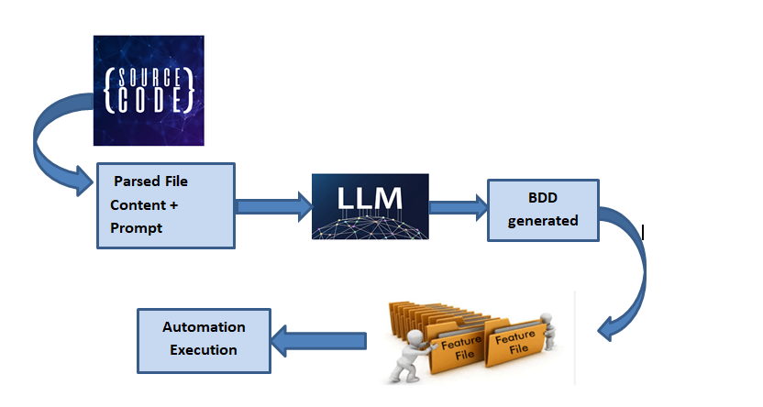
SOLUTION ARCHITECTURE

Slide 4
Loan Request Management Use Case

Slide 5
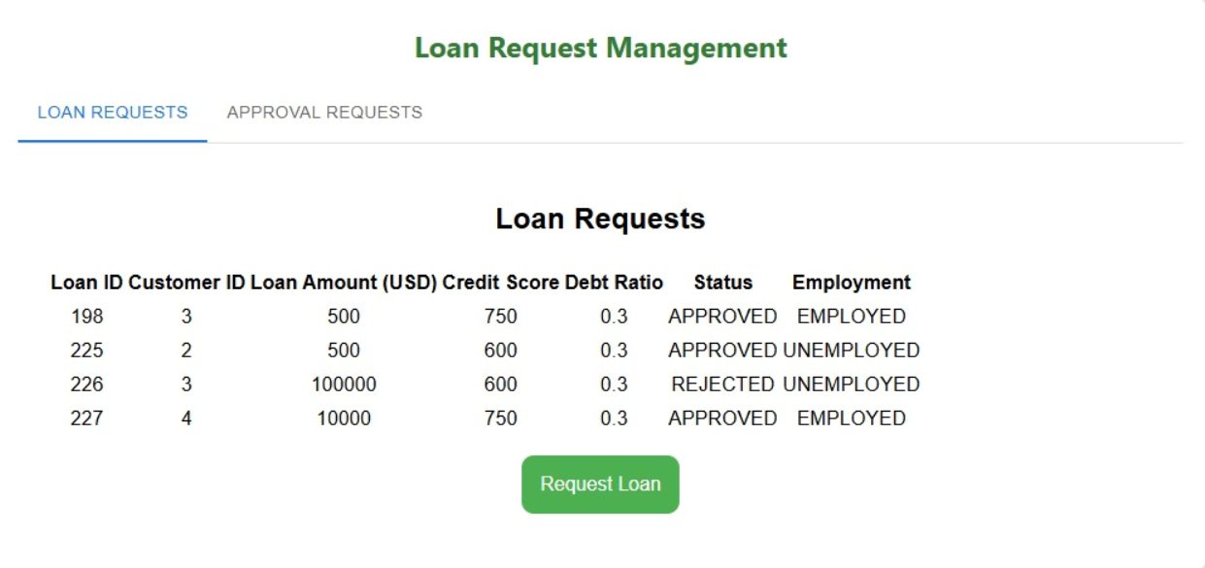

Slide 6
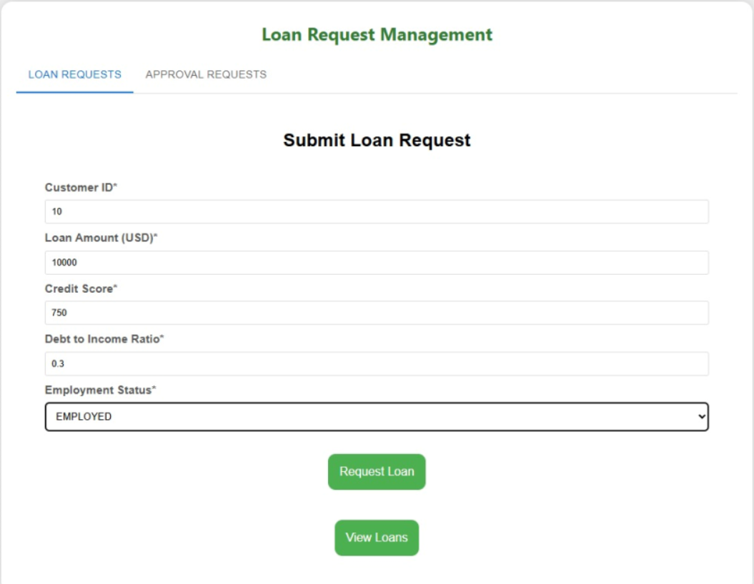

Slide 7
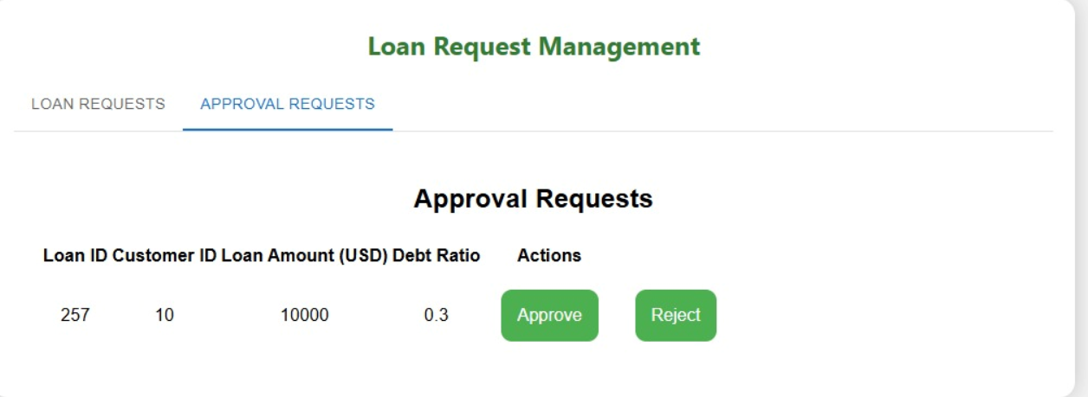

Slide 8
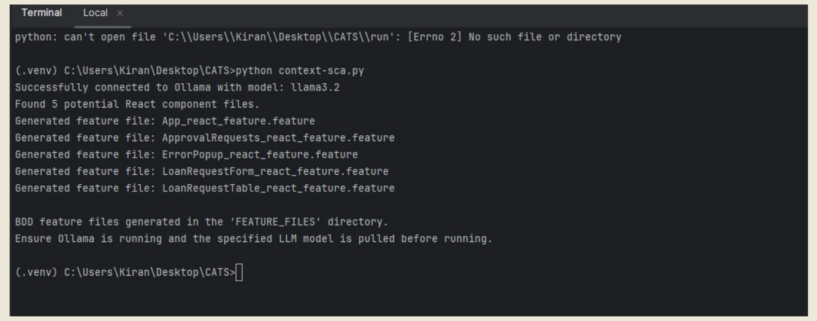

Slide 9
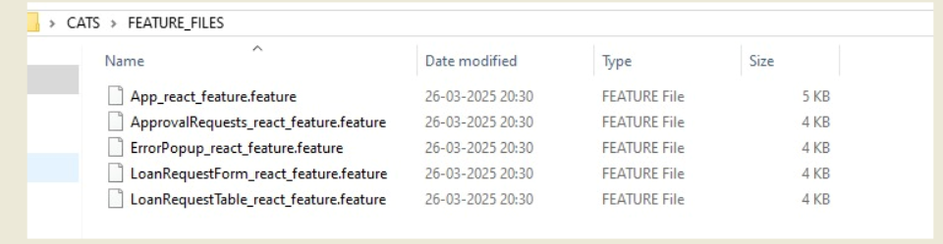

Slide 10


