Slide 1
Regulatory Compliance Advisor
Presented By:
Abhinav Apurva
Aditya Gupta
Anurag Dhote
Reena Gurjar

Slide 2
Introduction
The project aims to develop an AI-powered advisory system designed to assist businesses in navigating the complex and dynamic landscape of industry regulations
The system will leverage a Retrieval-Augmented Generation (RAG) setup to stay updated on the latest regulatory changes and provide actionable compliance guidance

Slide 3
Background
Regulatory Complexity
Businesses today operate in an increasingly complex regulatory environment, with rules and requirements that vary significantly across different jurisdictions.
Need for Compliance
Ensuring compliance with these regulations is crucial for avoiding legal penalties, maintaining reputation, and operating smoothly across different markets.
AI in Compliance
Traditional methods of keeping up with regulatory changes are often slow and inefficient. AI offers a powerful solution by automating the process of monitoring, interpreting, and advising on regulations.

Slide 4
Related Works and Gaps
Cost-Effectiveness of Proprietary Models (LLM & embedding)
Although OpenAI models deliver high performance, their cost can become prohibitive, especially for continuous monitoring and retrieval in large-scale regulatory environments
Data Privacy and Security
Using proprietary models for sensitive data, such as regulatory documents, poses risks regarding data privacy and security
Domain-Specific Fine-Tuning
Lack of domain specific knowledge can lead to generated answers appearing very generic

Slide 5
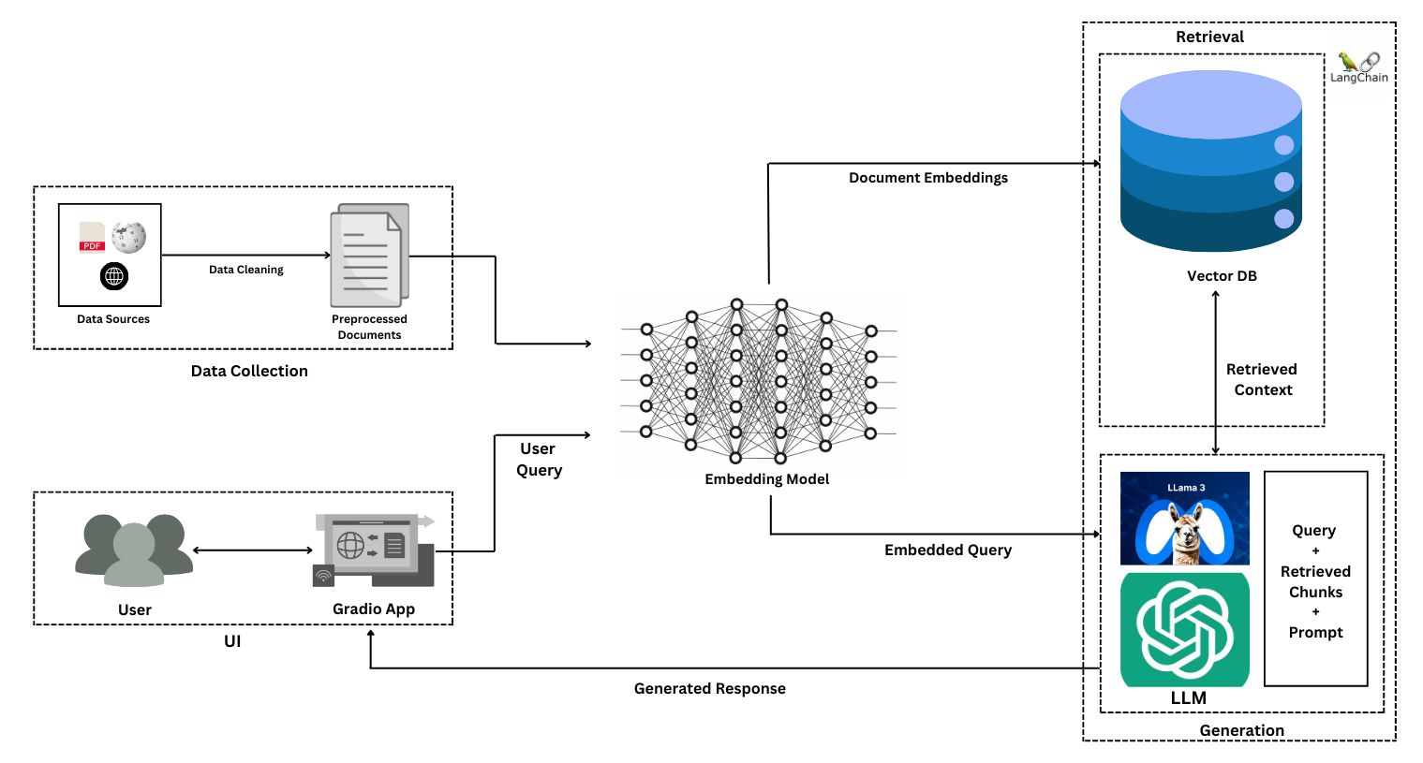
Project Methodology

Slide 6
Data Collection and Sources
Departments
Finance
Healthcare
Data Privacy
Sources
PDF documents
Wikipedia Pages
Websites
Region
US
European Union
India

Slide 7
Tools and Technologies Used
Framework :
LangChain
Data Preparation:
Embeddings – OpenAI Embedding Model
VectorDB – PineCone
Generation:
LLM – GPT-4o-mini
Evaluation:
RAGAS
User interface:
Gradio
Deployment
Docker

Slide 8
Experimental Setup
Vector Database
Chunk Size : 500
Indices: 3
Retrieval
Search Algorithm: Similarity Search
Retrieved Chunks: 20
Generation:
Output Tokens: 512
Temperature: 0

Slide 9
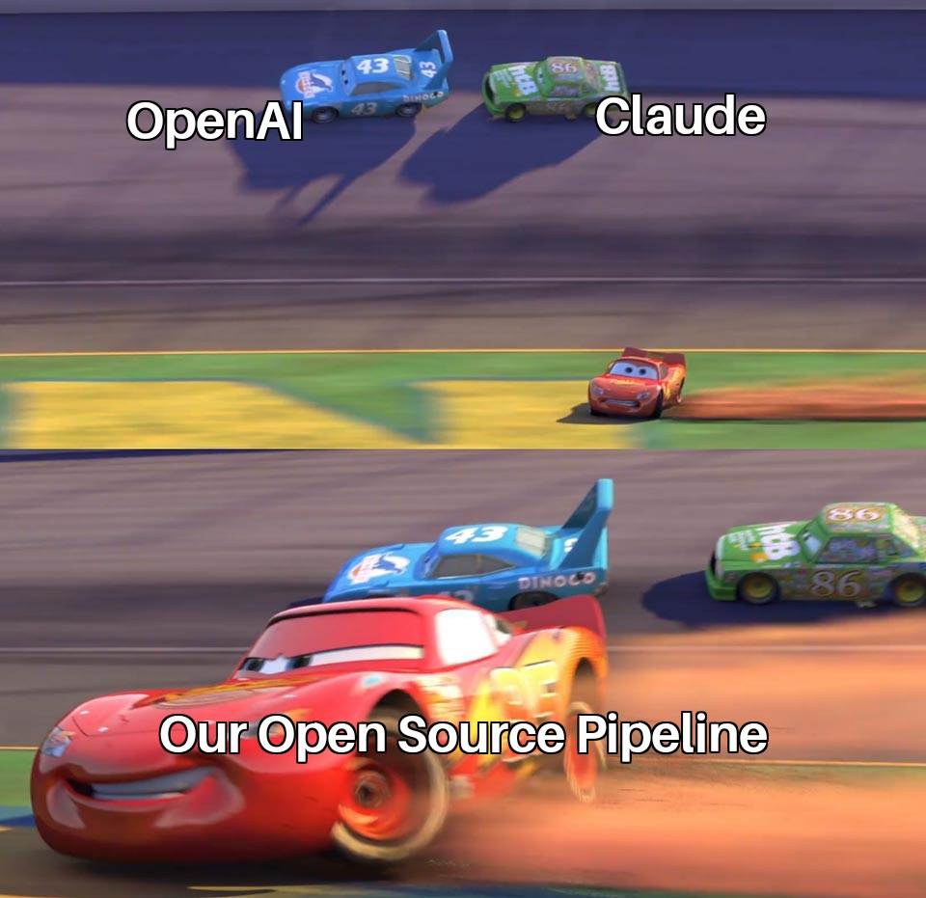
We also built a 2nd architecture
This one entirely on open source

Slide 10
Open-Source Pipeline
Used Stella embedding model
Stored embeddings in Qdrant vector database
Finetuned Llama 3.1 8B on synthetic data
However, the finetuned model gave gibberish output
Plugged in non finetuned llama 3.1 instruct 8B for generation

Slide 11
Finetuning Pipeline
Llama 3.1 8B Base
LoRA
Adaptor
LoRA Finetuning
Prompt Data Format
Contexts – 20 chunks (each of 512 tokens) Consisting of 4 relevant chunks All in random order
User Query
Answer
LLM merged with Adaptor
LoRA Adaptor Merging
Llama 3.1 8B Instruct
Final Model
Llama 3.1 8B Instruct
MergeKit with SLERP

Slide 12
RAG Evaluation
Data Generation:
Used free Groq API to generate query answer pairs using Llama-3.1-70B-instruct.
Generated 30 query-answer pairs for Data Privacy, Healthcare and Finance departments.
RAG Pipeline Evaluation:
Generated answers for the 30 queries for each department.
Based on the generated answers and retrieved context, evaluated the RAG pipeline using RAGAS framework for the following metrics:
Sent in chunks of 2048 tokens and generated 10 query-answer pairs for each chunks
Removed cases of hallucination by removing LLM outputs exceeding a certain threshold length (99 percentile)
Answer Relevancy
Context Recall
Faithfulness
Context Precision

Slide 13
RAGAS Results
RAGAS Metrics → | Context Precision |  | Faithfulness |  | Answer Relevancy |  | Context Recall
Sectors↓ | GPT-4o-mini | Llama-3.1 | GPT-4o-mini | Llama-3.1 | GPT-4o-mini | Llama-3.1 | GPT-4o-mini | Llama-3.1
Data Privacy | 1.0000 | 1.0000 | 0.9071 | 0.9095 | 0.9770 | 0.9143 | 0.8764 | 0.8764
Finance | 1.0000 | 1.0000 | 0.9161 | 0.7842 | 0.9353 | 0.8988 | 0.8833 | 0.8100
Healthcare | 1.0000 | 1.0000 | 0.8961 | 0.8456 | 0.9691 | 0.9476 | 0.8389 | 0.7989
Data Privacy | 1.0000 | 0.9655 | 0.9086 | 0.7471 | 0.9783 | 0.9075 | 0.9655 | 0.9828
Finance | 1.0000 | 1.0000 | 0.9094 | 0.8525 | 0.9330 | 0.9652 | 0.8889 | 0.8822
Healthcare | 0.9667 | 0.9667 | 0.9058 | 0.8700 | 0.9662 | 0.9524 | 0.8611 | 0.8444
OpenAI
Embeddings
Stella
Embeddings

Slide 14
Discussion
GPT-4o-mini performs better than Llama-3.1 for majority of the evaluation metrics.
01
Stella and OpenAI Embedding model offer comparable performances in the context of retrieval
02
Response time of GPT-4o-mini was 5x faster than Llama-3.1 model.
03
Hence, deployed GPT-4o-mini model with both OpenAI and Stella embedding model.
04

Slide 15
Deployment
Implemented an intuitive and user-friendly interface using Gradio.
Facilitated seamless interaction for users with the RAG (Retrieval-Augmented Generation) application.
Encapsulated the entire application into a Docker container.
Pushed the Docker container to Docker Hub.

Slide 16

Conclusion and Future Recommendations
Deployed a RAG pipeline that facilitates regulatory compliance guidance for the given query.
Emerging businesses can navigate the complex regulatory requirements to avoid legal penalties, maintain reputation and operate smoothly across different sectors.
The process of updating information in the database can be automated by applying regular update checks on specific data sources.
Embedding model can be finetuned to the stored embedding vector to further improve the generated answers.

Slide 17
References
Github: adi7820/Regulatory-Compliance-Advisor: GenAI based project RAG application (github.com)
LangChain
Pinecone
Qdrant - Vector Database – Qdrant
Gradio
Docker: Accelerated Container Application Development
meta-llama/Meta-Llama-3.1-8B-Instruct · Hugging Face

Slide 18
Thank You!

