Slide 1
ByteMe Gen AI data profiling
Presented By:
Changanti Vamsi Krishana
Siriki potha ramesh
Cherukula Mohan
Devaraju Somashekar
Koppuravuri Sarath Kumar

Slide 2
Introduction
The project aims to develop an AI-powered data profiling system designed to assist businesses in navigating the complex and dynamic landscape of industry regulations
The system will leverage a Retrieval-Augmented Generation (RAG) setup to stay updated on the latest data profiling to generated score system

Slide 3
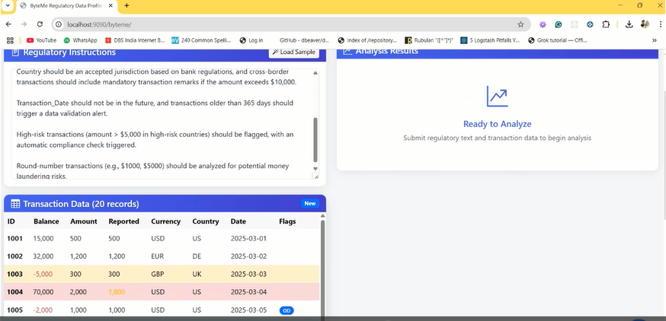
Demo screen shots

Slide 4
Related Works and Gaps
Cost-Effectiveness of Proprietary Models (LLM & embedding)
Although OpenAI models deliver high performance, their cost can become prohibitive, especially for continuous monitoring and retrieval in large-scale data profiling
Data Privacy and Security
Using proprietary models for sensitive data, such as provided documents, generate Score
Domain-Specific Fine-Tuning
Lack of domain specific knowledge can lead to generated answers appearing very generic

Slide 5
Data Collection and Sources
Departments
Finance
Healthcare
Data Privacy
Sources
PDF documents
Wikipedia Pages
Websites
Region
US
European Union
India

Slide 6
Tools and Technologies Used
Framework :
LangChain
Data Preparation:
Embeddings – OpenAI Embedding Model
VectorDB – PineCone
Generation:
LLM – GPT-4o-mini
Evaluation:
RAGAS
User interface:
Gradio
Deployment
Docker

Slide 7
Experimental Setup
LLM
AL LLM
Retrieval
Search Algorithm: Transformer-based NLP (GPT-3.5/4)
Retrieved Chunks: 20
Generation:
Output Tokens:
Temperature: 0

Slide 8
Demo Screenshot shots

Slide 9
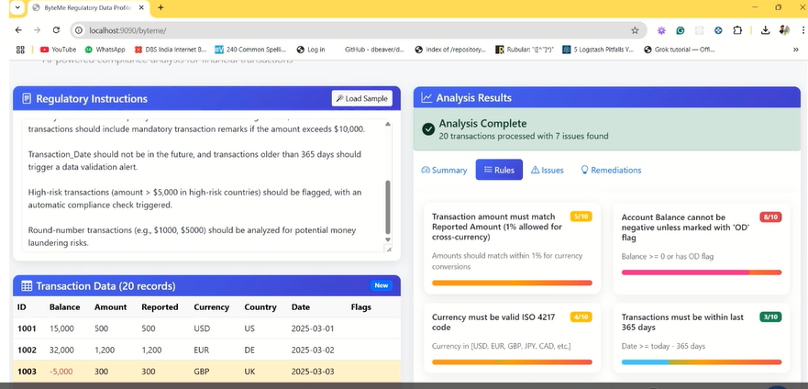
Demo Demo Screenshot screen shots

Slide 10
References
Github: ByteMe Data profiling: https://github.com/ewfx/catfe-byte-me (github.com)
Python
Open API LLM Model
Spring Boot
Thymeleaf UI

Slide 11
Thank You!

