Slide 1
Context Aware Testing System for Financial Ecosystems
Team Gen90s

Slide 2
Holistic Summary
This project is a Context-Aware Generative AI-driven Test Automation Platform built using Spring Boot and deployed in a Kubernetes environment.
It integrates OpenAI/LLM services, ethical hacking simulations, and fraud detection mechanisms to automate test case generation, execution, and security validation.
The application provides RESTful APIs for interacting with AI-driven test automation and security assessments.

Slide 3
Key Components and Their Roles
1. Controllers (REST APIs)
ChatController (ChatController.java)
Provides a chatbot API that interacts with AgentService for LLM-based conversations.
Generates BDD test cases based on user input.
Executes BDD tests and generates reports.
GreeterController (GreeterController.java)
A simple greeting API that responds with a message formatted dynamically using environment variables.
ContextAwareController (ContextAwareController.java)
Integrates OpenAI, Ethical Hacking, and Test Execution services.
Supports test case generation from app descriptions and URLs.
Executes ethical hacking simulations and fraud analysis.

Slide 4
Key Components and Their Roles
2. Services (Business Logic)
AgentService (AgentService.java)
Manages OpenAI API interactions for chat-based agent responses.
Generates BDD test cases using AI models.
Executes automated test cases with Maven and Cucumber.
Fetches real-time stock prices using Alpha Vantage API.
EthicalHackService (EthicalHackService.java)
Integrates OWASP ZAP for security vulnerability scanning.
Generates security reports in HTML format.
GenAIService (GenAIService.java)
Analyzes payment fraud data and generates BDD test cases.
Uses rule-based and AI-based fraud detection.
Handles chatbot interactions for test generation and security checks.
OpenAIService (OpenAIService.java)
Generates test cases using OpenAI's Llama-3.
Converts textual descriptions into structured test cases.
Executes BDD test cases via Cucumber.
TestExecutorService (TestExecutorService.java)
Parses and executes BDD test cases.
Simulates test execution and provides an execution summary.

Slide 5
Key Components and Their Roles
3.Application Entry Point
KubernetesSpringBootDemosConfigMapsDemoApplication (KubernetesSpringBootDemosConfigMapsDemoApplication.java)
The main Spring Boot entry point.
Loads configuration and starts the microservice.

Slide 6
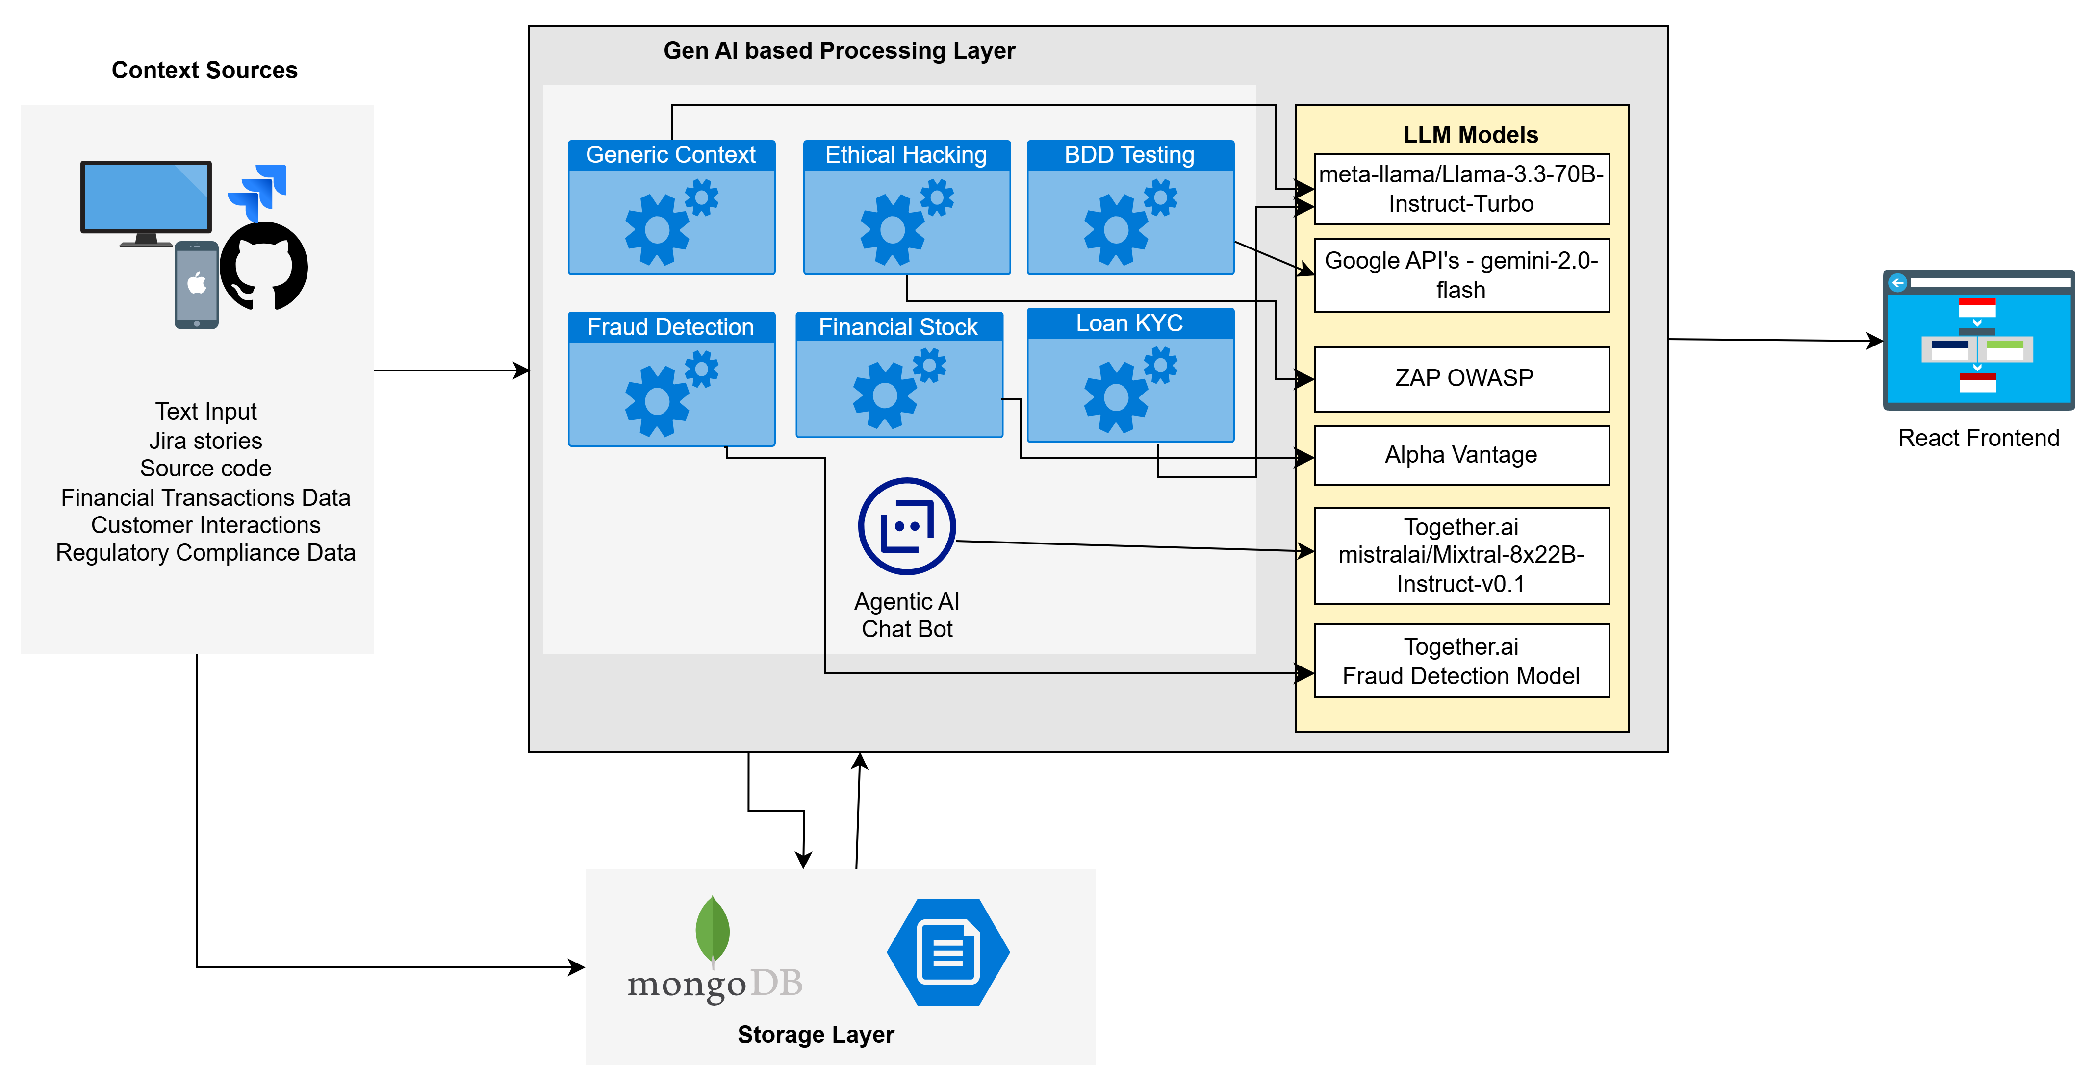
High Level Architecture

Slide 7
High Level Architecture
Below is the high-level architecture of the system:
Frontend (React/Vue/Angular - Not included in the uploaded files)
Interacts with backend APIs via HTTP requests.
Displays chatbot UI and test reports.
Backend (Spring Boot Microservices)
Controllers (REST APIs):
ChatController → AI-based chat
ContextAwareController → AI-driven test automation
GreeterController → Greeting API
Services (Business Logic):
AgentService → AI chat + test automation
OpenAIService → Test case generation
GenAIService → Fraud detection + test automation
EthicalHackService → Security scanning
TestExecutorService → BDD test execution
External Integrations
OpenAI/LLM APIs → AI-based test case generation
Alpha Vantage API → Real-time stock data
OWASP ZAP → Security penetration testing
TogetherAI API → Fraud detection
Deployment & Execution
Runs on Kubernetes using ConfigMaps.
Uses Maven + Cucumber for test execution.
Generates HTML reports for security & test execution.

