Slide 1
Context Aware Testing System
Memory Overflow - Team
Team Member - Saravana Manikandan Nagarajan

Slide 2
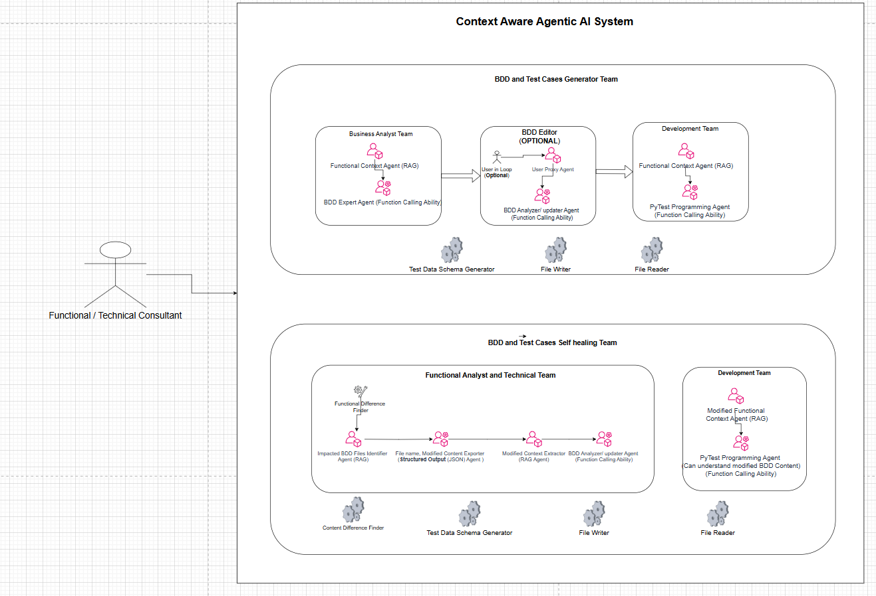
Architecture
Architecture Diagram

Slide 3
Completed Items/ Achievements
Built and an Multi Agent system (Around 10 + Agents ) are working together
And providing the complete AI Testing suit.
BDD Test cases generated based Functional Document and API Document (Swagger)
PyTest Test cases generation based on BDD Feature files, Functional Document and API Document
Agents will Automatically identifying the Documents and mapping it with Swagger document
API Test Data Schema Identification before generating the test data
Link between BDD files and Python Test Files
Ability to identify difference between two functional document versions and understand the context
Agents will understand the Testing Pre-Request Context to automatically setup the Test user and Authentication Context
(If user wants) Ability for the users to modify the existing Feature files and update the test cases Using Gen AI Agent (Demo Added)
Agents having Self healing ability if there is any update/addition in Functional Document or API Document and update the multiple BDD Files and PyTest Files
Ran Test cases using Command line

Slide 4
Documents used for BDD and test case generation
Open API Document Used
Functional Documents Used
Testing Initial Context document
(Test Account – this will vary from application to application and based on the authentication mechanism or if any other initial setup needed)

Slide 5
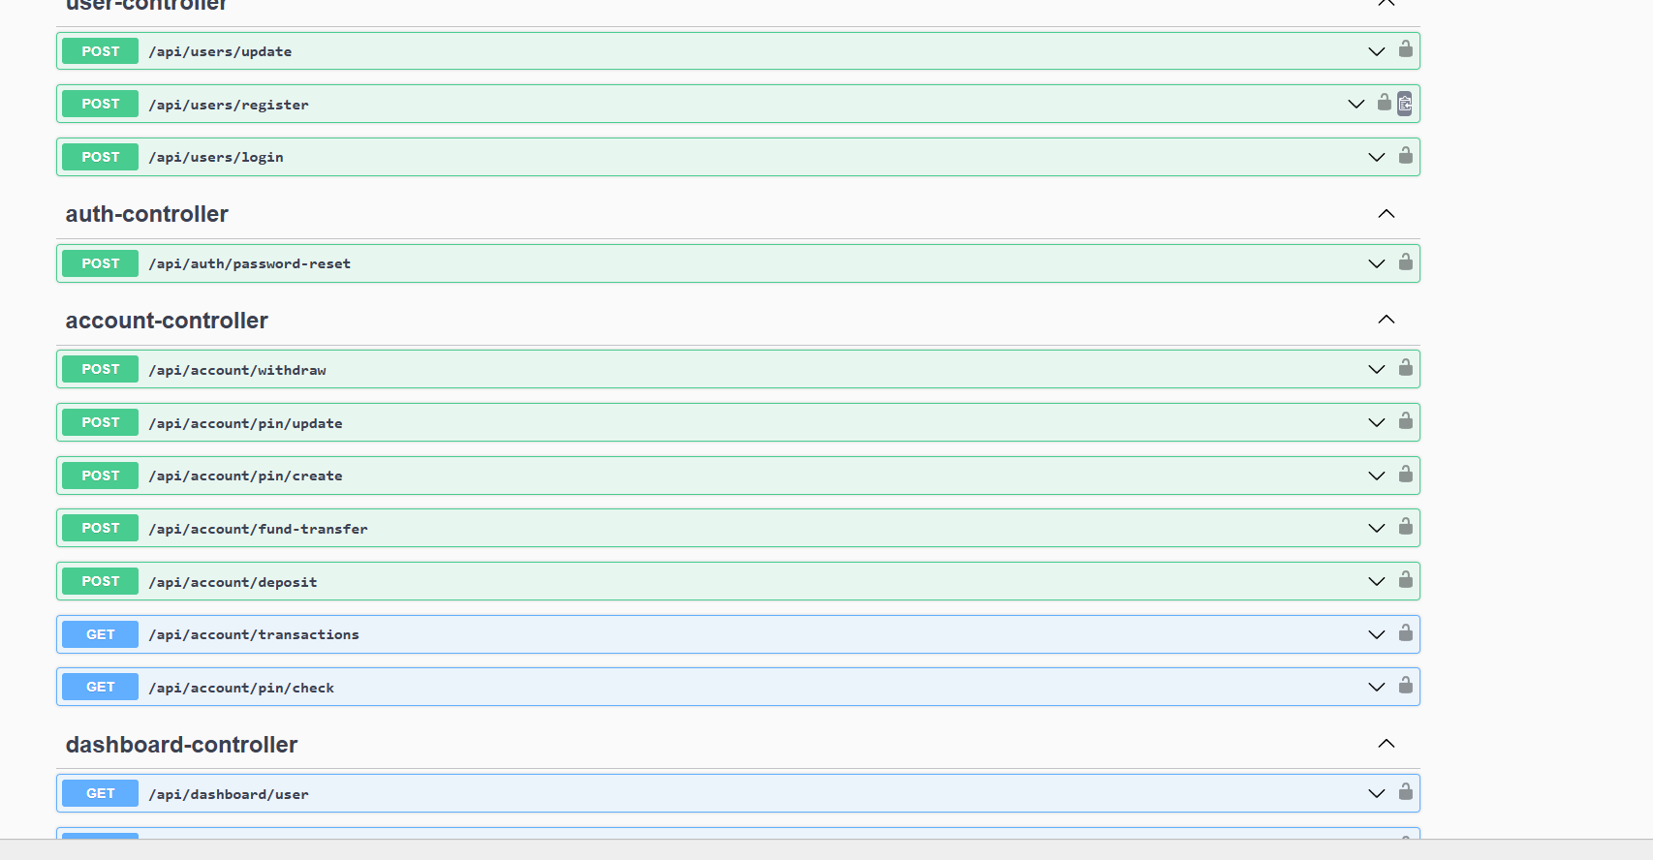
API Application used for Testing (This is not we developed. Just used for testing)

Slide 6
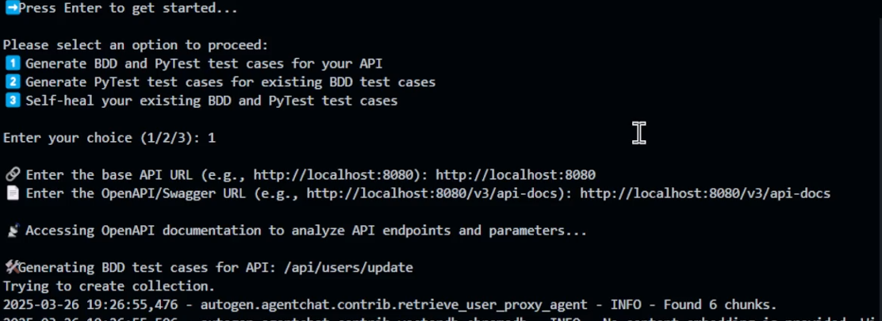
Analyzing Open API documents along with Functiona Documents

Slide 7
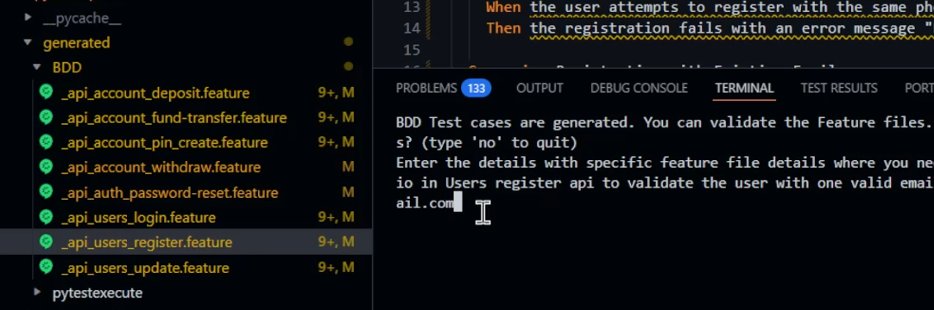
Generated BDD feature files

Slide 8
Analyzing Open API documents along with Functiona Documents

Slide 9
Thank you !!

