Slide 1
Context Aware Testing System
Memory Overflow - Team

Slide 2
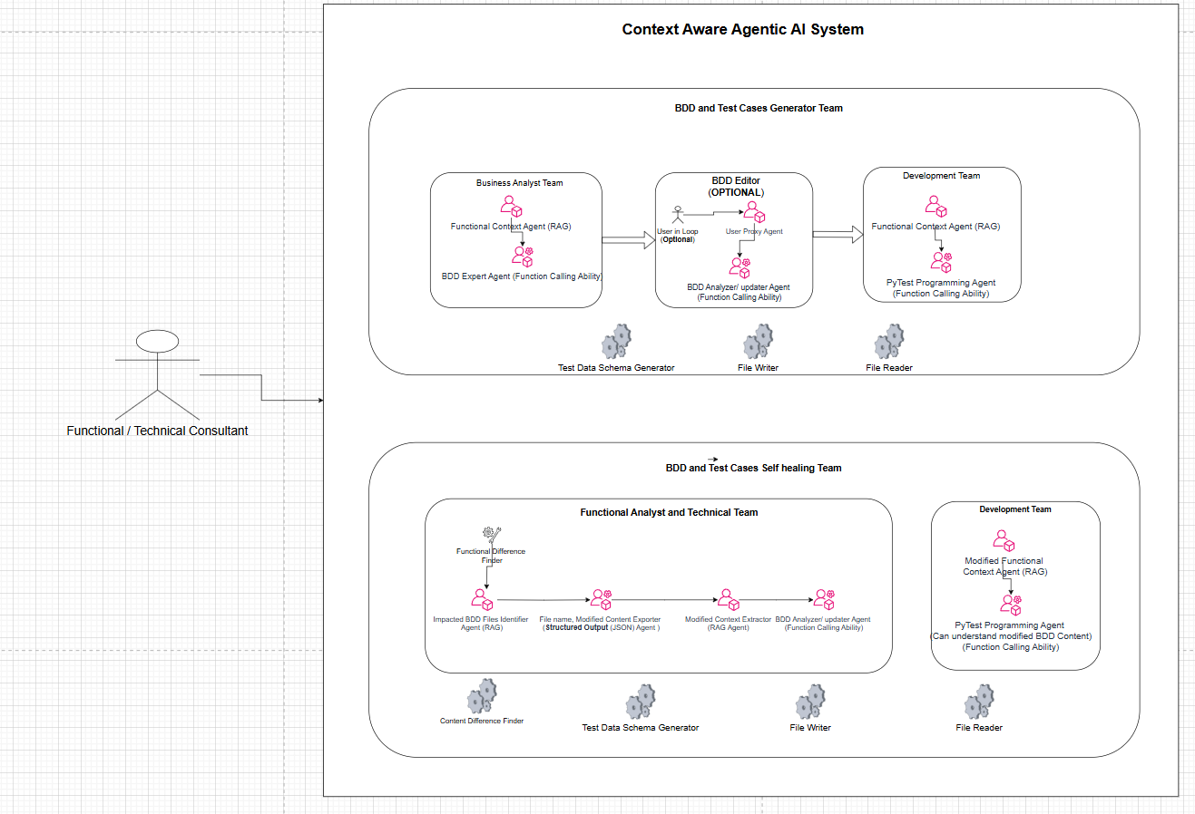
Architecture
Architecture Diagram

Slide 3
Completed Task Items
BDD Test cases generation based Functional Document and API Document (Swagger)
PyTest Test cases generation based on BDD Feature files, Functional Document and API Document
(If user wants) Ability for the users to modify the existing Feature files and update the test cases Using Gen AI Agent
Self healing ability if there is any update/addition in Functional Document or API Document and update the multiple BDD Files and PyTest Files

Slide 4
Documents used for BDD and test case generation
Open API Document Used
Functional Documents Used
Testing Initial Context document
(Test Account – this will vary from application to application and based on the authentication mechanism or if any other initial setup needed)

Slide 5
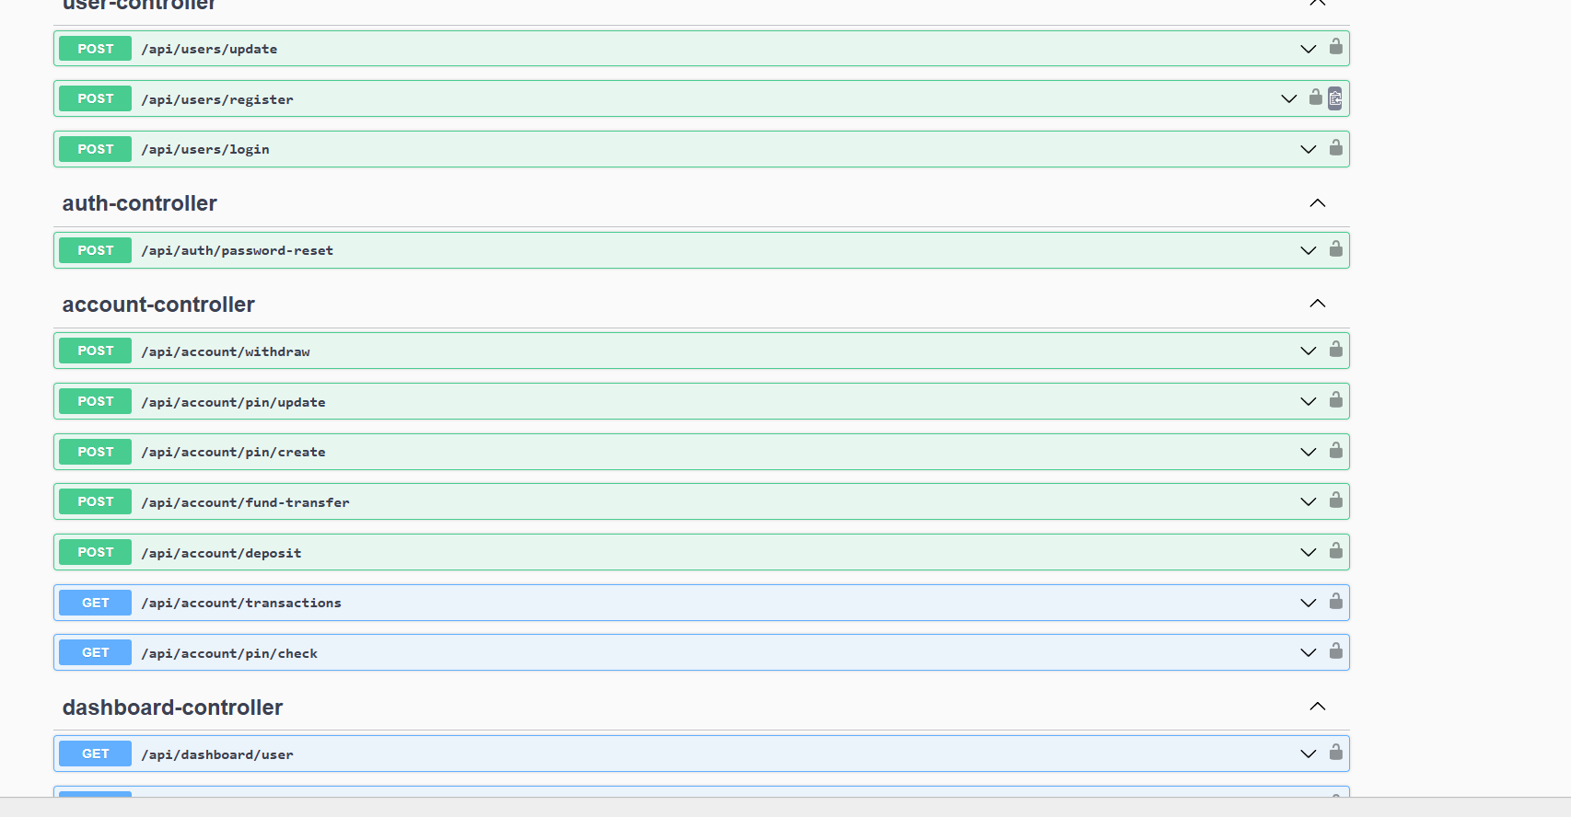
API Application used for Testing (This is not we developed. Just used for testing)

Slide 6
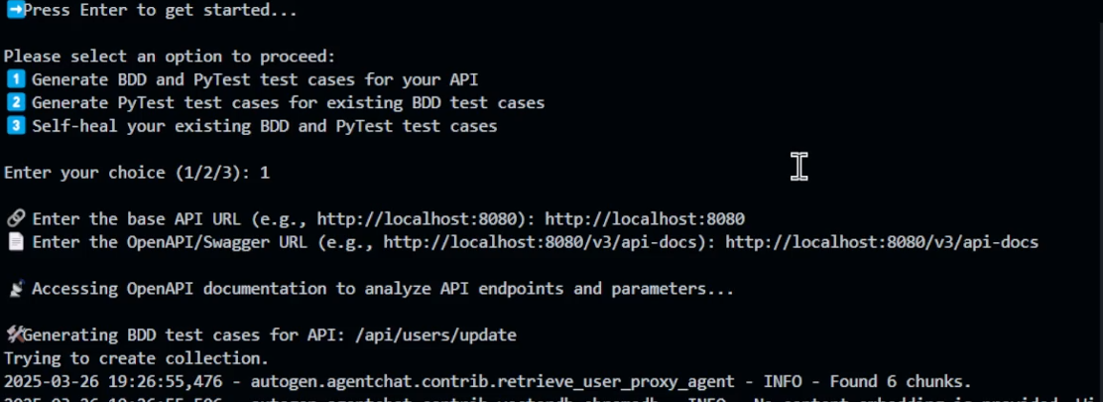
Analyzing Open API documents along with Functiona Documents

Slide 7
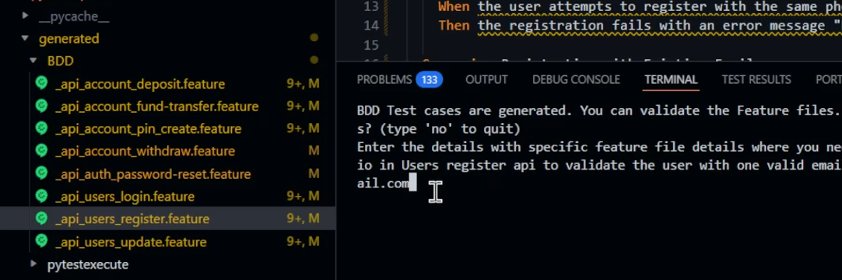
Generated BDD feature files

Slide 8
Analyzing Open API documents along with Functiona Documents

Slide 9
Thank you !!

