Slide 1

DATA PROFILING
TECHNOLOGY HACKATHON
2025
AI-Powered Compliance Validation System

Slide 2
Team Members
Rajendra Prasad, Ganji
Lohith, Muduthanapelly
Saleem, Shaik
Jaya Prakash, Gubbala
Sree, Kota

Slide 3
Problem Statement
Ensuring transaction compliance with federal laws and profiling rules is a highly intricate task. Financial institutions must adhere to complex regulations, and failing to do so can result in legal penalties, reputational damage, and financial losses. Currently, compliance validation is largely manual, requiring extensive human effort to analyze transactions against constantly evolving regulations. This manual process is not only time-consuming but also prone to errors, inconsistencies, and inefficiencies. With increasing transaction volumes and regulatory requirements, an automated, scalable, and intelligent solution is necessary to ensure accurate compliance validation while reducing operational costs and risks.

Slide 4
Solution
A system that extracts compliance rules from legal PDFs using AI.
Utilizes advanced AI models to interpret and structure compliance rules.
Dynamically maps incoming transactions to the extracted rules for real-time validation.
Provides compliance results, risk scores, violated rules, and remediation suggestions.
Offers an interactive dashboard for users to input transaction data and view results.
Leverages machine learning to improve accuracy over time based on historical compliance checks.
Ensures scalability to handle large volumes of transactions efficiently.
Reduces reliance on manual intervention, increasing accuracy and consistency in compliance validation.

Slide 5
Tech Stack
Backend: FastAPI (for API development), Python (for AI logic), LangChain (for structured document processing), Groq Llama3-70b (for AI inference)
Frontend: Streamlit (for UI/UX and interactive dashboard)
Deployment: Localhost
APIs: ChatGroq
Python Packages: fastapi, uvicorn, langchain, chromadb, streamlit, pydantic, requests, pandas, numpy, openai, groq, dotenv, pytest, logging

Slide 6
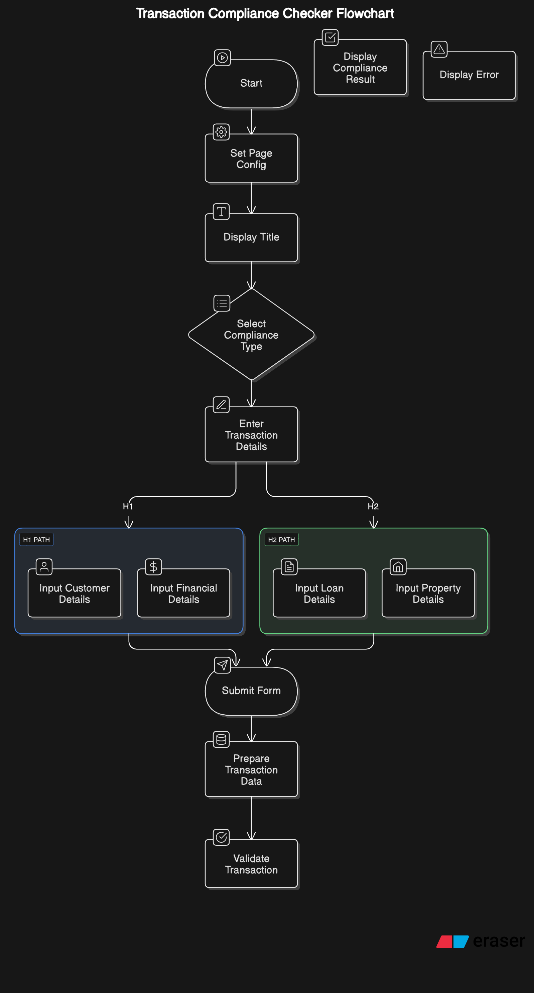
FLOWCHART

Slide 7
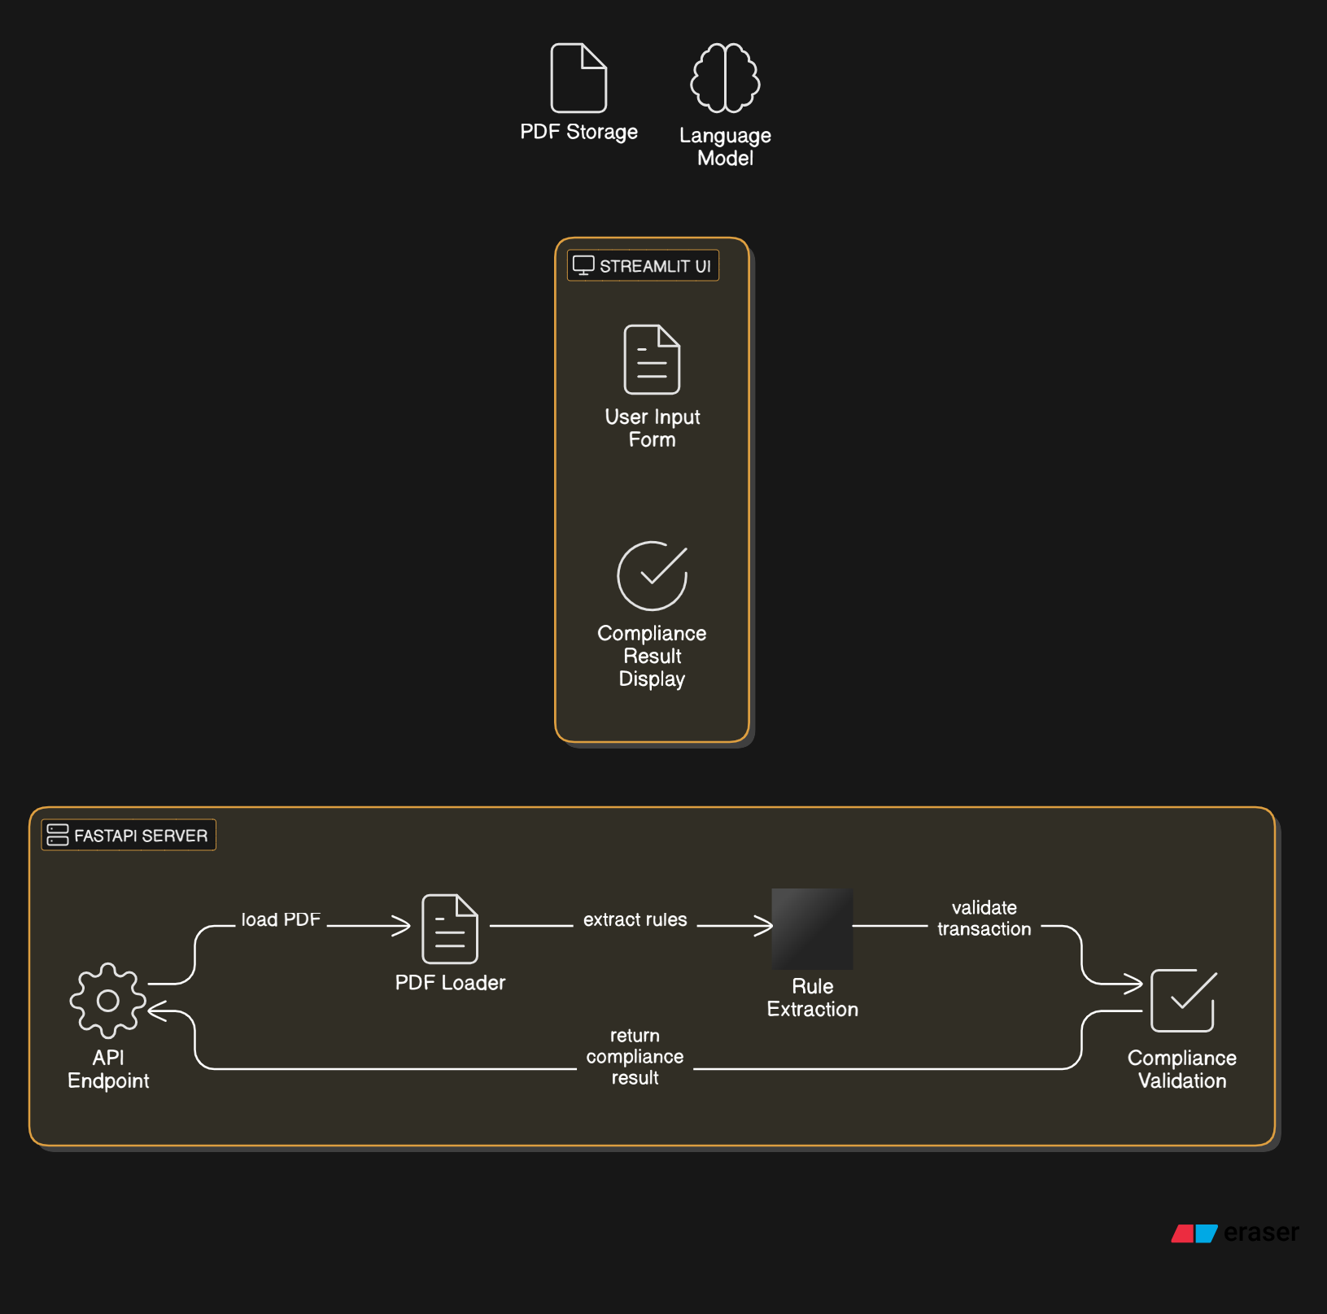
ARCHITECTURE

Slide 8
Challenged faced
Extracting structured compliance rules from unstructured PDF text.
Ensuring AI-generated JSON output is valid and reliable.
Mapping transaction data dynamically to extracted rules.
Handling API rate limits and response latencies.
Managing large-scale transaction validation without performance bottlenecks.
Ensuring regulatory updates are reflected dynamically in the compliance system.
Addressing potential false positives and negatives in risk assessment.

Slide 9
Results
Successfully automated compliance checking.
Reduced manual effort and processing time.
Provided structured compliance reports with remediation suggestions.
Enabled real-time validation of transactions.
Increased accuracy in detecting non-compliant transactions.
Improved scalability for handling large financial datasets.

Slide 10
Conclusion
The system streamlines compliance validation for transactions.
Future improvements: Enhancing AI model accuracy, integrating real-time data sources, and deploying at scale.
Expanding coverage to include additional compliance regulations and financial jurisdictions.
Implementing predictive analytics for fraud detection and risk assessment.

Slide 11
THANK YOU
Any questions?

