Slide 1


Interactive Compliance Assistant for Financial Transactions
Hackathon 2025
Avinash Nalla
Krishna Kodati

Slide 2
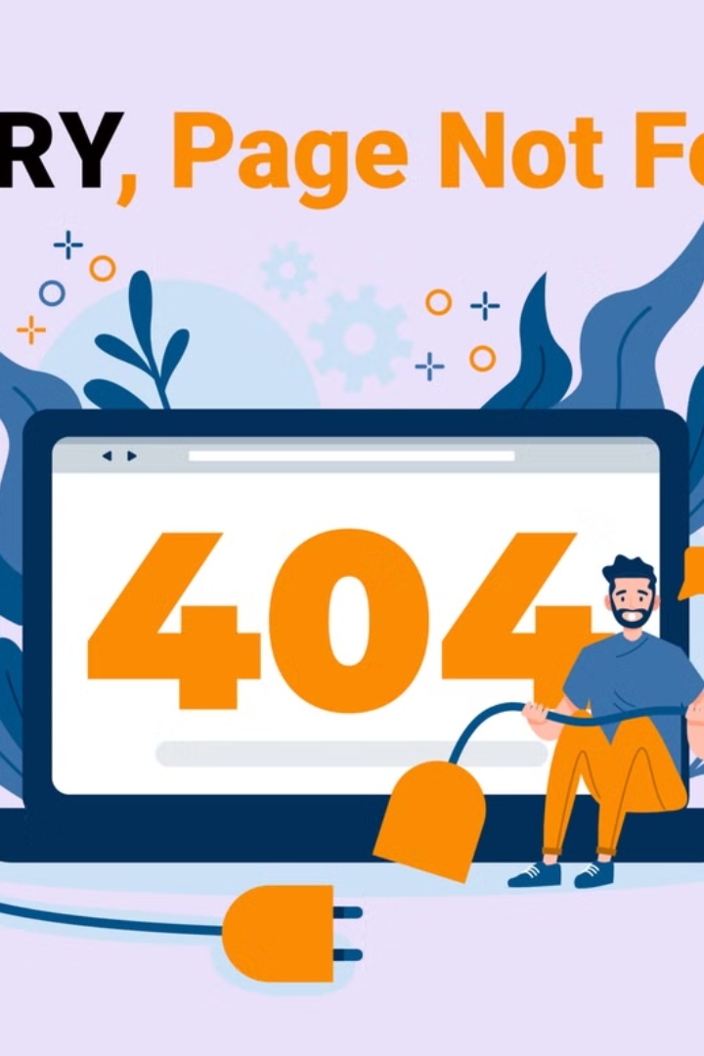
The Challenge: Ensuring Transaction Compliance
1
Manual Validation
Slow and error-prone.
2
Discrepancies
Transaction vs. Reported Amount (1% deviation).
3
Invalid Currency
Must be ISO 4217 codes.
4
High-Risk Transactions
Greater than $5,000 in high-risk countries.

Slide 3





Solution: Interactive Compliance Assistant
Jupyter Notebook
Streamlit App
Backend processing.
Interactive monitoring.
Data
Validation
Anomaly Detection
Risk Scoring
Reporting

Slide 4
Sample Dataset: Financial Transactions
Structure
Example Issues
Customer_ID
Missing data
Account_Balance
Amount discrepancy
Transaction_Amount
Reported_Amount
Currency
Country
Transaction_Date
Risk_Score

Slide 5




Validation Against Regulatory Rules
Missing Data
Amount Discrepancy
High-Risk
Currency and Country.
Exceeds 1% deviation.
Transaction flagged.

Slide 6
Anomaly Detection and Risk Scoring
Anomaly Detection
Risk Scoring
IsolationForest flagged discrepancy.
Adjusted dynamically.
5.0
10.0
Original Risk
Adaptive Risk

Slide 7
Actionable Remediation Suggestions
1
Missing Data
2
Amount Discrepancy
3
High-Risk
Request Currency and Country.
Adjust Reported_Amount.
Flag for compliance review.

Slide 8

Interactive Compliance Monitoring
Custom Datasets
Real-Time Monitoring
Upload option.
Simulated transactions.
Rule Refinement
PDF Report
Adjust deviation threshold.
Downloadable results.

Slide 9
Innovation and Challenges
Innovation
Challenges
Validation rules generated.
LLM failed.
Fallback to manual rules.
Download timeouts.
1
Resolve LLM
2
Expand Dataset
3
Add Features

Slide 10

Thank You!

