Slide 1
Transforming Regulatory Data Profiling with Generative AI & Machine Learning
ESSWarriors | Hackathon-2025

Slide 2
Understanding the Challenge
Regulatory reporting in financial institutions demands high-accuracy data validation.
Traditional manual data profiling is inefficient, time-intensive, and error-prone.
Objective: Implement AI-driven automation to streamline data profiling and regulatory compliance.
Goal: Enhance compliance by generating precise profiling rules, risk scoring, and remediation insights.

Slide 3
Identified problem statement
Extract and interpret complex regulatory guidelines.
Dynamically generate profiling rules using LLMs/ML.
Automate validation of reported data using executable Python scripts.
Detect anomalies, assess risk factors, and suggest intelligent remediation actions.
Provide a seamless, interactive compliance assistant for auditors.

Slide 4
Solution Strategy
Data Extraction & Preprocessing:
Process regulatory PDFs and store them in a structured vector database.
Identify tabular data and convert each row into separate records for efficient processing.
Profiling Rule Development:
Utilize LLM-powered logic to establish data validation rules specific to each column.
Automated Validation Engine:
Execute Python-based validation scripts that cross-check reported data.
Intelligent Remediation System:
Provide automated, rule-based remediation suggestions for flagged discrepancies.
Interactive Compliance Assistant:
AI-powered chatbot enables auditors to query compliance rules and validation processes seamlessly.

Slide 5
AI-Driven Compliance Assistant
Designed to assist auditors and compliance officers with real-time regulatory insights.
Operational Workflow:
User Query Submission: Auditors input queries related to compliance.
Data Processing: Backend system processes the request.
Regulatory Data Search: The system retrieves relevant compliance context from the vector database.
Contextual Processing: AI enhances query relevance using the retrieved context as well as chat history.
AI-Generated Response: LLM formulates responses based on regulatory knowledge.
Output Display: The chatbot presents structured, actionable compliance insights.

Slide 6
Data Validation Lifecycle
Dataset Upload & Processing: Users upload CSV datasets via an intuitive UI.
Anomaly Detection & Outlier Removal: Employs Isolation Forest ML algorithm to detect and visualize anomalies.
Generates outlier reports and delivers a cleaned dataset.
LLM-Enhanced Data Validation: LLM applies predefined validation logic tailored to specific data fields.
Searches vector database for contextual regulatory references.
Executes validation functions to ensure compliance.
Comprehensive Validation Report Generation: Identifies invalid records and explains errors with contextual justifications.

Slide 7
Solution Implementation Steps
Data Ingestion: Extract structured and unstructured regulatory data from file.
Convert extracted data into a vectorized format for efficient retrieval.
Validation Rule Generation: Use LLM to analyze data patterns and regulatory requirements.
Define and store validation rules in a dynamic, adaptive rule engine.
Data Validation Process: Execute validation scripts as per generated validation rule to assess data compliance against defined rules.
Use anomaly detection models to flag irregularities.
Automated Remediation: Generate recommendations for flagged data inconsistencies.
Suggest corrective actions using AI-driven insights.
Compliance Assistant Interaction: Enable auditors to query the system for validation logic, risk scores, and rule explanations.
Reporting & Monitoring: Generate real-time validation reports with insights on compliance risks.

Slide 8
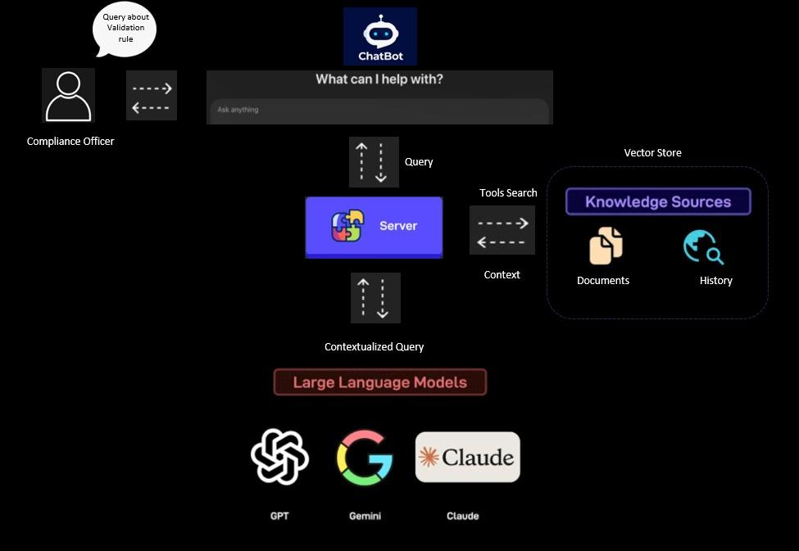
System Diagram for Chatbot

Slide 9
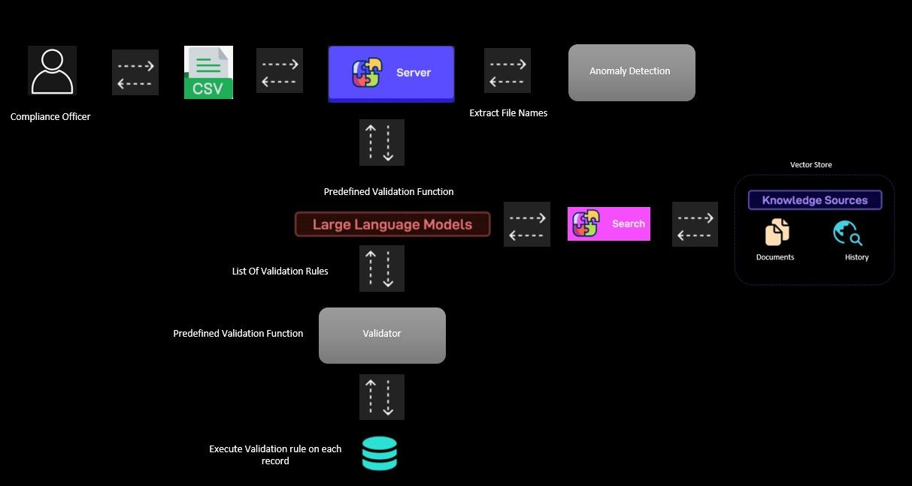
Data Validation Workflow

Slide 10
Implementation Framework
Inspired by MemGPT, enabling long-term memory retention.
User chat is also stored as history and used for generating context
AI recalls and searches relevant compliance contexts in vector databases.
Dynamically determines and registers necessary validation functions.
Example: AI identifies the need for range_validator and automatically assigns min/max values.

Slide 11
Key Challenges & Future Enhancements
Enhancing AI Accuracy: Improve precision in regulatory rule extraction.
Scalability Considerations: Optimize processing for large-scale, multi-column datasets.
Innovative Advancements:
AI-Generated Validation Rules: Automate new rule generation for diverse datasets.
Multi-Field Compliance Rules: Develop validation logic affecting multiple data attributes simultaneously.

