Slide 1

Welcome to Hackathon -2025
Gen AI-Based Data Profiling
Team - gen-ai-explorer
Munesh Sharma Shivam Srivastava Aditya Kashyap

Slide 2
About
Welcome to Hackathon 2025! We’re thrilled to have you join us for an exciting event filled with innovation, collaboration, and problem-solving. Over the next few days, you’ll have the opportunity to bring your ideas to life, tackle real-world challenges, and push the boundaries of technology. Whether you're here to build something groundbreaking, learn from industry experts, or connect with like-minded peers, this hackathon is your platform to shine.

Slide 3
Technology Stack
Python
Gemini LLM model
Python Libraries ( Panda, Flask APIs, Logging, RapidFuzz)
Jquery DataTable
HTML,CSS Bootstrep
Test Cases

Slide 4
What this Project Provide
1
📊 Comprehensive Dashboard View and analyze your entire Excel dataset effortlessly. Get insights at a glance with an intuitive and well-structured display.
📂 Seamless File Upload Upload new data files in XLSX format with just a few clicks. Ensure smooth and quick data processing without any hassle.
2
🔍 Why Choose This System? ✅ User-friendly interface for a seamless experience. ✅ AI-powered chatbot for easy rule creation. ✅ Secure & efficient data processing. ✅ Data with Logging data processing.
✅ Test Cases implemented
3
🤖 Smart Rule Generation & Editing View all existing validation rules and manage them efficiently. Easily create, modify, or fine-tune rules through an interactive chatbot.
4

Slide 5
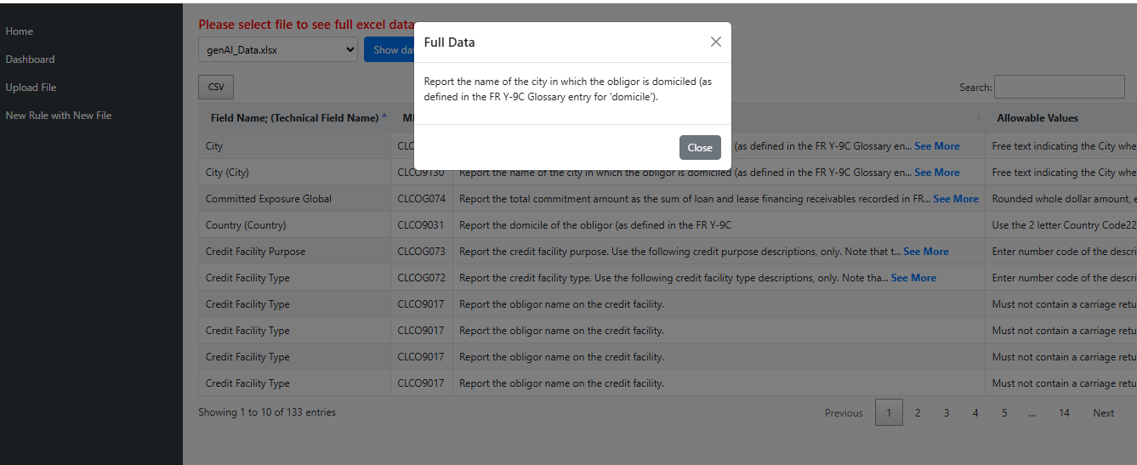
Dashboard page
View and analyze your entire Excel dataset effortlessly. Get insights at a glance with an intuitive and well-structured display.
If there is any large data, so “see more” link is given and when we click on it, we can see full data.
We can download data in CSV format as well.
We have Sorting, pagination and search functionality

Slide 6
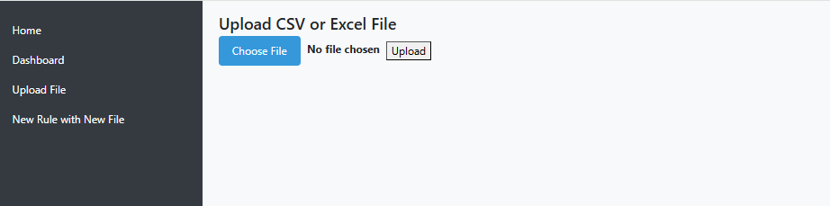
Dashboard page
📂 Seamless File Upload Upload new data files in XLSX format with just a few clicks. Ensure smooth and quick data processing without any hassle.

Slide 7
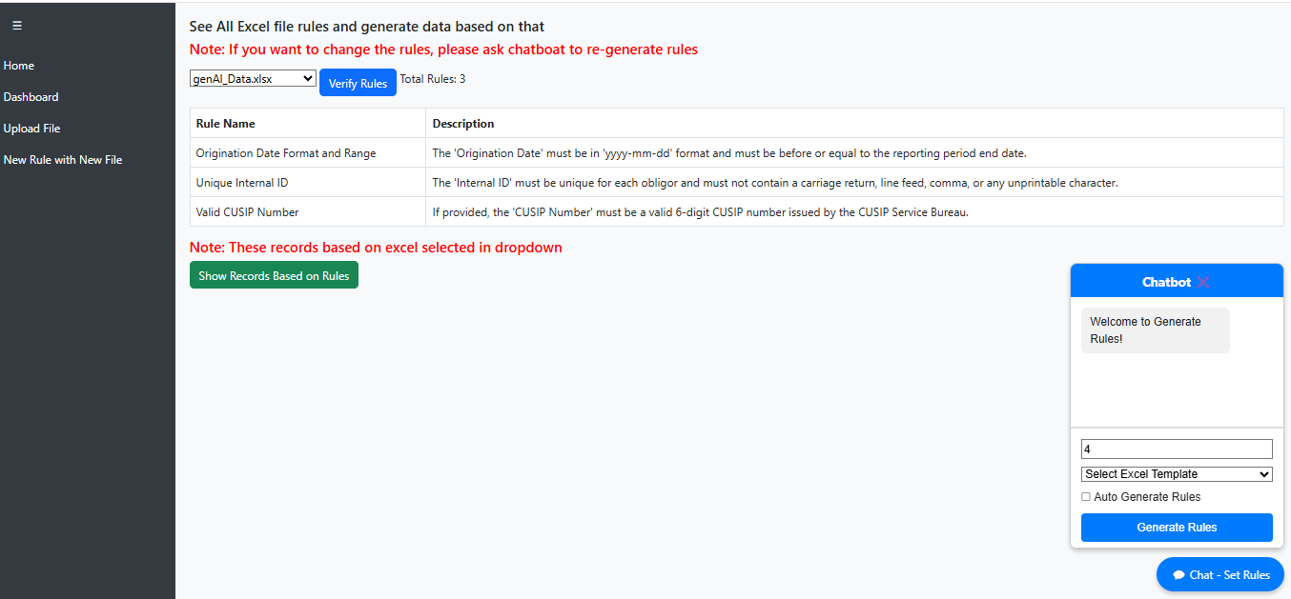
Dashboard page
🤖 Smart Rule Generation & Editing View all existing validation rules and manage them efficiently. Easily create, modify, or fine-tune rules through an interactive chatbot.

Slide 8
Thank you

