Slide 1

Team GenHack
Divya Mani
Nithyavani
Arun Kumar
Kishore
Vasanth Kumar Mareedu

Slide 2

Regulatory Reporting in Banking: The Compliance Struggle is Real
Regulatory reporting is a data monster. Banks wrangle massive amounts of data to meet compliance requirements.
Data profiling is the unsung hero. It ensures reported data actually matches what regulators expect.
The old way? Painfully manual. Defining profiling rules by hand is slow, tedious, and error-prone.
Let’s fix that with AI. Generative AI + Machine Learning can automate profiling, making it faster, smarter, and way less painful.

Slide 3

Design Approach
From Clueless to Confident in AI & Compliance
Learning the Ropes 🏗️
Built our first AI model—lots of trial, error, and teamwork.
Figured out the do’s and don’ts of prompting for better responses.
Making AI Work for Compliance 📜🤖
Fed regulatory documents into an LLM to generate rule-based responses.
Ensured AI stayed within the compliance framework.
Rethinking the Interface 🔄
Initially considered a fully conversational AI—great in theory, tricky in execution.
Pivoted to a traditional app with on-demand AI where it actually helps.
Final Product: Smart & Practical 🎯
Dashboards for insights.
Rule management & issue tracking.AI-powered assistance only when needed.

Slide 4
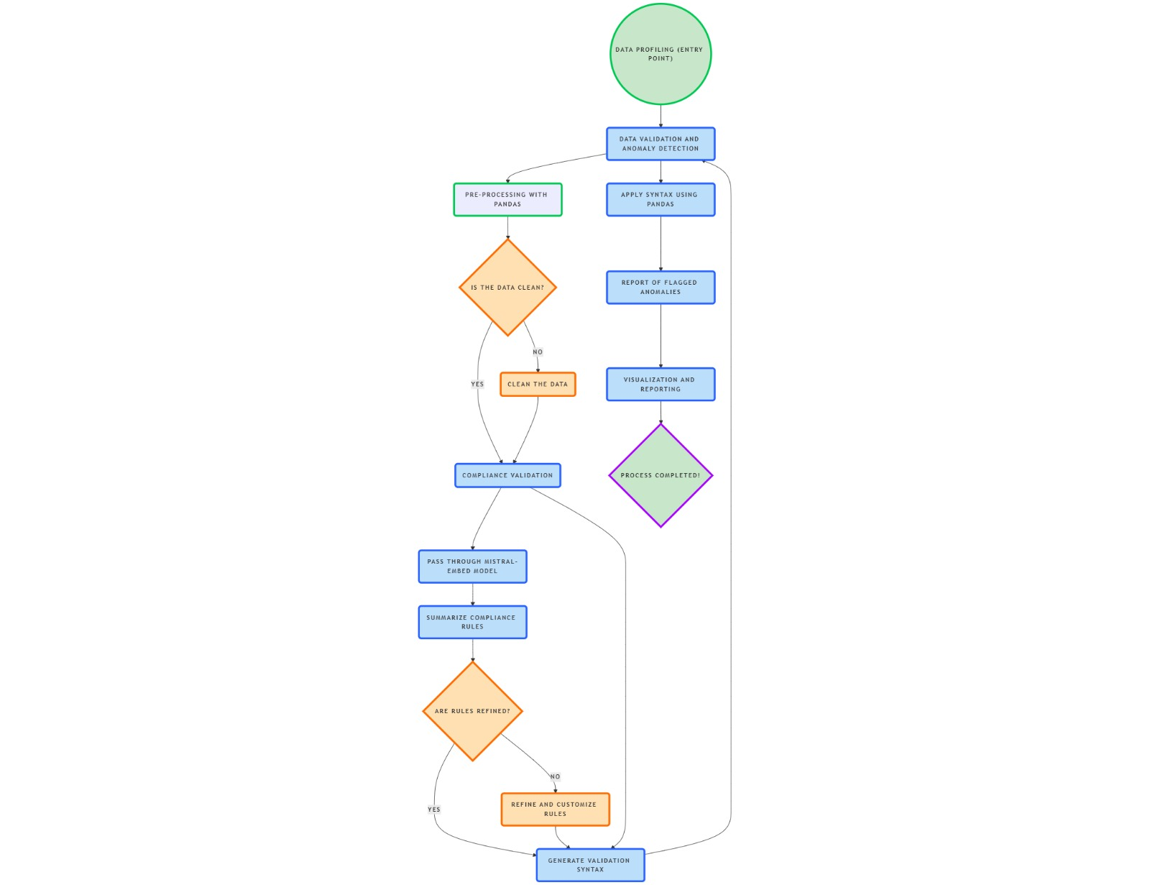
Proposed solution

Slide 5
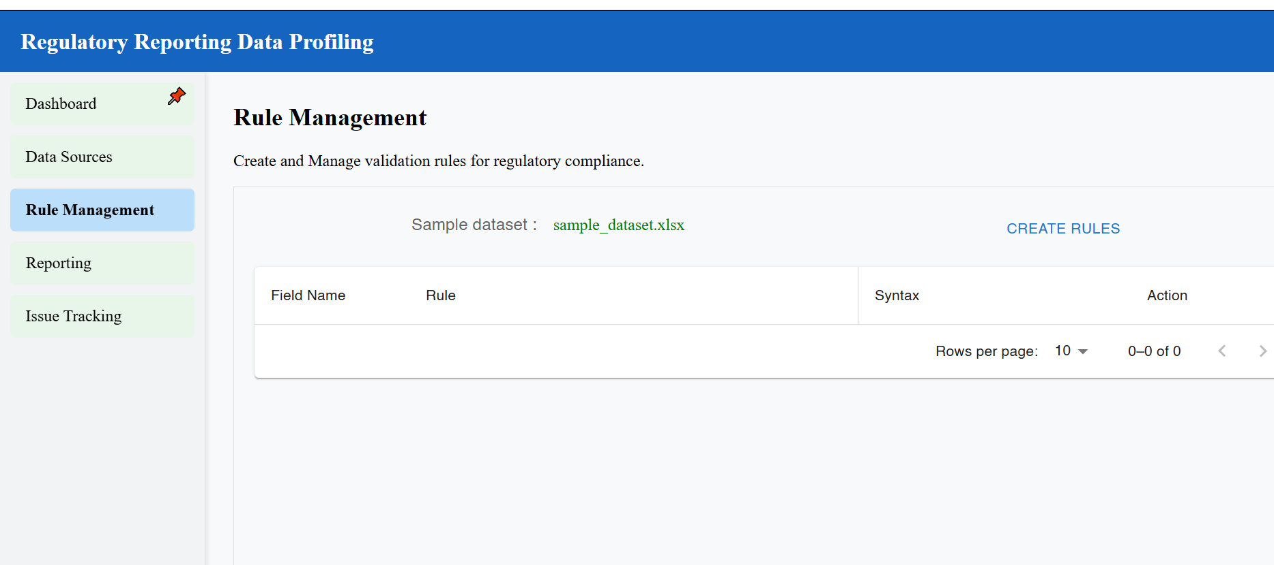
Screenshots

Slide 6
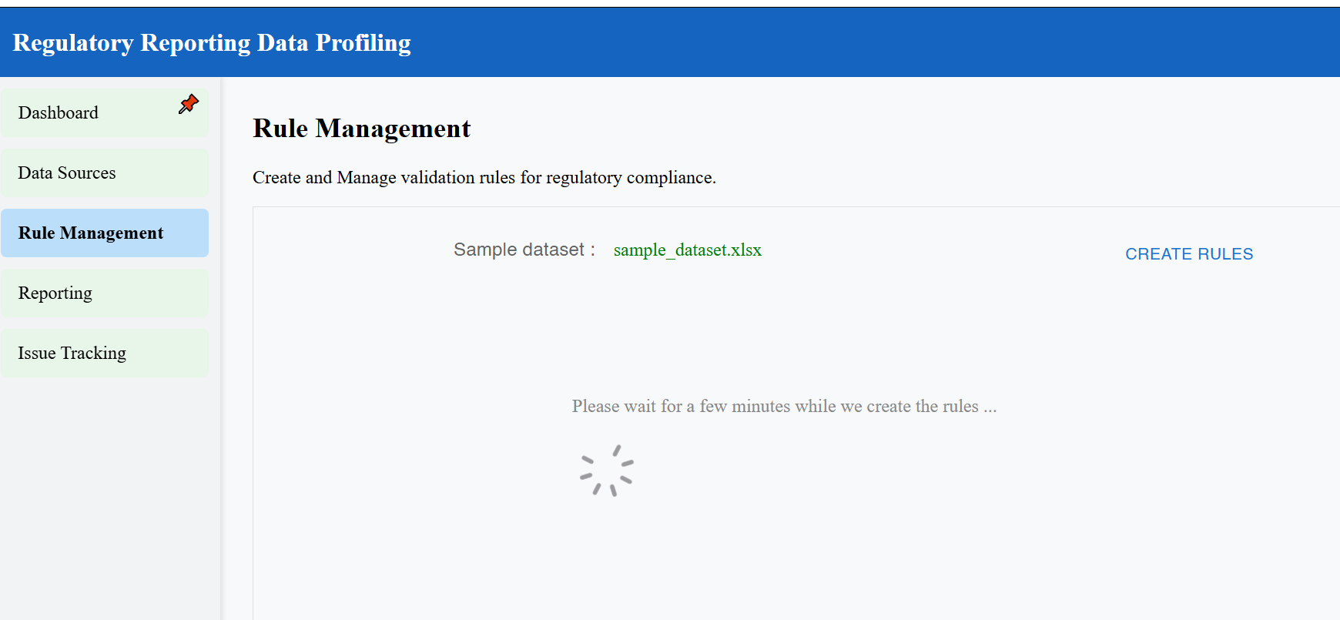

Slide 7
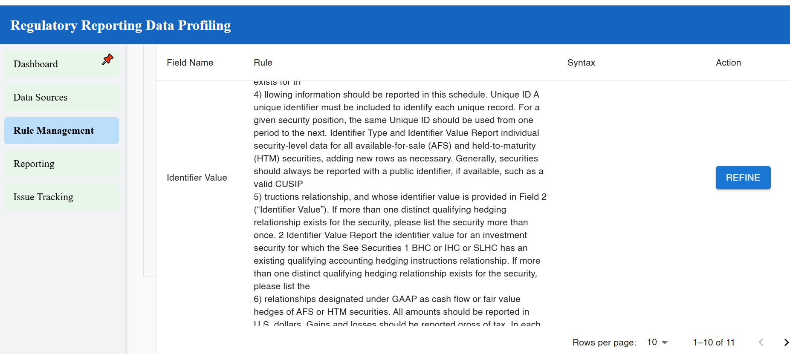

Slide 8
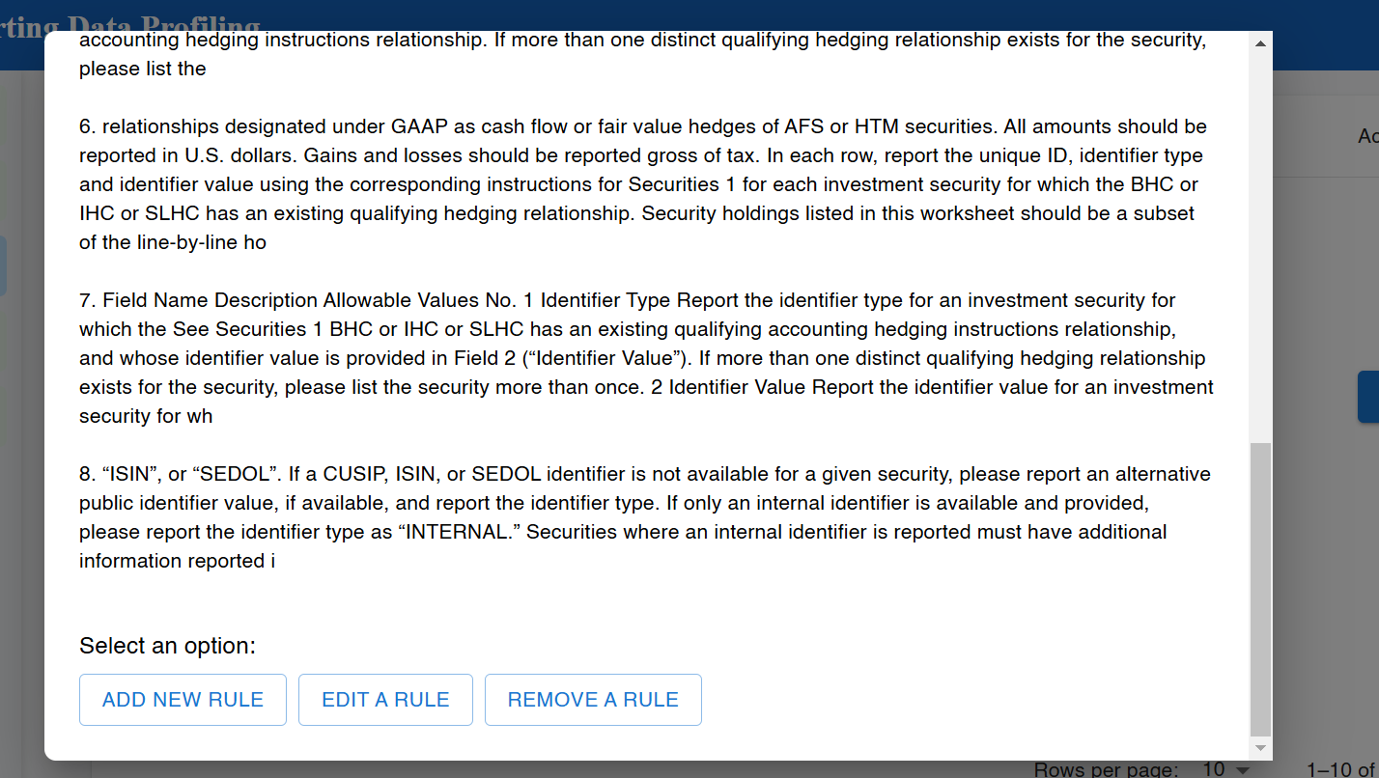

Slide 9
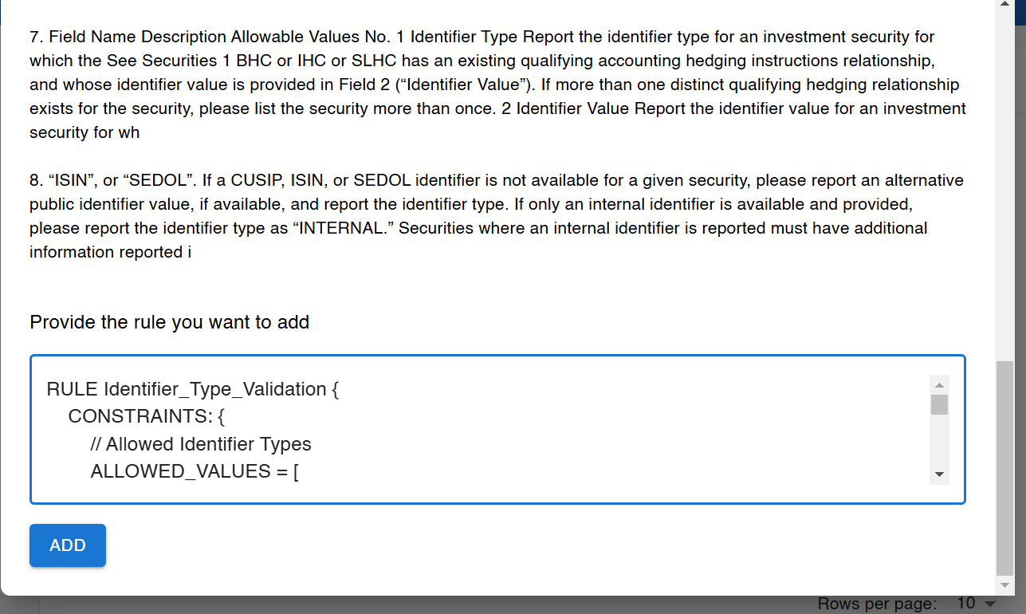

Slide 10
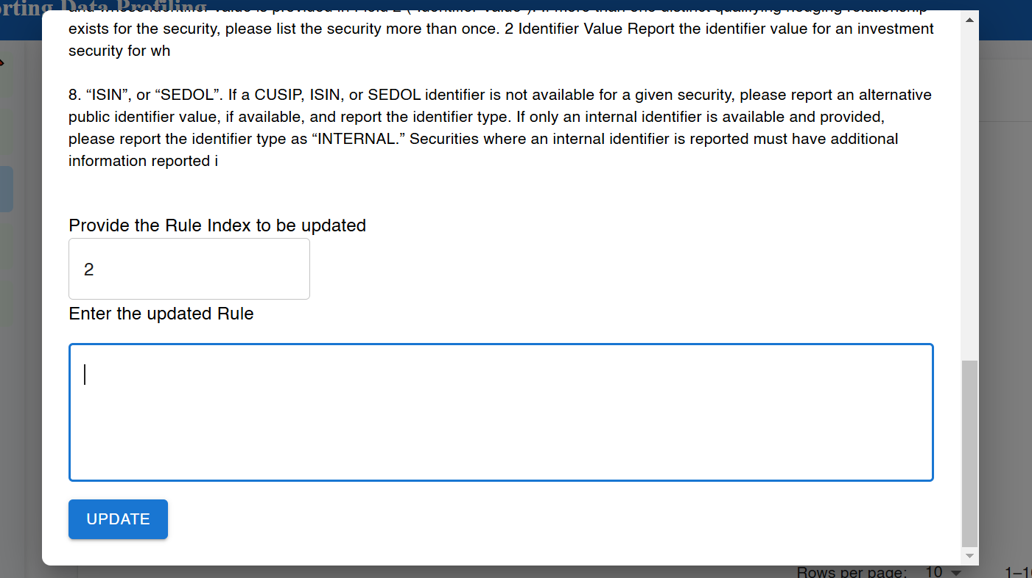

Slide 11
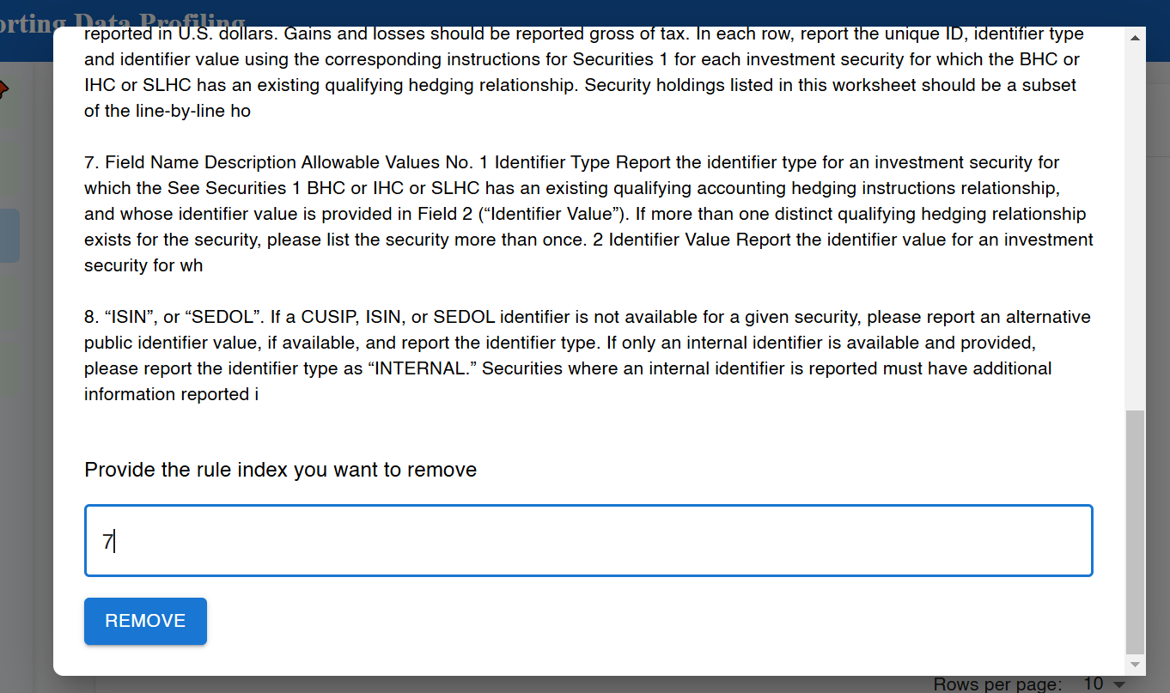

Slide 12
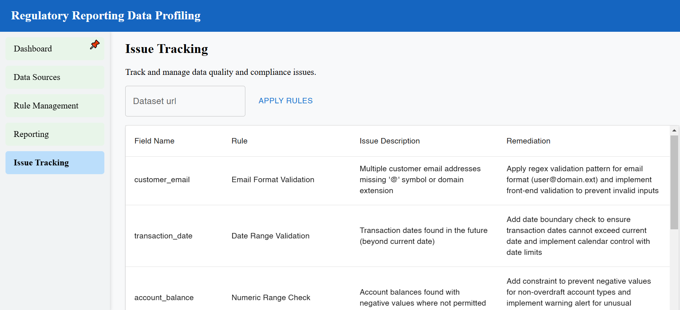

Slide 13
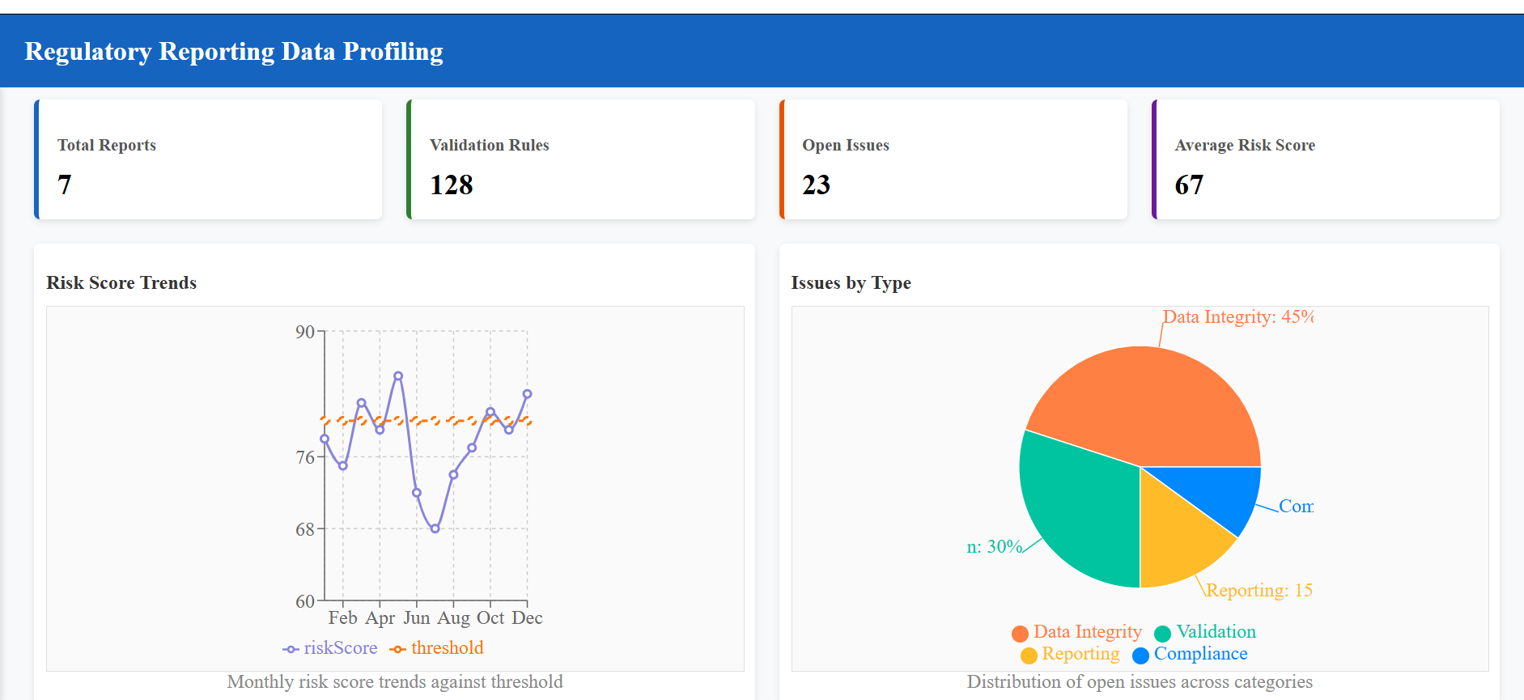

Slide 14
Thank You!

