Slide 1
GenAI-Powered Data Profiling & Anomaly Detection
Team RANGA

Slide 2
Summary
An AI-driven system for financial anomaly detection.
Uses Isolation Forest & DBSCAN for anomaly detection.
Google Gemini AI for validation and remediation.

Slide 3
System Architecture
Data Sources: Transaction data (CSV) and validation rules (PDF).
Preprocessing: Data loading, tokenization, and validation and Rules Extraction.
Anomaly Detection: Isolation Forest & DBSCAN.
AI Validation: Google Gemini AI for rule-based verification.
Output: Provide flagged transactions in structured format

Slide 4
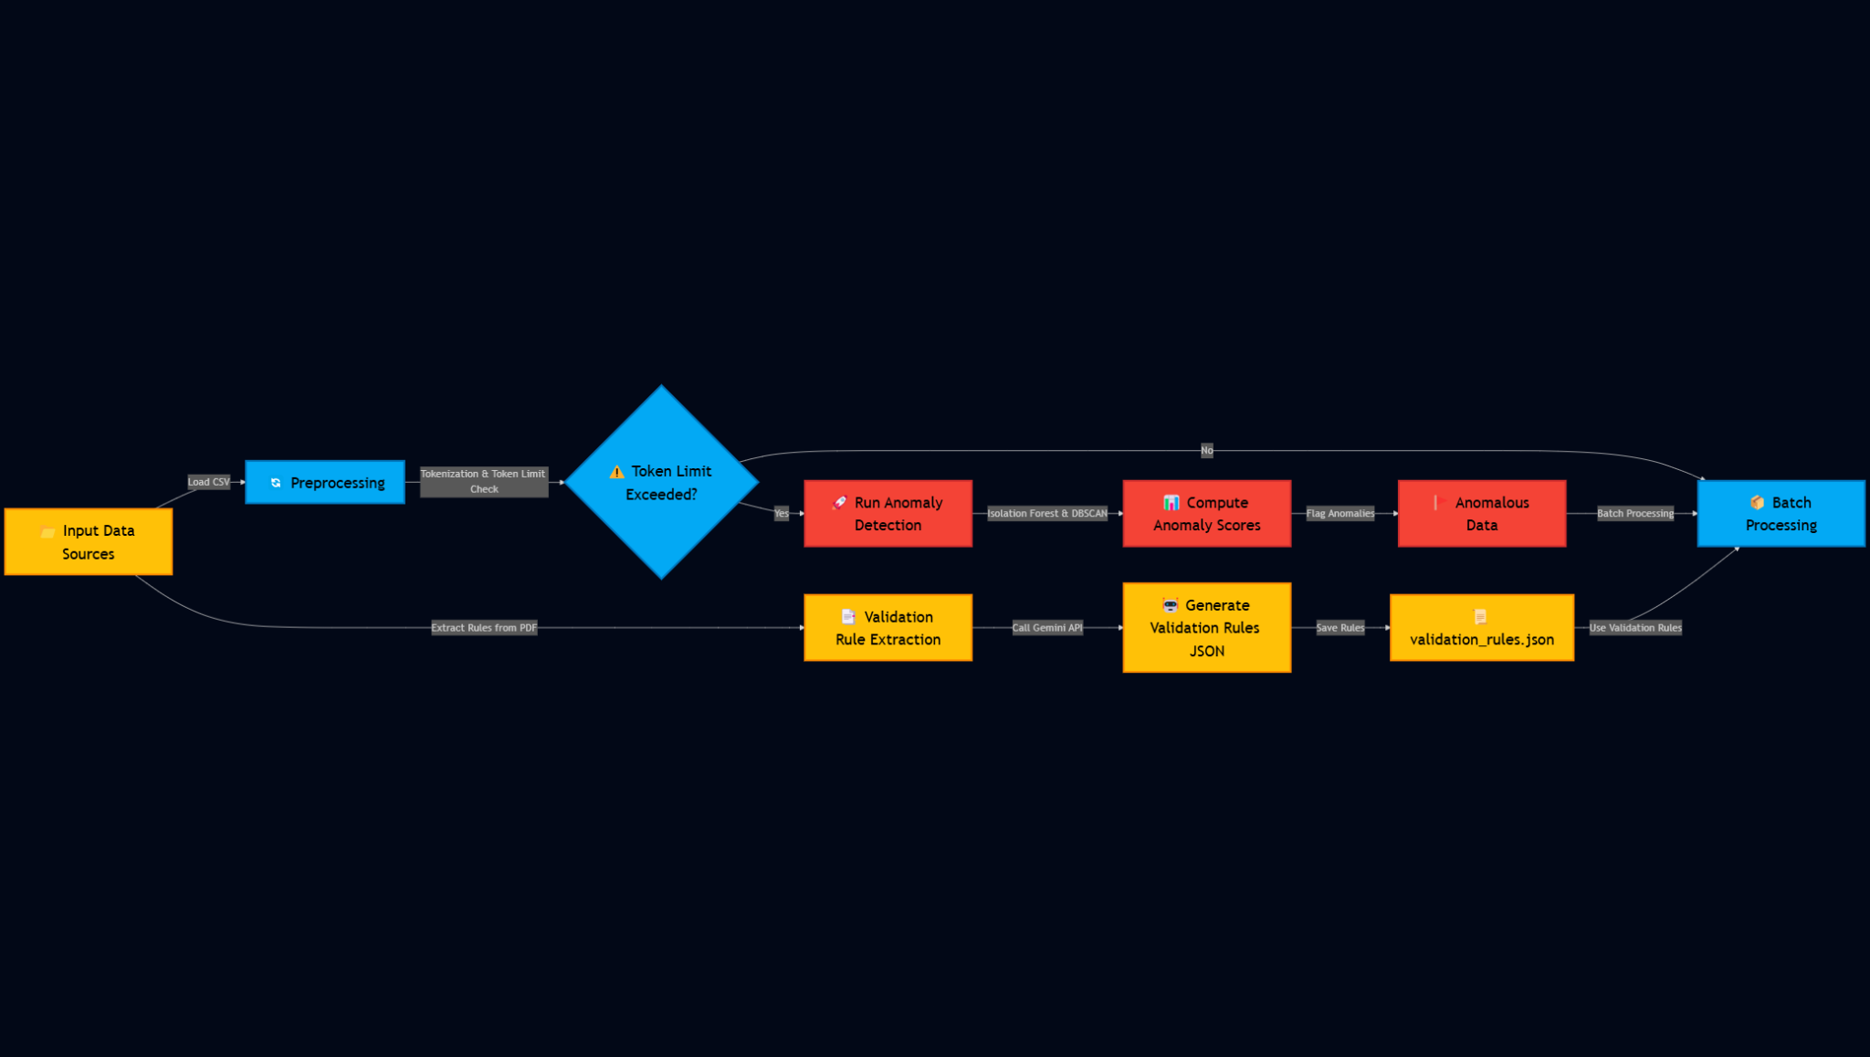
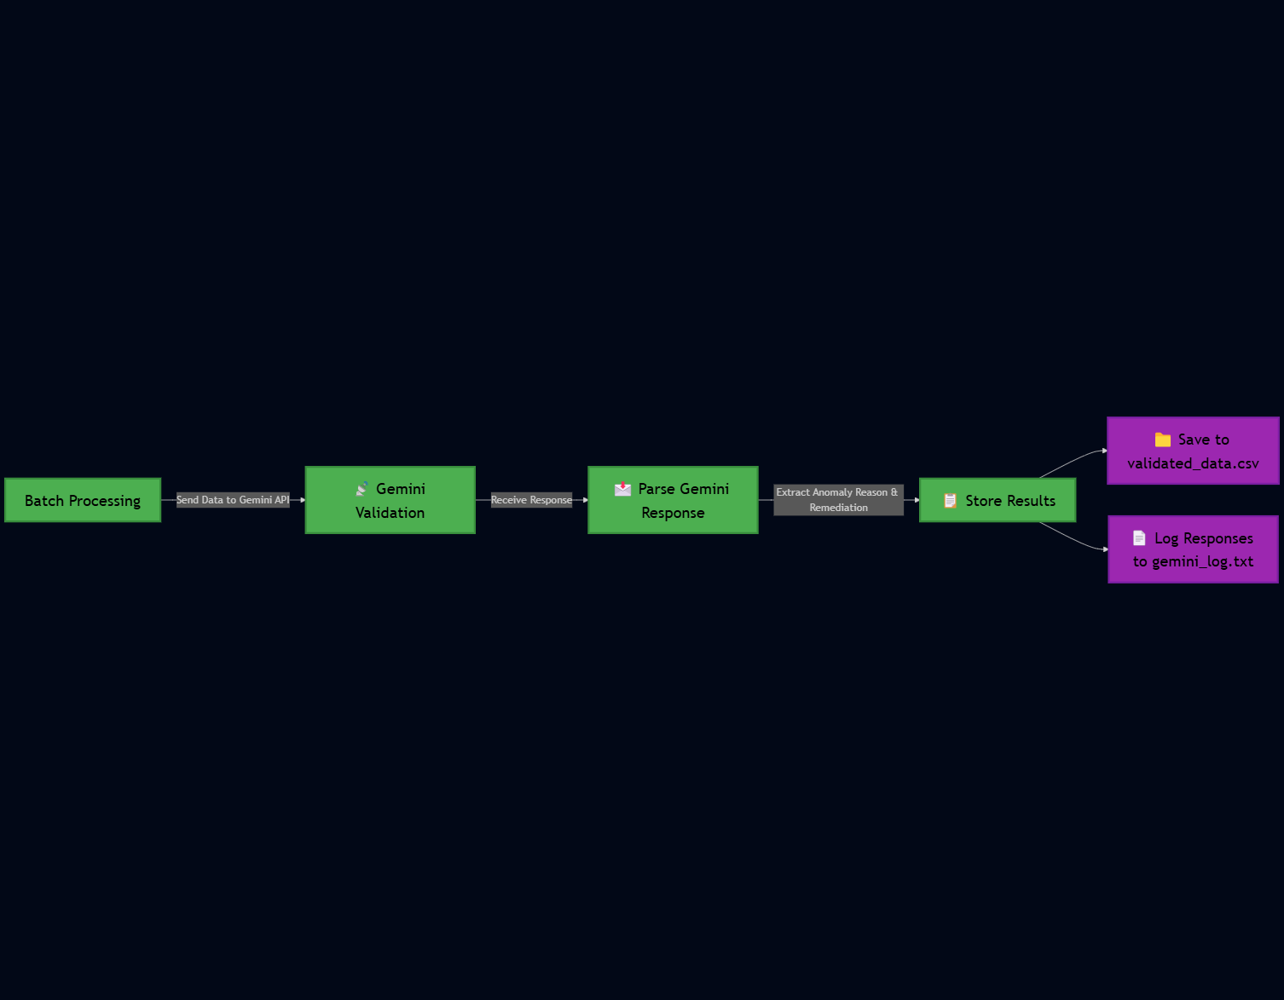
Architecture

Slide 5



Tech stack
Front-end Backend GenAI

Slide 6
Anomaly Detection Methodology
Isolation Forest: Detects anomalies based on data outliers.
DBSCAN Clustering: Identifies rare categorical patterns.
Anomaly Score Computation: Assigns scores to transactions.

Slide 7
AI-Based Validation
Google Gemini AI Validation: Ensures compliance with business rules.
Remediation Suggestions: AI suggests corrective actions.

Slide 8
Key Features
AI-driven rule extraction
Automated anomaly detection
Validation code generation
Structured report output in CSV format

Slide 9
Competitive Advantage
AI-driven anomaly detection surpasses rule-based methods.
Real-time validation ensures quick fraud detection.
Scalable and adaptable to different financial datasets.

Slide 10
Results & Impact
Successfully identified anomalies in synthetic financial datasets.
AI validation enhanced accuracy and reduced false positives.

Slide 11
Challenges & Future Enhancements
Handling complex regulations
Reducing false positives in anomaly detection
Scaling for large datasets
Enhancing interpretability for compliance teams

Slide 12
Conclusion
Automating regulatory reporting reduces errors, improves compliance, and saves time. Future enhancements will focus on improving accuracy and scalability.

Slide 13
Thank You

