Slide 1
Gen-AI Based Data Profiling
Team name: RiskyClan
Team members:
Ashray Raghuram Rai
Dhanish Kumar (Captain)
Jyoti Kumari
Kaustubh Kathare
Suman Saurabh

Slide 2
Problem Statement
Develop a GenAI powered data profiling solution that can:
Extract, interpret and refine regulatory reporting instructions to identify key data validation requirements
Automatically generate profiling rules based on allowable values and cross relation between the elements using an LLM or ML. Few line items will need interpretations from multiple sources.
Generate executable validation code to assess whether the reported data conforms to the extracted rules
Suggest remediation actions for flagged transactions/observations including automated explanations for the auditor

Slide 3
Workflow Overview
1. User uploads a PDF containing rules in the UI
2. Model extracts rules from the PDF
3. User uploads a CSV file for validation
4. System applies extracted rules to CSV
5. Output CSV with validation results is displayed
6. User can download the result CSV from the UI

Slide 4
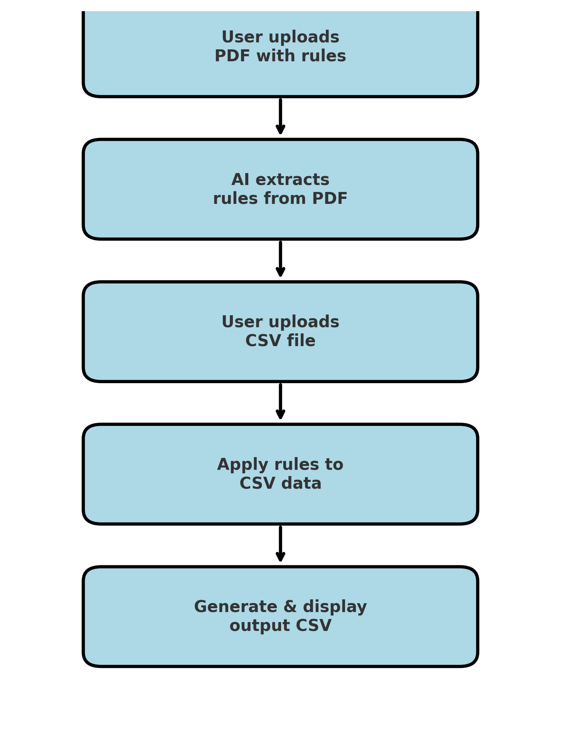
Flow

Slide 5
Techstack used
streamlit: Used for front-end for file upload/download.
pdfplumber: Used for rule extraction provided in the tabular format in the pdf
OpenAI: Used for text to token transformation using embedding model.
FAISS : Used for vector database to store and search text embedding efficiently.
difflib: Used for validation to get the closest match

Slide 6
Extracting Rules from PDF
• User uploads a PDF file containing business rules in tabular format
• Example:
- Rule in PDF: 'Age must be greater than 18’
- Extracted Rule: AGE > 18

Slide 7
Validating input CSV Data
• User uploads a CSV file containing data
• The system maps extracted rules to the input dataset
• AI identifies rule violations and inconsistencies and appends the result for every column in output csv.

Slide 8
Generating Output CSV
• The validated CSV is created
• Output includes:
- Original data
- Validation status for every column
• User can view, enlarge, search or download the CSV file generated from UI.

Slide 9
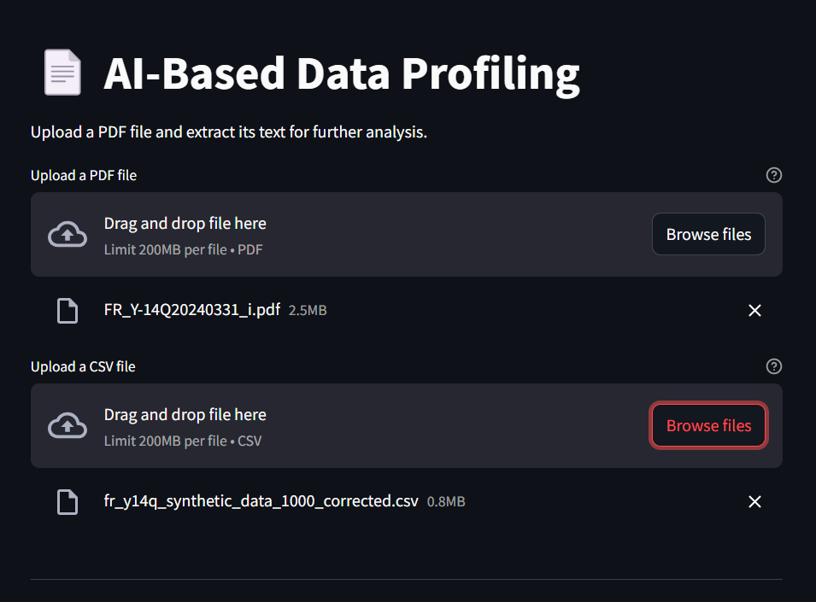
UI Demonstration

Slide 10
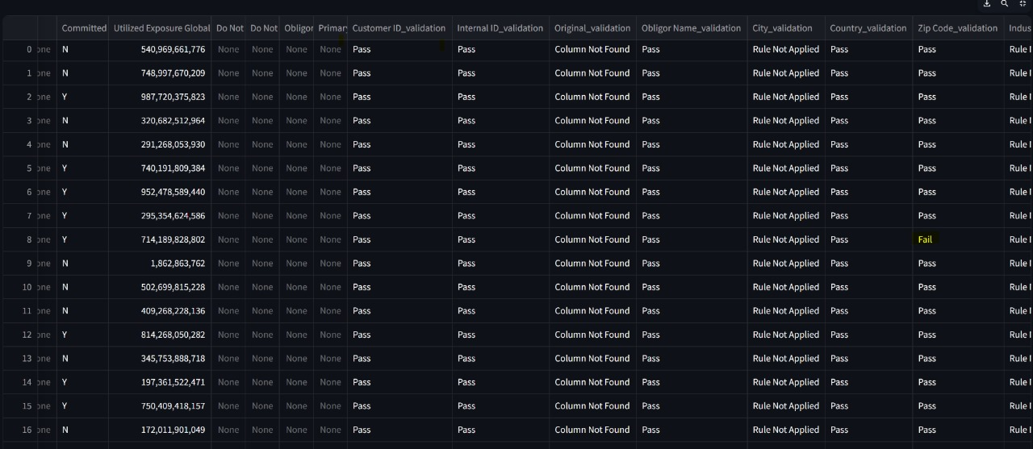
UI Demonstration

Slide 11
Benefits of AI-Based Data Profiling
✅ Automates Rule Extraction – Reduces manual effort
✅ Ensures Data Consistency – Validates datasets efficiently
✅ Saves Time – Faster than traditional methods
✅ Scalable & Adaptable – Works for multiple datasets

Slide 12
Thank You

