Slide 1
data profiling and regulatory compliance validation uSING GEN-AI
Sharanprasath S – CT(HLT-ORIGINATIONS)

Slide 2
Introduction
Data validation and compliance in financial institutions is complex and time-consuming.
Manual rule extraction and anomaly detection can lead to errors and inconsistencies.
This project automates data profiling using Generative AI & Machine Learning, ensuring regulatory compliance with minimal effort.

Slide 3
Why This Matters?
EFFICIENCY
Reduces manual effort in compliance validation.
ACCURACY
Improves data accuracy & consistency in financial datasets.
COMPLIANCE
Ensures regulatory adherence with AI-powered rule validation
DECISION-MAKING
Speeds up decision-making by providing real-time compliance insights.

Slide 4
What This System Does
RULE EXTRACTION
Extracts validation rules from regulatory PDFs using AI.
VALIDATE DATASET
Validates datasets against extracted rules to detect inconsistencies.
ANOMALY DETECTION
Identifies anomalies using ML techniques like Isolation Forest.
Compliance ASSistant
Provides an interactive AI-powered chat assistant for compliance queries.

Slide 5
TECH STACK
FRONTEND
BACKEND
STREAMLIT APPLICATION
PLOTLY AND ALTAIR FOR DATASET VISUALS
PYTHON
LANGCHAIN SUPPORTED
PANDAS
AI AND ML MODELS
DATABASE
GOOGLE GEMINI: gemini-2.0-flash
ISOLATION TREE
CHROMA-DB FOR VECTOR STORAGE

Slide 6
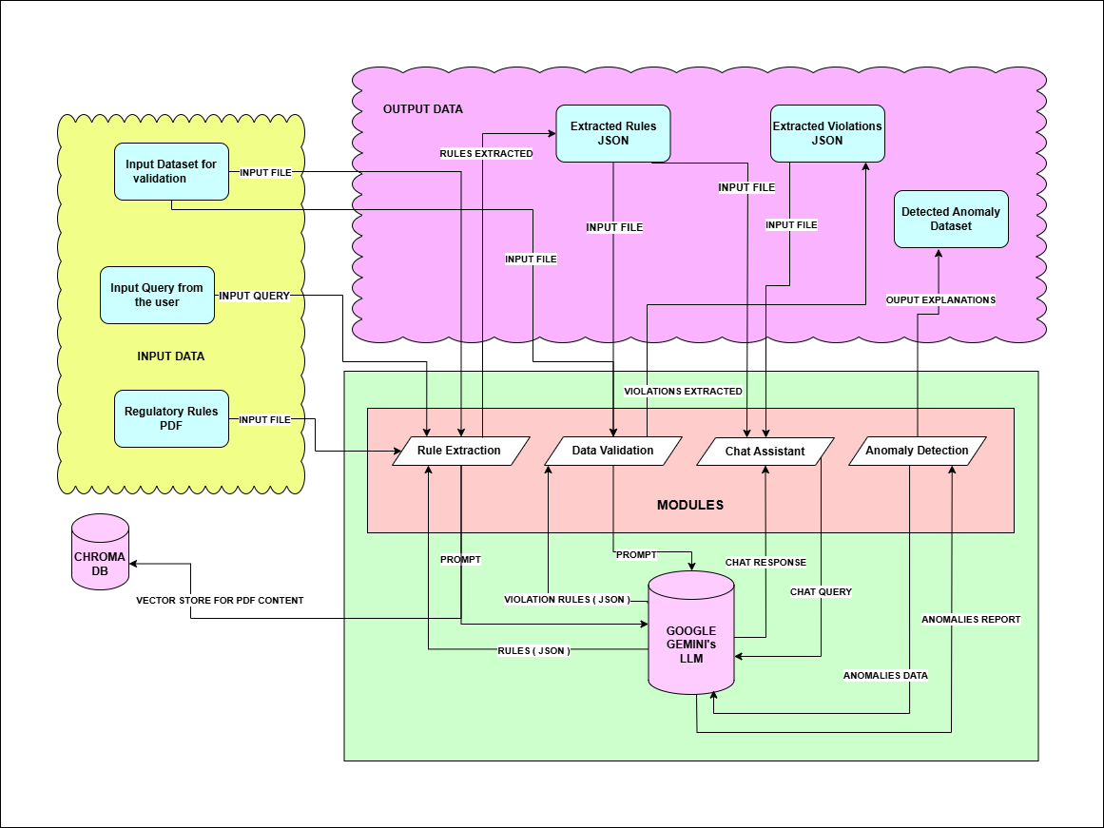
ARCHITECTURE

Slide 7
Rule Extraction (AI-Powered Regulatory Rule Extraction)
OVERVIEW
Extracts structured validation rules from regulatory PDFs using Generative AI and RAG (Retrieval-Augmented Generation).
PDF Processing & Text Extraction
JSON Rule Output
Chunking & Vector Storage (RAG Approach)
Rule Extraction using LLM (Google Gemini API)
Loads the PDF document using pdfplumber / PyPDFLoader.
Extracts text and tables separately for better accuracy.
Splits the extracted text into semantic chunks (RecursiveCharacterTextSplitter).
Stores these chunks in ChromaDB with embeddings (GoogleGenerativeAIEmbeddings).
Query: Extract structured validation rules for financial data reporting
Generative AI (Gemini) processes text → Outputs JSON-based validation rules (e.g., required format, data types, constraints).
AI-generated rules are stored as a structured JSON file.
Users can download the extracted rules for dataset validation.

Slide 8
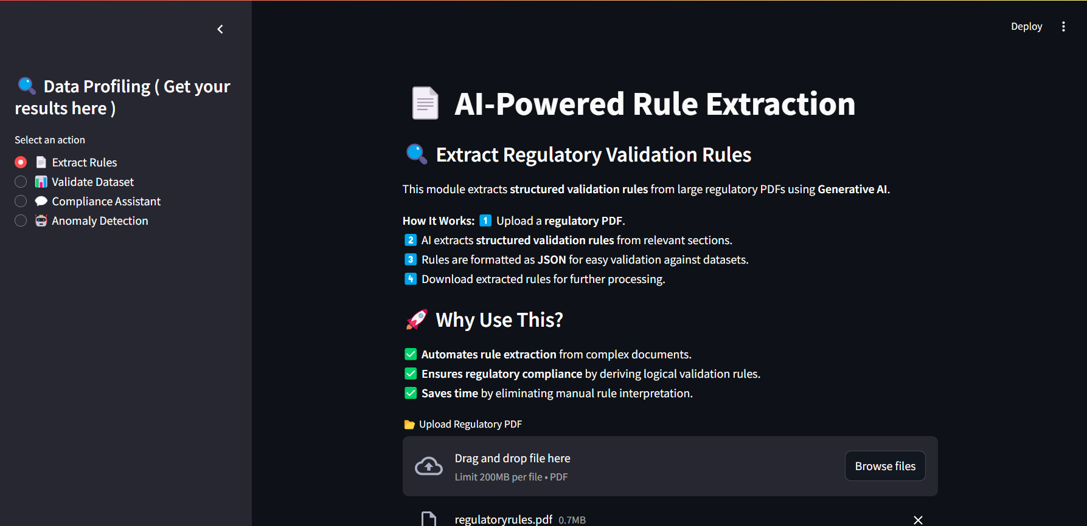
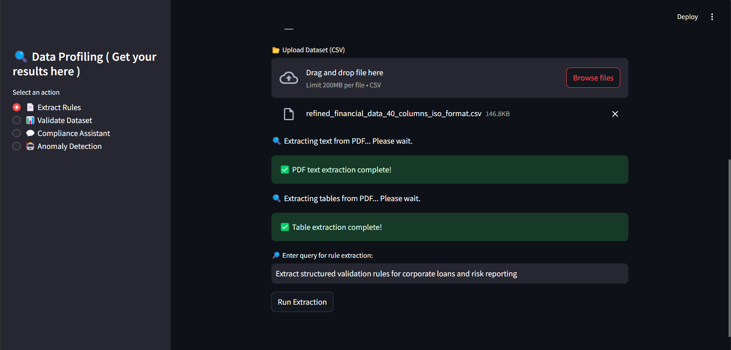
RULE EXTRACTION

Slide 9
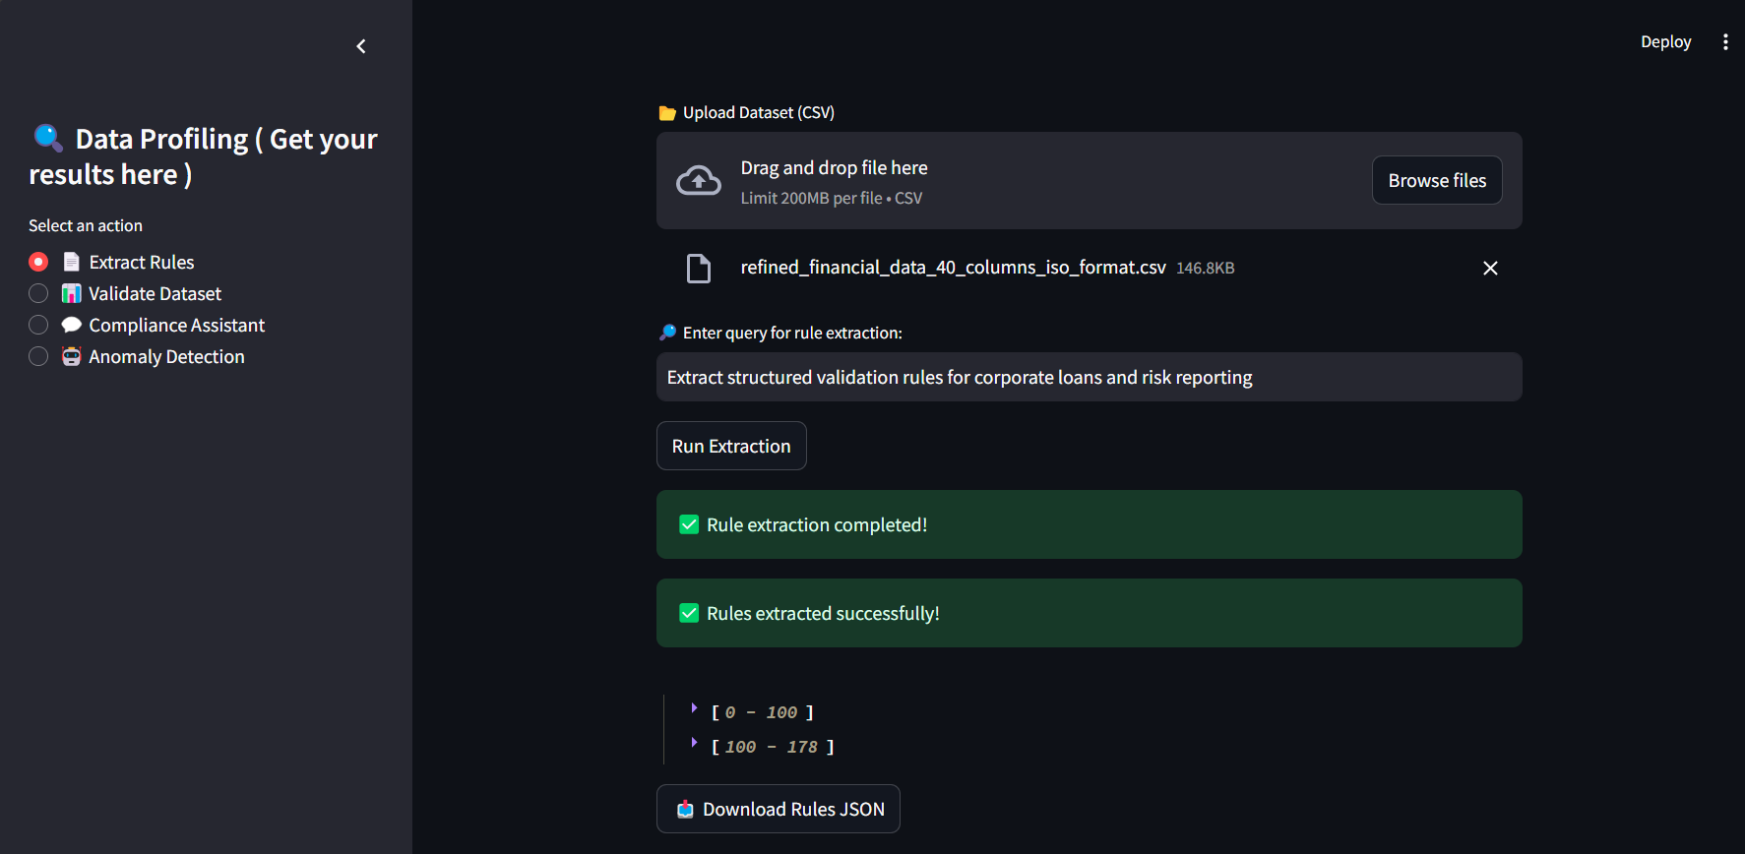
RULE EXTRACTION

Slide 10
Dataset Validation (Automated Compliance Checking)
OVERVIEW
Validates datasets by applying AI-extracted rules to check data quality, format, and compliance.
Batch Processing for Efficiency
AI-Powered Validation
Real-time UI & Reporting
Uploads Dataset (CSV) & Validation Rules (JSON)
Breaks dataset into batches (to reduce API usage).
Sends each batch to Google Gemini for validation.
AI checks each column’s format, constraints, and expected values.
Returns violations (e.g., missing values, incorrect types) with suggested fixes.
Progress bar updates per batch.
Validation report (CSV) is generated, with error explanations.
Reads dataset using Pandas.Loads validation rules into memory.

Slide 11
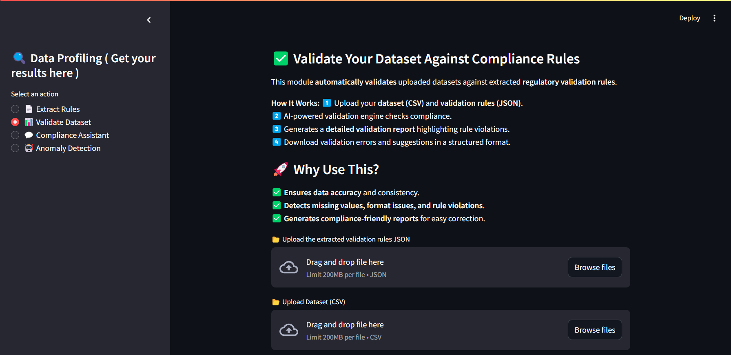
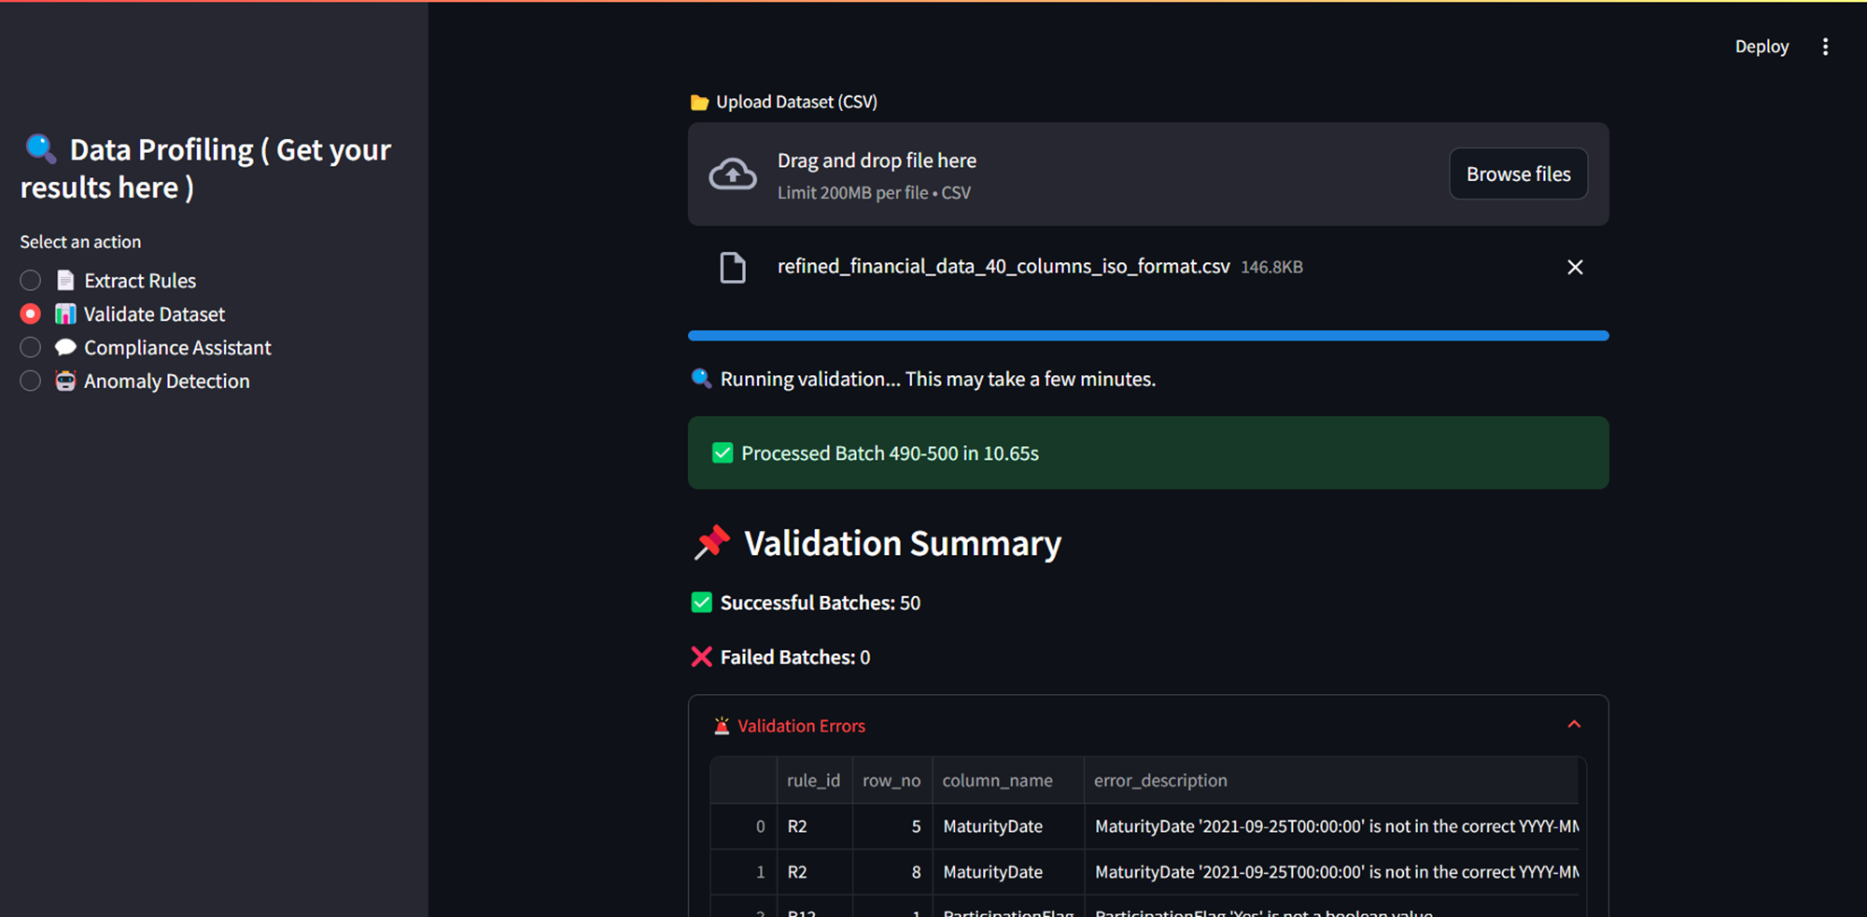
DATASET VALIDATION

Slide 12
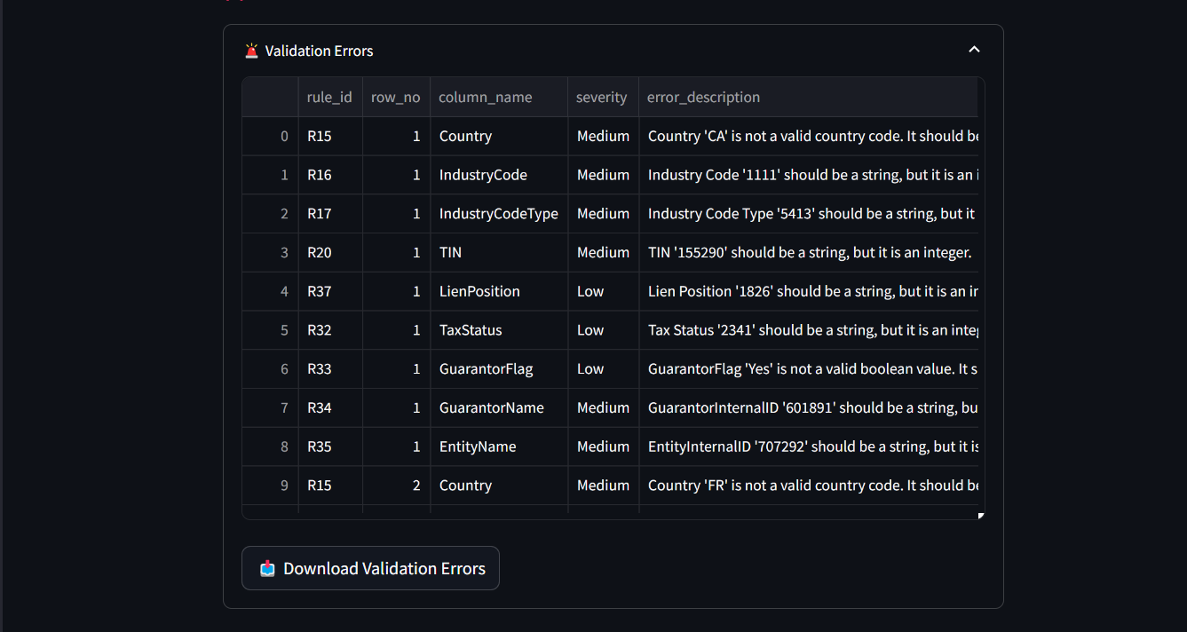
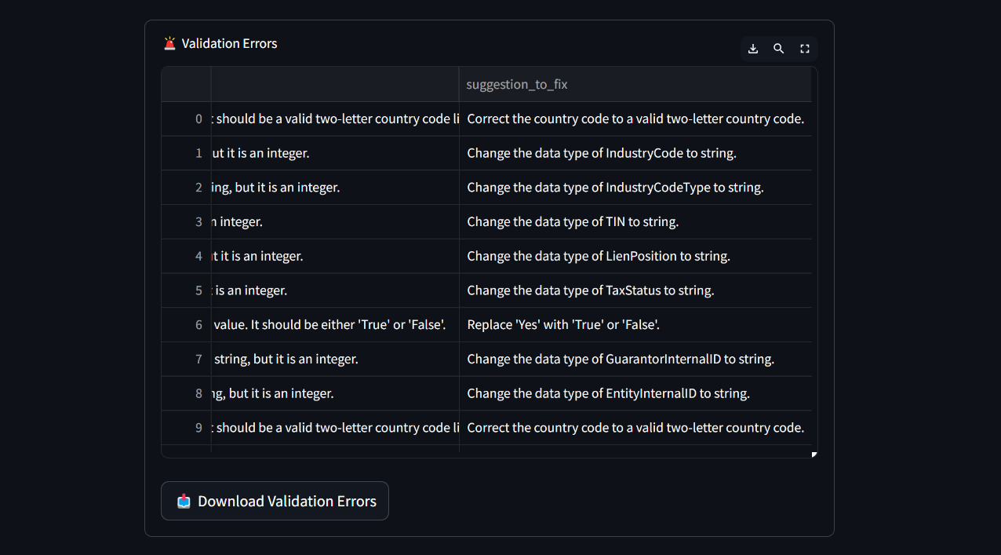
DATASET VALIDATION

Slide 13
Compliance Chat Assistant (Interactive AI Queries)
OVERVIEW
Users can ask compliance-related questions, refine validation rules, or request explanations for errors.
Interactive Chat UI
User Query Processing
Retrieval of Relevant Context
AI Response Generation (Google Gemini API)
User enters a question or rule modification request.
Violations & extracted rules stored in FAISS (vector database).
AI retrieves most relevant validation errors for the query.
AI explains violations (row_no, column_name, issue).
If rule refinement is requested, AI suggests an improved rule definition.
Messages are displayed in chat bubbles.
Users can refine rules iteratively with AI feedback.

Slide 14
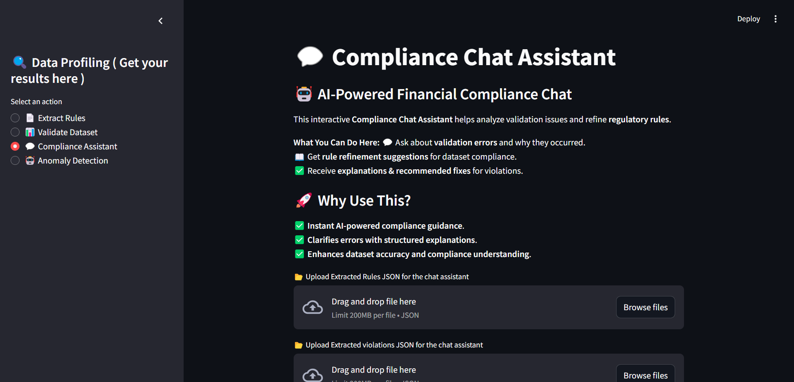
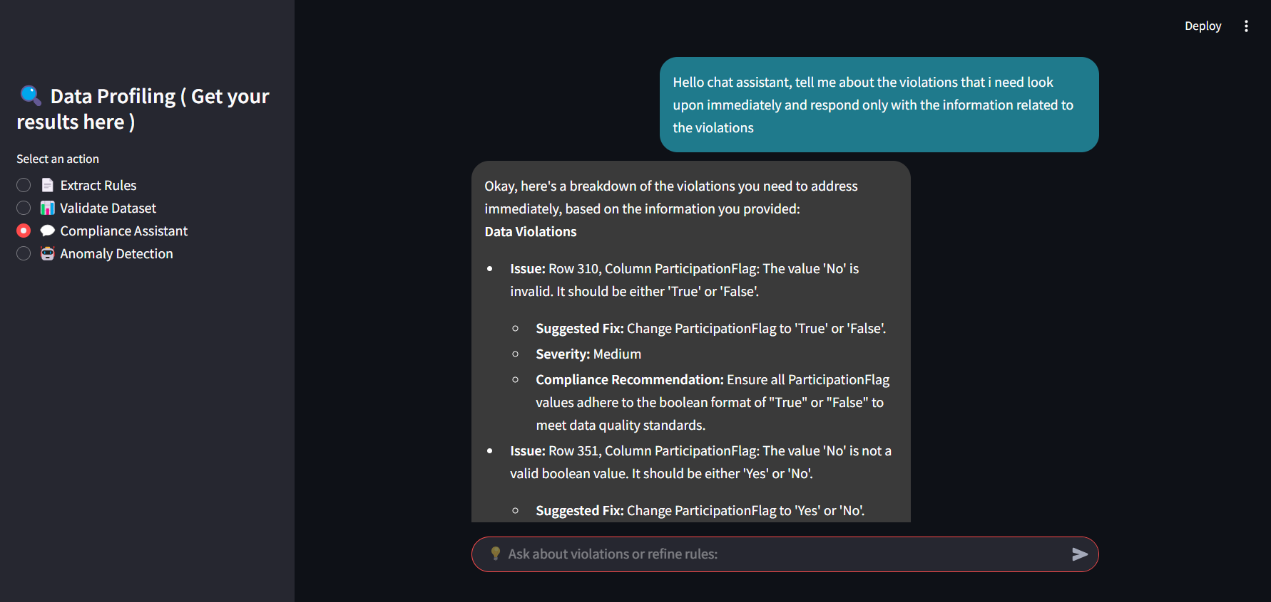
COMPLIANCE CHAT ASSISTANT

Slide 15
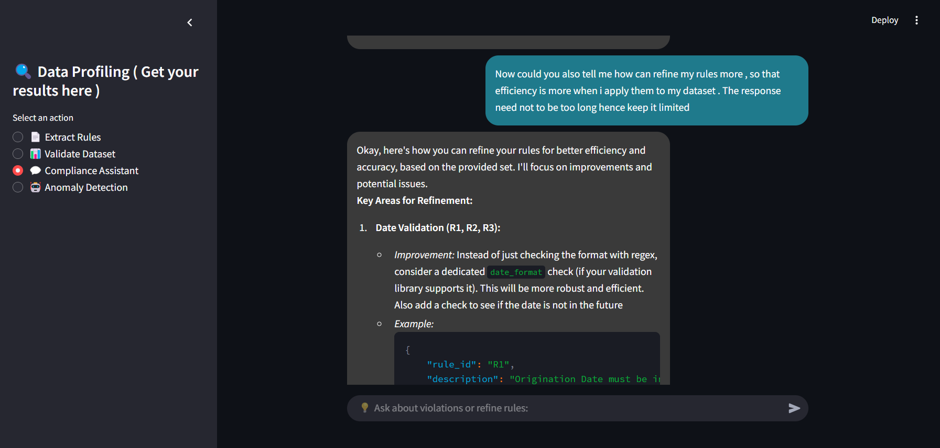
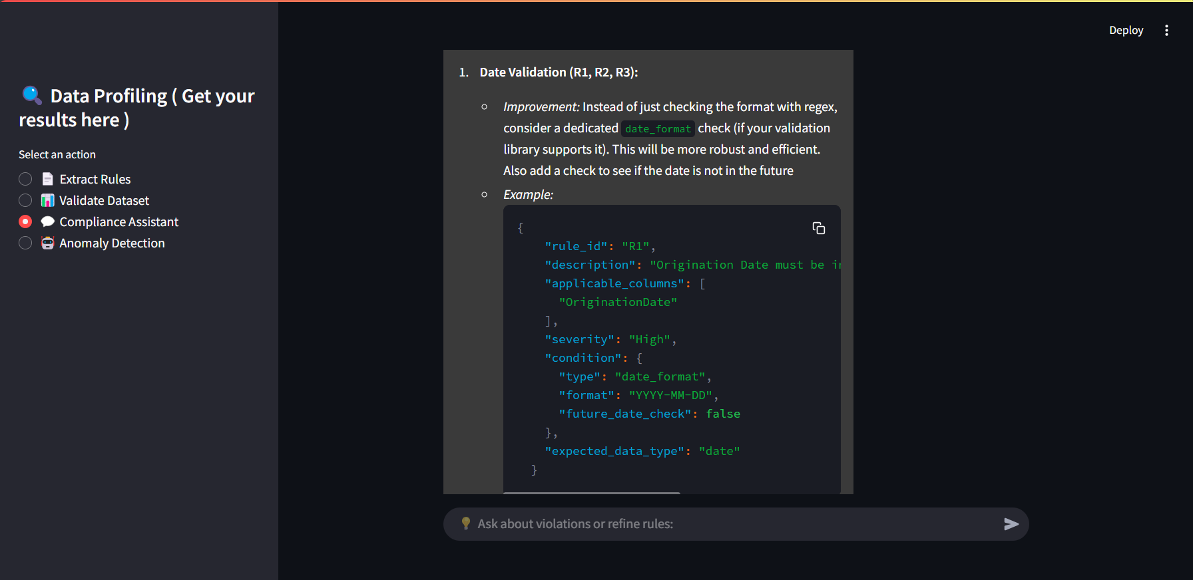
COMPLIANCE CHAT ASSISTANT ( REFINING RULES BY GENAI )

Slide 16
Anomaly Detection (Machine Learning-Based Outlier Detection)
OVERVIEW
Detects anomalies in datasets using Unsupervised Machine Learning techniques.
Feature Selection & Preprocessing
ISOLATON TREE MODEL TO DETECT ANOMALIES
Auto-Calculated Contamination Rate
Interactive UI & Visualization
Selects numeric columns for anomaly detection.
Standardizes features using MinMaxScaler.
works well with high-dimensional financial data without requiring extensive tuning.
Instead of profiling normal instances, it isolates anomalies quickly based on how easy they are to separate.
The model estimates the proportion of outliers dynamically.
Scatter plot highlights anomalies in red.Users can download anomaly reports (CSV) with flagged rows.

Slide 17
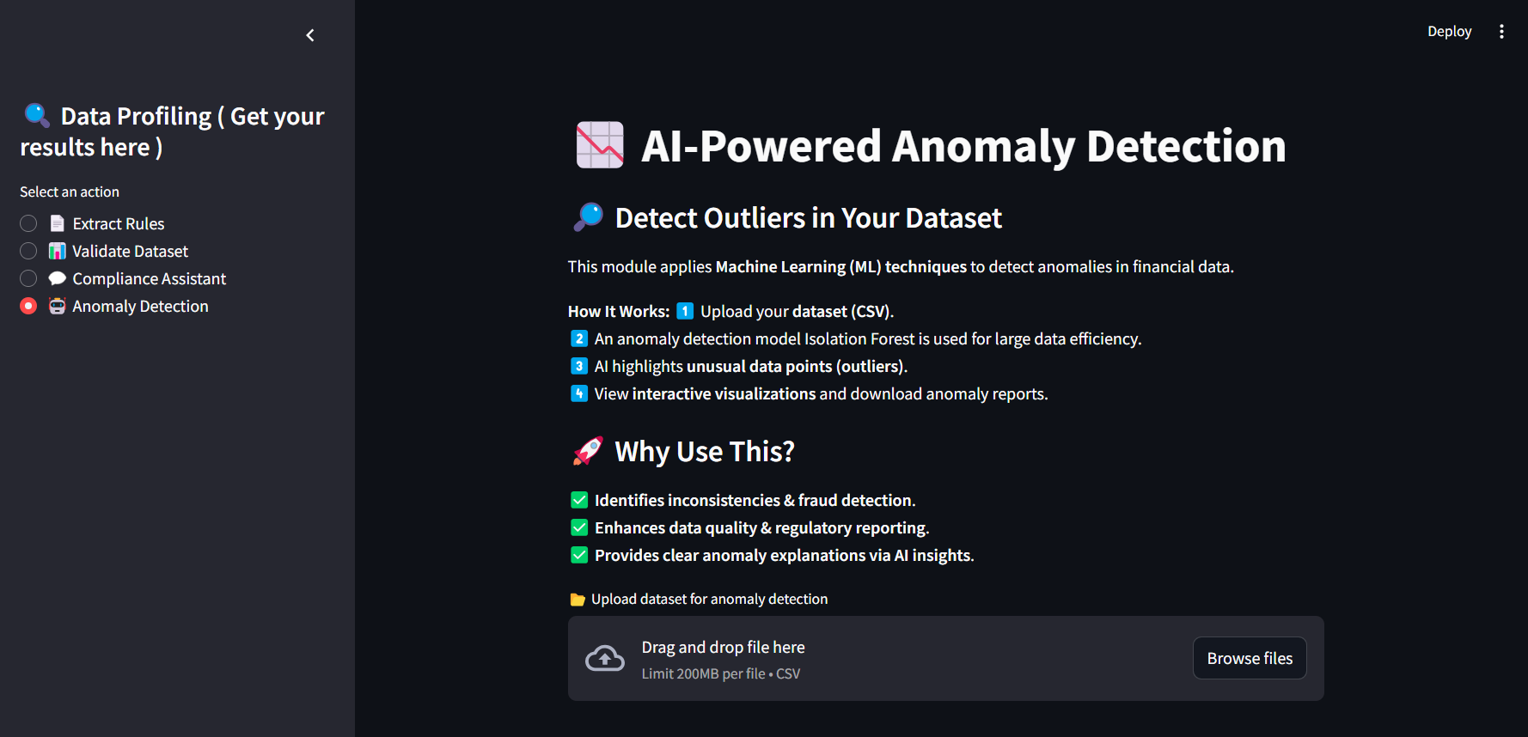
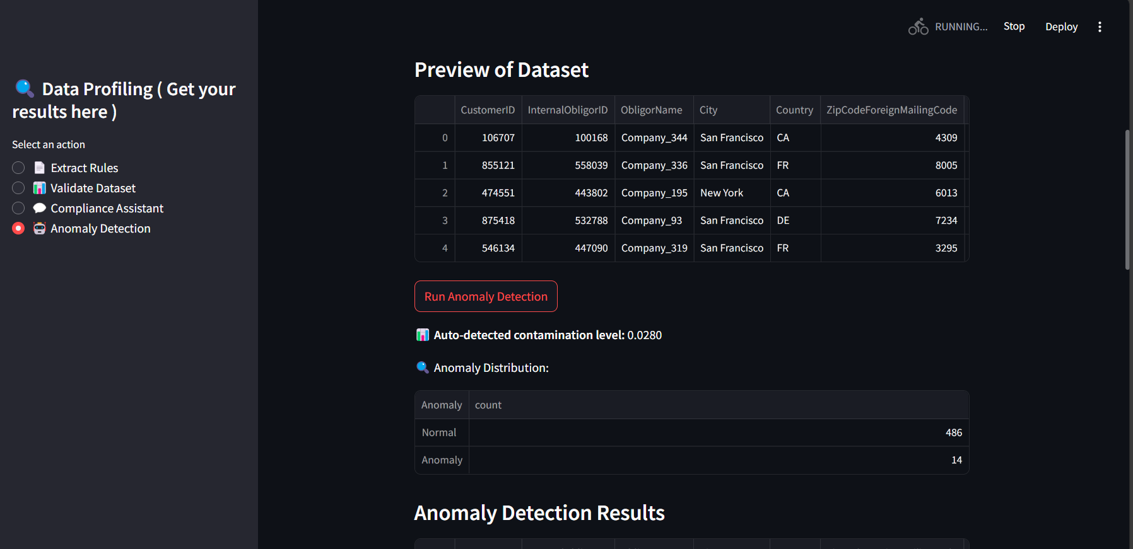
ANOMALY DETECTION

Slide 18
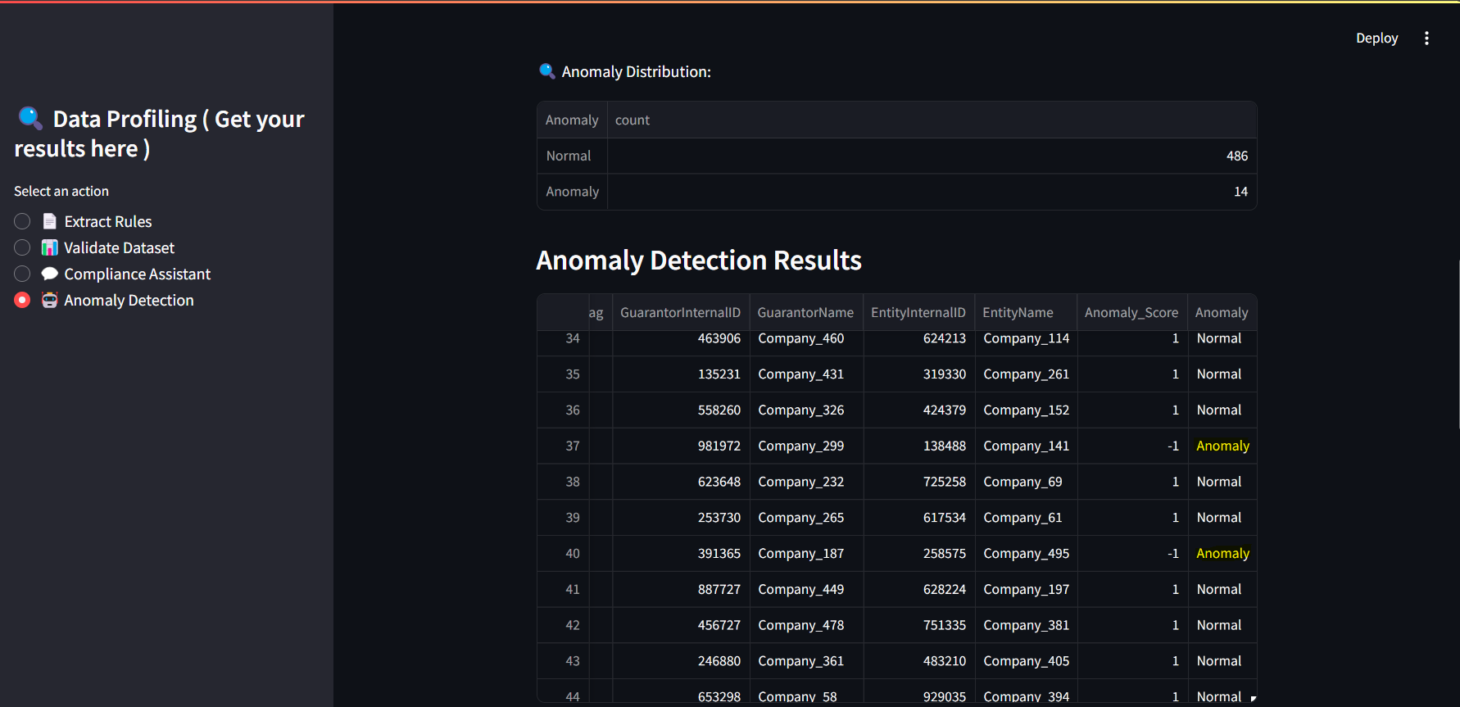
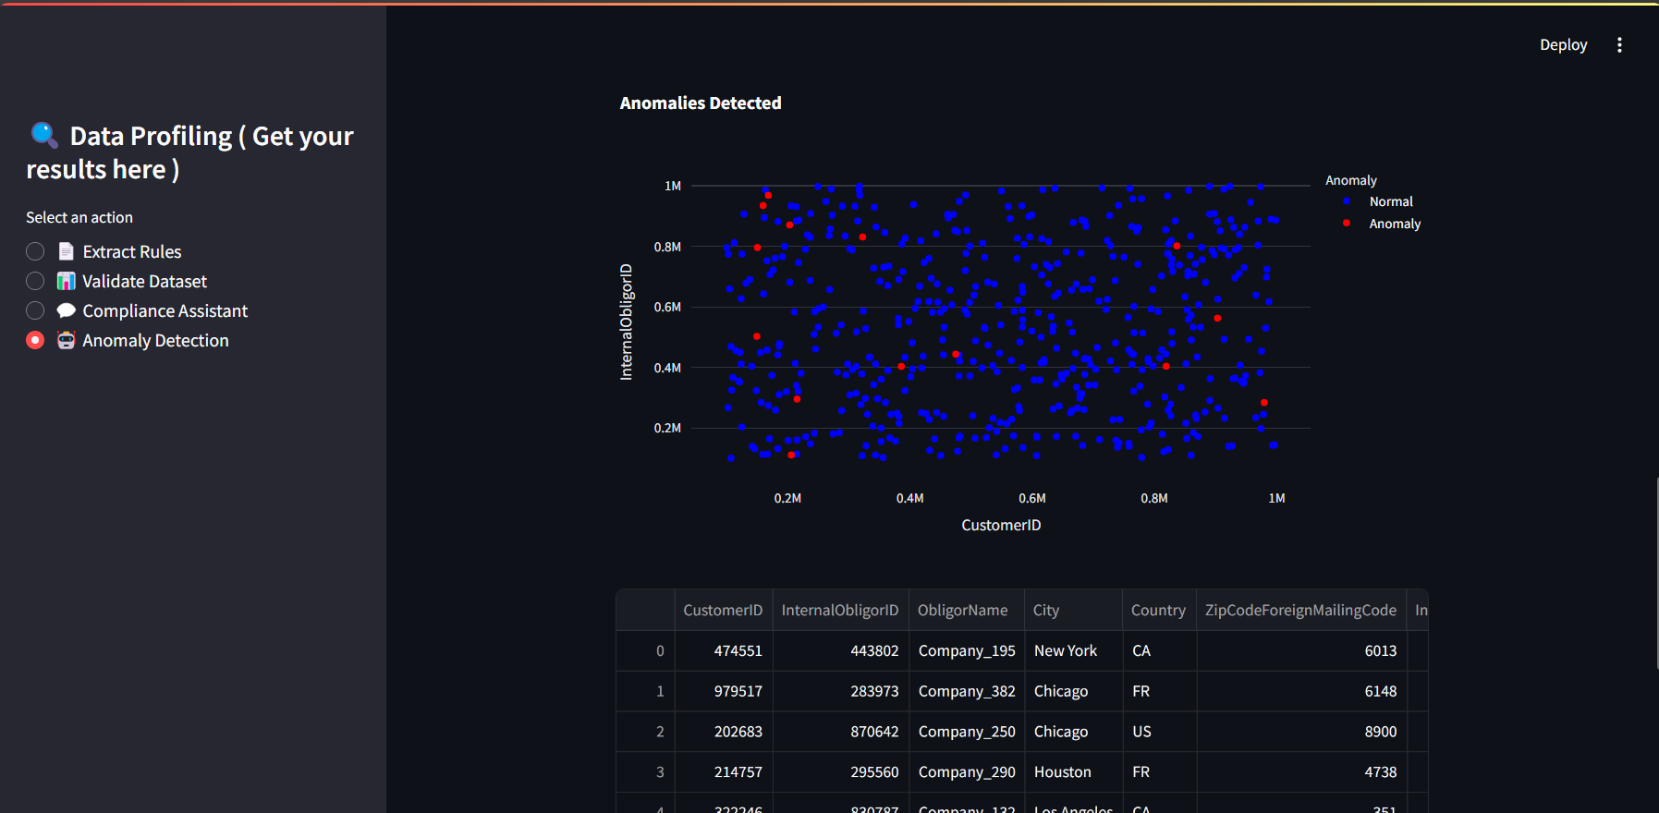
ANOMALY DETECTION

Slide 19
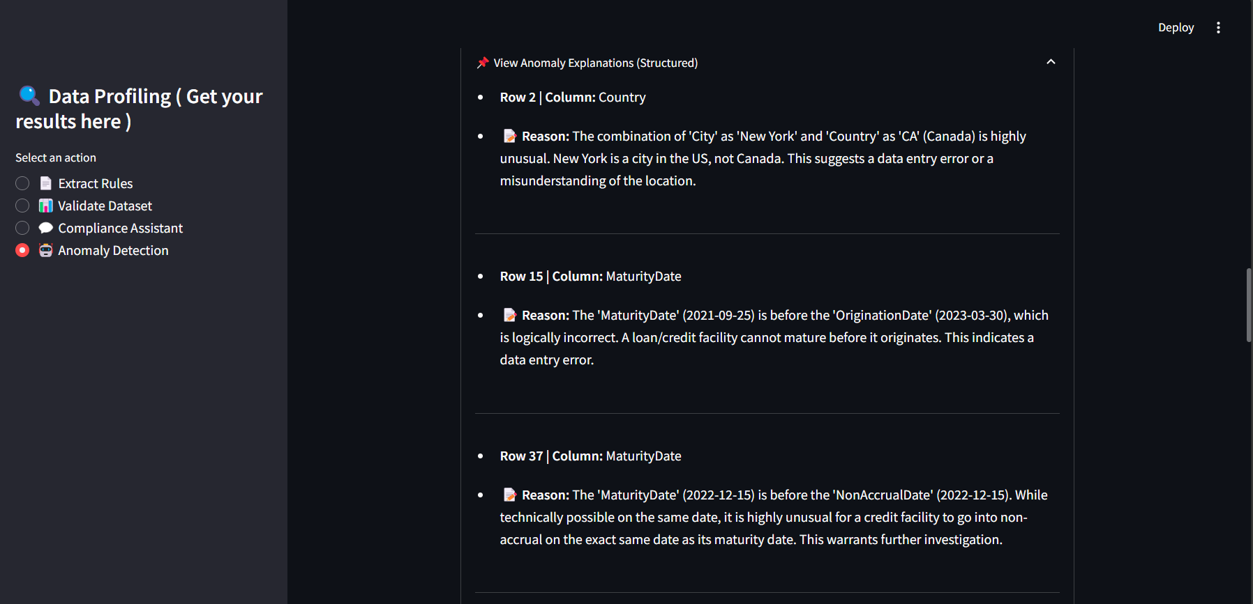
ANOMALY DETECTION

Slide 20
CHALLENGES FACED
Handling Large Regulatory PDFs Efficiently
Making UI Interactive & User-Friendly
PDFs contain complex text + tables → Extracting structured validation rules was difficult.
Solution: Used LangChain chunking & Chroma DB retrieval to process efficiently.
Users needed real-time feedback for validation & anomaly detection.
Solution: Used progress bars, collapsible reports, and color-coded chat bubbles for better UX.
Reducing API Usage & Cost Management
Generative AI API calls can be expensive when processing large datasets.
Solution: Implemented batch processing to optimize API usage & reduce costs.
Aligning Rule Extraction with Dataset Validation
Ensuring Valid JSON Responses from AI
Extracted validation rules sometimes didn’t match the dataset structure.
Solution: Improved LLM prompts & ensured column mapping consistency.
AI responses sometimes truncated JSON output, making it unreadable.
Solution: Used regex fixes, error handling, and AI prompt tuning to fix response formatting.

Slide 21
FUTURE SCOPE
Advanced Machine Learning for Anomaly Detection
Incorporate deep learning-based anomaly detection (e.g., Autoencoders, GANs).
Implement ensemble models that combine multiple anomaly detection techniques for better accuracy.
Real-Time Data Validation & Streaming Support
Integrate with real-time data sources (Kafka, Spark Streaming).
Perform continuous validation instead of batch processing.
Automated Data Correction & Compliance Reports
Instead of just detecting violations, AI can suggest & auto-correct issues in datasets.
Generate automated compliance reports for auditors & regulators.
Adaptive AI-Powered Rule Learning
Enable AI to dynamically learn new validation rules over time based on past violations.
Use reinforcement learning to improve compliance recommendations.
API Integration & Enterprise Deployment
Develop REST APIs for easy integration with existing banking & enterprise systems.
Deploy as a cloud-based SaaS solution for scalability & security.

Slide 22
SUMMARY
Our AI-powered Regulatory Data Profiling & Compliance System automates rule extraction, validation, and Anomaly Detection using Generative AI and Machine Learning techniques
Google Gemini AI : Made use of free tier model available directly for the user efficiently
Intelligent Rule Extraction: AI-driven approach to extract compliance rules from regulatory documents.
Automated Data Validation: Ensures data accuracy and integrity using validation rules and anomaly detection.
AI-driven Chat Assistant: Enable users for an interactive AI-powered chat assistant for compliance queries and refine rules for validation effieciency
Scalable & Future-Ready: Designed for real-time processing and integration with Kafka, Spark, and cloud systems. modify this and give

Slide 23
THANK YOU

