Slide 1

Email Eclipse
Gen AI's Revolutionizing
Email Classification
Satyanarayana J
VijayaSree A
Pranit B
Laxmana
Notes:
AI-generated content may be incorrect. --- This presentation will explore the AI pipeline designed for processing emails. We will cover each stage of the pipeline, from data ingestion through to deployment, highlighting key techniques and methodologies used in email processing.

Slide 2
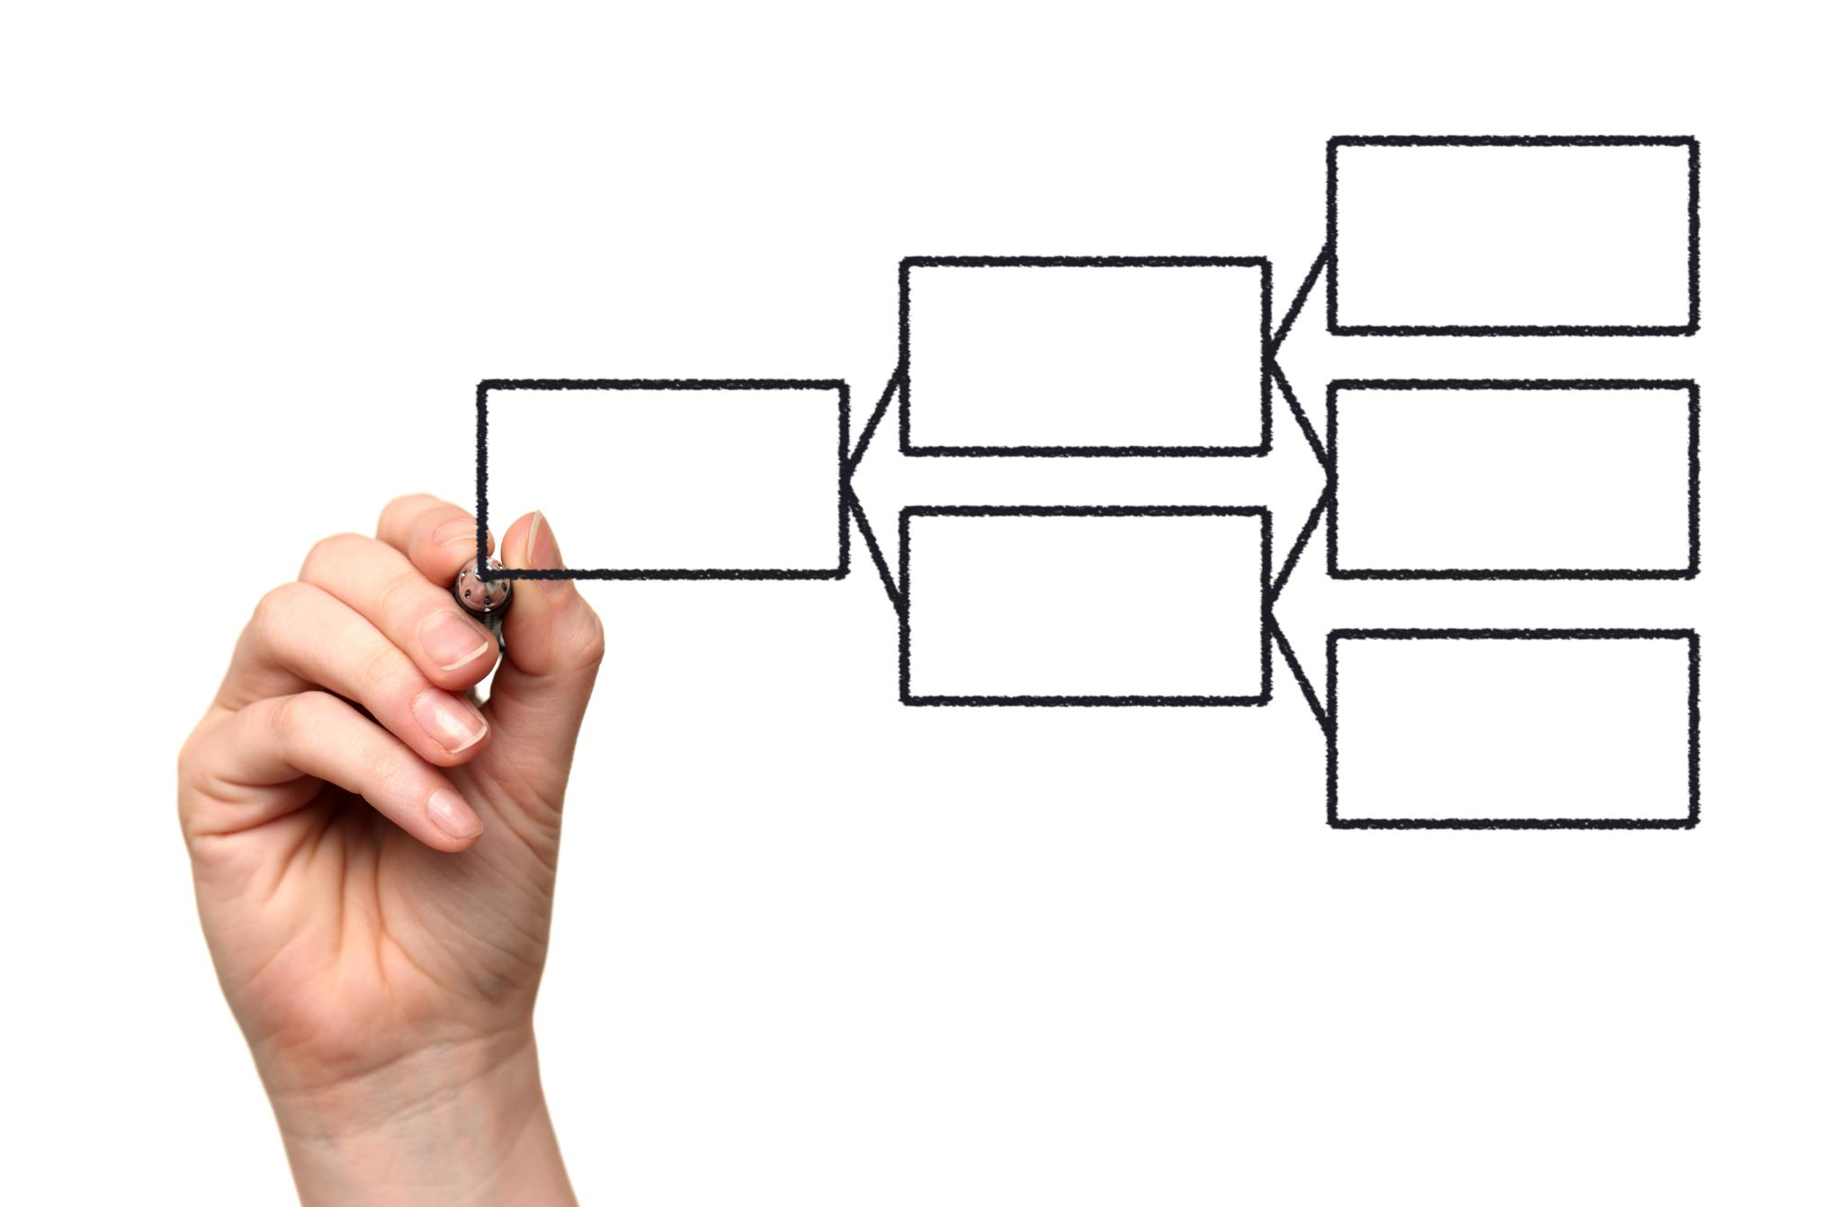
Agenda
Introduction
Inspiration and Motive
Architecture
Tech Stack
How it Works
Email Data Ingestion
Preprocessing
Context/ Intent Extraction with OCR
Prioritization
Categorize-Request /Sub-Request Type
Duplicate Detection
Confidence Score
Assignment of requests
Deployment and Maintenance
Challenges & RoadMap
Conclusion
Notes:
In this presentation, we will discuss the essential steps in our AI pipeline: starting with data ingestion, followed by preprocessing, context extraction, intent identification, request type classification, sub-request type classification, postprocessing, and finally deployment.

Slide 3

Introduction
Many Service Teams like Commercial bank Lending Services receive many service requests in email with unstructured attachments.
Lot of Manual Efforts are needed to understand Diverse requests from email and route it to right technical team for processing requests based on skill sets.
Email Eclipse-Gen AI's Revolutionizing Email Classification is an End-to-End Pipeline implemented to automated Service Request creation by extracting email content through Gen AI.

Slide 4
Inspiration
Automation of Repetitive Tasks.
Enhanced Productivity by reducing Gate keeper Manual Efforts
Improved Email Management during High Volume
Motive
Increased Accuracy.
Enhanced Decision Making by avoiding Manual errors
Scalability

Slide 5
Architecture

Slide 6
Tech Stack
Python
Pandas
PyMuPDF
NLP- Spacy{Named Entity Recognition (NER)}
IMAP + OCR
OpenAI- Gemini 2.0, Crewai
Transformers-Hugging Face
Pytesseract
Tesseract
Hashlib

Slide 7
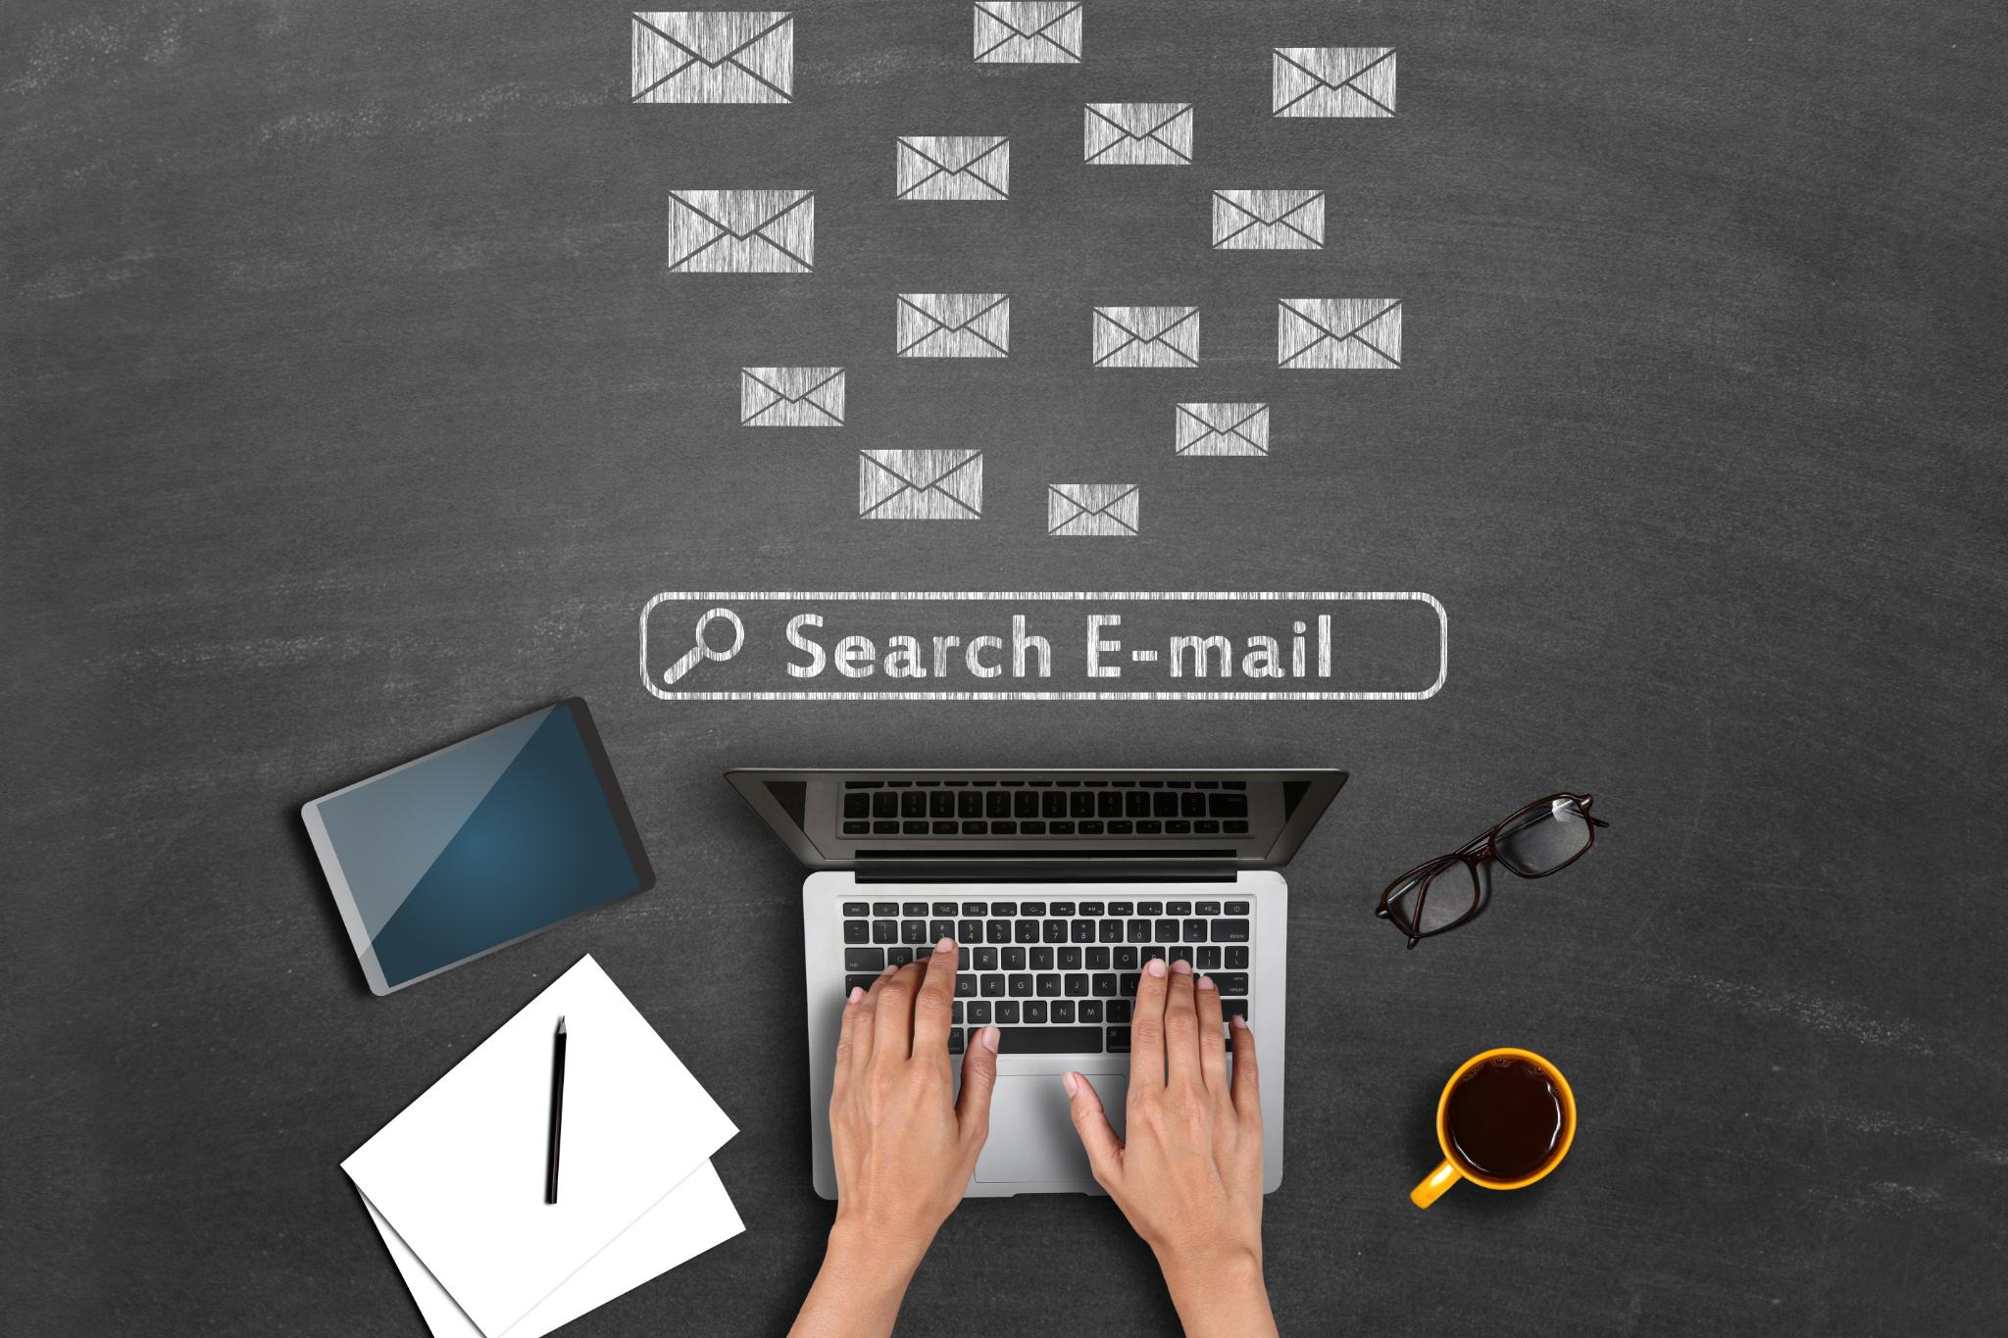

1. Email Data Ingestion
Collection of Emails
Emails can originate from multiple channels, such as Outlook Emails- direct email servers, or Local/Cloud storage.
Preprocessing
2. NLP Preprocessing
Tokenization and Stemming
Removing Stop Words
Named Entity Recognition (NER)}
Notes:
Emails can come from various channels, including web forms, customer service platforms, and direct email servers. We will discuss methods for effectively ingesting this unstructured data to ensure all relevant information is captured.

Slide 8
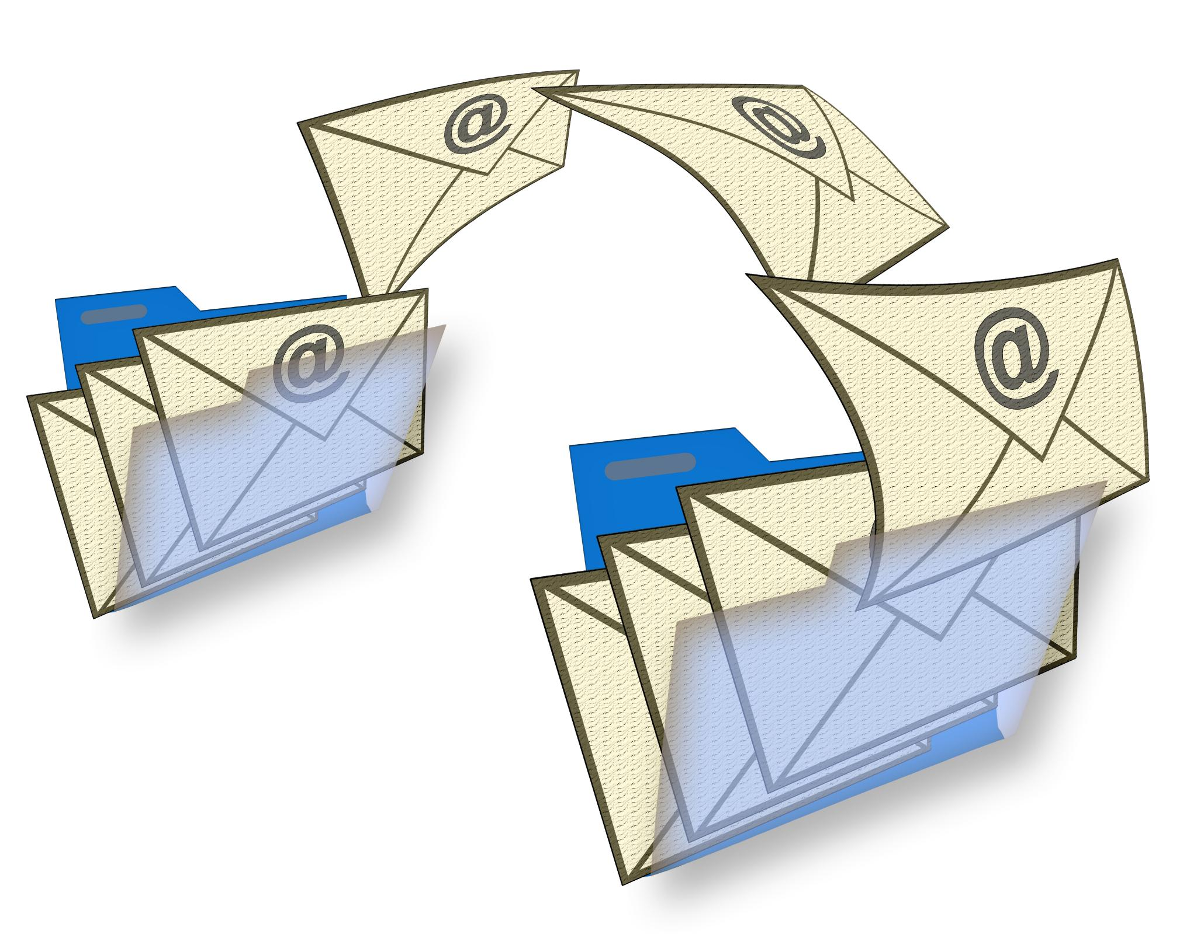

3. Content/Intent Extraction
Processing Email Attachments
Integrating Extracted Data
Context Comprehension
Subsequent Processing
4. Prioritization
Customizable solution to Prioritize based on Intent, Urgency, request types.
Notes:
Many emails include attachments that need to be processed. Optical Character Recognition (OCR) can be used to extract text from these documents, allowing us to incorporate this information into our processing pipeline.

Slide 9
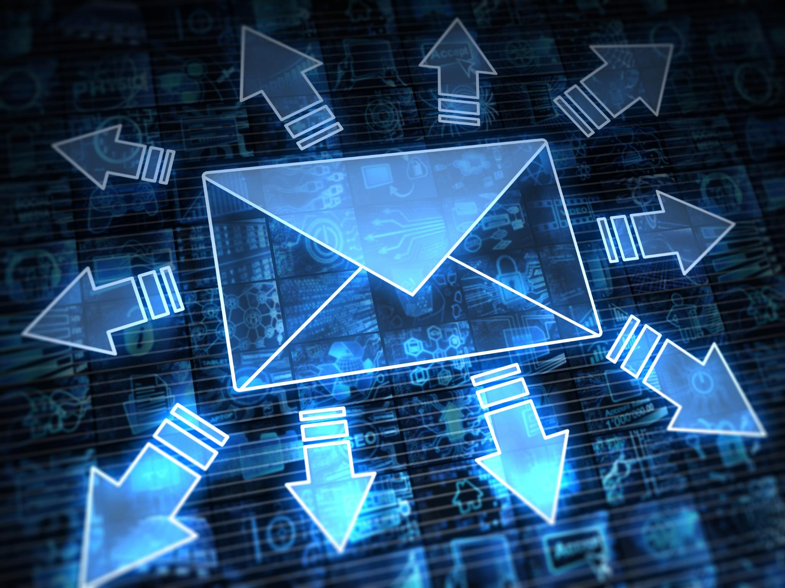

5. Categorization and Attribute Generation
Request Types, Sub Request Types based on Sender’s Intent.
Generate Other Attributes: Deal Name, Amount, Expiry Date, Amount etc..
6. Duplicate Detection
MD 5 Hashing, Jaccard Similarity
Duplicate Flag Reason

Slide 10

7. Confidence Score
Assess the model's classification confidence.
Provide insights into classification decisions.
Use scores for improving model reliability.
8. Assignment of Requests
Assignment based on skill set and Intent extracted from email

Slide 11

Deployment
Enabling quick adjustments to cater ongoing needs.
ReadMe in GitHub is having complete deployment instructions.
All necessary Tools and Libraries are listed with install instructions.

Slide 12
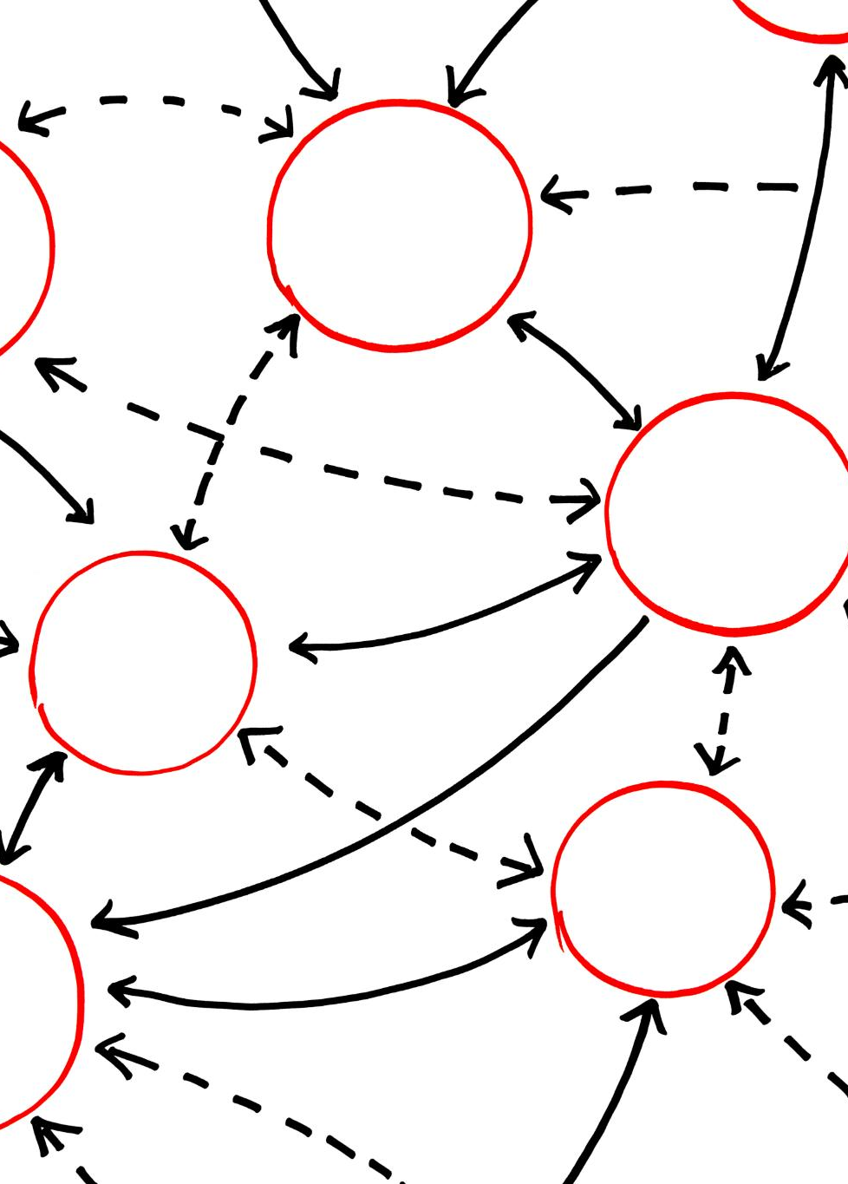
Challenges
Intent Identification
Historical Email Data generation for training
Confidence score calculation.
Notes:
To improve intent identification, we fine-tune Open LLMs using labeled datasets. This training enables the model to better understand varied intents based on historical email data.

Slide 13
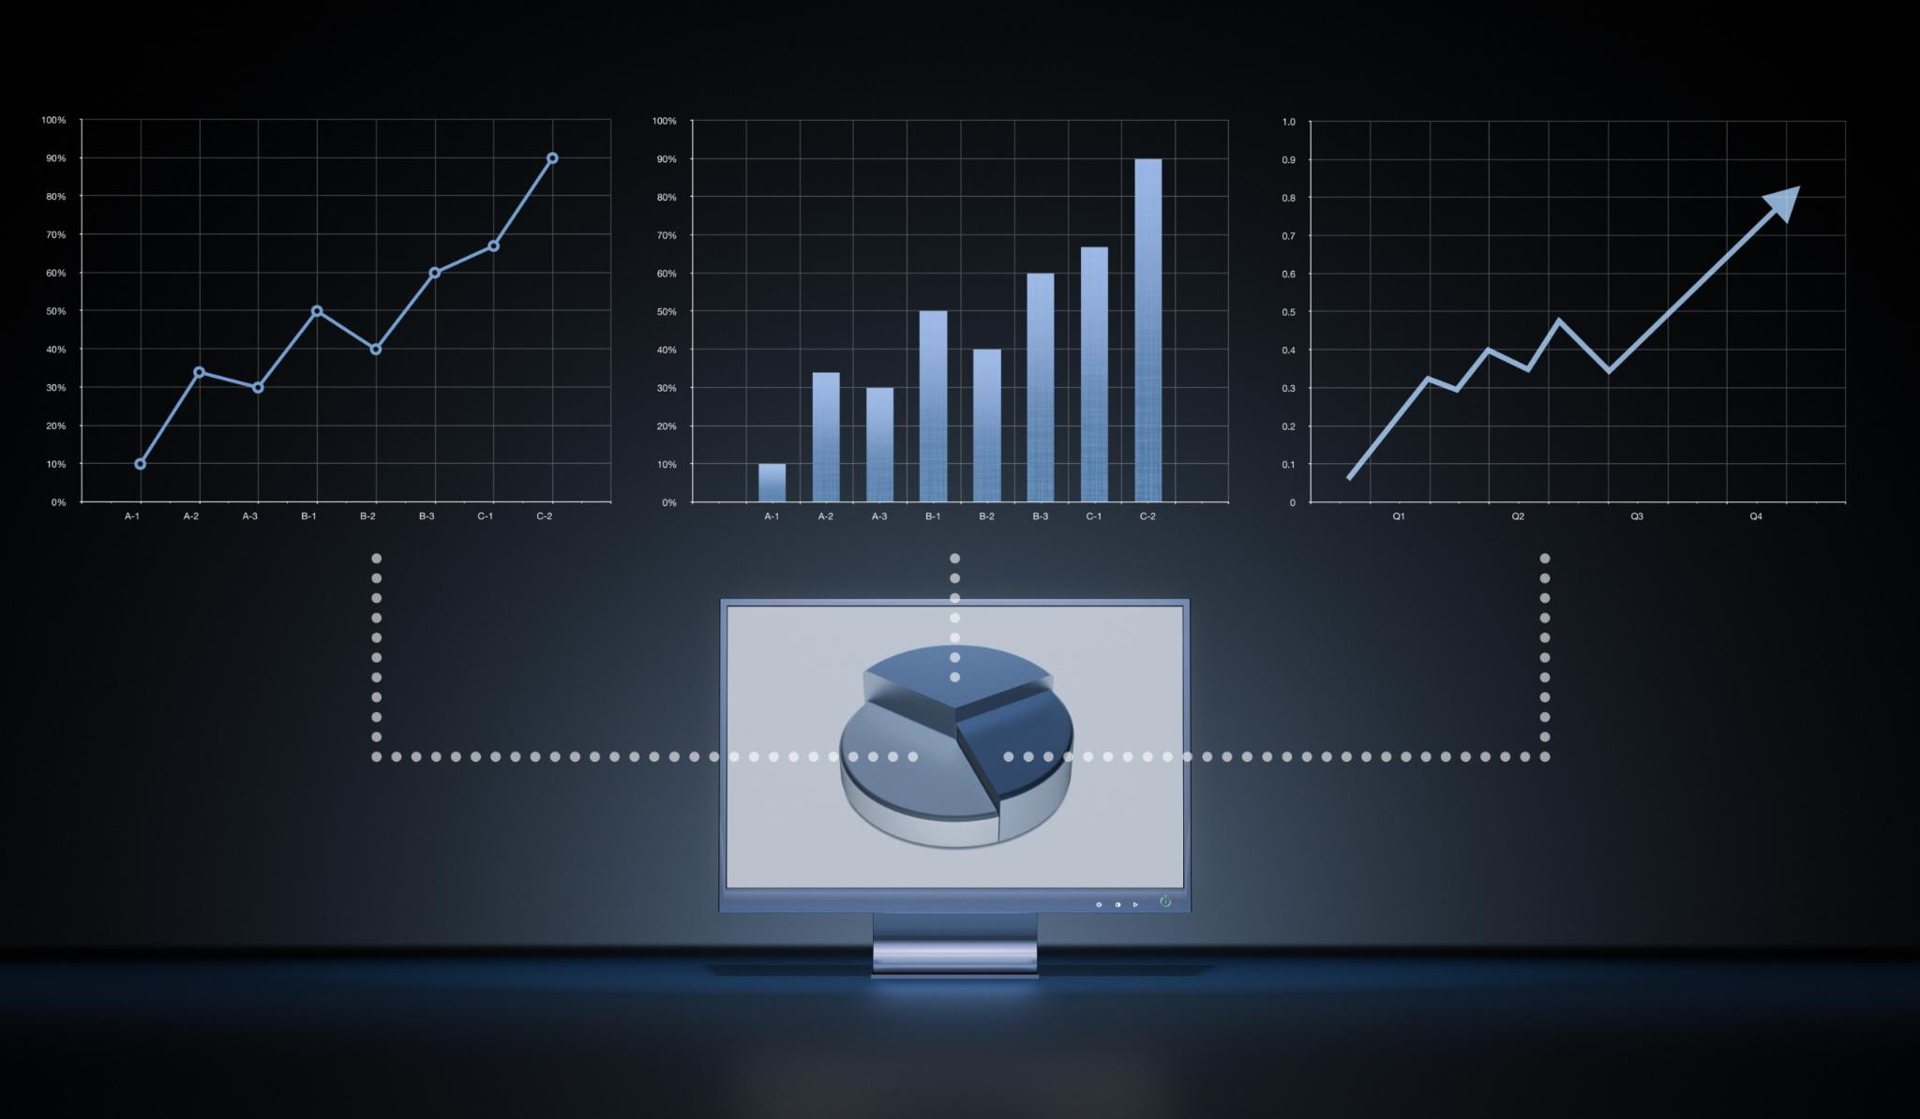
Monitoring Performance, Accuracy, and Scalability
Importance of Monitoring
Monitoring system performance is essential to ensure it operates efficiently and meets user expectations.
Tracking Metrics
Tracking performance metrics helps identify issues early and supports informed decision-making in system management.
Scalability Considerations
Ensuring the system can scale effectively based on demand is crucial for maintaining performance during peak usage.
Notes:
After deployment, it is crucial to monitor the system's performance and accuracy. This involves tracking metrics and ensuring the pipeline can scale based on demand.

Slide 14

Conclusion
A robust, streamlined email management system improves efficiency by prioritizing and classifying emails effectively and reduces lot of manual intervention in creating Service requests.

