Slide 1
Automating Email Classification and Data Extraction for Commercial Bank Lending Service
Enhancing Efficiency with Generative AI and OCR
Team Name: AI Agents

Slide 2
Introduction
Commercial bank lending service teams process a high volume of service requests via email. These requests often include attachments and require manual triage by a gatekeeper who interprets the email, classifies the request, extracts key attributes, and assigns it to the correct processing team. This process is labour-intensive, error-prone, and inefficient at scale.
This solution details the implementation of an AI-powered loan servicing automation system that uses Generative AI (LLMs) and OCR technologies to classify emails, extract relevant data, and automate the service request workflow.

Slide 3
Problem Statement
Challenges with Manual Processing:
High Volume: A large number of incoming emails require manual triaging.
Error-Prone: Misclassification and incorrect data extraction lead to inefficiencies.
Time-Consuming: Significant manual effort is required for processing requests.
Duplicate Emails: Multiple replies or forwarded emails cause redundant service requests.

Slide 4
Proposed Solution
AI-Driven Automation Approach
The solution leverages Large Language Models (LLMs) and OCR to enhance efficiency and reduce manual intervention
Classify Emails - Identify the request type and sub-type based on email content.
Extract Key Data - Extract relevant information such as deal name, amount, and expiration date.
Prioritize Requests - Detect primary request type in multi-request emails.
Detect Duplicates - Identify and flag redundant emails within a thread.
Automate Routing - Assign service requests to the correct team based on classification.

Slide 5
Technology Stack and Tools Used
Programming: Python (Google Colab)
LLM Model : Gemini (Google Generative AI)
OCR & Email Parsing: pytesseract, pdfplumber, PyMuPDF
Document & Email Parsing: python-docx, email module
Similarity Detection: TfidfVectorizer & cosine_similarity
Data Processing: pandas
Export Format: CSV

Slide 6
Solution Architecture Overview
Email Ingestion
Output & Storage
Context-Based Data Extraction
LLM Classification
Pre-processing Layer
Upload EMLfiles Extract raw content
Extract deal name, amount, expiration date, etc. Handle multi-intent emails
Use Gemini LLM API Classify into request types Extract confidence score
Extract text using OCR Parse attachments (PDF, DOCX, Images) Identify duplicates
Export results to CSV Confidence scores Duplicate flag

Slide 7
Workflow Execution
Email Processing: Accepts EML files. Extract plain text from emails, including attachments.
OCR for Scanned Documents: Convert image-based PDFs and DOCX into readable text
Duplicate Detection: Implement NLP-based similarity checks to detect redundant emails.
AI-Based Classification: Use Gemini LLM to classify emails into predefined request types.
Context-Aware Data Extraction: Identify and extract key attributes (deal name, amount, expiration) dynamically based on email intent.
Output Generation: Exports structured results to CSV

Slide 8
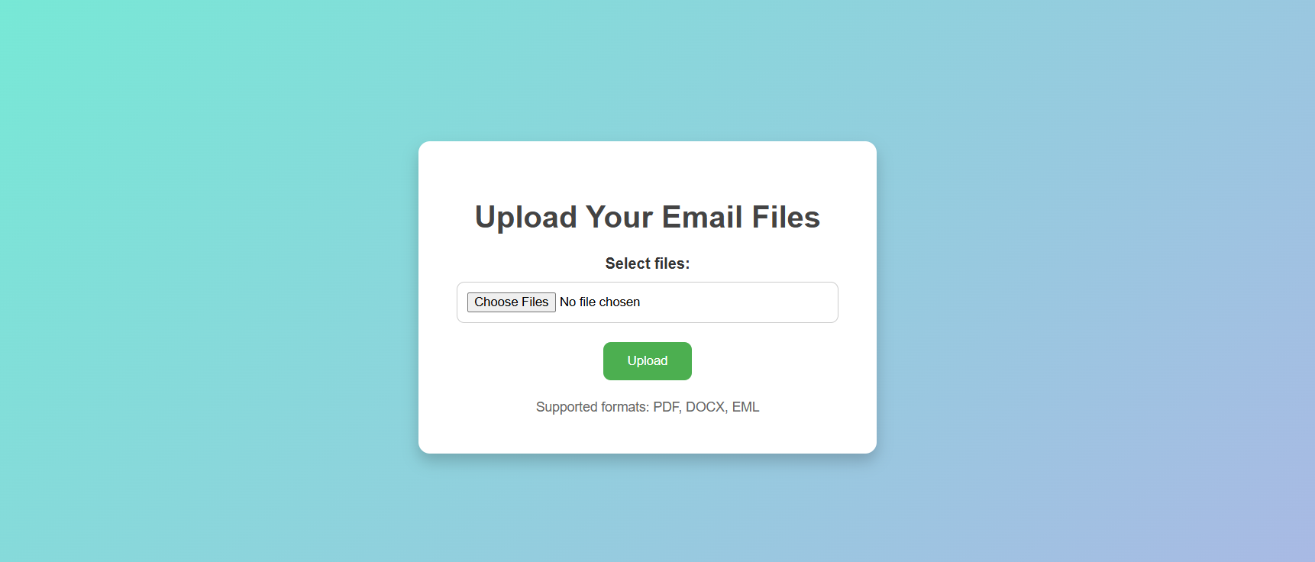
User Interface to Upload Input Email Files

Slide 9
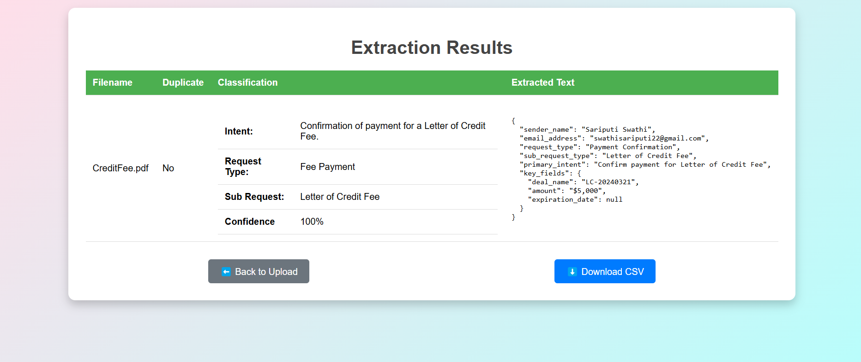
Response

Slide 10
Challenges & Solutions
Challenge | Solution
Misclassification of emails | Fine-tuning LLMs with real data
Extracting structured data from unstructured emails | Context-aware NLP processing
Handling multiple request types in a single email | Priority-based classification logic
Identifying duplicate emails | NLP-based duplicate detection (TfidfVectorizer)

Slide 11
Key Benefits and Impact
Reduction in Manual Workload: Automated data extraction and classification reduce gatekeeping efforts.
Efficiency Gains: Significant reduction in processing time by reducing manual triage workload
Accuracy Improvement: AI ensures consistent classification resulting into higher precision in email classification compared to manual triage
Operational Risk Mitigation : Duplicate Detection Prevents redundant service requests
Scalability: Handles large volumes seamlessly

Slide 12
Future Enhancements
CRM Integration: Automating updates to the CRM system for seamless tracking.
Custom Extraction Rules: More configurable fields
Fine-Tuning AI Model: Continuous improvement in classification accuracy with more training data.
Real-Time Processing: Enable live classification

Slide 13
Conclusion & Next Steps
🚀 The AI-driven solution improves efficiency, accuracy, and scalability in commercial bank lending service email classification.
🚀 NLP and OCR enable automated email classification and structured data extraction
🚀 Duplicate detection reduces redundant processing and operational risks.
📌 Ready for deployment with CSV-based output and seamless integration potential.
📈 Next steps: Expand CRM Integration, enhance customization, and enable real-time processing.

